Slide 1
Content-based Music Retrieval System
Team B
Hernandez Almanza Eduardo
Richard Degenfellner
……….

Slide 2
Dataset Music4All-Onion
Lyrics
Tf-idf , word counts
Word2vec, word representation in vector space
bert
Audio
Mel Frequency Cepstral Coefficients (MFFCs)
Essentia: An audio Analysis Library for Music Information Retrieval
Block Leve Features (BLFs)
Video
VGG19 Very Deep Convolutional Networks For Large Scale Image Recognition
Inception v3 Deep Convolutional Neural Network architecture codename Inception
Resnet 13. Deep Residual Networks for Image Recognition

Slide 3
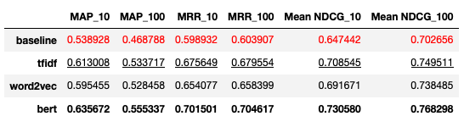
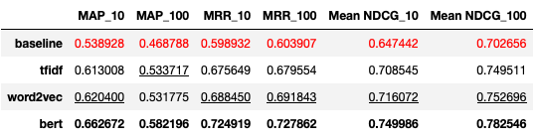
Individual Analysis of features - Lyrics
With Jaccard Similarity
With Cosine Similarity
LowerValue | SecondBestValue. | BestValue

Slide 4
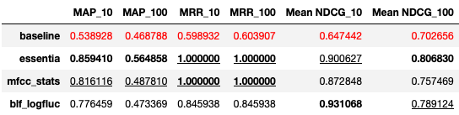
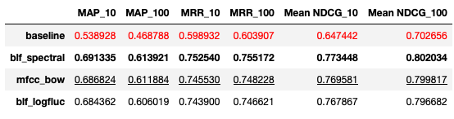
Individual Analysis of features - Audio
With Jaccard Similarity
With Cosine Similarity
LowerValue | SecondBestValue. | BestValue

Slide 5
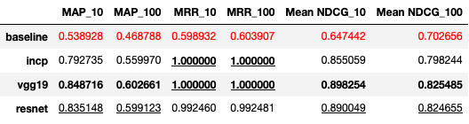
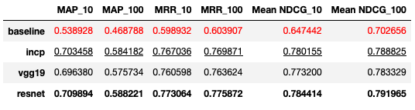
Individual Analysis of features - Video
With Jaccard Similarity
With Cosine Similarity
LowerValue | SecondBestValue. | BestValue

Slide 6
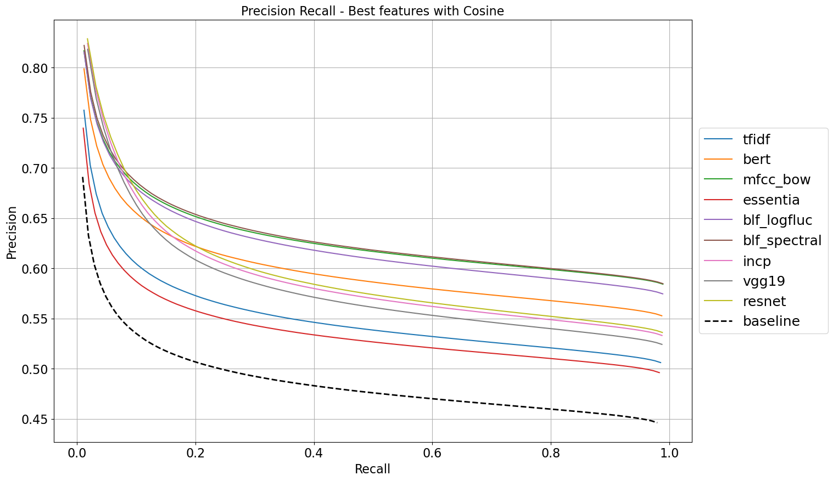
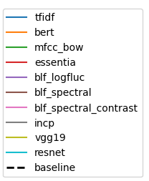

Slide 7
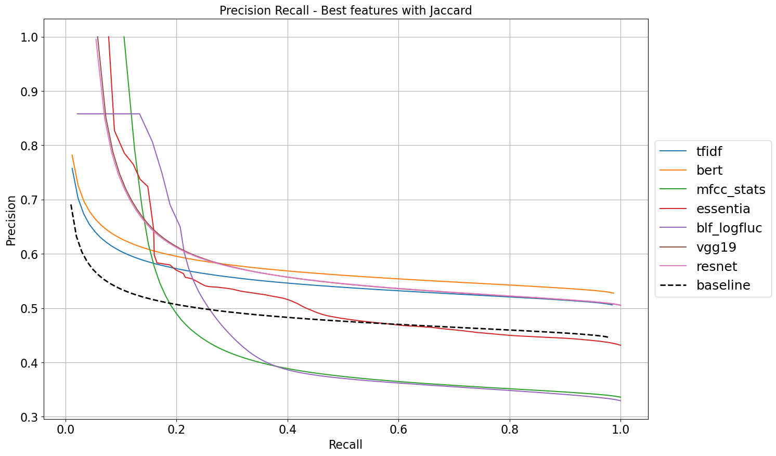

Slide 8
Selection of the best features
Cosine Similarity | Jaccard Similarity
Lyrics | Bert Tfidf
Audio | BLF spectral MFCC bow BLF loglfuc
Video | Resnet Incp
Jaccard Similarity | Jaccard Similarity
Lyrics | Bert Tfidf
Audio | Essentia BLF loglfuc MFCC stats
Video | Vgg19 Resnet

Slide 9
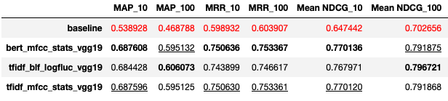
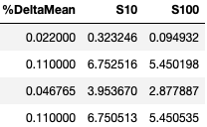
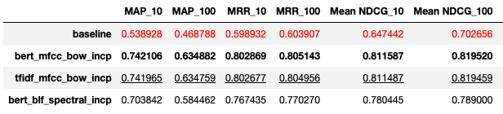
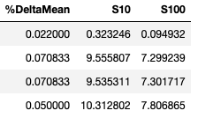
Early Fusion
With Jaccard Similarity
With Cosine Similarity
LowerValue | SecondBestValue. | BestValue

Slide 10
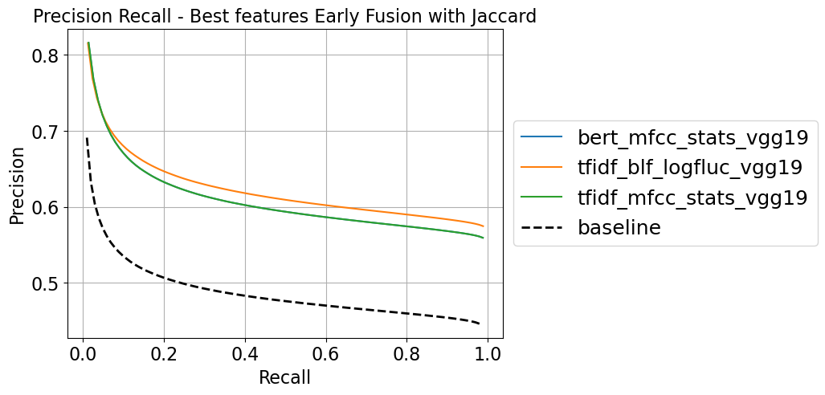

Slide 11
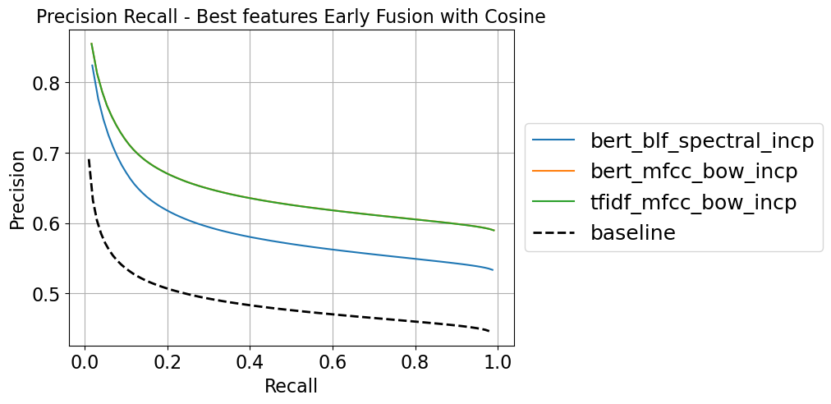

Slide 12
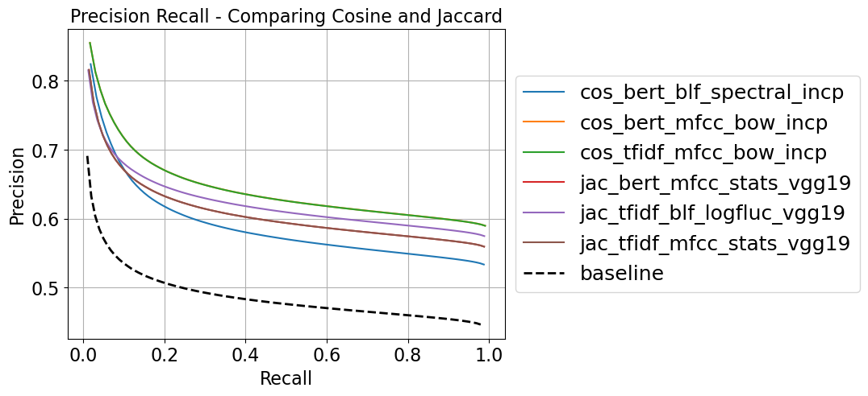

Slide 13
Late fusion
Best of Late Fusion
Maybe two tables, comparing the 2 best of Late Fusion for jaccard and cosine

Slide 14
Slide of precision-recall comparing them

Slide 15
Top 5 Comparing Early and Late Fusion
Mark in the table the best, the worst, etc

Slide 16
Demo
https://mmsr-app.vercel.app

