Slide 1


Programming with Triggers
Michał Moskal
University of Wrocław
Wrocław, Poland
Aachen, Germany
Satisfiability Modulo Theories Workshop
August 2nd, 2009, McGill University, Montreal, Canada

Slide 2
Outline
case-study: an SMT-powered software verifier applied to a commercial operating system
tools and methods to make this work
trigger-engineering
tools:
Axiom Profiler – postmortem analysis of the search
Model Viewers – analysis of counter examples
Z3 Inspector – live view of Z3 operation

Slide 3
Windows Hypervisor
virtualization platform
thin layer of software between guest operating systems and the hardware
essentially a small operating system
small by OS standards: 100kloc of C, 5kloc x64 asm
scheduler, memory allocator, etc
lock-free data structures
shipping with Windows Server 2008

Slide 4

Hypervisor Verification (2007 – 2010)
Partners:
European Microsoft Innovation Center
Microsoft Research Redmond
Microsoft’s Windows Div.
Universität des Saarlandes
German Research Center for Artificial Inteligence
co-funded by the German Ministry of Education and Research
http://www.verisoftxt.de

Slide 5
Goal: Full-blown Verification For Everyone
functional properties
but even memory safety depends on functional correctness of complex data structures and concurrency protocols
automatic
exercised on real code
scalable – modular
concurrency
not changing existing code
necessary tool support

Slide 6
VCC
a deductive verifier for C
verification methodology centered around
two-state invariants
ownership system
concurrency
uses Boogie and Z3 (or other Boogie-supported provers)

Slide 7

VCC Architecture
#include <vcc2.h>
typedef struct _BITMAP {
UINT32 Size; // Number of bits …
PUINT32 Buffer; // Memory to store …
// private invariants
invariant(Size > 0 && Size % 32 == 0)
…
$ref_cnt(old($s), #p) == $ref_cnt($s, #p) && $ite.bool($set_in(#p, $owns(old($s), owner)),
$ite.bool($set_in(#p, owns),
$st_eq(old($s), $s, #p),
$wrapped($s, #p, $typ(#p)) &&
$timestamp_is_now($s, #p)),
$ite.bool($set_in(#p, owns),
$owner($s, #p) == owner && $closed($s,
Annotated C
Generated Boogie
:assumption
(forall (?x Int) (?y Int)
(iff
(= (IntEqual ?x ?y) boolTrue)
(= ?x ?y)))
:formula
(flet ...
Boogie
owner)),
$ite.bool($set_in(#p, owns),
$st_eq(old($s), $s, #p),
$wrapped($s, #p, $typ(#p)) &&
$timestamp_is_now($s, #p)),
$ite.bool($set_in(#p, owns),
$owner($s, #p) == owner && $closed($s,
Z3
SMT
VCC Prelude
Available at http://vcc.codeplex.com/

Slide 8
A Verification Methodology
annotation language
e.g., first-order logic, higher-order logic, separation logic; + specific features
specification concepts
ownership, type invariants, permissions
modeling of the programming language semantics
how precise, what assumptions, etc.
specification idioms

Slide 9
Verification Methodology As An SMT Theory
complex
all input language + specification language constructions
evolving with the verification tool
not practical to implement as part of SMT solver
instead encoded using first-order logic

Slide 10
Programming With Triggers
SMT formulas with quantifiers handled with instantiation
guided by E-matching, controlled by trigger annotations
SMT theory is programmed using triggers

Slide 11
Triggers
(usually) subterms of the quantified formula, with free variables
matched against active terms
terms with interpretation in the current partial model considered by the SMT solver

Slide 12

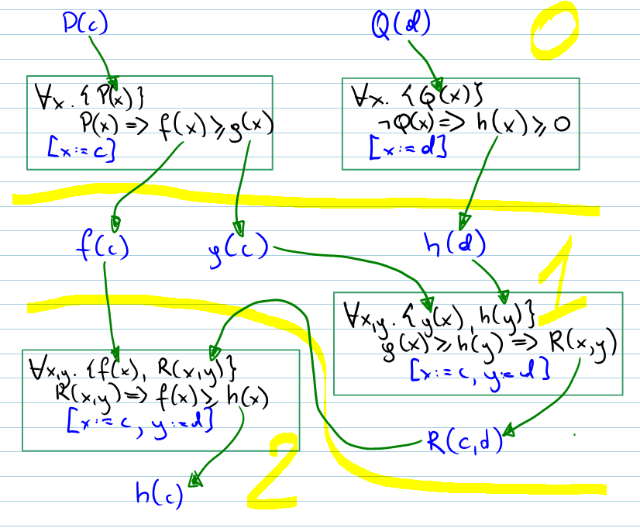
Causal DAG

Slide 13
A List Invariant
inv(H, S): nodes in set S form a doubly-linked list in heap H
data is non-null
prev link in the next node points back here
S is next- and prev-closed
(forall H:heap, S:set :: {inv(H, S)}
inv(H, S) <==>
(forall n:ptr :: {in(n, S)}
in(n, S) ==>
H[n, data] != null &&
(H[n, next] != null ==>
H[H[n, next], prev] == n) &&
in(H[n, next], S) &&
in(H[n, prev], S)))

Slide 14
Demo of The Axiom Profiler

Slide 15
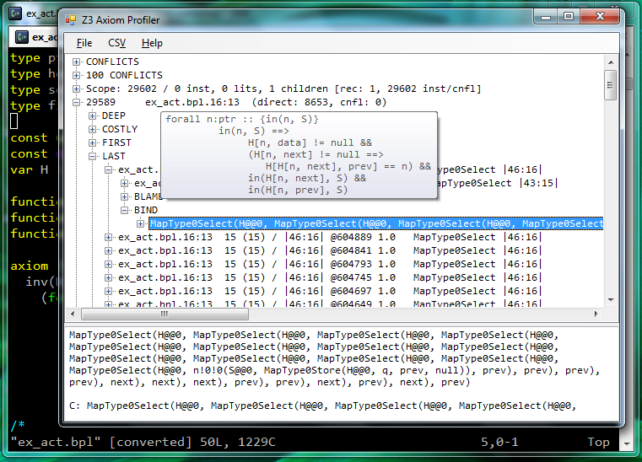
The Axiom Profiler

Slide 16
Prevent Loop By Splitting Next-closedness
(forall H:heap, S:set :: {inv(H, S)}
inv(H, S) <==>
(forall n:ptr :: {in(n, S)}
in(n, S) ==>
H[n, data] != null &&
(H[n, next] != null ==>
H[H[n, next], prev] == n))
&& (forall n:ptr :: {in(H[n, next], S)}
in(n, S) ==> in(H[n, next], S))
&& (forall n:ptr :: {in(H[n, prev], S)}
in(n, S) ==> in(H[n, prev], S)))

Slide 17
Check a Program
procedure add(S:set, q:ptr)
requires inv(H, S);
requires H[q, data] == null;
ensures inv(H, S);
modifies H;
{
H := H[q, prev := null];
}
Program correct iff formula is UNSAT
inv(H, S) &&
H[q, data] == null &&
G == H[q, prev := null] &&
!inv(G, S)

Slide 18
Demo of The MODEL VIEWER

Slide 19
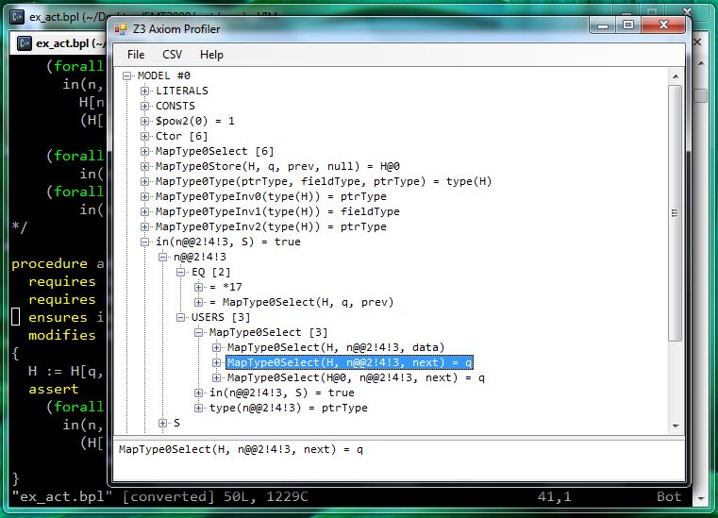
The Model Viewer

Slide 20
Witnesses
(forall n:ptr :: {in(n, S)}
in(n, S) ==> H[n, data] != null &&
(H[n, next] != null ==> H[H[n, next], prev] == n)) &&
(forall n:ptr :: {in(H[n, next], S)}
in(n, S) ==> in(H[n, next], S)) &&
(forall n:ptr :: {in(H[n, prev], S)}
in(n, S) ==> in(H[n, prev], S)) &&
H[q, data] == null &&
G == H[q, prev := null] &&
!(forall n:ptr :: {in(n, S)}
in(n, S) ==>
(G[n, next] != null ==>
G[G[n, next], prev] == n))
in(n0, S) &&
G[n0, next] != null &&
G[G[n0, next], prev] != n
Z3 thinks that
G[n0, next] == q
We know: H[q, data] == null and H[n0, next] == G[n0, next],
and thus we need: in(G[n0, next], S) to trigger
But n0 is a skolem constant, so it’s hard for the user to introduce it.

Slide 21
One Step Ahead
!(forall n:ptr :: {in(n, S)}
in(n, S) ==>
(G[n, next] != null ==>
G[G[n, next], prev] == n))
Whenever proving this thing, look one step ahead, or:
i.e., get in(G[n0, next], S) activated but don’t loop. Please.
Hack the SMT solver to do it :-)
!(forall n:ptr :: {in(n, S)}
{ex_act(in(G[n, next]))}
in(n, S) ==>
(G[n, next] != null ==>
G[G[n, next], prev] == n))

Slide 22
Existential Activation
When proving this quantifier, use lemma trigged by this
(forall H:heap, S:set :: {inv(H, S)}
inv(H, S) <==>
(forall n:ptr :: {in(n, S)}
{ex_act(in(H[n, next], S))}
in(n, S) ==>
H[n, data] != null &&
(H[n, next] != null ==>
H[H[n, next], prev] == n))
&& (forall n:ptr :: {in(H[n, next], S)}
in(n, S) ==> in(H[n, next], S))
&& (forall n:ptr :: {in(H[n, prev], S)}
in(n, S) ==> in(H[n, prev], S)))

Slide 23
VCC In Action

Slide 24
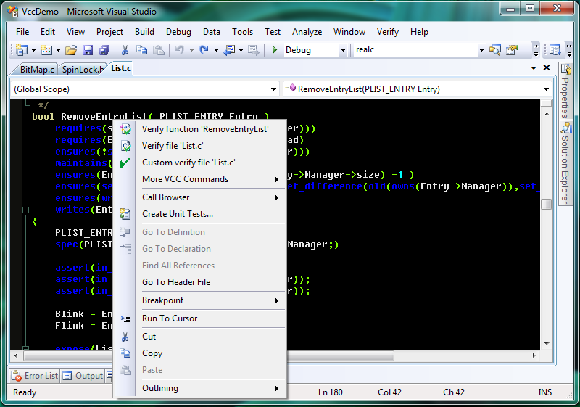
VCC Visual Studio Plugin

Slide 25
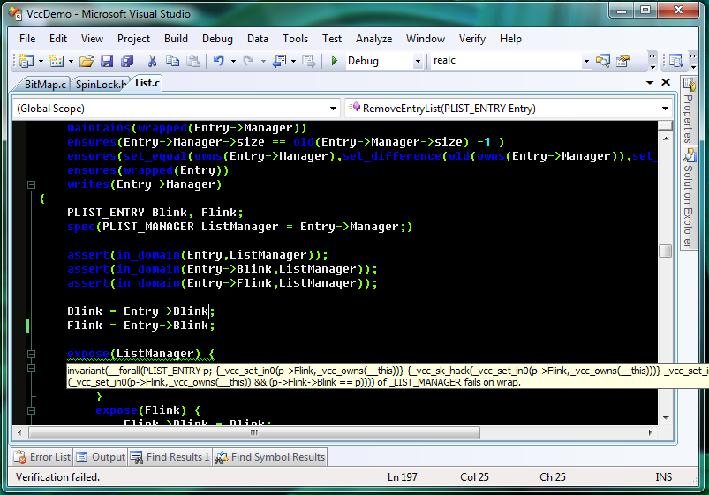
VCC: Failed Verification Attempt

Slide 26
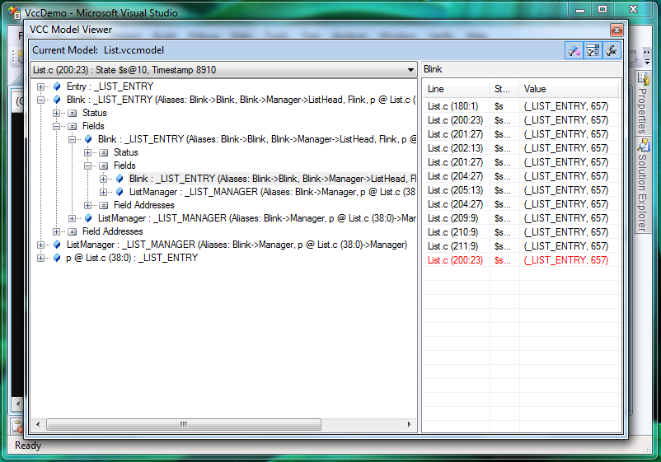
VCC-Specific Model Viewer

Slide 27
Working With VCC
write a version of the spec
verify, fail
add assertions or look at the model to see why it failed
for bigger functions, do it a couple of lines at a time, moving focus window down
repeat

Slide 28
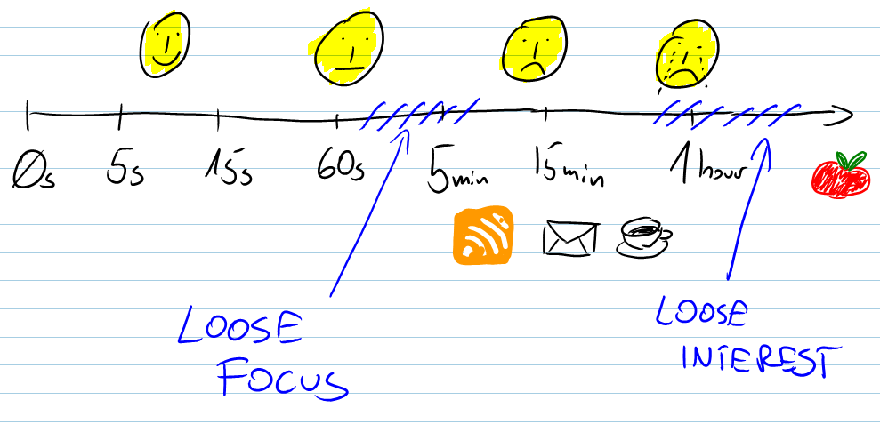
Verification Attempt Time vs Satisfaction and Productivity

Slide 29
WANT it TO go FASTER? Profile!

Slide 30
Causal DAG

Slide 31
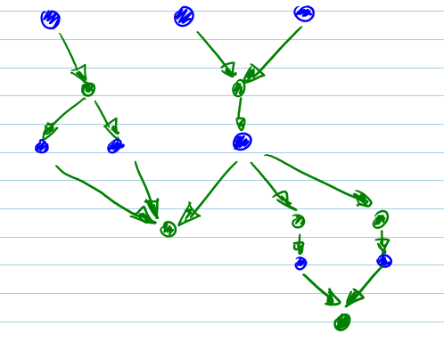
Cost In The Causal DAG

Slide 32
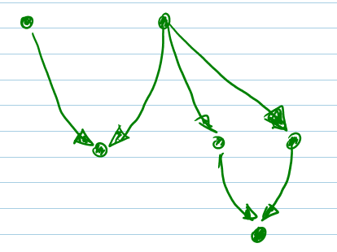
Cost In The Causal DAG

Slide 33
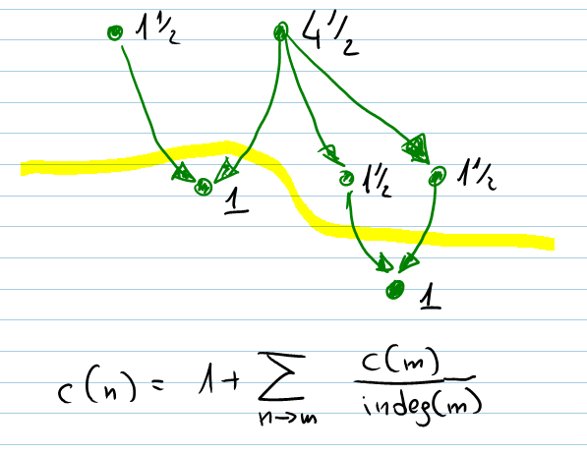
Cost In The Causal DAG

Slide 34
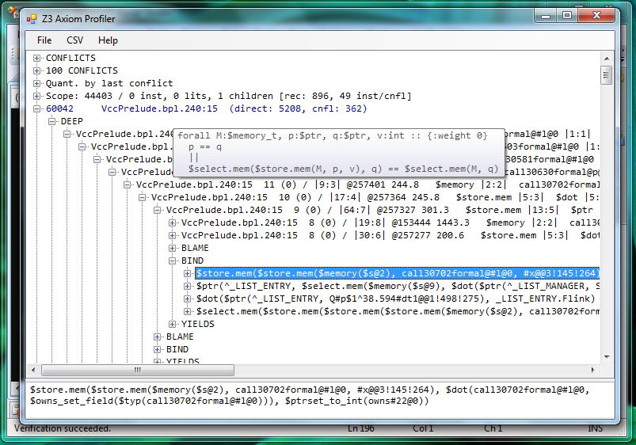
Browsing The Causal DAG

Slide 35
The Inspector: Control to the people

Slide 36
The Inspector
ask Z3 to state the current model from time to time
in forms of labels
translate such models to error messages
display all possible error message and blink the current one

Slide 37
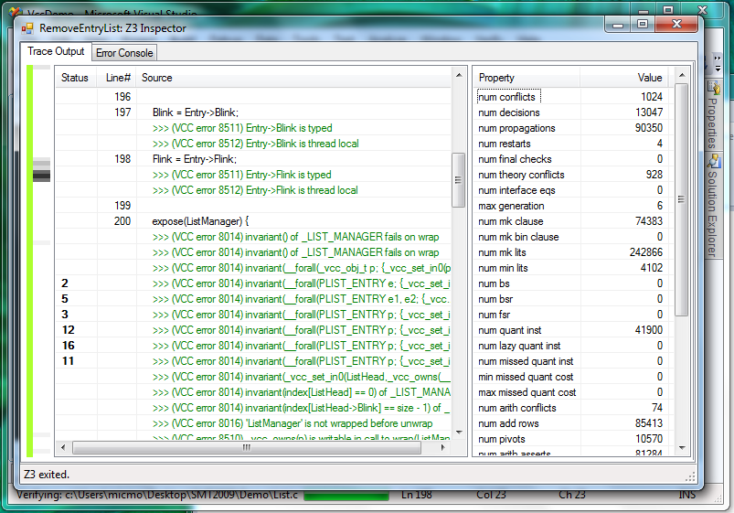
Screenshot

Slide 38
Some numbers

Slide 39
Limits on Matching Depth
matching depth on one of the list functions
10 heap related (10 heap updates in the function)
6 user-defined (different levels of expansion of the invariant)
total of 17
the looping example shows that number of instances can be easily exponential with depth

Slide 40
Scale of Problems
prelude: 300 quantifiers, 50 multi-triggers
Hypervisor program-specific background predicate:
300 types, 1500 fields => 13000 axioms
type description dwarfs VC for the function itself
even Z3 E-matching indices didn’t take that lightly
without proper guidance any SMT solver is likely to be lost

Slide 41
Performance, Performance, Performance
Experience from the Hyper-V verification
successful verifications:
typical: 0.5–500s, average 25s
current max: 2 500s
all time max: 50 000s (down to 1 000s with Z3v2)
acceptable time for interactive work: < 30s
annotations (since Nov 2008):
15 000 lines
400 functions
ca. 20% of codebase verified

Slide 42
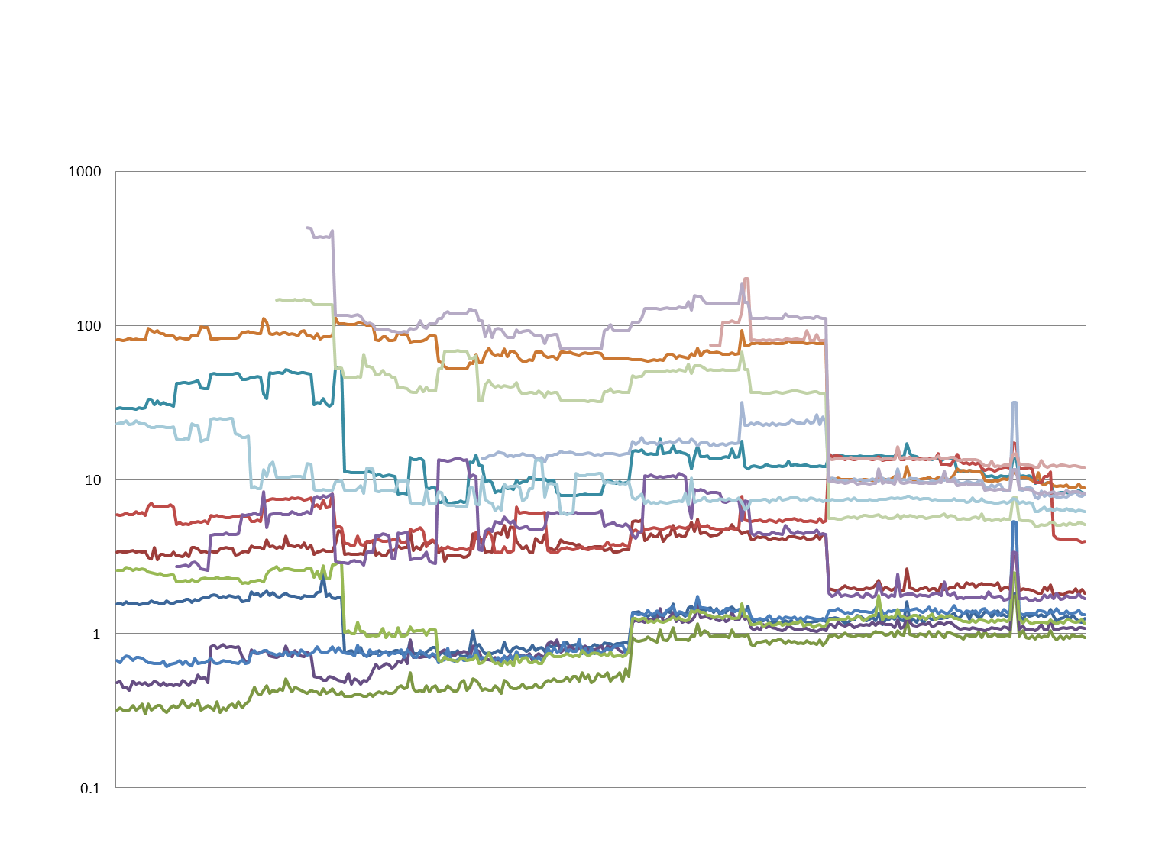
VCC Performance Trends Nov 08 – Mar 09
Modification in invariant checking
Switch to Z3 v2
Z3 v2 update
Attempt to improve Boogie/Z3 interaction
Switch to Boogie2
Notes:
Timeline

Slide 43
summary

Slide 44
Summary
program a custom theory for the SMT solver
like for a “normal” programming language
debug models (model viewers)
profile traces (axiom profiler)
profile with sampling (the inspector)
but:
lack of clear semantics
possibly not the best programming model

Slide 45
VCC Is Available!
source code available for non-commercial purposes at http://vcc.codeplex.com/
includes the SMT tools!
further information linked from there

Slide 46
Thank You!

