Slide 1
A Content-Centric Networking Forwarding Design for a Network Processor
Marc Mosko, Palo Alto Research Center (PARC)
IEEE ICC 2015 – Next Generation Networks (NGN)

Slide 2
Paper topic
How to implement
token-by-token Longest Prefix Match
with variable length tokens
using hardware-assisted hash tables

Slide 3
Hardware hash table
Hardware accepts keys of fixed sizes
(e.g. up to 48 bytes)
And stores data of fixed size
(e.g. up to 96 bytes)
Performance degrades with longer sizes
If a name component does not fit in the key, we need to compress key.

Slide 4
relevance
Implement Content Centric Networking
(CCNx)
On network processors
(EZchip NP4)
In multi-slot chassis switch

Slide 5
Ezchip np4
Task Optimized Processors (TOPs)
Parsing
(32 @ 365 MHz)
Search
(128 @ 1460 Msps)
Resolve
(32 @ 365 MHz)
Modify
(32 @ 365 MHz)
Input Stage
Output Stage
Software hashing
String table compare,
Collision resolution
Hardware hash tables

Slide 6
outline
ICN/CCNx Introduction
Methodology
Data structures + Algorithms
Results

Slide 7
Information centric networks
Name the data
Transfer data based on the names
Break end-to-end paradigm
Ted Nelson’s Project Xanadu (1979)

Slide 8
Request/response protocol
Client
Cache / Producer
/foo/bar/chunk=0
Client sends “Interest” with name
Cache/Producer sends “Content Object”
Transfer using “window” of outstanding Interests
/foo/bar/chunk=1
/foo/bar/chunk=3

Slide 9
Forwarder’s job
Interest
A
B
C
Forward an Interest based on
Forwarding Information Base (FIB)
---
Token-by-token Longest Prefix Match (LPM)
lci:/apple/banana/cherry
(the topic of this talk)
Interest
D

Slide 10
Forwarder’s job
Data
A
B
C
Return data on reverse path
----
Pending Interest Table (PIT)
(not covered in this talk)
Data
D

Slide 11
methodology
Statistical description of CCNx Names
+
Data Structures & Algorithms
+
Hardware Performance Model
=
Expected Performance

Slide 12
What is a name?
Use the Stanford WebBase for URIs
(http://ilpubs.stanford.edu:8090/652)
March 2014
64 million pages from 39,624 web sites.
Download of Links is 251GB.
Yielded 275 million unique URIs.

Slide 13
Name anatomy
http://host.dom.tld/a/b/c/d?query_string
lci:/tld/dom/host/a/b/c/d/query_string
Non-terminal tokens
Terminal
token

Slide 14
Analysis of uri names

Slide 15
Main takeaway
 | mean | stdev | 99% bound
Name components | 7.08 | 1.99 | 12.3
 | mean | stdev | 99% bound
Component Length (Overall With Query) | 12.03 | 32.8 | 98.0
Component Length (Overall No Query) | 7.3 | 11.7 | 38.0
Component Length (Non-terminal) | 6.8 | 9.4 | 31.3
Component Length (Query String alone) | 44.1 | 76.7 | 245.1
Some of these are too big for a
hardware hash table

Slide 16
Main takeaway
 | mean | stdev | 99% bound
Name components | 7.08 | 1.99 | 12.3
 | mean | stdev | 99% bound
Component Length (Overall With Query) | 12.03 | 32.8 | 98.0
Component Length (Overall No Query) | 7.3 | 11.7 | 38.0
Component Length (Non-terminal) | 6.8 | 9.4 | 31.3
Component Length (Query String alone) | 44.1 | 76.7 | 245.1
The QueryString (app data) more than triples the storage requirements of the Name

Slide 17
Algorithm: incremental hybrid tables
Key = ParentKey + NameComponent
Or
Key = ParentKey + SWHash(NameComponent)

Slide 18
example
T
L
T
L
T
L
1
5
apple
1
3
pie
2
47
Abcd…
K1 = 0x00000000 + “0x00010005apple” + pad
➤ EID = 0x00000011 + FIB entry
K2 = 0x00000011 + “0x000010003pie” + pad
➤ EID = 0x00002200 + FIB entry
K3 = 0x00002200 + Hash(“0x0002002FAbcd…”)
➤ EID = 0x00770000 + FIB entry + String ID

Slide 19
Data structures
Control plane knows names N[i] with components N[i,j]
It inserts FIB entries on each line card and uses a bitmap for egress card slots. It also contains a Route ID (RID) programmed on each egress slot to resolve specific media ports.
Fabric switching is done on the egress bitmap and carries the RID.
On each egress card, the RID resolves to the specific egress media ports on that card.
For name components that are too large for a hardware hash table key, the control plane also inserts the full name component in a string table identified by a String ID (SID).
If two or more name components (plus parent id) collide, there is also a Collision ID (CID), but for the hash size used this is very rare.

Slide 20
Example
Slot 0
FIB lookup
Fabric

Slide 21
Example
Slot 0
FIB lookup
0110
“42”
RID
lookup
“42”
Fabric
RID
lookup
“42”

Slide 22
HYBRID TABLES
Hash Key
Result
Row Length
3B
2B
2B
9B
2B
3B
2B
3B
16+10
PEID
Type
Len
Value
Flags
EID
Bitmap
RID
26 ≤ 32
3B
2B
2B
21B
2B
3B
2B
3B
28+10
PEID
Type
Len
Value
Flags
EID
Bitmap
RID
3B
2B
2B
41B
2B
3B
2B
3B
48+10
PEID
Type
Len
Value
Flags
EID
Bitmap
RID
58 ≤ 64
3B
16B
2B
3B
2B
3B
3B
19+13
PEID
Hash
Flags
EID
Bitmap
RID
SID/CID
32 ≤ 32

Slide 23
fIB table result
Flags
EID
Bitmap
RID
SID/CID
Flags NP4 flags
EID Entry ID (used as Parent ID in next lookup)
Bitmap Indicates egress slots
RID Route ID (index to table on each egress card)
SID/CID String ID or Collision ID (software hash lookups)

Slide 24
What can go wrong?
Software Hash will result in key collisions
If routing process inserts two names with same hash, it detects and indicates a “Collision ID” for second lookup
A lookup on a name may not be an actual match (hash bucket collision) so still need to do a string comparison via “String ID” lookup

Slide 25
Software hashing
Area of Interest

Slide 26
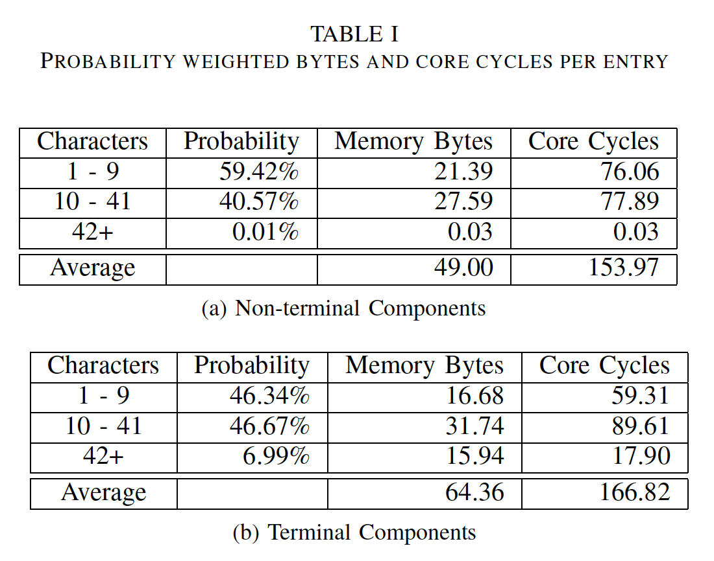
Architecture summary
Hardware Hash Table
(up to 9 chars)
Hardware Hash Table
(up to 41 chars)
Software Hash Table
(over 41 chars)
String Table
(over 41 chars)
RID Table
Collision Table

Slide 27
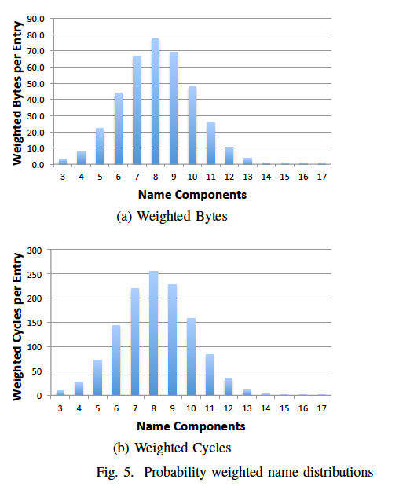
Final results
Summing 3 … 17
Average FIB Entry is
378.3 bytes
Average Lookup is
1246.2 core cycles

Slide 28
Expected performance
2GB DRAM stores 5.6M FIB entries
1246 core cycles over 128 lookup engines service 37 Mpps
Computing SIPHash 2-4 for the 0.01% of long tokens is done in the Parse TOP takes 1178 cycles, done in parallel with search

Slide 29
Conclusion
Analysis of today’s URIs shows that most names will fit in hardware hash tables.
Implemented several hash functions on EZchip NP4.
Propose a multi-stage incremental hash lookup to allow mixing plain keys and software compressed keys in hardware hash tables.
Using performance model from EZchip, estimate 37Mpps.
Software compressed keys are calculated in separate processor from hash lookups.

