Slide 1
Application Aware Switching with Zodiac FX
Markus Moskopp and Mayukh Das Software Defined Networking Laboratory Chair of Communication Networks

Slide 2
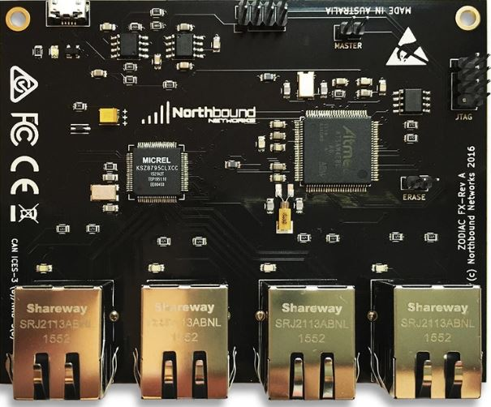
Zodiac FX
Considered as the smallest SDN test bed. Some features are:
4 Fast Ethernet ports
CLI accessible via virtual serial port
Support for OpenFlow 1.0, 1.3 & 1.4
802.1q VLAN support

Slide 3
Problem at Hand
The switch processes all data and control packets in the software running on the main processor
the processing time of the switch directly depends on the code running on it.
The firmware is complex as it supports extensive features which are not always used for specific switching applications.

Slide 4
Project Goal
The goal of the project was to optimize the firmware of the switch for a particular use case and compare the change in throughput of the data plane traffic.

Slide 5
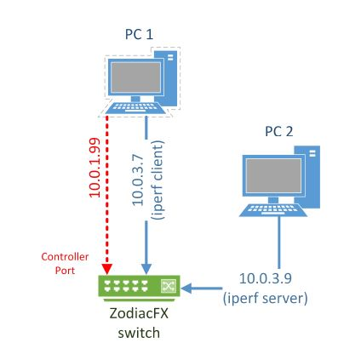
Setup
Controller port connected to Ryu controller with ip 10.0.1.99
2 different host were connected to switch ports with ip 10.0.3.7 and 10.0.3.9
OF version used for the entire project was OF 1.0

Slide 6
Ryu Controller
Based on
simple L2-Learning Switch provided by Ryu
Additional Features
For every packet from 10.0.3.7 to 3.9 install new flow with match on Mac src, dst address
Then, 100 ”dummy” flows are installed, yet this happens only once.
dummy flows are installed with a lower priority as not to influence the resulting logical behaviour of the switch but to check whether adding more flows impacts the switch throughput

Slide 7
Preparing the Firmware
Zodiac FX switch validates a checksum of uploaded firmware before actually running it
the hidden CLI command get crc can be invoked which outputs the required checksum
appended to the firmware file with a hex editor

Slide 8
Flashing the Firmwares
Actual Firmwares
Could be done using SAM-BA In-system Programmer by Atmel
Also with CLI
Custom Firmwares
Could only be done using CLI
For updating firmware using the CLI we need Extra putty that supports XMODEM file transfer.

Slide 9
TEST-BED Configuration
Configure the switch via CLI
“failstate” must be set to “safe”
all previous flows have to be cleared via the CLI
The CLI must be disconnected before
Measure Throughput
IPERF3
measure the bandwidth through the switch for 10 seconds
iperf3 -s -B 10.0.3.9 -p 5201 for server
iperf -c -B 10.0.3.7 -p 5201 for client

