Slide 1



What limits the loss of
recombination on sex chromosomes
Sally Otto
Department of Zoology
& Biodiversity Research Centre
University of British Columbia

Slide 2
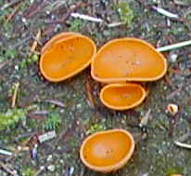
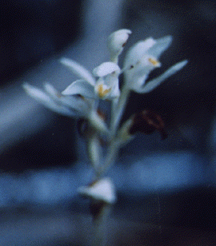


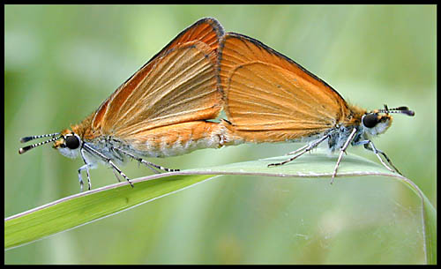
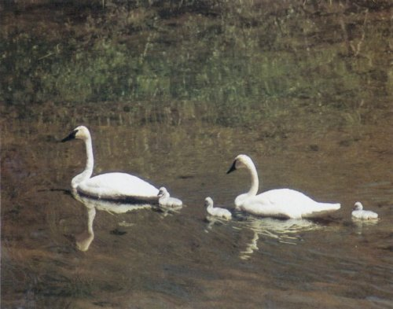
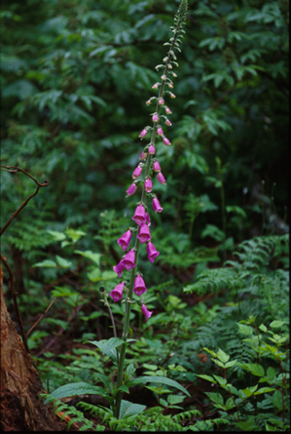


Sex and recombination
Despite the many costs of sex, the vast majority
of eukaryotic organisms are sexual
The paradox of sex

Slide 3
Heightening the paradox of sex
Earliest models: Sexual recombination never favored
Modifiers increasing sex or recombination never spread in a population at equilibrium under constant viability selection.
– Kimura 1956, Nei 1967, Feldman et al. 1983
  Reduction Principle

Slide 4
The paradox of sex
Earliest models: Sexual recombination never favored
At equilibrium, sex and recombination simply break down genetic associations built by past dominance and epistasis, generating a high segregation and recombination load.
  In a static world, sex would be absent.

Slide 5
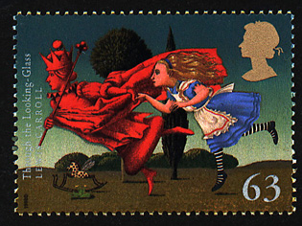

Resolving the paradox of sex
Breaking down genetic associations built by past selection
Selection varies temporally, e.g., Red Queen Hypothesis
Selection varies spatially
Associations limit variation (negative epistasis hypothesis)
Reducing selective interference among loci
Hill-Robertson effects, including Muller’s Ratchet, Ruby-in-the-Rubish, Fisher-Muller, & Clonal Interference.

Slide 6
Another paradox of sex
How organisms reproduce sexually is…
remarkably diverse

Slide 7
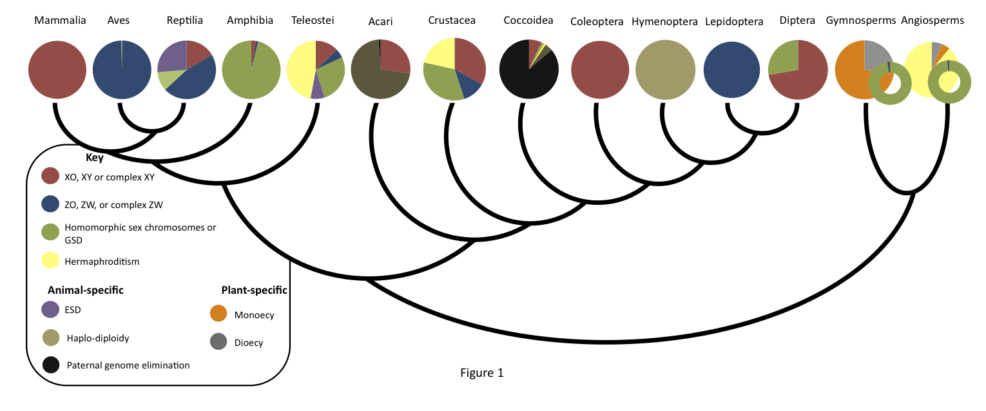
Another paradox of sex
Tree of Sex, NESCent working group
remarkable diversity

Slide 8
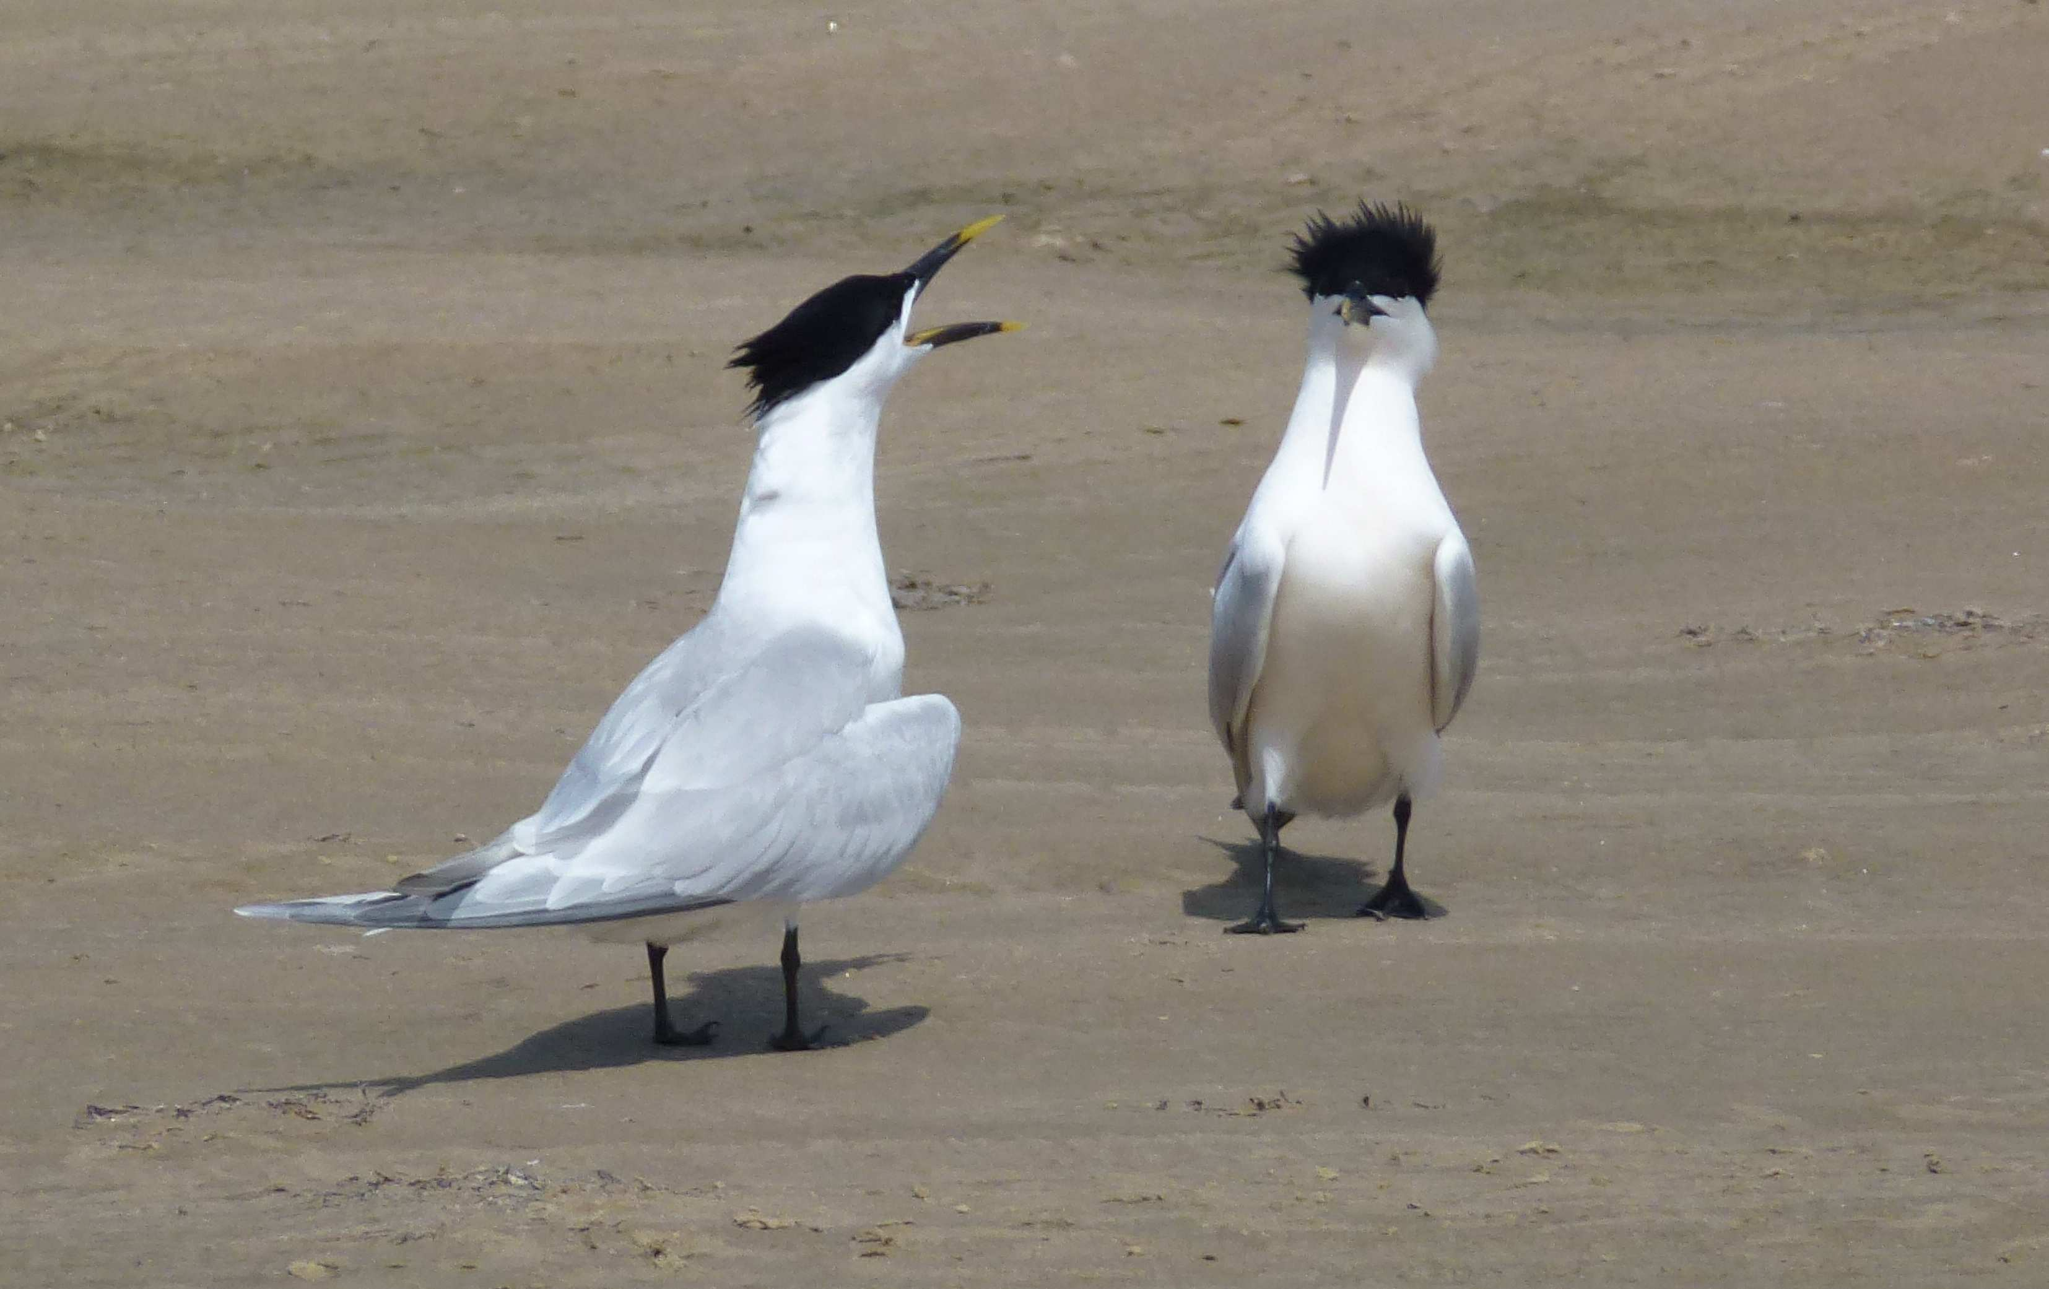
Sex chromosome evolution
Evolutionary transitions involving sex chromosomes raise several of the same issues associated with sex & recombination:
keeping alleles together that work well with each other
moving alleles onto new genetic backgrounds

Slide 9
Sex chromosome evolution
keeping alleles together that work well with each other
One of the first modifier models explored the tendency for recombination to decrease between two sex determining genes on a sex chromosome.
- Nei 1969

Slide 10
Sex chromosome evolution
keeping alleles together that work well with each other
The force favoring linkage – selection against intersexes – is an example of epistasis creating a strong recombination load.

Slide 11
Sex chromosome evolution
keeping alleles together that work well with each other
Epistasis similarly drives reduced recombination between male-sterile and female-sterile mutations in the evolutionary transition from hermaphroditism to dioecy (separate sexes).
– Charlesworth & Charlesworth 1978

Slide 12
Sex chromosome evolution
keeping alleles together that work well with each other
More generally, when different alleles benefit males and females (“sexually antagonistic selection”), decreased recombination is favored between that locus and the sex determining region.
– Fisher 1931, Rice 1987

Slide 13
Sex chromosome evolution
keeping alleles together that work well with each other
Drives reduced recombination on sex chromosomes
True for fusions (Charlesworth & Charlesworth 1980)
True for loosely linked loci, even if selection differs only in magnitude (“sex specific selection”) rather than sign (Lenormand 2003)
True for sexually antagonistic loci tightly linked to the sex determining region (Otto in prep)

Slide 14
Sex chromosome evolution
As recombination declines, deleterious alleles become less efficiently eliminated and the Y (or W) degenerates.
As degeneration proceeds, males stop benefiting from Y-linked alleles and other features (e.g., Y centromeres) may degrade.

Slide 15
Sex chromosome evolution
Degeneration can promote sex chromosomes transitions
Stronger sexually antagonistic selection at an autosomal locus promotes a switch (van Doorn & Kirkpatrick 2007, 2010)
Load due to degeneration of the Y (or W) relieved by a switch to a new Y (or W) (Blaser et al 2012)

Slide 16

Sex chromosome evolution
But is the eventual loss of recombination on sex chromosomes inevitable?

Slide 17
Sex chromosome evolution
But is the eventual loss of recombination on sex chromosomes inevitable?
No
Some old sex chromosomes remain completely homomorphic (e.g., 5.4MY sex chromosomes in tree frogs) or only partially heteromorphic (e.g., 140MY and 120MY in pythons and ratites; Bachtrog et al. 2013).
Few dioecious plants exhibit heteromorphic sex chromosomes
(~20 of 15000 dioecious angiosperms), even in very old lineages
(e.g., only minor heteromorphism in gingkos).

Slide 18
Sex chromosome evolution
What maintains recombining
sex chromosomes?
Selection for proper segregation of X and Y

Slide 19
Sex chromosome evolution
What maintains recombining
sex chromosomes?
Selection for proper segregation of X and Y
In humans, incidence of XXY (Klinefelter syndrome) is high (~1/1000) and primarily paternal non-disjunction.
Single sperm typing: Recombination in disomic sperm 2/3 of that in monosomic sperm (Shi et al. 2001).

Slide 20
Sex chromosome evolution
What maintains recombining
sex chromosomes?
Selection for proper segregation of X and Y
But recombination can be confined to extremely small
“pseudo-autosomal regions”
&
segregation can be accomplished by other mechanisms
(e.g., distributive disjunction system in Drosophila,
X-Y synaptonemal associations lacking chiasmata in marsupials)
Notes:
http://www.plosgenetics.org/article/info%3Adoi%2F10.1371%2Fjournal.pgen.0020136

Slide 21
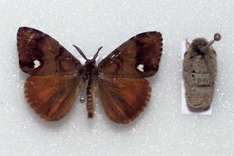
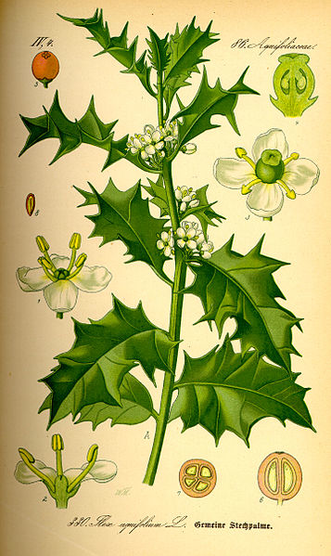
Sex chromosome evolution
What maintains recombining
sex chromosomes?
Lack of sexual antagonism may slow loss of recombination
♂
♀
Ilex aquifolium
http://www.lba.uk.com/Orgyia-recens-SCARCE-VAPOURER_A187RK.aspx
Orgyia recens
http://en.wikipedia.org/wiki/Ilex_aquifolium

Slide 22
Sex chromosome evolution
What maintains recombining
sex chromosomes?
Hill-Robertson interference among sex-linked selected loci

Slide 23
Sex chromosome evolution
What maintains recombining
sex chromosomes?
Hill-Robertson interference among sex-linked selected loci
Recombination between the X and Y (or Z and W) allows favorable alleles to escape deleterious alleles in their genetic backgrounds
Maintains chromosome-wide recombination (Grossen et al 2012)
?Prevents spread of non-recombining region? (Cavoto & Perrin)

Slide 24
Sex chromosome evolution
What maintains recombining
sex chromosomes?
Some forms of selection

Slide 25
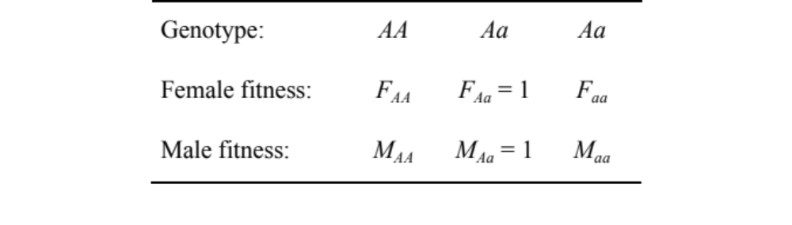
Sex chromosome evolution
Model:
Consider a locus with two alleles (A/a) tightly linked to the sex determining region.

Slide 26
Sex chromosome evolution
Model:
Can modifiers increasing recombination
ever spread?
Yes – Requires that an allele that is beneficial for daughters is at higher frequency on the Y.

Slide 27
Sex chromosome evolution
Model:
Can modifiers increasing recombination
ever spread?
Yes – Requires that an allele that is beneficial for daughters is at higher frequency on the Y.
What??

Slide 28
Sex chromosome evolution
Step back: The sexual three-some

Slide 29
Sex chromosome evolution
Step back: The sexual three-some
We view selection on sex chromosomes as involving two partners – males and females.

Slide 30
Sex chromosome evolution
Step back: The sexual three-some
Yet selection involves three players:
X in females
X in males
Y
Can generate surprisingly results!

Slide 31
Sex chromosome evolution
What is the nature of polymorphic equilibria?
How does recombination evolve between a selected locus and the sex determining region?

Slide 32
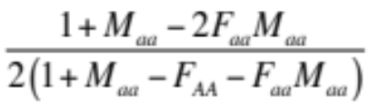
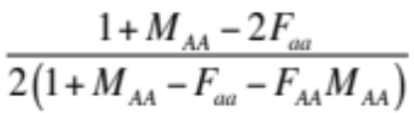

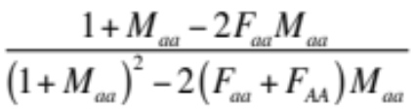
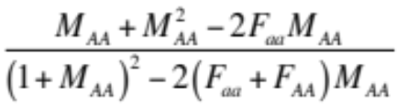
Sex chromosome evolution
Potential polymorphic equilibria
Frequency of A approximately:
(plus one equilibrium with Y polymorphic that is never stable)
p_{Xf} in female X
p_{Xm} in male X
p_{Y} in male Y

Slide 33
Sex chromosome evolution
Potential polymorphic equilibria
Frequency of A approximately:
p_{Xf} in female X
p_{Xm} in male X
p_{Y} in male Y
Equilibrium allele frequencies never equal in males and females

Slide 34
Sex chromosome evolution
p_{Xf} in female X
p_{Xm} in male X
p_{Y} in male Y
Selection must act in opposite directions on XA in males and females
Notes:
Otherwise the A (or a) allele would fix on the X.

Slide 35
Sex chromosome evolution
p_{Xf} in female X
p_{Xm} in male X
p_{Y} in male Y
Selection must act in opposite directions on XA in males and females
Appearance of sexually antagonistic selection even when absent
Notes:
Otherwise the A (or a) allele would fix on the X.

Slide 36
Sex chromosome evolution
p_{Xf} in female X
p_{Xm} in male X
p_{Y} in male Y
Selection may act in opposite directions on XA in males and females

Slide 37
Sex chromosome evolution
p_{Xf} in female X
p_{Xm} in male X
p_{Y} in male Y
Balance of selection
for Xa and XA
Net selection for
Xa XA

Slide 38
Sex chromosome evolution
p_{Xf} in female X
p_{Xm} in male X
p_{Y} in male Y
Selection on YA may thus act in the same or opposite direction as selection on XA in females.

Slide 39
Sex chromosome evolution
p_{Xf} in female X
p_{Xm} in male X
p_{Y} in male Y
When the same allele is favored in females as is present on the Y,
fathers that recombine produce more fit daughters.

Slide 40
Sex chromosome evolution
When the same allele is favored in females as is present on the Y,
fathers that recombine produce more fit daughters.
Sexually antagonistic selection: Never
Directional selection in males: Never
Overdominance in males: Required
Does this favor modifiers increasing recombination?

Slide 41
Sex chromosome evolution
When the same allele is favored in females as is present on the Y,
fathers that recombine produce more fit daughters.
Overdominance in males
In females, selection must act & favor the allele common on Y
Benefit to daughters must outweigh cost to sons
Modifier must be sufficiently loosely linked
Increased recombination evolves if

Slide 42
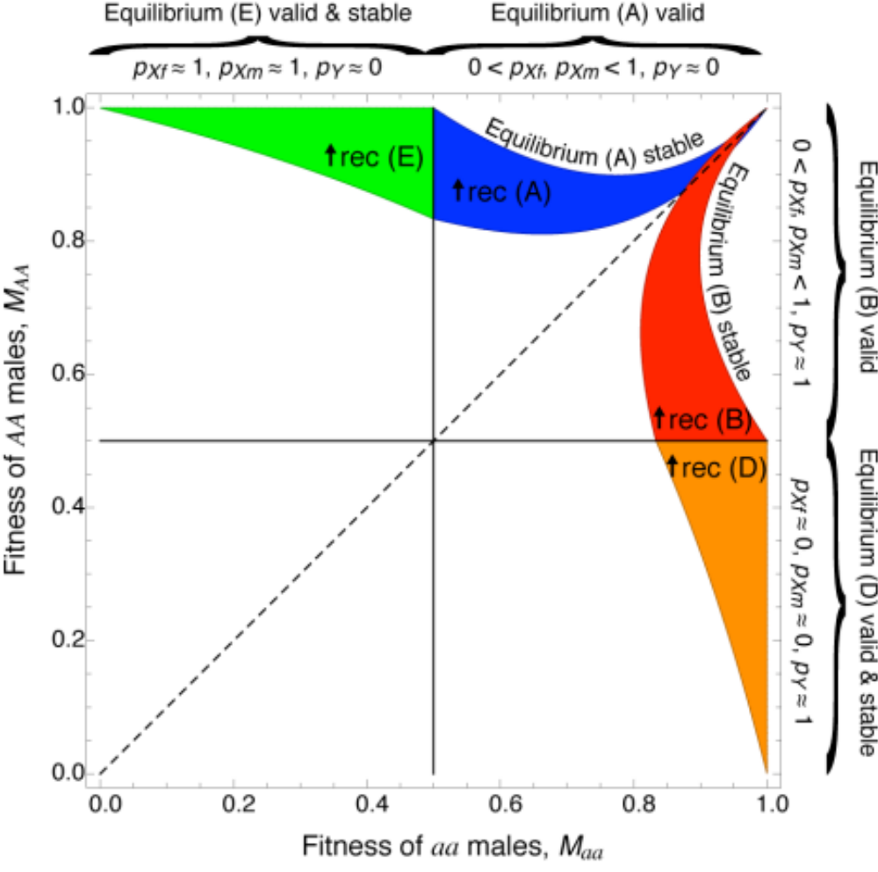
Unlinked modifier
F_{AA} = 0.75
F_{Aa} = 1
F_{aa} = 0.75

Slide 43
Unlinked modifier
F_{AA} = 0.75
F_{Aa} = 1
F_{aa} = 0.75
Ya nearly fixed in males
XA strongly favored in males
(because of overdominance with high M_{AA})
but Xa favored in females

Slide 44
Unlinked modifier
F_{AA} = 0.75
F_{Aa} = 1
F_{aa} = 0.75
Thus, recombination in males
produces Xa gametes,
leading to more fit daughters,
with only a slight fitness cost to sons.

Slide 45
Unlinked modifier
F_{AA} = 0.75
F_{Aa} = 1
F_{aa} = 0.75
Thus, recombination in males
produces Xa gametes,
leading to more fit daughters,
with only a slight fitness cost to sons.

Slide 46
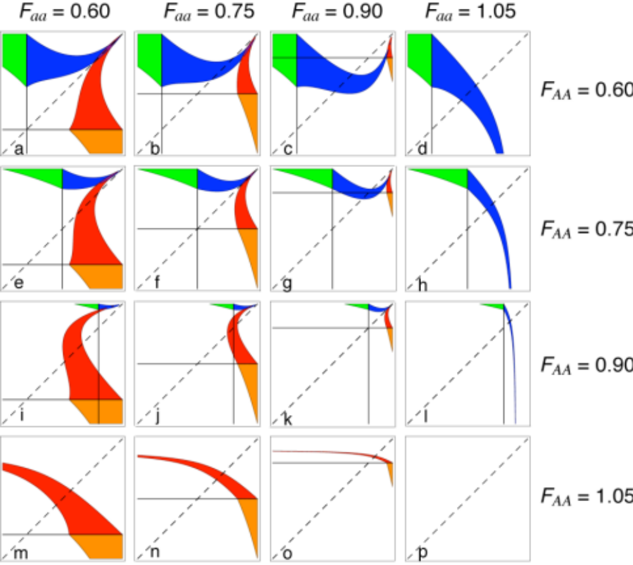

Slide 47
In females,
selection may be
overdominant

Slide 48
…or directional

Slide 49
Stronger selection
in females broadens
conditions.

Slide 50
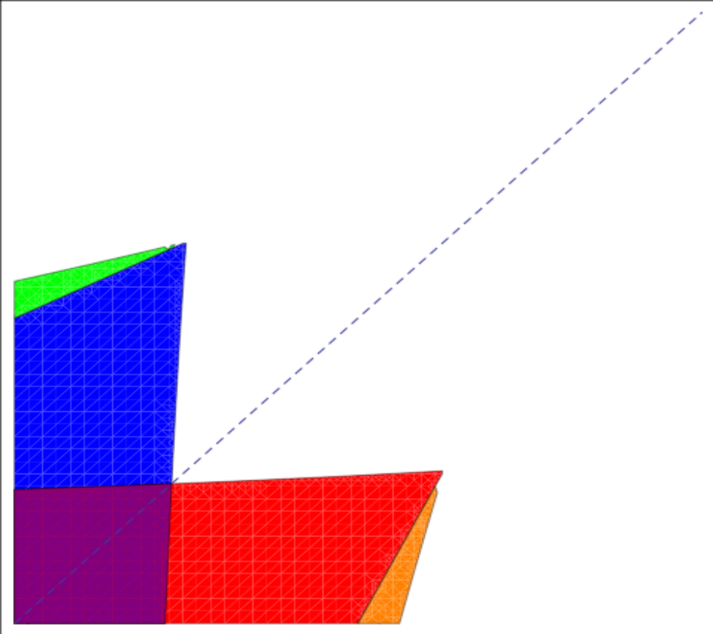
But equal selection in males and females can still favor recombination
…if selection is strong and overdominant
1
F_{AA} = M_{AA}
0
0
F_{aa} = M_{aa}
1
Notes:
R=1/2

Slide 51
Sex chromosome evolution
Theoretical interest:
Allele frequencies at tightly sex-linked loci always differ between the sexes at equilibrium, even with equal selection in males and females.

Slide 52
Sex chromosome evolution
Theoretical interest:
Sex-linked alleles will often be selected in opposite directions in males and females, even when selection is not sexually antagonistic.

Slide 53
Sex chromosome evolution
Theoretical interest:
Selection can oppose the decay of recombination on the sex chromosomes, when Y allele is beneficial for daughters.

Slide 54
Sex chromosome evolution
General point:
Selection is a three-player interaction
X in females
X in males
Y

Slide 55
Sex chromosome evolution
Is the eventual loss of recombination on sex chromosomes inevitable?
No
Selection for proper segregation of X and Y
Lack of sexual antagonism may slow loss of recombination
Hill-Robertson interference among sex-linked selected loci
Some forms of selection

Slide 56
Sex and recombination generate variation needed by selection but depleted in finite populations

Slide 57
Ironically, where sex is determined is often where recombination is least favored…but not always

Slide 58

Acknowledgments
Collaborators:
Tree of Sex NESCent working group
Marc Feldman
Mark Kirkpatrick
Nick Barton
Peter Keightley
Thomas Lenormand
Guillaume Martin
Lilach Hadany
Aneil Agrawal
Matthew Hartfield
Funding:
NSERC (Canada)
CNRS (France)
NESCent (USA)

Slide 60
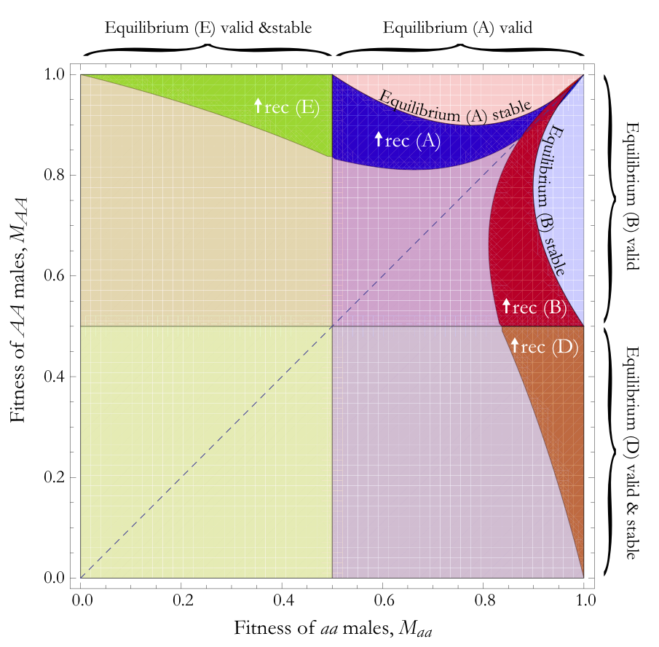
Unlinked modifier
F_{AA} = F_{aa} = 0.75

