Slide 1
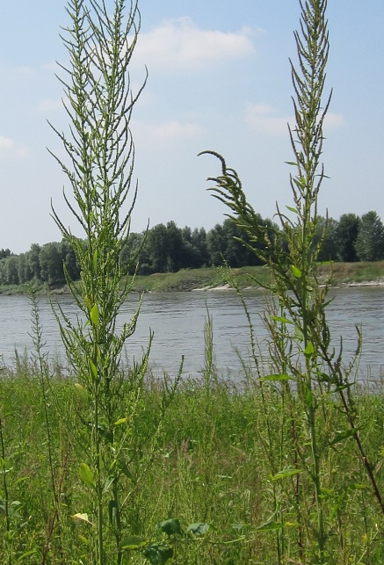

Herbicide resistance
Kreiner et al 2019
Multiple modes of convergent adaptation in the spread of glyphosate-resistant Amaranthus tuberculatus
This Photo by Unknown author is licensed under CC BY-NC-ND.

Slide 2
Background

Slide 3
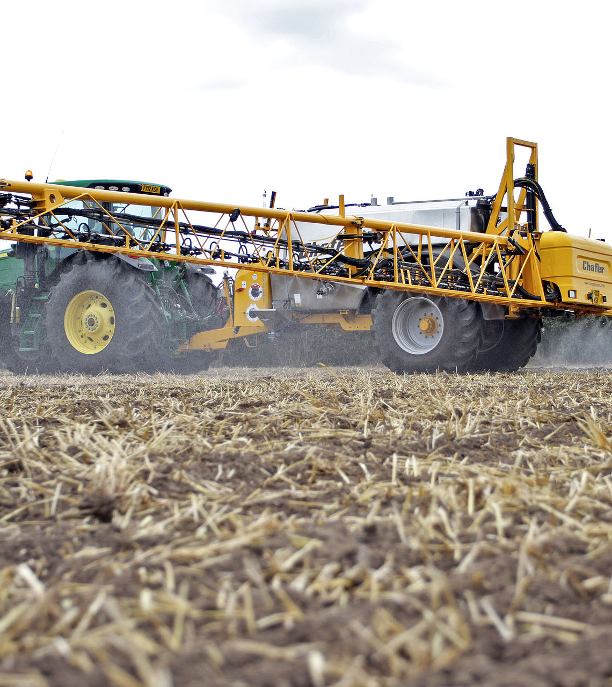
Herbicide resistance
Herbicides are used across the world to control weeds
Strong selective pressure on weeds to evolve resistance
>500 unique cases of resistance known (Heap 2021)
How does resistance evolve?
Population genetics may help predict and prevent future resistance (Kreiner et al 2018)
This Photo by Unknown author is licensed under CC BY-SA.

Slide 4

Glyphosate
Glyphosate is the active ingredient in Roundup Ready technology
Ubiquitous (e.g., >80% of soybean fields in USA)
Resistance is widespread (weedscience.org)
This Photo by Unknown author is licensed under CC BY-NC-ND.

Slide 5
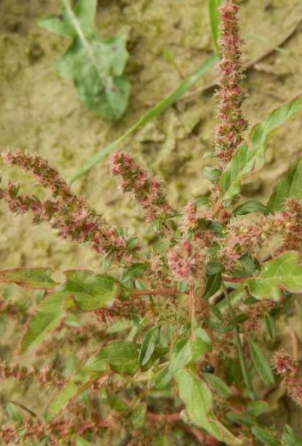
Amaranthus Tuberculatus
Historically a riparian species
There are now many agriculturally associated populations
Resistance first arose in Missouri in 2005, now in 19 states
Resistance in Ontario ~2010
This Photo by Unknown author is licensed under CC BY-NC-ND.

Slide 6
Questions
How does resistance evolve?
- what is its genetic basis?
How many times has resistance evolved?
- one mutation that spread via gene flow, or multiple mutations?

Slide 7
METHODS

Slide 8
METHODS
Seeds from 163 individuals from 19 fields
- Missouri, Illinois, and Ontario (Essex and Walpole)
Seeds from 10 individuals in non-agricultural setting (Ontario)
Built genome, resequenced all individuals
Scored resistance in the greenhouse

Slide 9
Results

Slide 10
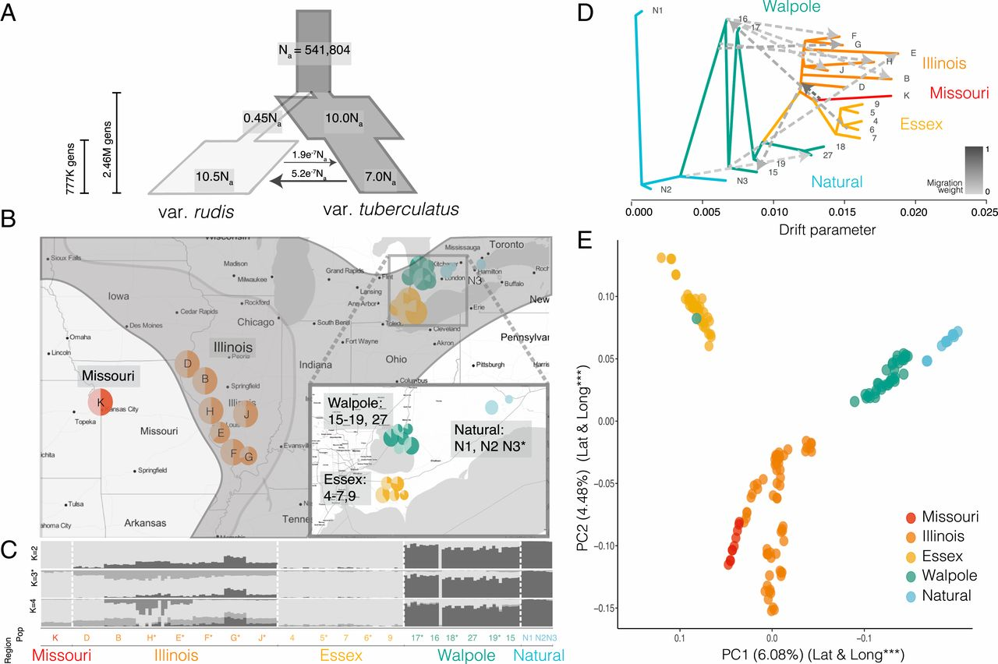
Demography
Used computer programs (STRUCTURE, dadi, treemix, and PCA) to infer demography of the population from genomes
- 2 varieties
- lots of gene flow
- resistance everywhere
This Photo by Unknown author is licensed under CC BY.

Slide 11
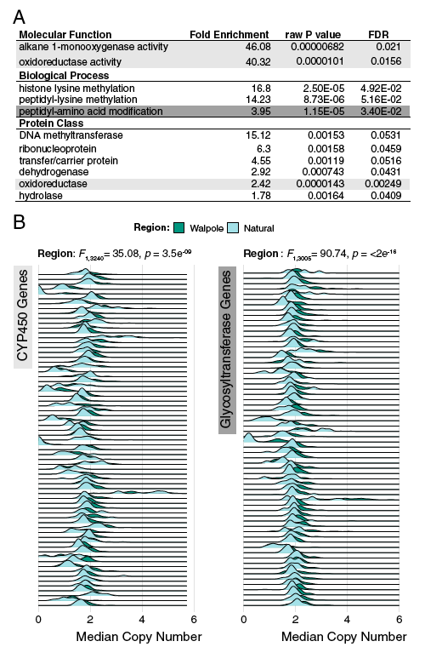
GEnetic basis of resistance
Compared genomes of Walpole individuals (some resistant) with non-agricultural individuals (not resistant) to look for difference that might explain resistance
- 2 families of genes involved in detoxifying herbicides have increased copy number in Walpole
- but did not correlate with resistance in the greenhouse, suggesting more factors involved

Slide 12
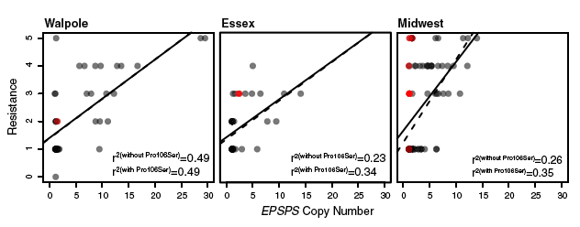
Genetic Basis of resistance
Suspected EPSPS gene might be involved in resistance, so compared copy number of EPSPS and mutations in EPSPS with greenhouse resistance
- together explained ~30-60% of variation in resistance

Slide 13
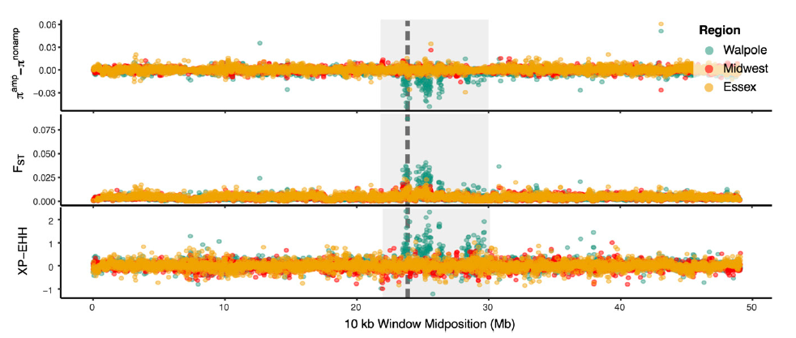
Genetic signals of selection
Looked at the EPSPS region of the genome for signatures of natural selection
- found evidence for strong selection in Walpole

Slide 14
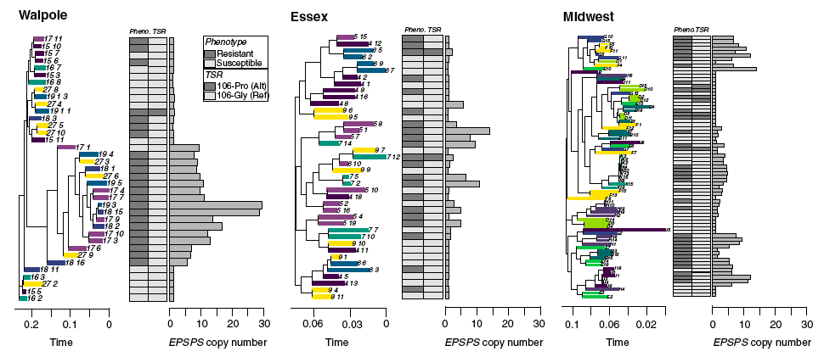
How many times has resistance arisen?
Mapped resistance and EPSPS copy number onto a phylogenetic tree to count occurrences
- 1 mutation in Walpole
- >1 elsewhere

Slide 15
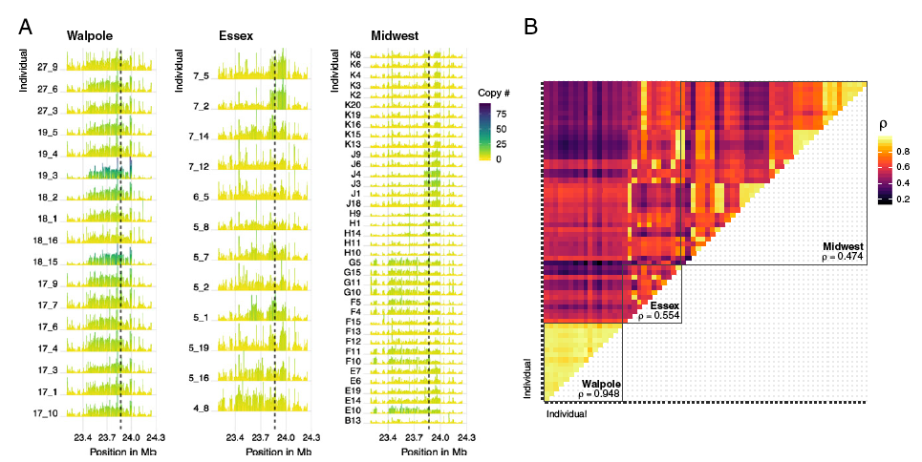
HOW MANY TIMES HAS RESISTANCE ARISEN?
Compared EPSPS copy number profile across individuals
- 1 group in Walpole
- >1 elsewhere
- Essex and Midwest share some groups

Slide 16
CONCLUSIONS

Slide 17
CONCLUSIONS
Resistance widespread
Resistance involves multiple genes (EPSPS, CYP450s, …)
Resistance has rapidly evolved multiple times (at least 3?)
Resistance genes also appear to have spread via gene flow
So perhaps resistance can be slowed by reduced gene flow, but seems inevitable that resistance will arise in this system?

Slide 18
Outstanding questions
1. Where did resistance in Walpole arise from? Was it new mutations on the non-agricultural var. tuberculatus background? Or was it introgression from an unsampled var. rudis population? How to test for this?
2. How could we prevent resistance arising from sensitive populations in the future? On/off herbicide regimes (crop rotation)? More herbicides? Different herbicides?
3. Why is the number of copies of a gene so important in this case? Why isn't resistance determined more by mutations in the gene copies that are already there?

