Slide 1

A General Framework For Dictionary Based Audio Fingerprinting
M. Moussallam, L. Daudet
Institut Langevin, ESPCI ParisTech - Univ Paris VII Diderot

Slide 2
Introduction
State of the art fingerprinting methods:
Extract keypoints from a TF representation
Build landmarks by combining neighbor keypoints
A landmark is associated with an audio object at a given time position. Recognition is performed by fast comparison of landmarks.

Slide 3
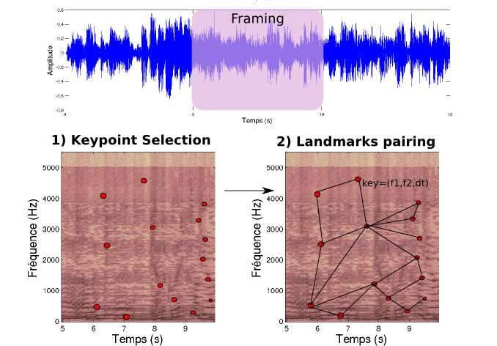
Introduction

Slide 4
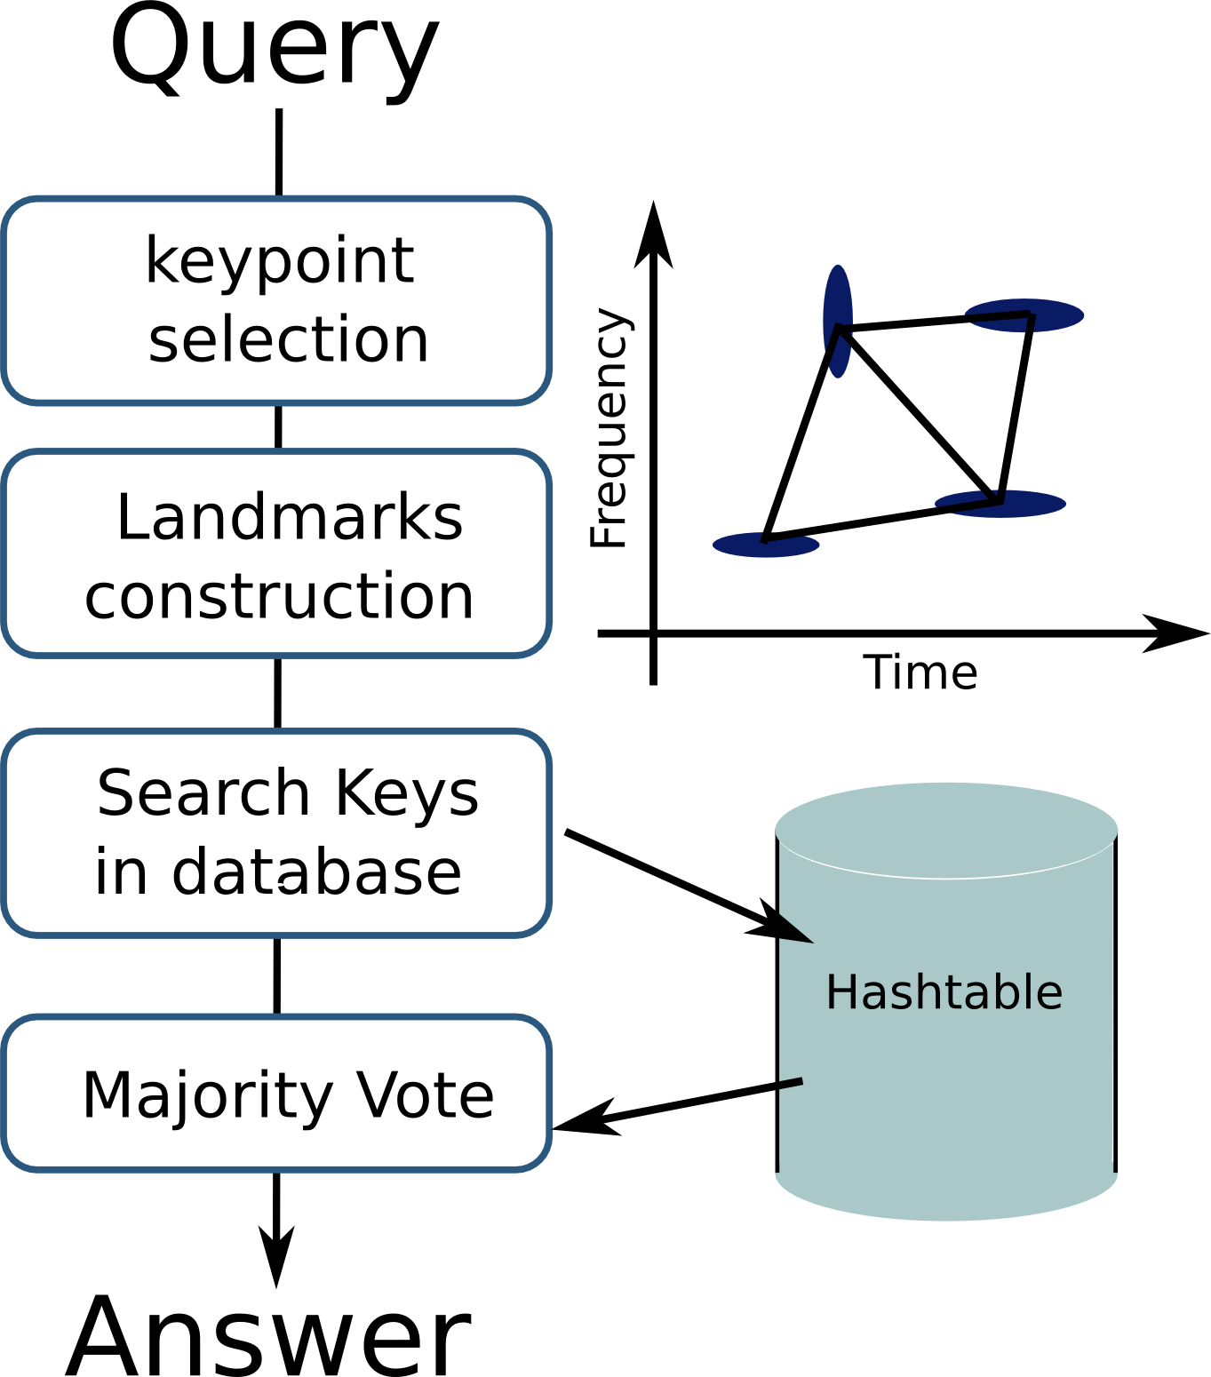
Complete recognition system

Slide 5
Introduction : objectives
Robustness: landmarks should not be modified by sound distortion
Discriminating: landmarks must be specific of a sound
Problem: these may be concurrent objectives !
Sound specificities are in the high frequencies… also the most easily distorted ones

Slide 6
Introduction : objectives
State of the art methods put the emphasis on:
Robustness → Cotton and Ellis 2010 (Keypoints selected by MP, goal is to recognized highly distorted versions of the same sound object : Obama's investment speech)
Discriminating → Wang 2003 (lead to Shazam algorithm: keypoints are deliberately spread in the TF plane to have the most efficient “snapshot” of an audio object)

Slide 7
Introduction : this work
Express the audio fingerprinting problem as a Dictionary-based one
Propose a generalized framework and algorithm

Slide 8
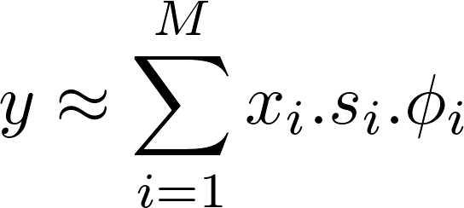
A Dictionary point of view
Keypoints → Atoms in a dictionary
Keypoint selection → decomposition process
Landmarks → Structures (molecules)
Fingerprint → Sparse representation
Standard dictionary-based algorithms such as IHT or MP are appropriate
What is the problem formulation ?

Slide 9
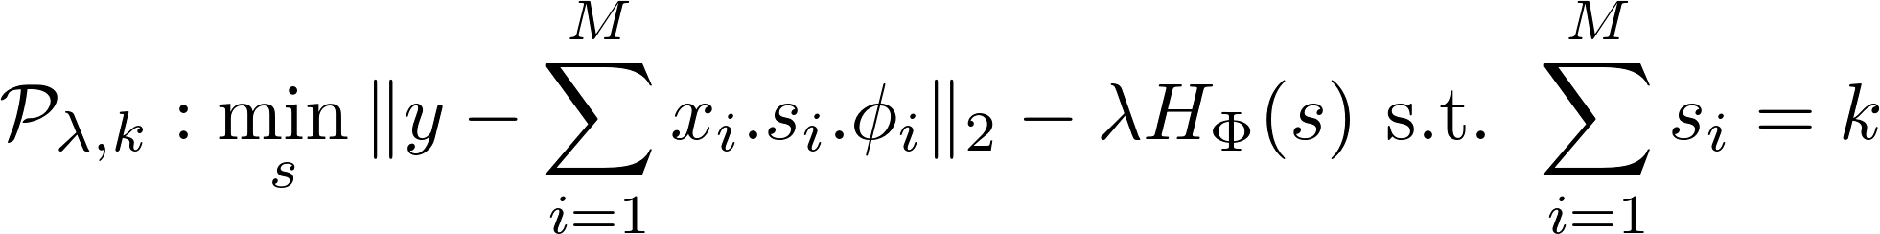
Problem formulation
Constraints:
Robustness → define a reconstruction metric
Discriminating → evaluate the information carried by a fingerprint (e.g. an entropy measure)
Sparsity
Penalized form of the problem:
Robustness
Descriptiveness
Sparsity

Slide 10
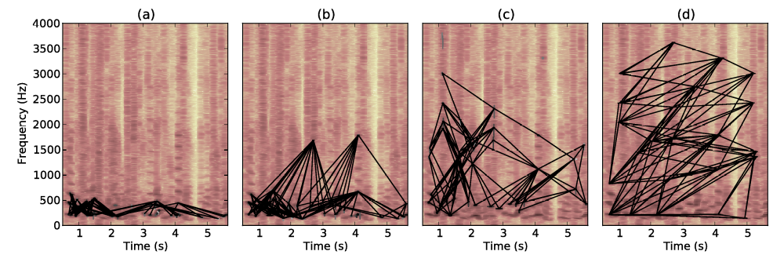
A continuum of system
Cotton and Ellis (2010)
Wang (2003)
Robustness
Descriptiveness

