Slide 1
Understanding Deep Learning
Chapter 11: Residual Networks
https://github.com/mmovahed/UDLbook_ResNet/tree/main
This work is subject to a Creative Commons CC-BY-NC-ND license. (C) MIT Press.

Slide 2
Residual Networks
Residual block + batch normalization
Applications:
Image classification
Image segmentation
Pose estimation

Slide 3
General approach
Residual Neural Network: Linear mapping of activation functions
Convolutional Neural Network: Convolution of activation functions

Slide 4
This work is subject to a Creative Commons CC-BY-NC-ND license. (C) MIT Press.

Slide 5
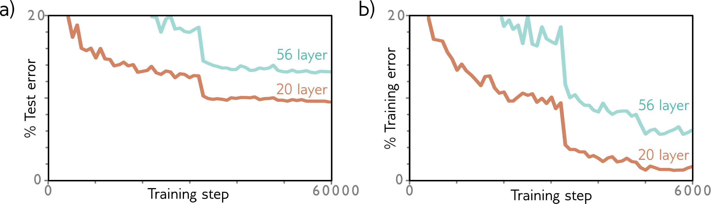
This work is subject to a Creative Commons CC-BY-NC-ND license. (C) MIT Press.

Slide 6
Autocorrelation function

Slide 7
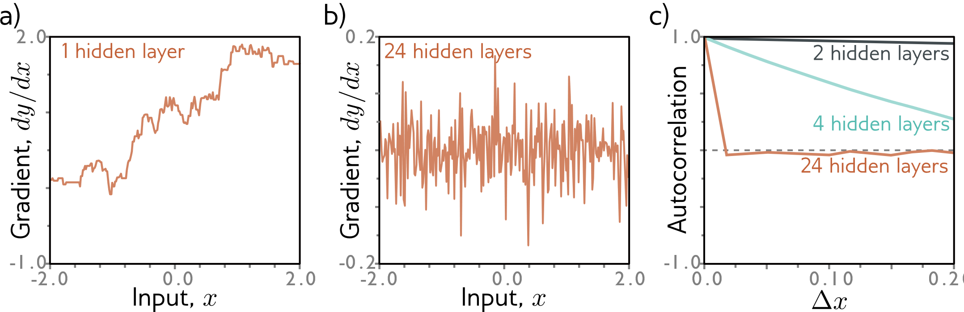
This work is subject to a Creative Commons CC-BY-NC-ND license. (C) MIT Press.

Slide 8
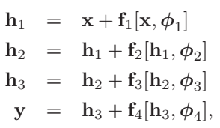
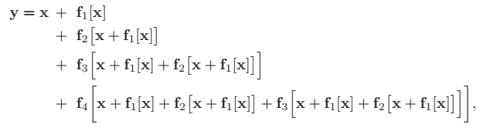
Residual Neural Network

Slide 9
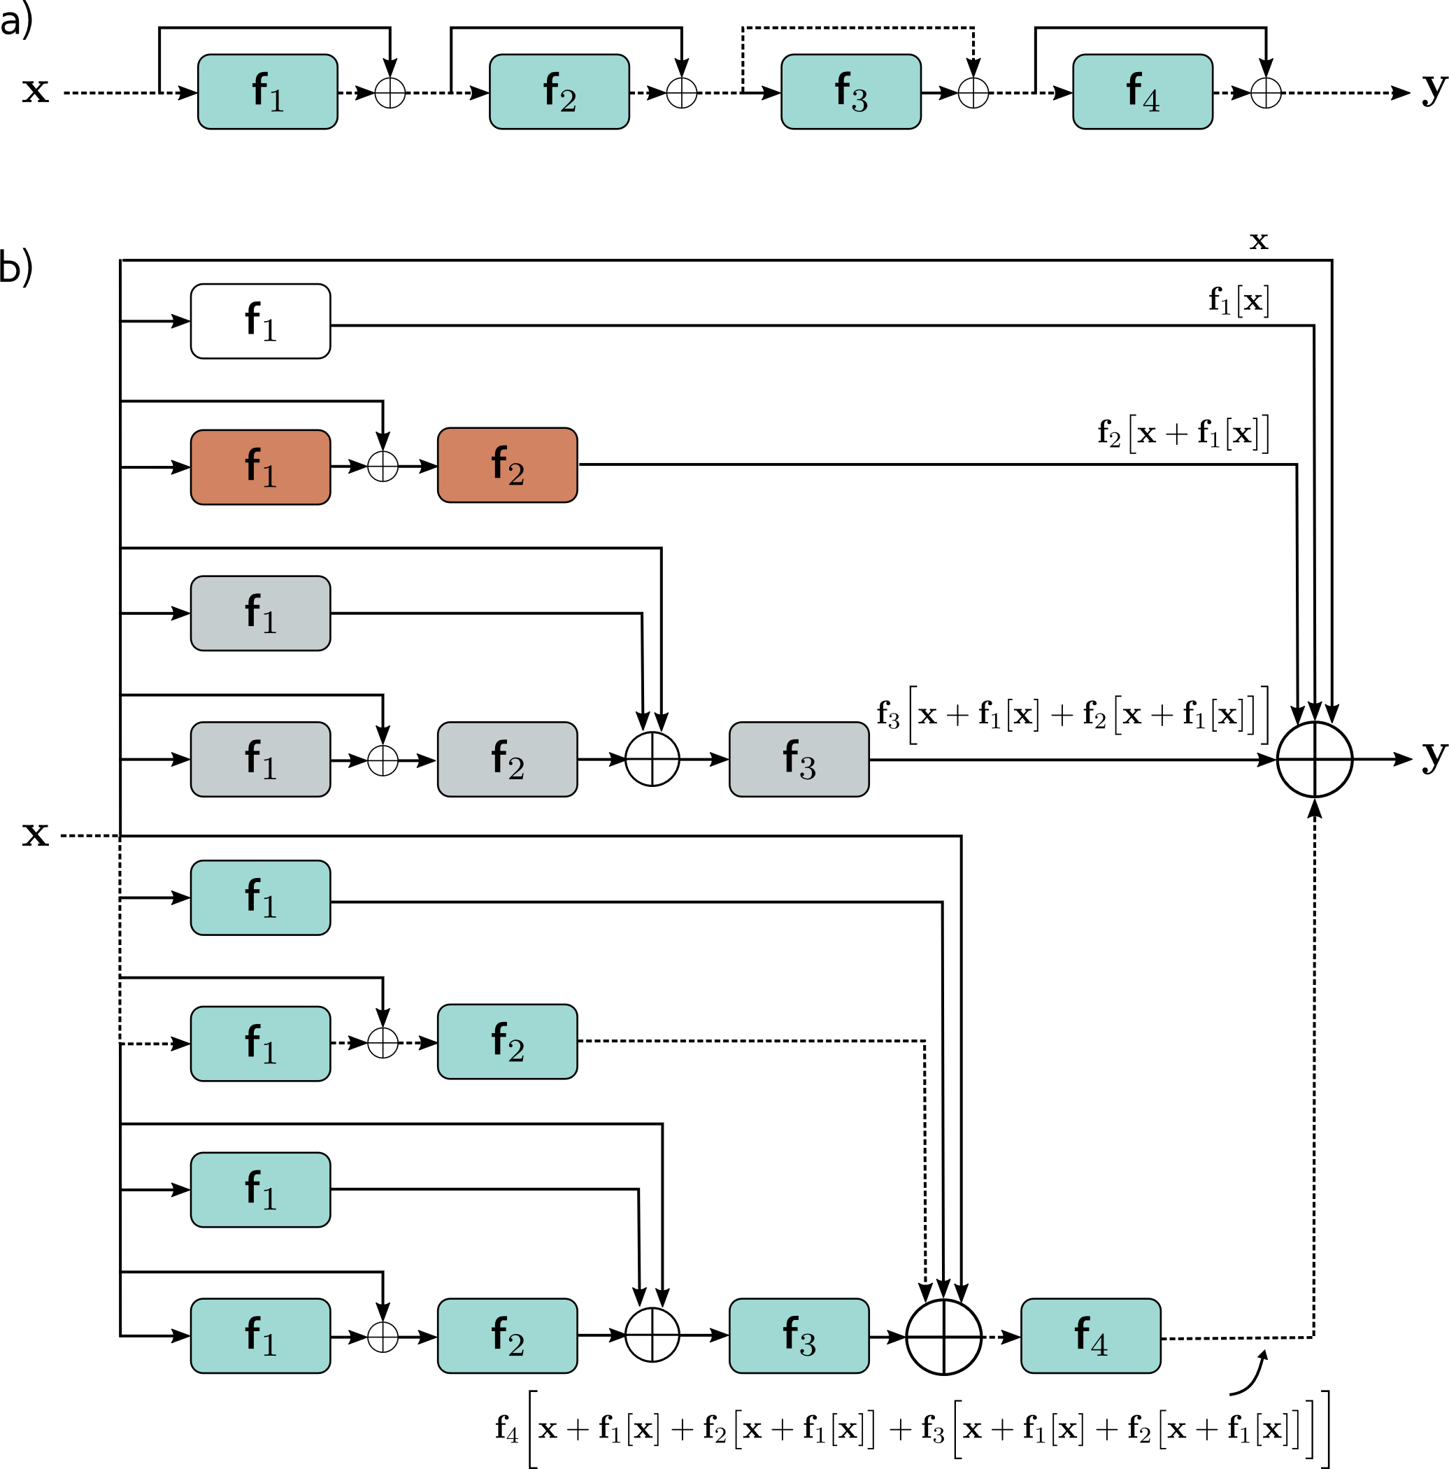
This work is subject to a Creative Commons CC-BY-NC-ND license. (C) MIT Press.

Slide 10

Shattered gradients

Slide 11
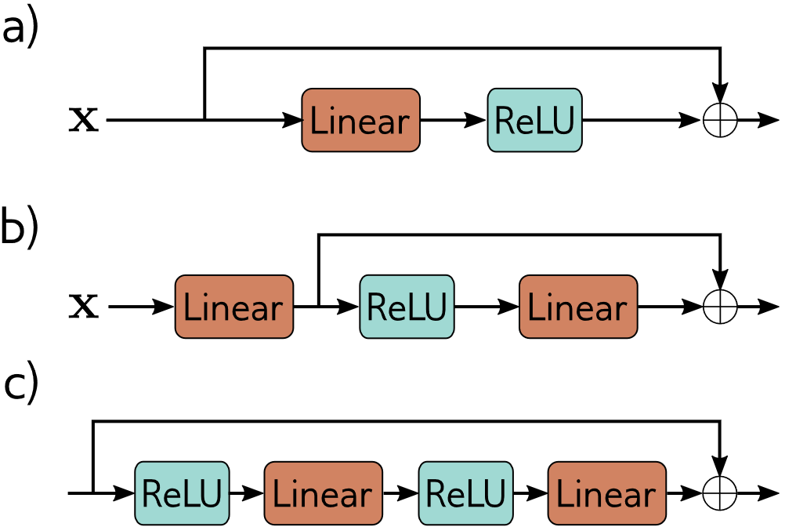
Order of operations
This work is subject to a Creative Commons CC-BY-NC-ND license. (C) MIT Press.

Slide 12
Challenges
Variance of activation changes in forward pass
Gradient magnitude changes in backward pass

Slide 13
Initialization strategies
He initialization → Exponential increase
Rescaling
Batch Normalization → Linear increase

Slide 14
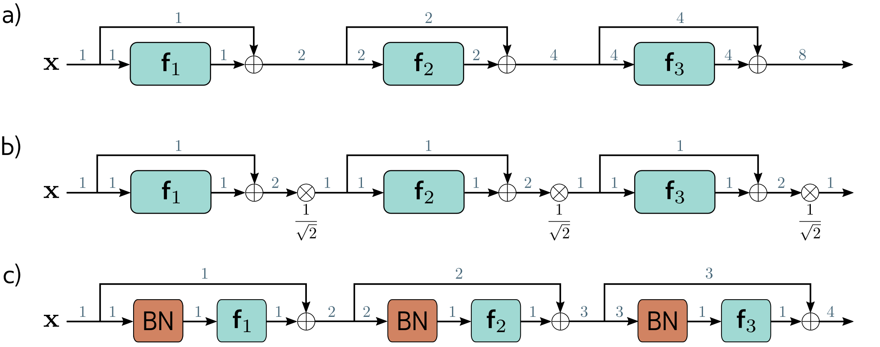
This work is subject to a Creative Commons CC-BY-NC-ND license. (C) MIT Press.

Slide 15
Batch normalization
Standard N.N.
K layers, D units → KD offset and scale
Convolutional N.N.
K layers, C channels → KC offset and scale

Slide 16
Advantages of batch normalization
Stable forward propagation
Higher learning rates
Low differentiation in loss and gradients
Regularization
Using noise adding technique

Slide 17
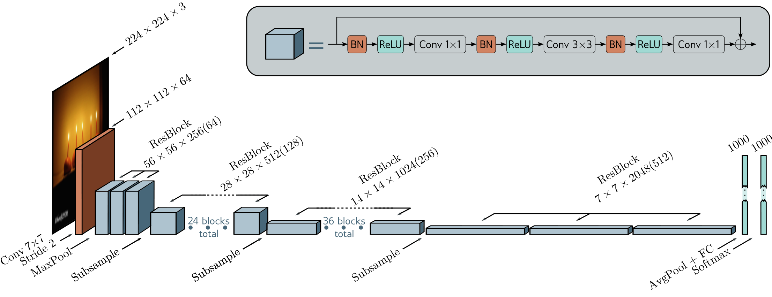
ResNet
This work is subject to a Creative Commons CC-BY-NC-ND license. (C) MIT Press.

Slide 18
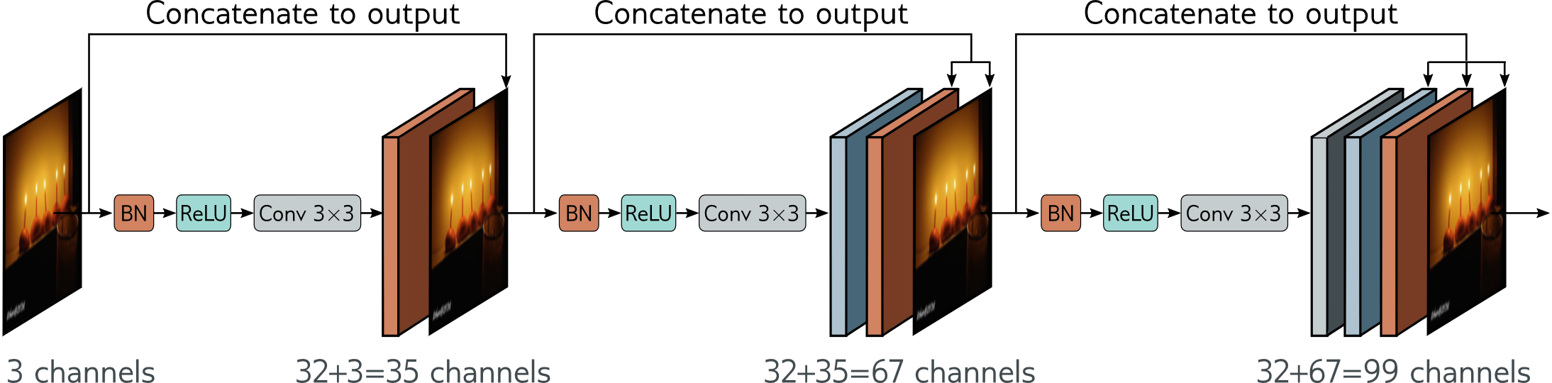
DenseNet
This work is subject to a Creative Commons CC-BY-NC-ND license. (C) MIT Press.

Slide 19
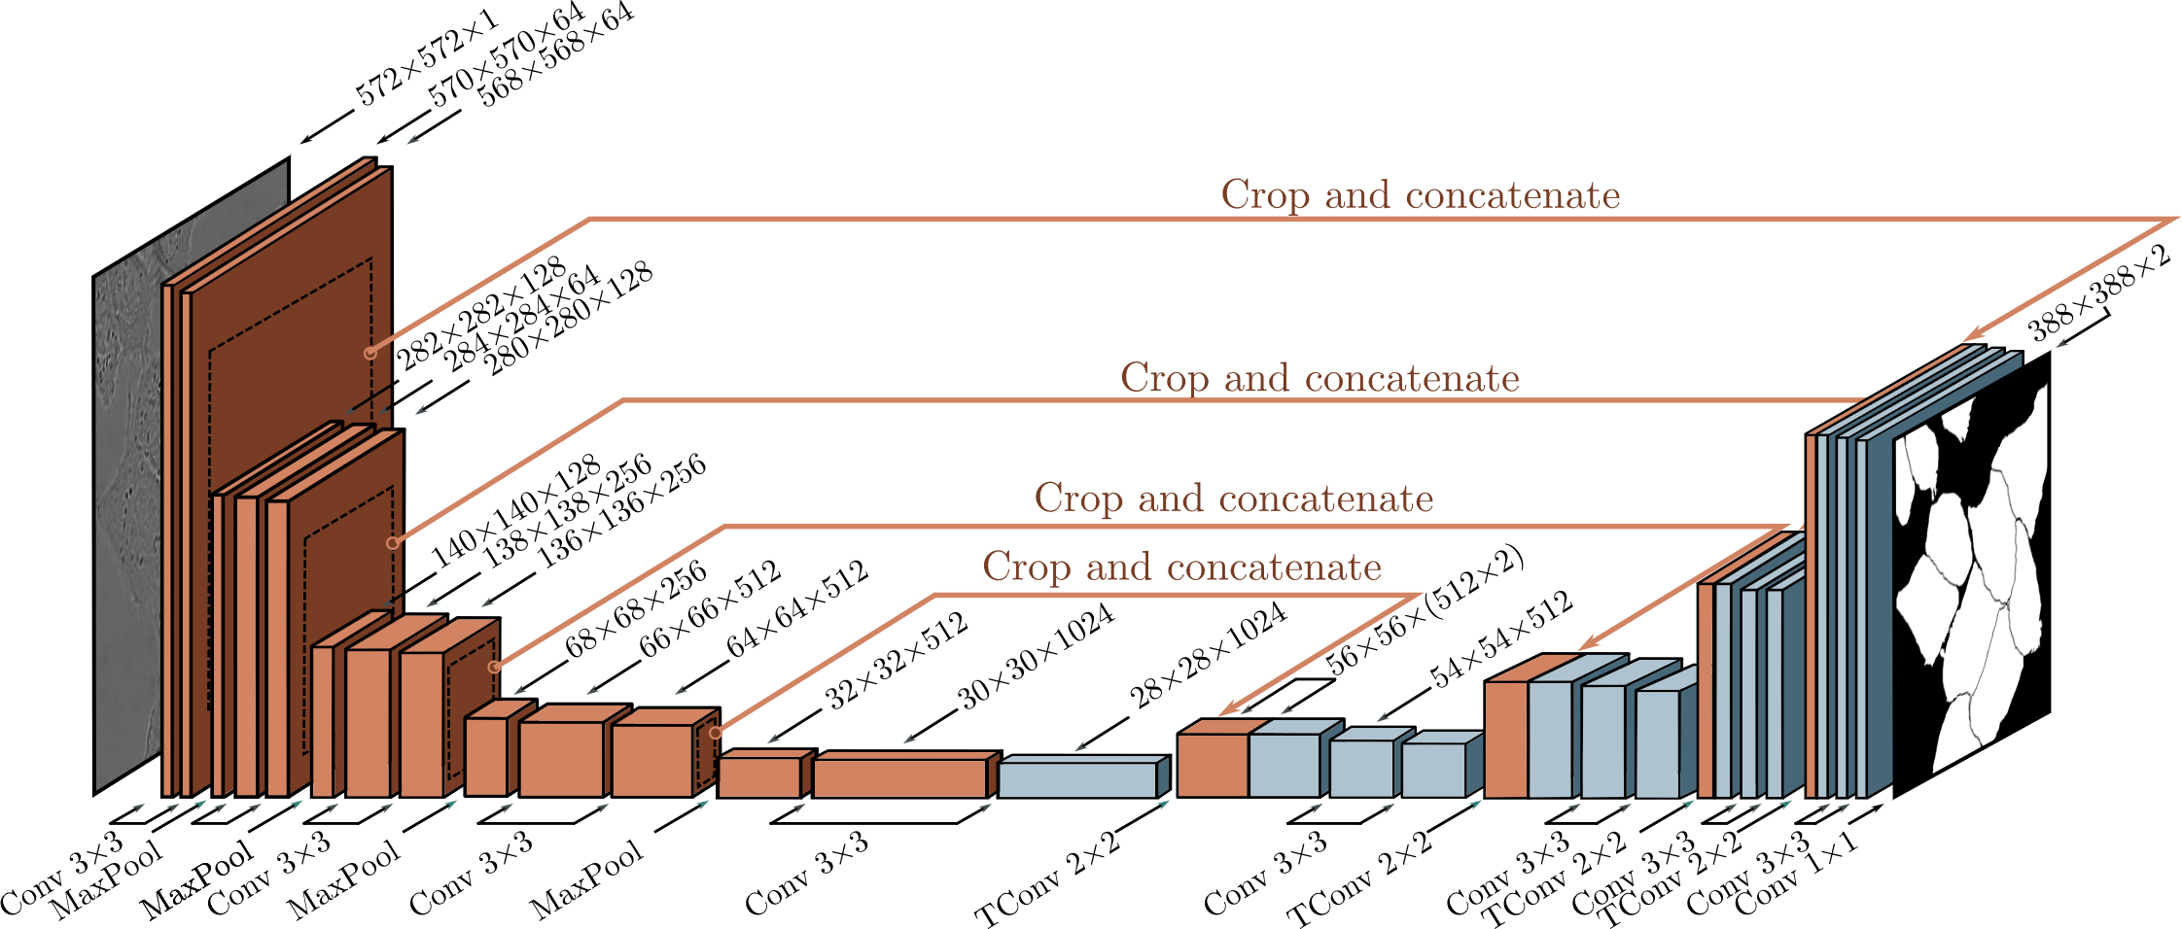
U-Net
This work is subject to a Creative Commons CC-BY-NC-ND license. (C) MIT Press.

