Slide 1


Climate Change: Why it Matters and What You Can Do!
Citizens for our Children’s Future

Slide 2
Who We Are
Citizens for our Children’s Future
-Non-profit advocacy group
-Leaders on a variety of initiatives
-Volunteer-powered
Citizens for our Children’s Future

Slide 3
Our Mission
We know that people care for the health and wellness of the children and grandchildren of the future.
Our mission is to bridge the gap on public perception of climate change by addressing it in common sense terms and creating actionable solutions.
We seek to frame climate change in terms of why it matters to people, especially from a public health perspective.

Slide 4
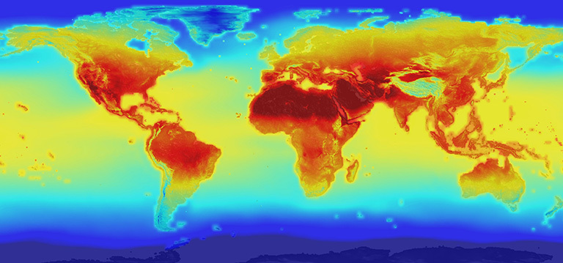
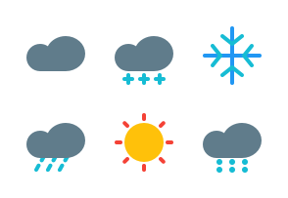
Definitions
Climate:
Conditions over a period of time
Weather:
Conditions at a specific time
Notes:
Climate: prevailing conditions over a period of time
Global warming: the planet is warming long-term.
Climate change: encompasses global warming, also refers to broader trends in
weather

Slide 5



What is climate change?
A significant change over time of one or more climate factors:
Temperature
Rainfall
Wind
Notes:
Climate: prevailing conditions over a period of time
Global warming: the planet is warming long-term.
Climate change: encompasses global warming, also refers to broader trends in

Slide 6
What is climate change?
Scientists agree that climate change is occurring and the primary cause is human activity.
Human activity that causes climate change includes:
-CO2 emissions from burning fossil fuels
-Emissions from agriculture
-Emissions from deforestation and urbanization
Notes:
Climate: prevailing conditions over a period of time
Global warming: the planet is warming long-term.
Climate change: encompasses global warming, also refers to broader trends in

Slide 7

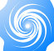
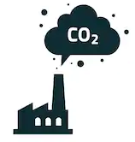
How does this affect us?
Increasing Temperatures
Severe Weather
Increasing Air Pollution
Extreme heat exposure can increase risk of illness and death among older adults, young children, and individuals with chronic health conditions.
Increase prevalence of certain disease and their carriers:
→ Lymes Disease (Ticks)
Storm related injuries & fatalities.
- Increase temperatures and standing water lead to vector changes and
disease risk.
→ Malaria / West Nile Virus (Mosquitos)
- Reduced water quality
→ May contribute to intestinal issues
-Increased pollution, dust, and smoke degrades air quality and worsens respiratory conditions that are common in older adults:
→ Asthma
→ Chronic Obstructive
Pulmonary Disorder

Slide 8



What can you do to help?
Educate yourself and others
Reduce your carbon footprint
Vote!

Slide 9

Visit our website!
Visit Our Website for more suggestions!
https://mmozack.github.io/ClimateChange/

Slide 10
References and image credits
Climate graphic: https://climate.nasa.gov/news/2293/nasa-releases-detailed-global-climate-change-projections/
Weather graphic: https://www.iconfinder.com/weather-icons?price=free
Thermometer icon: EpicCoders on FlatIcon https://www.flaticon.com/free-icon/thermometer_134125#term=temperature&page=1&position=2
Rainfall icon: bqlqn on FlatIcon https://www.flaticon.com/free-icon/rain_1004513#term=rainfall&page=1&position=2
Breeze icon: hirschwolf on FlatIcon https://www.flaticon.com/free-icon/breeze_809188#term=wind&page=1&position=29
Book icon: Zlatko Najdenovski on FlatIcon https://www.flaticon.com/free-icon/open-book_182321#term=education&page=1&position=1
Climate Data and information: NASA https://climate.nasa.gov/

