Slide 1

Natural Language Processing with Deep Learning
CS224N/Ling284
Christopher Manning
Lecture 2: Word Vectors, Word Senses, and Neural Classifiers

Slide 2
Lecture Plan
Lecture 2: Word Vectors, Word Senses, and Neural Network Classifiers
Course organization (3 mins)
Optimization basics (5 mins)
Review of word2vec and looking at word vectors (12 mins)
More on word2vec (8 mins)
Can we capture the essence of word meaning more effectively by counting? (12m)
Evaluating word vectors (10 mins)
Word senses (10 mins)
Review of classification and how neural nets differ (10 mins)
Introducing neural networks (10 mins)
Key Goal: To be able to read and understand word embeddings papers by the end of class

Slide 3
1. Course Organization
First assignment is due before class next Tuesday!
Come to office hours/help sessions!
They started yesterday (but sorry for the rescheduling mess-up!)
Come to discuss final project ideas as well as the assignments
Try to come early, often and off-cycle!
TA office hours: 3-hour blocks Mon–Fri, with multiple TAs
Just show up! Our friendly course staff will be on hand to assist you!
https://web.stanford.edu/class/cs224n/office_hours.html
Instructor’s office hours (in person by default):
Monday 2-4pm, booked via Calendly
Opening some time tonight, 2 weeks in advance
I can’t meet everyone, don’t hog the slots!

Slide 4
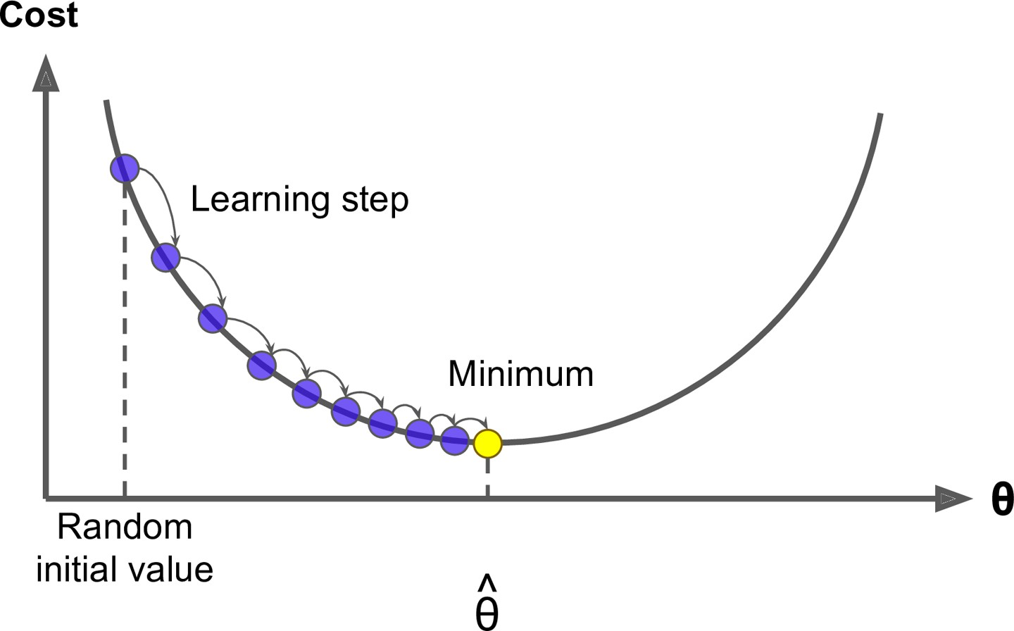
2. Optimization: Gradient Descent
We have a cost function 𝐽 𝜃 we want to minimize
Gradient Descent is an algorithm to minimize 𝐽 𝜃
Idea: for current value of 𝜃, calculate gradient of 𝐽 𝜃 , then take small step in direction of negative gradient. Repeat.
Note: Our objectives may not be convex like this ☹
But life turns out to be okay ☺

Slide 5
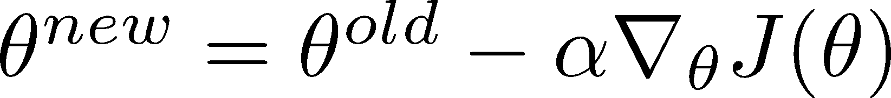
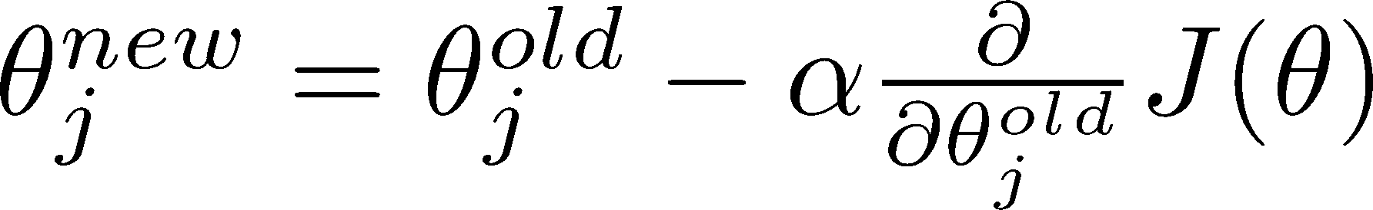
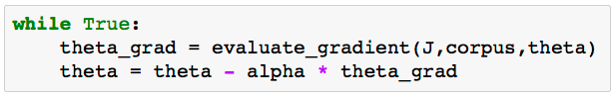
Gradient Descent
Update equation (in matrix notation):
𝛼 = step size or learning rate
Update equation (for each single parameter 𝜃_{j}):
Algorithm:

Slide 6

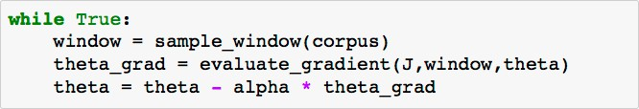
Stochastic Gradient Descent
Problem: 𝐽 𝜃 is a function of all windows in the corpus (potentially billions!)
So is very expensive to compute
You would wait a very long time before making a single update!
Very bad idea for pretty much all neural nets!
Solution: Stochastic gradient descent (SGD)
Repeatedly sample windows, and update after each one
Algorithm:
Mini Batch Gradient Descent

Slide 7
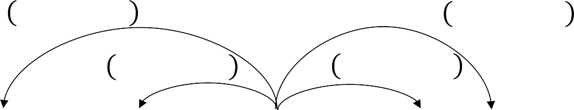

3. Review: Main idea of word2vec
Start with random word vectors
Iterate through each word position in the whole corpus
Try to predict surrounding words using word vectors: 𝑃 𝑜 𝑐 =
exp(𝑢^{𝑇}𝑣 )
𝑜 𝑐
∑ exp(𝑢^{𝑇} 𝑣_{𝑐})
w∈7
w
𝑃 𝑤_{𝑡–2} | 𝑤_{𝑡}
𝑃 𝑤_{𝑡–1} | 𝑤_{𝑡}
𝑃 𝑤_{𝑡+2} | 𝑤_{𝑡}
𝑃 𝑤_{𝑡+1} | 𝑤_{𝑡}
…
problems
turning
into
banking
crises
as
…
Learning: Update vectors so they can predict actual surrounding words better
Doing no more than this, this algorithm learns word vectors that capture well word similarity and meaningful directions in a word space!
Magic!

Slide 8
Word2vec parameters …
and computations
• • • • •
• • • ••
• • • ••
• • • ••
• • • ••
• • • ••
U
• • • • •
• • • ••
• • • ••
• • • ••
• • • ••
• • • ••
V
•
•
•
•
•
•
•
•
•
•
•
•
𝑈. 𝑣*^{𝑇}
dot product
softmax(𝑈. 𝑣*^{𝑇}) probabilities
outside
center
“Bag of words” model!
The model makes the same predictions at each position
We want a model that gives a reasonably high probability estimate to all words that occur in the context (at all often)

Slide 9
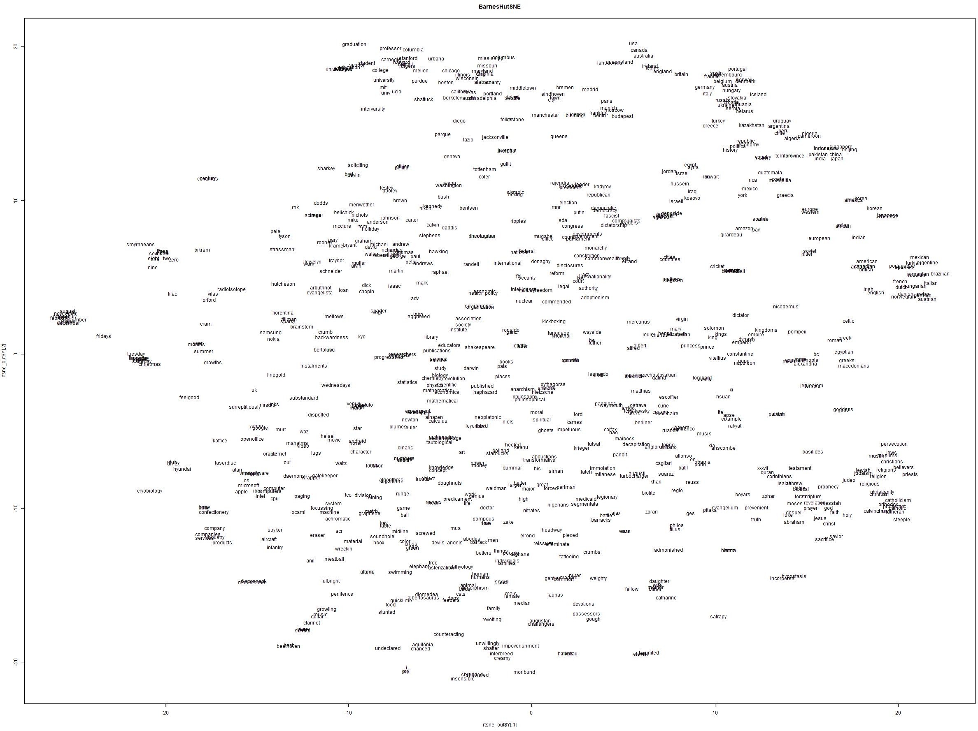
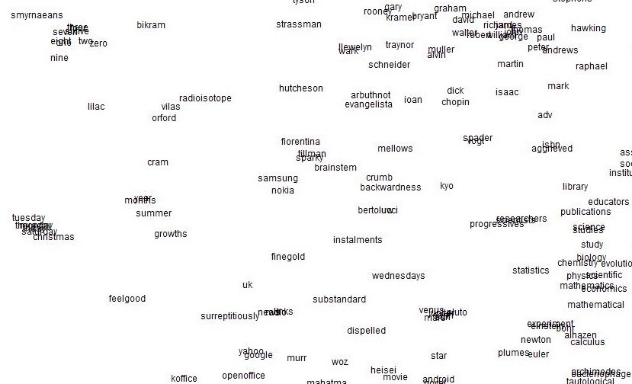
Word2vec maximizes objective by putting similar words nearby in space

Slide 10
4. Word2vec algorithm family: More details
[Mikolov et al. 2013: “Distributed Representations of Words and Phrases and their Compositionality”]
Why two vectors? → Easier optimization. Average both at the end
But can implement the algorithm with just one vector per word … and it helps a bit Two model variants:
Skip-grams (SG)
Predict context (“outside”) words (position independent) given center word
Continuous Bag of Words (CBOW)
Predict center word from (bag of) context words We presented: Skip-gram model
Loss functions for training:
Naïve softmax (simple but expensive loss function, when many output classes)
More optimized variants like hierarchical softmax
Negative sampling
So far, we explained naïve softmax

Slide 11
The skip-gram model with negative sampling
The normalization term is computationally expensive (when many output classes):
exp(𝑢^{𝑇} 𝑣 )
𝑃 𝑜 𝑐 =
𝑜 𝑐
∑
exp(𝑢^{𝑇} 𝑣 )
w∈𝑉
w 𝑐
A big sum over many words
Hence, in standard word2vec, you implement the skip-gram model with negative sampling
Idea: train binary logistic regressions to differentiate a true pair (center word and a word in its context window) versus several “noise” pairs (the center word paired with a random word)

Slide 12
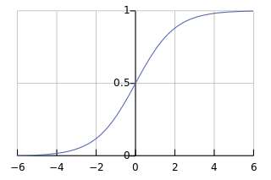
The skip-gram model with negative sampling [Mikolov et al. 2013]
We take K negative samples (using word probabilities*)
Maximize probability of real outside word; minimize probability of random words
Using notation consistent with this class, we minimize:
^{𝐽}𝑛𝑒g–𝑠𝑎𝑚𝑝𝑙𝑒 ^{𝒖}𝑜^{, 𝒗}𝑐^{, 𝑈}
= − log 𝜎 𝒖^{𝑇}𝒗 −
𝑜 𝑐
; log 𝜎 −𝒖^{𝑇}𝒗_{𝑐}
𝑘
𝑘∈ 𝐾 𝑠𝑎𝑚𝑝𝑙𝑒𝑑 𝑖𝑛𝑑𝑖𝑐𝑒𝑠
sigmoid rather than softmax
The logistic/sigmoid function:
(we’ll become good friends soon)
𝜎 𝑥 = ¹
1 + 𝑒^{!𝑥}
*Sample with P(w) = U(w)^{3/4}/Z, the unigram distribution U(w) raised to the 3/4 power
The power makes less frequent words be sampled a bit more often

Slide 13
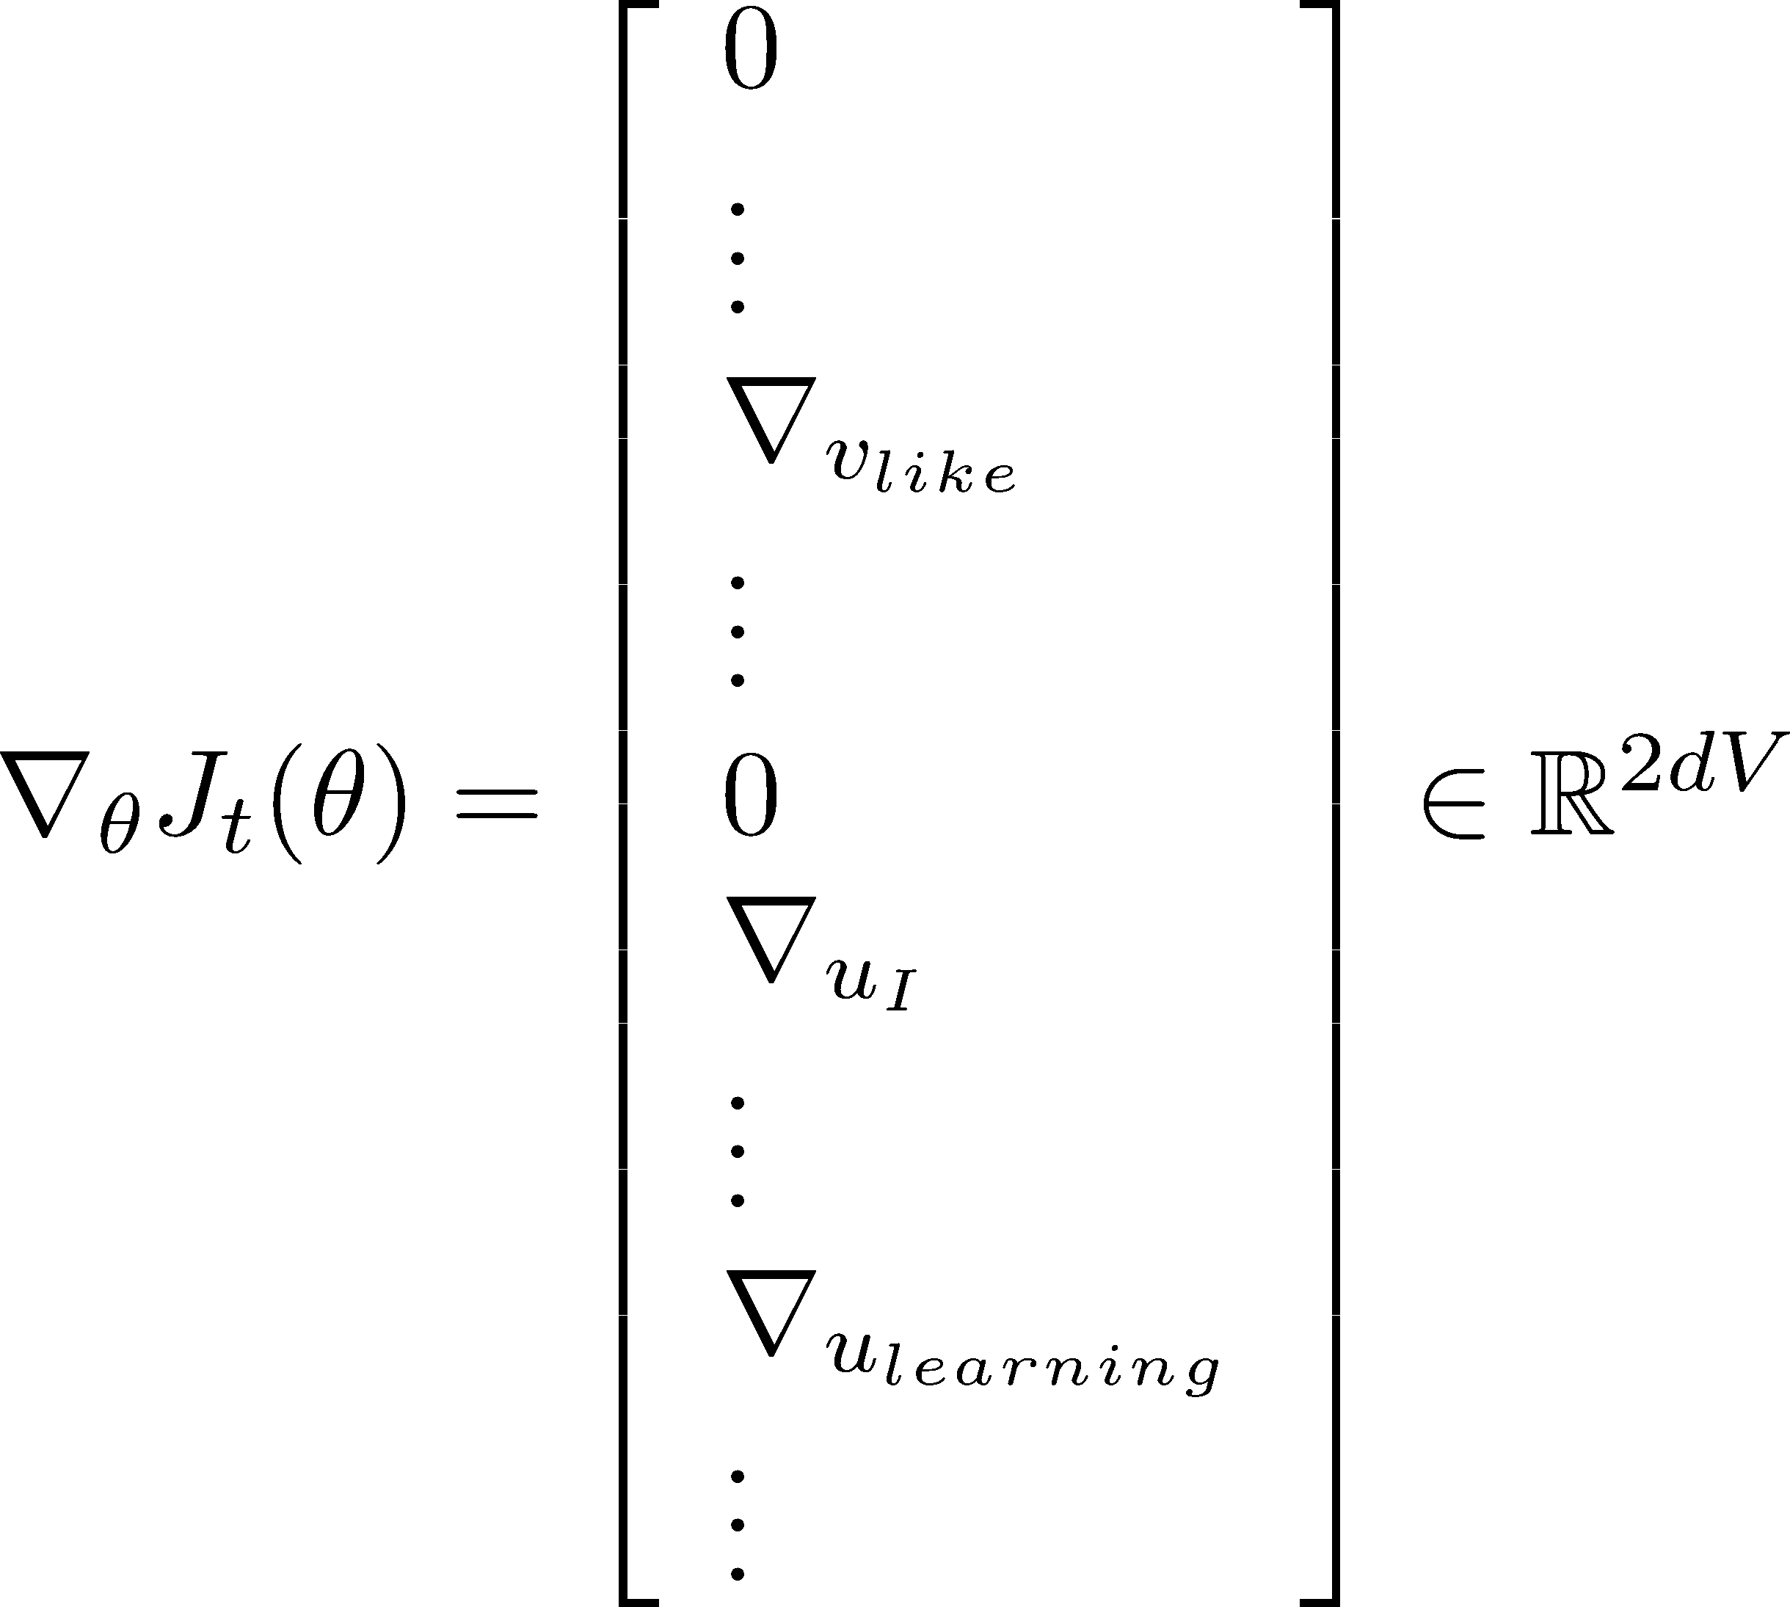
Stochastic gradients with negative sampling [aside]
We iteratively take gradients at each window for SGD
In each window, we only have at most 2m + 1 words plus 2km negative words with negative sampling, so ∇_{𝜃}𝐽_{𝑡}(𝜃) is very sparse!

Slide 14




Stochastic gradients with with negative sampling [aside]
We might only update the word vectors that actually appear!
Solution: either you need sparse matrix update operations to only update certain rows of full embedding matrices U and V, or you need to keep around a hash for word vectors
Rows not columns in actual DL packages!
|V|[
d
]
If you have millions of word vectors and do distributed computing, it is important to not have to send gigantic updates around!

Slide 15
5. Why not capture co-occurrence counts directly?
There’s something weird about iterating through the whole corpus (perhaps many times) Why don’t we just accumulate all the statistics of what words appear near each other??
Building a co-occurrence matrix X
2 options: windows vs. full document
Window: Similar to word2vec, use window around each word → captures some syntactic and semantic information (“word space”)
Word-document co-occurrence matrix will give general topics (all sports terms will have similar entries) leading to “Latent Semantic Analysis” (“document space”)

Slide 16
Example: Window based co-occurrence matrix
Window length 1 (more common: 5–10)
Symmetric (irrelevant whether left or right context)
Example corpus:
I like deep learning
I like NLP
I enjoy flying
counts | I | like | enjoy | deep | learning | NLP | flying | .
I | 0 | 2 | 1 | 0 | 0 | 0 | 0 | 0
like | 2 | 0 | 0 | 1 | 0 | 1 | 0 | 0
enjoy | 1 | 0 | 0 | 0 | 0 | 0 | 1 | 0
deep | 0 | 1 | 0 | 0 | 1 | 0 | 0 | 0
learning | 0 | 0 | 0 | 1 | 0 | 0 | 0 | 1
NLP | 0 | 1 | 0 | 0 | 0 | 0 | 0 | 1
flying | 0 | 0 | 1 | 0 | 0 | 0 | 0 | 1
. | 0 | 0 | 0 | 0 | 1 | 1 | 1 | 0

Slide 17
Co-occurrence vectors
Simple count co-occurrence vectors
Vectors increase in size with vocabulary
Very high dimensional: require a lot of storage (though sparse)
Subsequent classification models have sparsity issues → Models are less robust
Low-dimensional vectors
Idea: store “most” of the important information in a fixed, small number of dimensions: a dense vector
Usually 25–1000 dimensions, similar to word2vec
How to reduce the dimensionality?

Slide 18
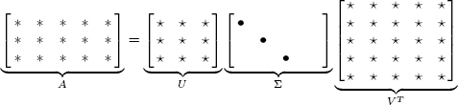

Classic Method: Dimensionality Reduction on X (HW1)
Singular Value Decomposition of co-occurrence matrix X
Factorizes X into UΣV^{T}, where U and V are orthonormal (unit vectors and orthogonal)
_{X} k
Retain only k singular values, in order to generalize.
𝑋& is the best rank k approximation to X , in terms of least squares. Classic linear algebra result. Expensive to compute for large matrices.

Slide 19
Hacks to X (several used in Rohde et al. 2005 in COALS)
Running an SVD on raw counts doesn’t work well!!!
Scaling the counts in the cells can help a lot
Problem: function words (the, he, has) are too frequent → syntax has too much impact. Some fixes:
log the frequencies
min(X, t), with t ≈ 100
Ignore the function words
Ramped windows that count closer words more than further away words
Use Pearson correlations instead of counts, then set negative values to 0
Etc.

Slide 20
Interesting semantic patterns emerge in the scaled vectors
DRIVER
JANITOR STUDENT
DRIVE
SWIMMER
CLEAN
TEACHER
DOCTOR
BRIDE
SWIM
PRIEST
LEARN
TEACH
MARRY
TREAT
PRAY
A meaning component (doer of event) becomes a linear meaning component in the space! This is the COALS model from
Rohde et al. ms., 2005. An Improved Model of Semantic Similarity Based on Lexical Co-Occurrence

Slide 21
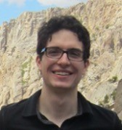



Encoding meaning components in vector differences
[GloVe: Pennington, Socher, and Manning, EMNLP 2014]
Crucial insight: Ratios of co-occurrence probabilities can encode meaning components We want to capture them as linear meaning components in a word vector space!
 |  | x = solid | x = gas | x = water | x = random
 |  | large | small | large | small
 |  | small | large | large | small
 |  | large | small | ~1 | ~1

Slide 22
Encoding meaning components in vector differences
[GloVe: Pennington, Socher, and Manning, EMNLP 2014]
Crucial insight: Ratios of co-occurrence probabilities can encode meaning components We want to capture them as linear meaning components in a word vector space!
 |  | x = solid | x = gas | x = water | x = fashion
 |  | 1.9 x 10⁻⁴ | 6.6 x 10⁻⁵ | 3.0 x 10⁻³ | 1.7 x 10⁻⁵
 |  | 2.2 x 10⁻⁵ | 7.8 x 10⁻⁴ | 2.2 x 10⁻³ | 1.8 x 10⁻⁵
 |  | 8.9 | 8.5 x 10⁻² | 1.36 | 0.96

Slide 23


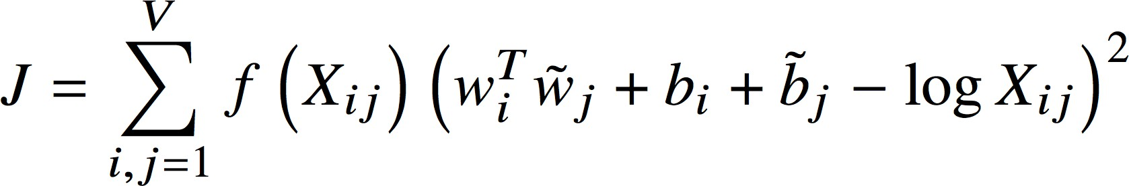
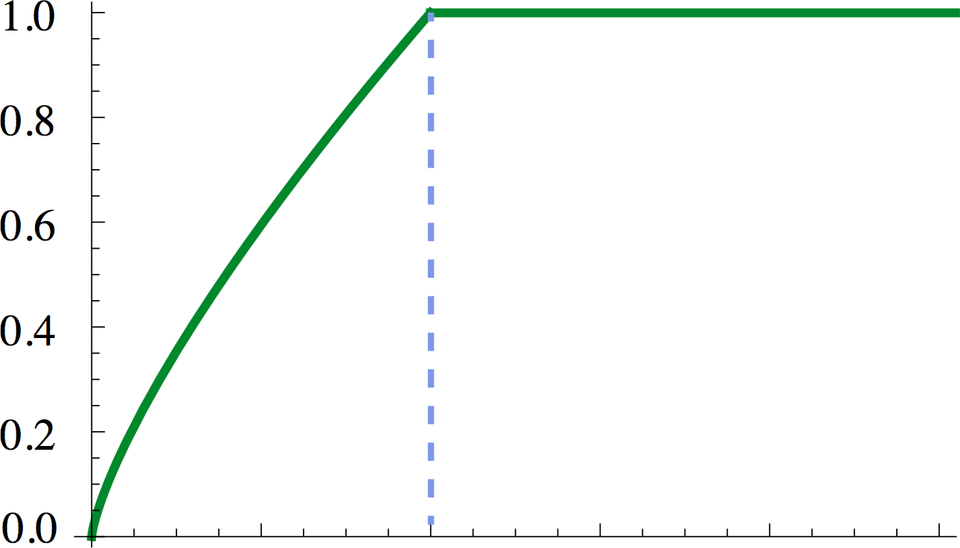

GloVe [Pennington, Socher, and Manning, EMNLP 2014]: Encoding meaning components in vector differences
Q: How can we capture ratios of co-occurrence probabilities as linear meaning components in a word vector space?
A: Log-bilinear model:
with vector differences
Loss:
Fast training
Scalable to huge corpora

Slide 24
6. How to evaluate word vectors?
A general concept of evaluation (in NLP): Intrinsic vs. extrinsic
Intrinsic:
Evaluation on a specific/intermediate subtask
Fast to compute
Helps to understand that system
Not clear if really helpful unless correlation to real task is established
Extrinsic:
Evaluation on a real task
Can take a long time to compute accuracy
Unclear if the subsystem is the problem or its interaction or other subsystems
If replacing exactly one subsystem with another improves accuracy → Winning!

Slide 25


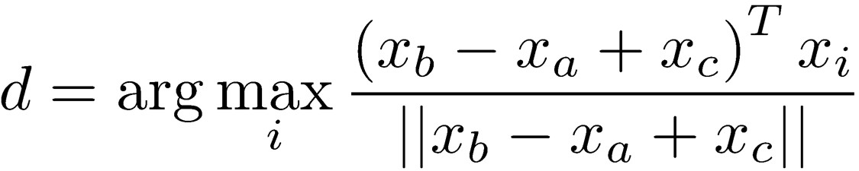

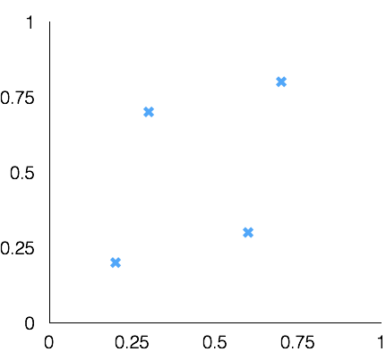
Intrinsic word vector evaluation
Word Vector Analogies
a:b :: c:?
man:woman :: king:?
Evaluate word vectors by how well their cosine distance after addition captures intuitive semantic and syntactic analogy questions
Discarding the input words from the search (!!!)
Problem: What if the information is there but not linear?
king
woman
man

Slide 26
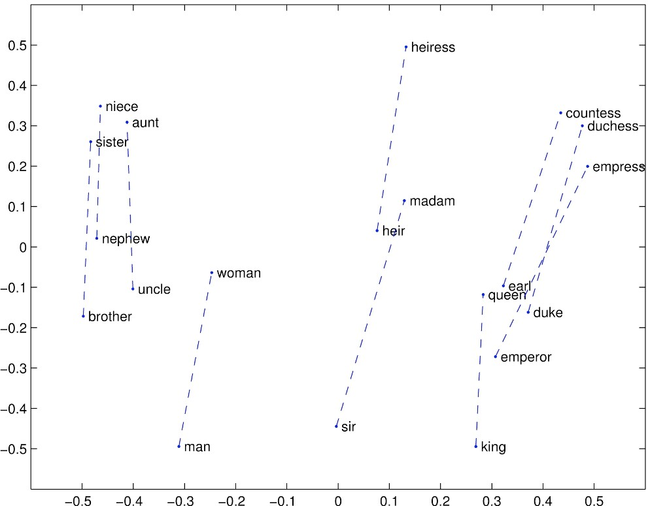
GloVe Visualization

Slide 27
Meaning similarity: Another intrinsic word vector evaluation
Word vector distances and their correlation with human judgments
Example dataset: WordSim353 https://gabrilovich.com/resources/data/wordsim353/wordsim353.html
Word 1 | Word 2 | Human (mean)
tiger | cat | 7.35
tiger | tiger | 10
book | paper | 7.46
computer | internet | 7.58
plane | car | 5.77
professor | doctor | 6.62
stock | phone | 1.62
stock | CD | 1.31
stock | jaguar | 0.92

Slide 28
Correlation evaluation
Word vector distances and their correlation with human judgments
Model | Size | WS353 | MC | RG | SCWS | RW
SVD | 6B | 35.3 | 35.1 | 42.5 | 38.3 | 25.6
SVD-S | 6B | 56.5 | 71.5 | 71.0 | 53.6 | 34.7
SVD-L | 6B | 65.7 | 72.7 | 75.1 | 56.5 | 37.0
CBOW† | 6B | 57.2 | 65.6 | 68.2 | 57.0 | 32.5
SG† | 6B | 62.8 | 65.2 | 69.7 | 58.1 | 37.2
GloVe | 6B | 65.8 | 72.7 | 77.8 | 53.9 | 38.1
SVD-L | 42B | 74.0 | 76.4 | 74.1 | 58.3 | 39.9
GloVe | 42B | 75.9 | 83.6 | 82.9 | 59.6 | 47.8
CBOW⇤ 100B |  | 68.4 | 79.6 | 75.4 | 59.4 | 45.5

Slide 29
Extrinsic word vector evaluation
One example where good word vectors should help directly: named entity recognition:
Identifying references to a person, organization or location: Chris Manning lives in Palo Alto.
Model | Dev | Test | ACE | MUC7
Discrete | 91.0 | 85.4 | 77.4 | 73.4
SVD | 90.8 | 85.7 | 77.3 | 73.7
SVD-S | 91.0 | 85.5 | 77.6 | 74.3
SVD-L | 90.5 | 84.8 | 73.6 | 71.5
HPCA | 92.6 | 88.7 | 81.7 | 80.7
HSMN | 90.5 | 85.7 | 78.7 | 74.7
CW | 92.2 | 87.4 | 81.7 | 80.2
CBOW | 93.1 | 88.2 | 82.2 | 81.1
GloVe | 93.2 | 88.3 | 82.9 | 82.2

Slide 30
7. Word senses and word sense ambiguity
Most words have lots of meanings!
Especially common words
Especially words that have existed for a long time
Example: pike
Does one vector capture all these meanings or do we have a mess?

Slide 31
pike
A sharp point or staff
A type of elongated fish
A railroad line or system
A type of road
The future (coming down the pike)
A type of body position (as in diving)
To kill or pierce with a pike
To make one’s way (pike along)
In Australian English, pike means to pull out from doing something:
I reckon he could have climbed that cliff, but he piked!

Slide 32
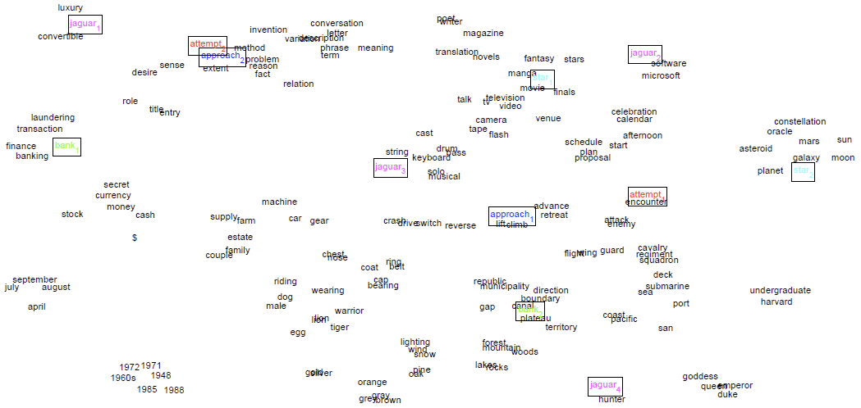
Improving Word Representations Via Global Context And Multiple Word Prototypes (Huang et al. 2012)
Idea: Cluster word windows around words, retrain with each word assigned to multiple different clusters bank₁, bank₂, etc.

Slide 33
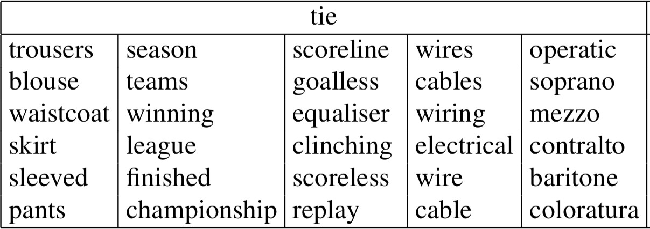
Linear Algebraic Structure of Word Senses, with
Applications to Polysemy
(Arora, …, Ma, …, TACL 2018)
Different senses of a word reside in a linear superposition (weighted sum) in standard word embeddings like word2vec
•
^{𝑣}pike ^{= 𝛼1𝑣}pike₁ ^{+ 𝛼2𝑣}pike₂ ^{+ 𝛼3𝑣}pike₃
Where 𝛼₁ =
𝑓₁
, etc., for frequency f
𝑓₁+𝑓₂+𝑓₃
Surprising result:
Because of ideas from sparse coding you can actually separate out the senses (providing they are relatively common)!

Slide 34
8. Deep Learning Classification: Named Entity Recognition (NER)
The task: find and classify names in text, by labeling word tokens, for example:
Last night , Paris Hilton wowed in a sequin gown .
PER PER
Samuel Quinn was arrested in the Hilton Hotel in Paris in April 1989 . PER PER LOC LOC LOC DATE DATE
Possible uses:
Tracking mentions of particular entities in documents
For question answering, answers are usually named entities
Relating sentiment analysis to the entity under discussion
Often followed by Entity Linking/Canonicalization into a Knowledge Base such as Wikidata

Slide 35
Simple NER: Window classification using binary logistic classifier
Idea: classify each word in its context window of neighboring words
Train logistic classifier on hand-labeled data to classify center word {yes/no} for each class based on a concatenation of word vectors in a window
Really, we usually use multi-class softmax, but we’re trying to keep it simple ☺
Example: Classify “Paris” as +/– location in context of sentence with window length 2:
the museums in Paris are amazing to see .
^{X}window ^{= [ x}museums ^{x}in ^{x}Paris ^{x}are ^{x}amazing ^{]T}
Resulting vector x_{window} =
x ∈ R^{5d}
To classify all words: run classifier for each class on the vector centered on each word in the sentence

Slide 36
Classification review and notation
Supervised learning: we have a training dataset consisting of samples
{x_{i},y_{i}}^{N}_{i=1}
x_{i} are inputs, e.g., words (indices or vectors!), sentences, documents, etc.
Dimension d
y_{i} are labels (one of C classes) we try to predict, for example:
classes: sentiment (+/–), named entities, buy/sell decision
{location, not-location}
other words
later: multi-word sequences

Slide 37
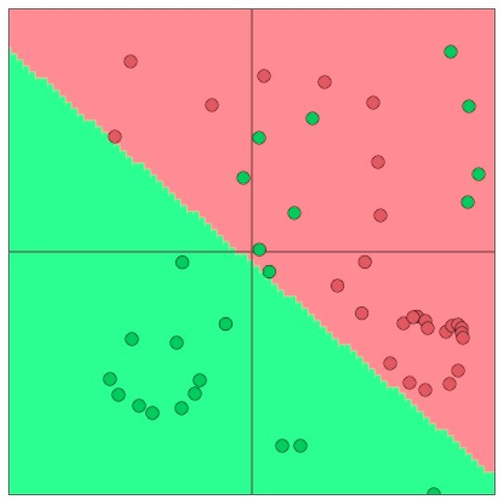
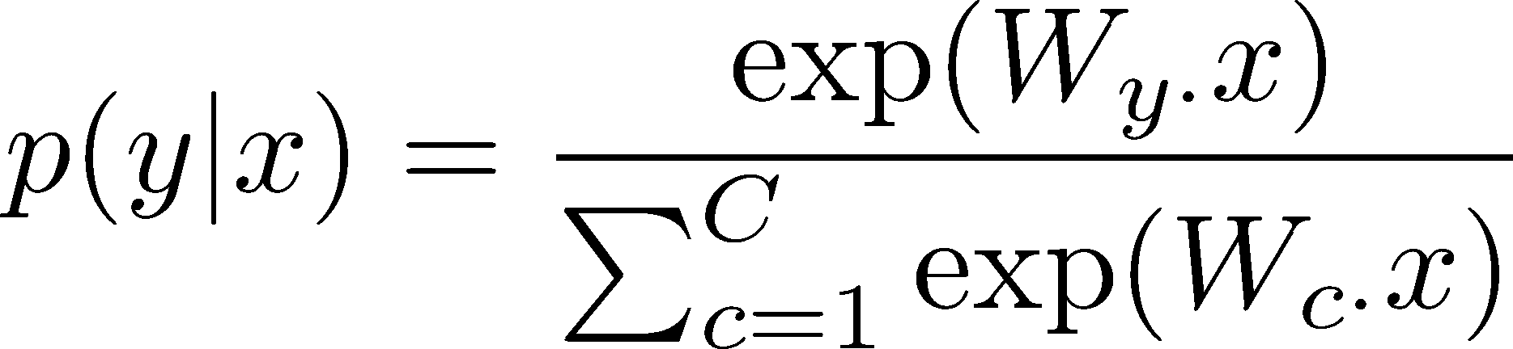
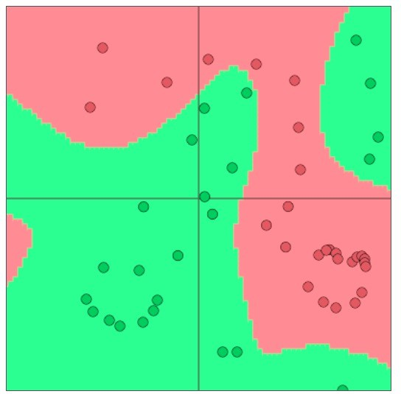
Neural classification
Typical ML/stats softmax classifier:
Learned parameters θ are just elements
of W (not input representation x, which has sparse symbolic features)
Classifier gives linear decision boundary, which can be limiting
A neural network classifier differs in that:
We learn both W and (distributed!) representations for words
The word vectors x re-represent one-hot vectors, moving them around in an intermediate layer vector space, for easy classification with a (linear) softmax classifier
Conceptually, we have an embedding layer: x = Le
We use deep networks—more layers—that let us re-represent and But typically, it is linear
relative to the pre-final
compose our data multiple times, giving a non-linear classifier
layer representation

Slide 38
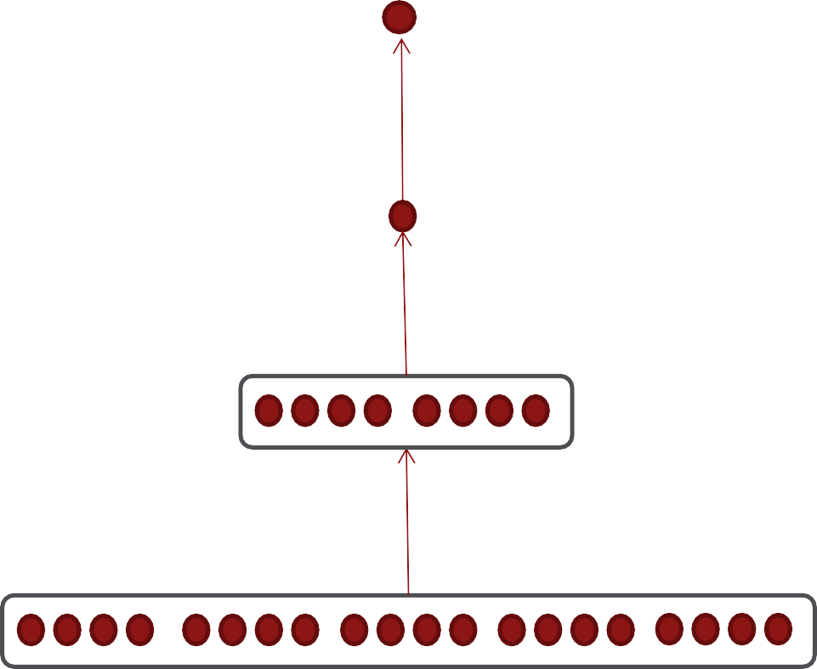
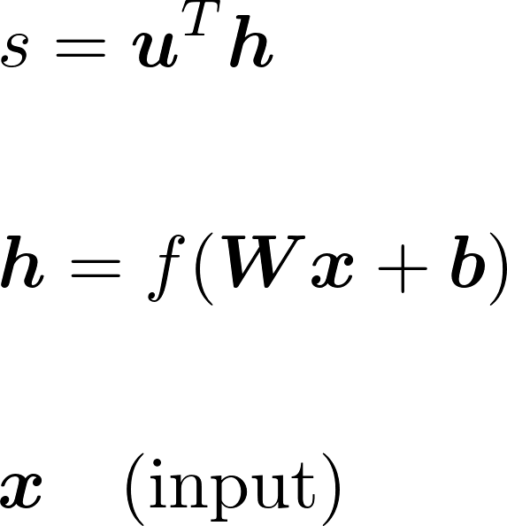
NER: Binary neural classifier for center word being location
We do supervised training and want high score if it’s a location
1
1 + 𝑒^{–𝑠}
𝐽 𝜃
= 𝜎 𝑠 =
𝑡
predicted model probability of class
f = Some element- wise non-linear function, e.g., logistic, tanh, ReLU
^{x = [ x}museums
^{x}in ^{x}Paris
^{x}are
^{x}amazing ]

Slide 39
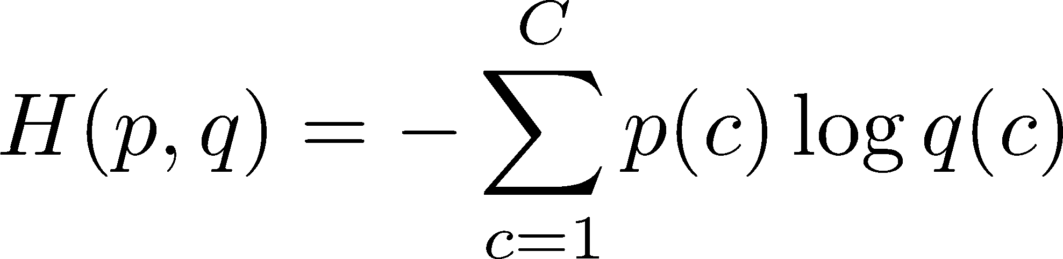
Training with “cross entropy loss”
Until now, our objective was stated as to maximize the probability of the correct class y
or equivalently to minimize the negative log probability of that class on training data
Now restated in terms of cross entropy, a concept from information theory
Let the true probability distribution be p; let our computed model probability be q
The cross entropy is:
Assuming a ground truth (or true or gold or target) probability distribution that is 1 at the right class and 0 everywhere else, p = [0, …, 0, 1, 0, …, 0], then:
Because of one-hot p, the only term left as our loss function is the negative log probability of the true class y_{i}: − log 𝑝(𝑦_{𝑖}|𝑥_{𝑖})
Use this in PyTorch! torch.nn.CrossEntropyLoss()
Cross entropy can be used in other ways with a more interesting p,
but for now just know that you’ll want to use it as the loss in PyTorch

Slide 40
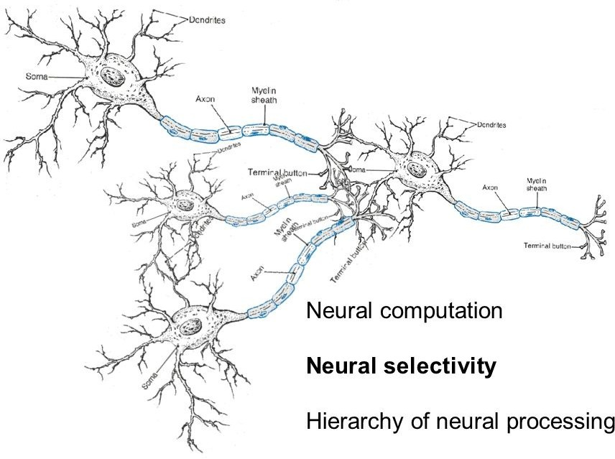
9. Neural computation

Slide 41
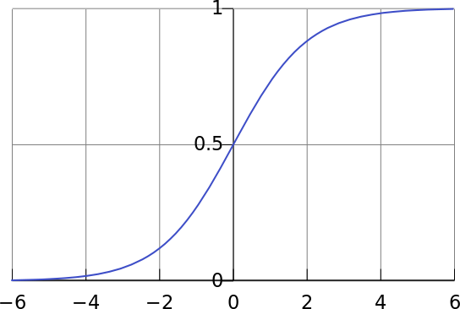
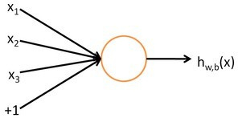
A binary logistic regression unit is a bit similar to a neuron
f = nonlinear activation function (e.g. sigmoid), w = weights, b = bias, h = hidden, x = inputs
b: We can have an “always on” bias feature, which gives a class prior, or separate it out, as a bias term
h (x) = f (w^{T} x + b)
w,b
1
f (z) =
1+ e^{− z}
w, b are the parameters of this neuron i.e., this logistic regression model

Slide 42
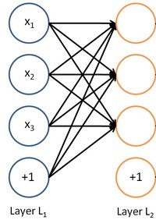
A neural network
= running several logistic regressions at the same time
If we feed a vector of inputs through a bunch of logistic regression functions, then we get a vector of outputs …
But we don’t have to decide ahead of time what variables these logistic regressions are trying to predict!

Slide 43
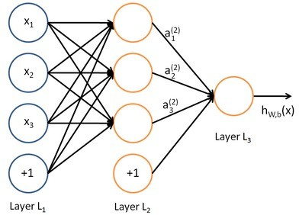
A neural network
= running several logistic regressions at the same time
We can feed them into another logistic regression function, giving composed functions
It is the final loss function that will direct what the intermediate hidden variables should be, so as to do a good job at predicting the targets for the next layer, etc.

Slide 44
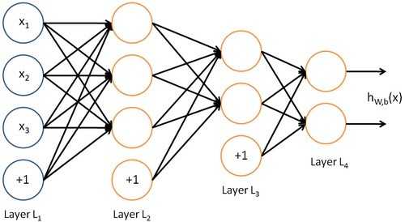
A neural network
= running several logistic regressions at the same time
Before we know it, we have a multilayer neural network….
This allows us to re-represent and compose our data
multiple times and to learn a classifier that is highly non-linear in terms of the original inputs
(but typically is linear in terms of
the pre-final layer representations)

Slide 45
Matrix notation for a layer
We have
a₁ = f (W₁₁x₁ + W₁₂ x₂ + W₁₃ x₃ + b₁ )
^{W}12
a₂ = f (W₂₁x₁ + W₂₂ x₂
etc.
In matrix notation
z = Wx + b a = f (z)
+ W₂₃ x₃ + b₂ )
a₁
a₂
a₃
Activation f is applied element-wise:
f ([z₁, z₂, z₃ ]) = [ f (z₁ ), f (z₂ ), f (z₃ )]
b₃

Slide 46
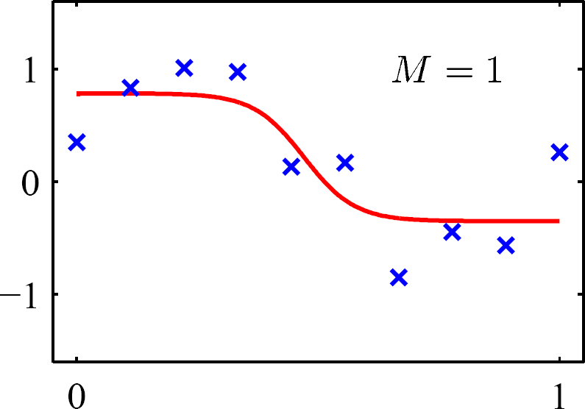
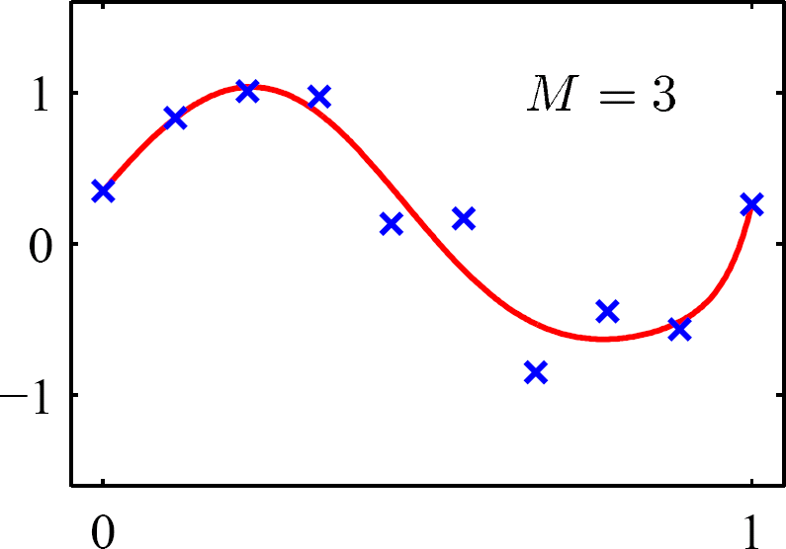
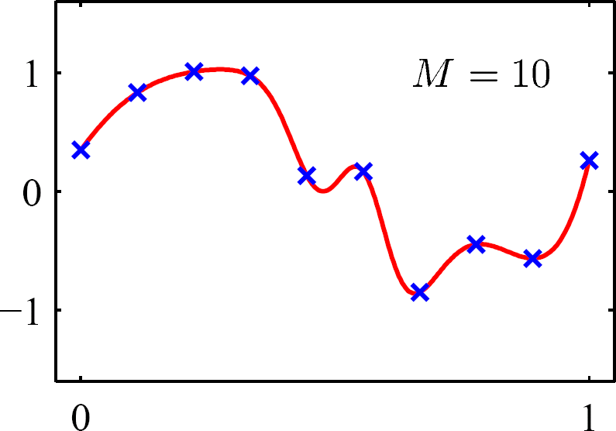
Non-linearities (like f or sigmoid): Why they’re needed
Neural networks do function approximation, e.g., regression or classification
Without non-linearities, deep neural networks can’t do anything more than a linear transform
Extra layers could just be compiled down into a single linear transform: W₁ W₂ x = Wx
But, with more layers that include non-linearities, they can approximate more complex functions!

