Slide 1
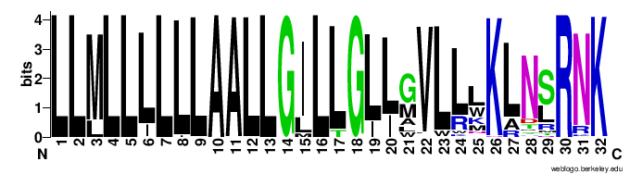
Interface
Buried if TRP
Buried
*
^
Met, Leu, Ala
To PHE
Other CHAMPs should have large Resi here
Model 702: LLMLLLLLLAALLGILLGLIAVWLWKLTRRNK
Model 505: LLMLLLLLLAALLGLLLGLLLVLLWKANTRNK
Model 779: LLMLLLLLLAALLGILLGLLMVLWWKLNLRNK
Notes on Match_1 backbone for anti a5 CHAMPs

Slide 2
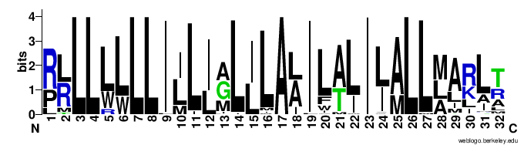
interface
Met or big hole
* “hydrogen bond?”
ALA packs close too
Model 496 PLLLLLLLIILIMLIIALIVAIILMLLAILLA

