Slide 1
NEWS CLASSIFIER
Group : Delta
Git link: https://github.com/mmrkavya/newspaper/tree/TEST
Done by:
Kavya M
Aditi Shilke

Slide 2
Architecture
Topics:
1.Business
2.Entertainment
3.General
4.Health
5.Science
6.Sports
7.Technology
Tools and installation:
Kafka
Python
Atlas mongo db (database: newspaper , collection : newspaperFeed)
Zookeeper
vagrant
Milestone 1
kafka
Newsapi(API)
broker
mongodb
queue
consumer
Triggered every 15 min
Gnewsclient( rssfeed)
zookeeper
Data Ingestion Architecture

Slide 3
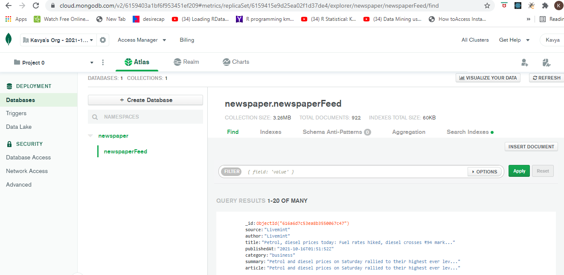
Mongodb Documents

Slide 4
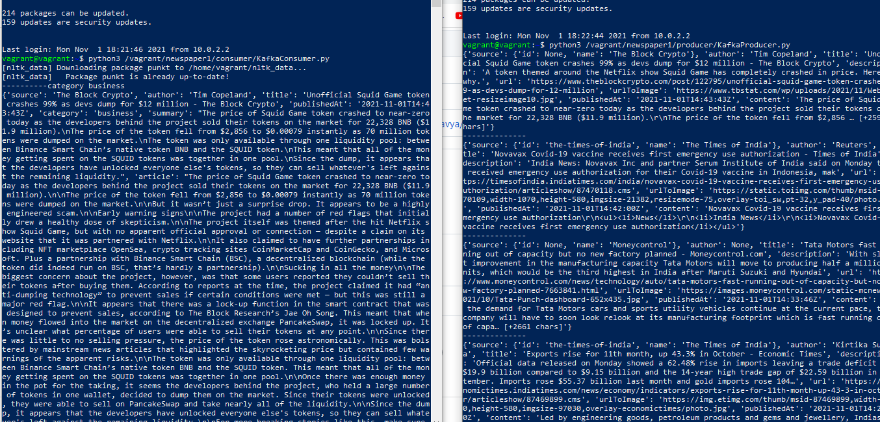
Consumer and newsapi producer

Slide 5
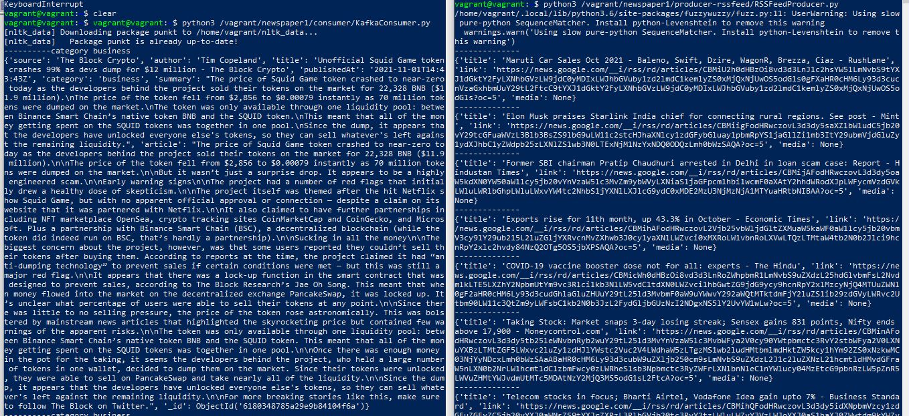
Consumer and gnewsclient producer

Slide 6
Challenges for data ingestion
1. Used online mongodb (atlas) so that no set up for mongo is required
2. data :
i. couldn't find appropriate api which gave the full data
ii. couldn't find topic in the newsapi that we selected
Solution:
I. to overcome the first challenge, instead of relying on teh data present in response. we used the link of the article in api response to retrieve the required data. The data from link was retrieved using 'newspaper3k' python library
II. for the topic, instead of retrieving the entire without topic, we found the list of topics that was allowed to be send in request, and then called the api with the topic in list as category request param. i.e for every 15 min the newsapi was called with one topic from the list as param at a time in loop.
3. Couldn't find proper source rssfeed
Solution:
Found gnewsclient library, which provided the necessary feed. Same method as mentioned as solution for point 2.ii, was used to retrieve data specific to topic. other than link and title, no other data could be retrieved so only these data were stored in the db. While training the data, the link of the article was used to retrieve other necessary data

Slide 7
Architecture
Tools and Installation:
Pyspark
Scala
Newspaper3k python library
Jar for pyspark mongodb connection
Fastapi python library
Milestone 2 and Milestone 3
Preprocess
( 1. converts to lower cases
2. removes stop words
3. lemmitization)
Mongodb
Model training using decision tree(pyspark)
Model saved as pickle file
News_article(retriving data from article url(
Preprocessor and model training

Slide 8
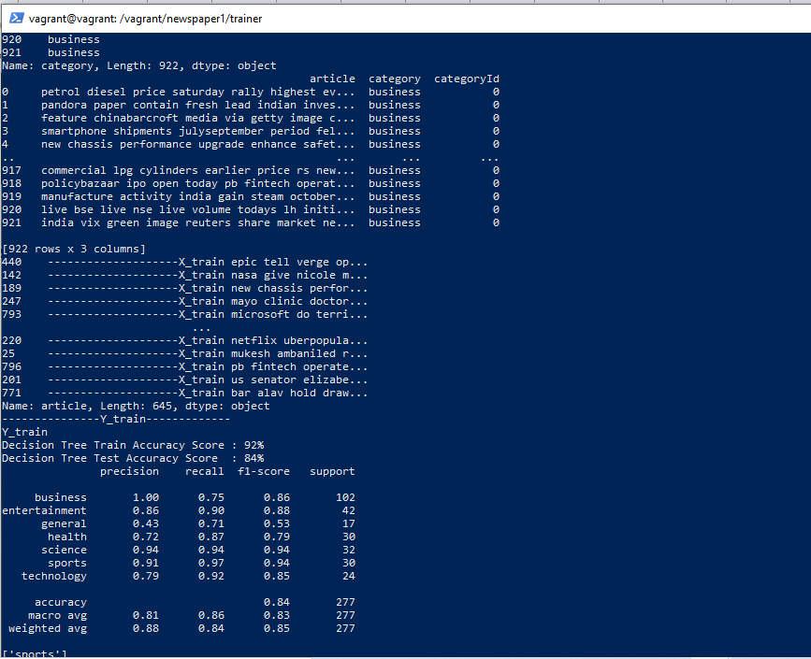
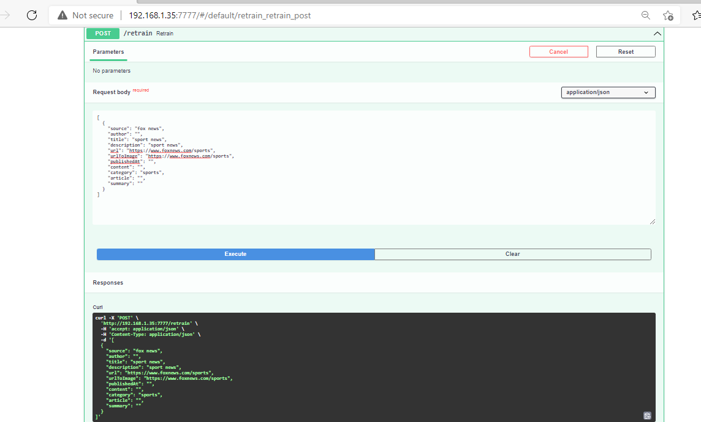
Preprocessing and Model training
Model training initiated during api deployment
Model retraining

Slide 9
Challenges for Preprocessing and Model training
1. Training model
Training data as such wasn't difficult. But found difficulty in finding the right set of jars of right versions to connect mongo db using pyspark. At then end, based on the version mongo db connector of version 2.11 or 2.12 based on scala and python version, it worked.
.2.Model registry
Wasn't successfull in storing the model in mlflow registry hence stored it in pickle file.

Slide 10
Architecture
Tools and Installation
newspaper3k python library
Python
Flask python library for api
HTML and javascript for UI
Milestone 4
API
News classifier UI
(html, js)
1. Extract data if its url
Topics:
1.Business
2.Entertainment
3.General
4.Health
5.Science
6.Sports
7.Technology
Article/url
2.Preprocess data
category
3.Extract model from pickle file .Predict and give back response
Prediction

Slide 11
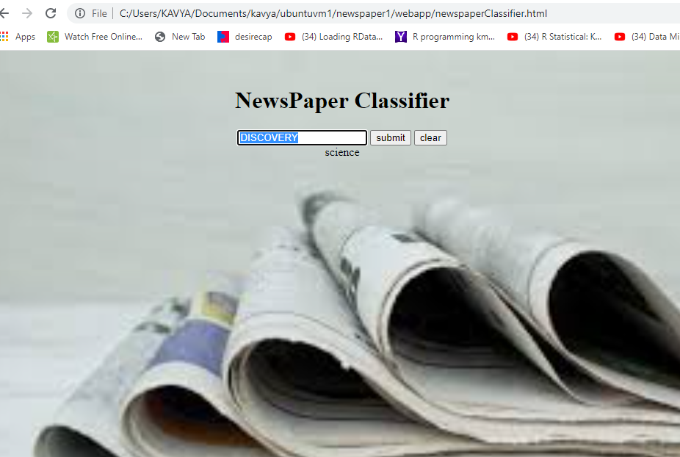
UI
The text can be used to input either the web site of article or any text

Slide 12
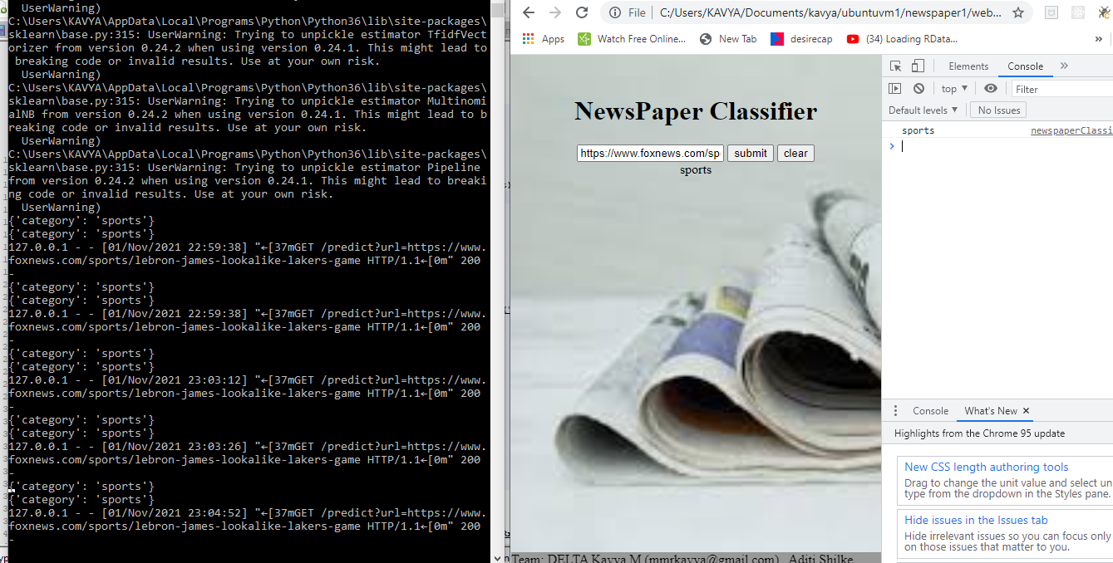
UI to API interaction

Slide 13
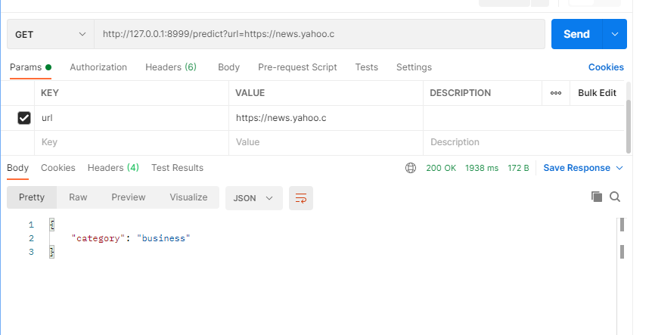
API postman

Slide 14
Architecture
Spark worker
Tools and Installation:
1.Docker engine
2. Docker compose
Mileston 4
Spark master
producer
newsapi
consumer
Mongo db(atlas)
Kafka
2
3
1
rssfeed
4
UI
Predict api
5
7
Model.pickle
Preprocessor and model trainer
6
5
Docker containers and images
(each rectangular box represents a separate image and arrows represent the direction of communication)

Slide 15
Challenges in building UI and containers
Containerization:
kafka , producer and consumer dockerfile were relatively easy build. Docker file for training and prediction took time as it needed both python ,java and right set of jars to be imported.

Slide 16
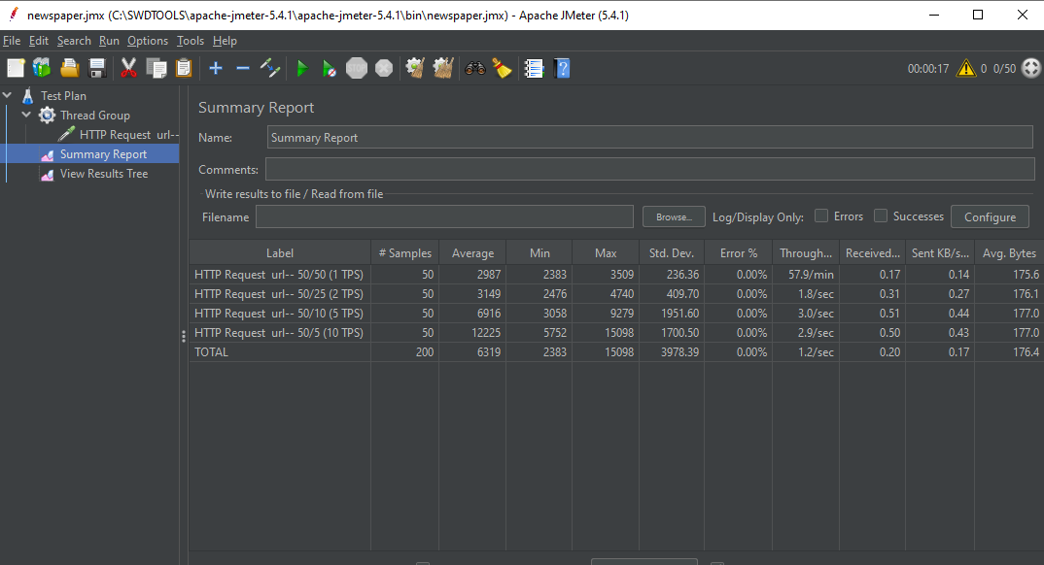
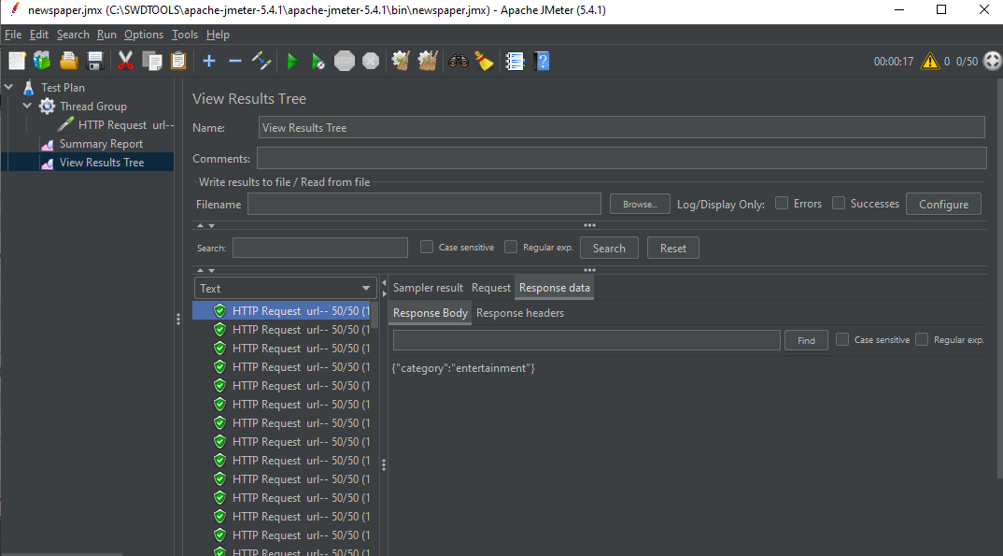
Load Testing (Jmeter)
Responses time is reasonable when TPS is 1-2

Slide 17
Thank You

