Slide 1

TechCore Innovation- HR
Date Range

Slide 2
TechCore Innovation- HR
Date Range
Resignation Overview
Resignation by Reason
Resignation by Gender
Resignation by Type
Resignation by
Resignation by

Slide 3
TechCore Innovation- HR
Date Range
Department
Resignation Overview
Gender-Based Resignation Trends
Resignation by Organizational Level and Gender
Resignation (Current Year vs Previous Year)
Resignation vs Hires
Time to Quit by Age Band
Time to Quit ( Years)
Time to Quit by Location

Slide 4
TechCore Innovation- HR
Year
Month
Department
Attrition Rate Overview
Attrition Rate by
Attrition Rate by
Voluntary Attrition by Gender
Overall and Voluntary Attrition Rate

Slide 5
TechCore Innovation- HR
Employee ID
Prediction Result
Likelihood of Resignation and Risk Probability
Prediction Accuracy

Slide 6
TechCore Innovation- HR
Date Range
Voluntary Attrition by Job Title
Voluntary Attrition Rate

Slide 7
TechCore Innovation- HR
Year
Month
Department
% of Female Leaders
% of Female Leaders by Department
Headcount by Gender and Org Level
Gender Diversity by
Ethnicity Diversity by Department
Ethnicity Diversity by Org Level

Slide 8
TechCore Innovation- HR
Year
Month
Department
Demographic
Headcount by Country and Employment Type
Headcount
Hires
Resignation
Salary Diversity by
Headcount by Org Level
Headcount by Gender and Ethnicity

Slide 9
TechCore Innovation- HR
Year
Month
Department
Hires & Attrition Rate
Proportion of Employee by Org Level
Headcount by Org Level and Department
Hires (Rolling 12 months
Hires (Rolling 12 months
Avg Age vs Avg Tenure
Headcount by Org Level
Avg Age
Avg Tenure

Slide 10
TechCore Innovation- HR
Year
Month
Absenteeism Overview
Absenteeism Rate Trends
Absenteeism Rate by Tenure Band
Absenteeism Rate by Org Level and Department
Absenteeism Rate by Age Band

Slide 11
TechCore Innovation- HR
Year
Month
Leave
Leave Trends
Leave Liability Trends
Leave Cost by Department
Leave Reason
Annual Leave Days Taken by Department and Educational Level
Leave Liability by Org Level

Slide 12
TechCore Innovation- HR
Year
Month
Department
Leave
Leave Trends
Leave Liability Trends
Leave Cost by Department
Leave Reason
Annual Leave Days Taken by Department and Educational Level
Leave Liability by Org Level

Slide 13
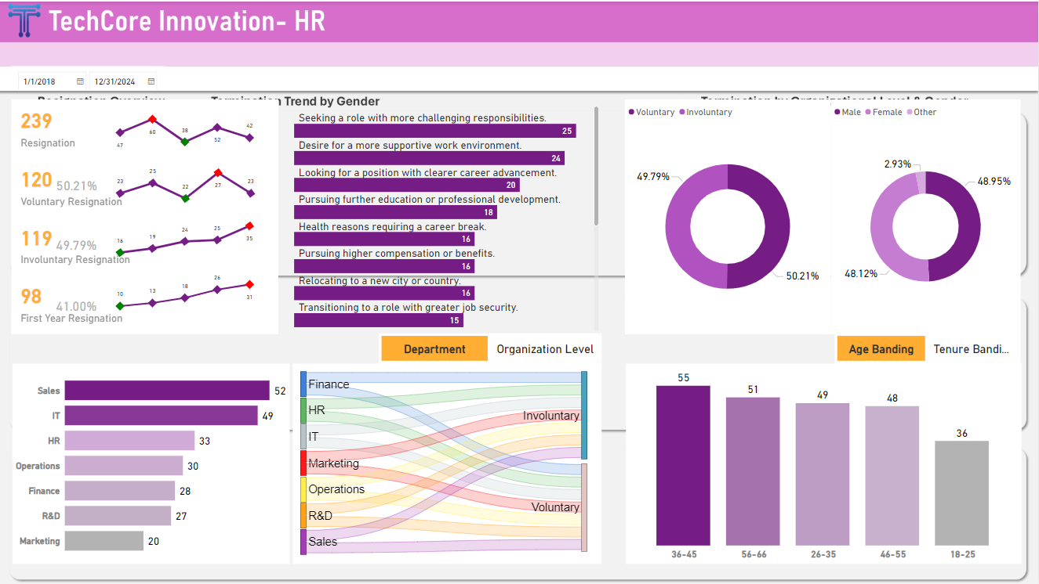

Slide 14
TechCore Innovation- HR
Performance Review Years
Employee ID
Full Name

Slide 15
TechCore Innovation- HR
Performance Review Years
% Distinct ID by Organization Level & Performance Rating
% Distinct ID by Gender & Performance Rating
Distinct ID (Year)
Distinct Count of ID by Age Category & Performance Rating
Distinct Count of ID by Department & Performance Rating

Slide 16
TechCore Innovation- HR
Performance Review Year
Department
Month Name
Distinct Count
Percentage

Slide 17
TechCore Innovation- HR
Date Range
Average Days on Leave by Age range
Leave Status Insight
V
Average Total Leave Days
Annual Leave Balance
Annual Leave Liability
Average Cost of Remaining Annual Leave by Dept
Average Annual Leave Liability
Annual Leave Utilization by Ethnicity
Department

Slide 18
TechCore Innovation- HR
Date Range
Absenteeism Rate by Department
Absenteeism Rate by Age Range
V
Availability Rate
Organizational Level
Absenteeism Rate
Total Absenteeism Cost
Average Leave Days Taken
Department
Absenteeism Rate by Organizational Level
Availability Rate by Tenure Band
Availability Rate Trend

Slide 19
TechCore Innovation- HR
Date Range
Average Days on Leave by Department
V
Average Leave Taken by Department and Gender
Total Leave Liability
Leave Type Cost by Department
Total Leave Days Trend
Leave Liability Forecast
Total and Average Leave Days by Category

