Slide 1

AGILE HR ANALYTICS
TechCore Innovation
Diversity Analysis
Salary Analysis
Leave Analysis
Project Overview:
This analysis is a part of group project work of High-Performance Team, Organized by Data Solution-360. All the data used in this analysis was generated using Python. All the images of people used here are AI generated. API was used to generate the pictures in Python as well. Name of the company “TechCore Innovation” is also a fictious name.
Contributor : Md Mizanur Rahman Mushfiqur Rahman Asif Adnan
Tahnin Mashruba Tisha Tasmin Akter Tripty Shaek Ahmed
Training Analysis
Performance Analysis
Resignation Analysis

Slide 2
TechCore Innovation- HR
Date Range

Slide 3
TechCore Innovation- HR
Date Range
Resignation Overview
Resignation by Reason
Resignation by Gender
Resignation by Type
Resignation by
Resignation by

Slide 4
TechCore Innovation- HR
Date Range
Department
Resignation Overview
Gender-Based Resignation Trends
Resignation by Organizational Level and Gender
Resignation (Current Year vs Previous Year)
Resignation vs Hires
Time to Quit by Age Band
Time to Quit ( Years)
Time to Quit by Location

Slide 5
TechCore Innovation- HR
Year
Month
Department
Attrition Rate Overview
Attrition Rate by
Attrition Rate by
Voluntary Attrition by Gender
Overall and Voluntary Attrition Rate

Slide 6
TechCore Innovation- HR
Employee ID
Prediction Result
Likelihood of Resignation and Risk Probability
Prediction Accuracy

Slide 7
TechCore Innovation- HR
Date Range
Voluntary Attrition by Job Title
Voluntary Attrition Rate

Slide 8
TechCore Innovation- HR
Year
Month
Department
% of Female Leaders
% of Female Leaders by Department
Headcount by Gender and Org Level
Gender Diversity by
Ethnicity Diversity by Department
Ethnicity Diversity by Org Level

Slide 9
TechCore Innovation- HR
Year
Month
Department
Demographic
Headcount by Country and Employment Type
Headcount
Hires
Resignation
Headcount
(%)
Avg Tenure
(years)
Avg Age
(years)
Avg Annual Salasry
Salary Diversity by
Headcount by Org Level
Headcount by Gender and Ethnicity

Slide 10
TechCore Innovation- HR
Year
Month
Department
Hires & Attrition Rate
Proportion of Employee by Org Level
Headcount by Org Level and Department
Hires (Rolling 12 months
Hires (Rolling 12 months
Avg Age vs Avg Tenure
Headcount by Org Level
Avg Age
Avg Tenure

Slide 11
TechCore Innovation- HR
Year
Month
Absenteeism Overview
Absenteeism Rate Trends
Absenteeism Rate by Tenure Band
Absenteeism Rate by Org Level and Department
Absenteeism Rate by Age Band

Slide 12
TechCore Innovation- HR
Year
Month
Leave
Leave Trends
Leave Liability Forecast
Leave Cost by Department
Leave Reason
Annual Leave Days Taken by Department and Educational Level
Leave Liability by Org Level

Slide 13
TechCore Innovation- HR
Year
Month
Department
Leave
Leave Trends
Leave Liability Trends
Leave Cost by Department
Leave Reason
Annual Leave Days Taken by Department and Educational Level
Leave Liability by Org Level

Slide 14
TechCore Innovation- HR
Year
Department
Project Details
Employee Details

Slide 15
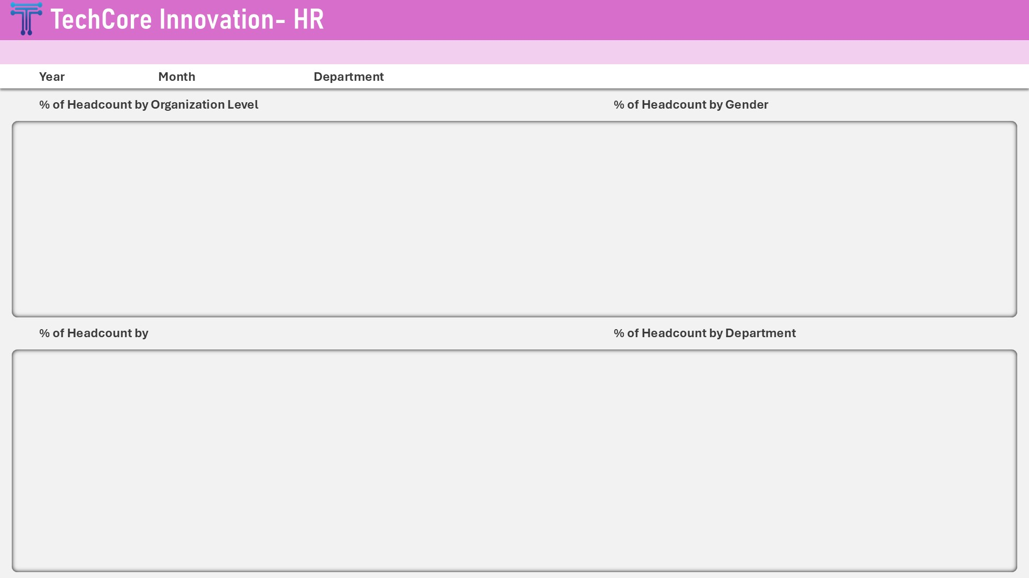

Slide 16
TechCore Innovation- HR
Year
Department
Employee Performance Category
Overview
Potential
# of Employee:
Performance: Did not meet Expectation Potential: High
Aspiring Performer
# of Employee:
Performance: Meet Expectation Potential: High
High Achiever
# of Employee:
Performance: Exceeded Expectation Potential: High
Top Talent
# of Employee:
Performance: Did not meet Expectation Potential: Moderate
Emerging Contributor
# of Employee:
Performance: Meet Expectation Potential: Moderate
Core Performer
# of Employee:
Performance: Exceeded Expectation Potential: Moderate
Rising Potential
# of Employee:
Performance: Did not meet Expectation Potential: Low
Growth Opportunity
# of Employee:
Performance: Meet Expectation Potential: Low
Reliable Contributor
# of Employee:
Performance: Exceeded Expectation Potential: Low
Consistent Performer
Performance

Slide 17
TechCore Innovation- HR
Year
Month
Department
Overview
Payable
House Rent
Overtime Cost
Provident Fund
TAX
Payroll Cost
Sales Growth Trends by Year

Slide 18
TechCore Innovation- HR
Year
Month
Country
Salary Details by
Salary Distribution
Overtime Pay by Job Title
Salary Variance by Employment Status

Slide 19
TechCore Innovation- HR
Year
Month
Country
Salary Details

Slide 20
Aspiring Performer
Performance: Did not meet Expectation Potential: High
Employees by Department
Employees by Hire Date
Details

Slide 21
High Achiever
Performance: Meets Expectation Potential: High
Employees by Department
Employees by Hire Date
Details

Slide 22
Top Talent
Performance: Exceeded Expectation Potential: High
Employees by Department
Employees by Hire Date
Details

Slide 23
Emerging Contributor
Performance: Did not meet Expectation Potential: Moderate
Employees by Department
Employees by Hire Date
Details

Slide 24
Core Performer
Performance: Meet Expectation Potential: Moderate
Employees by Department
Employees by Hire Date
Details

Slide 25
Rising Potential
Performance: Exceeded Expectation Potential: Moderate
Employees by Department
Employees by Hire Date
Details

Slide 26
Growth Opportunity
Performance: Did not meet Expectation Potential: Low
Employees by Department
Employees by Hire Date
Details

Slide 27
Reliable Contributor
Performance: Meet Expectation Potential: Low
Employees by Department
Employees by Hire Date
Details

Slide 28
Consistent Performer
Performance: Exceeded Expectation Potential: Low
Employees by Department
Employees by Hire Date
Details

Slide 29
TechCore Innovation- HR
Year
Department
Employee Performance Category
Overview
Potential
# of Employee:
Performance: Did not meet Expectation Potential: High
Aspiring Performer
# of Employee:
Performance: Meet Expectation Potential: High
High Achiever
# of Employee:
Performance: Exceeded Expectation Potential: High
Top Talent
# of Employee:
Performance: Did not meet Expectation Potential: Moderate
Emerging Contributor
# of Employee:
Performance: Meet Expectation Potential: Moderate
Core Performer
# of Employee:
Performance: Exceeded Expectation Potential: Moderate
Rising Potential
# of Employee:
Performance: Did not meet Expectation Potential: Low
Growth Opportunity
# of Employee:
Performance: Meet Expectation Potential: Low
Reliable Contributor
# of Employee:
Performance: Exceeded Expectation Potential: Low
Consistent Performer
Performance

Slide 30
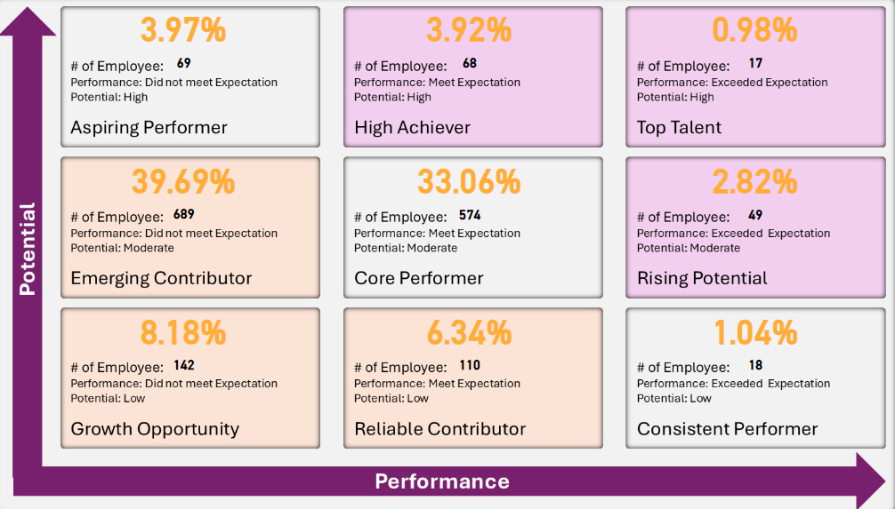

Slide 32
