Slide 1

1. Affinity Propagation
Groups similar observations around exemplars: real data points that represent each cluster.
Similarity
Compare pairs of observations to identify suitable representatives.
Message passing
Responsibility measures suitability. Availability reflects support from other points.
Exemplar selection
Combined messages identify exemplars. Points sharing an exemplar form a cluster.

Slide 2
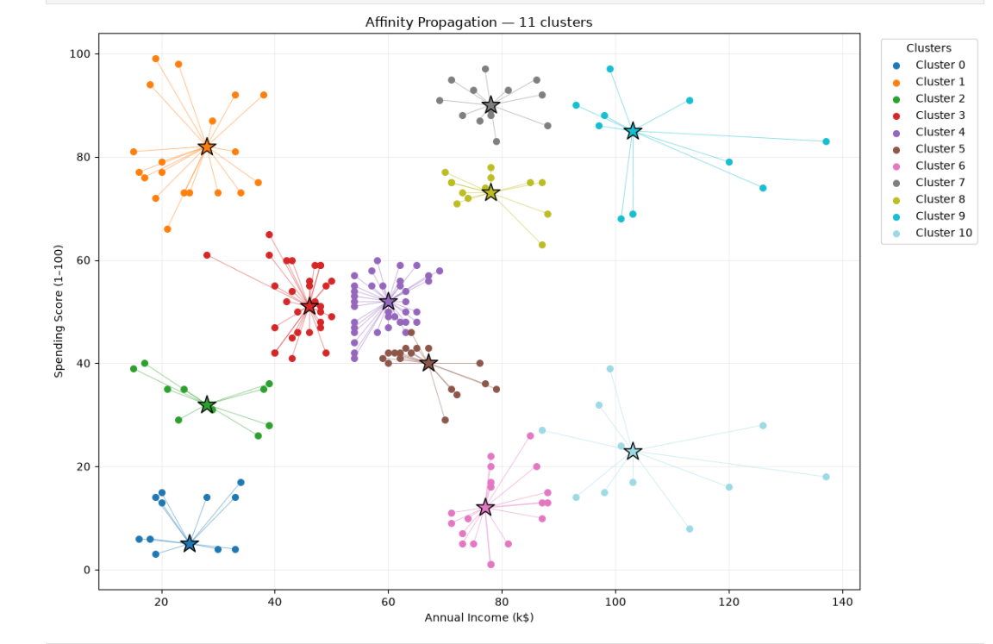
Example result: 11 clusters
Plot interpretation
Colors show clusters.
Stars identify exemplars.
Lines connect members to their representative.
This supplied run has 11 clusters. Other data or settings can change the count.

Slide 3
Strengths, limitations and applications
Strengths
No cluster count to specify in advance
Actual observations as representatives
Custom similarity matrices supported
Limitations
O(N²) memory and O(N²T) total time
Sensitive to settings and feature scaling
Convergence requires checking
Possible applications
Neighborhood grouping, traffic patterns, land-use profiles and environmental analysis.

Slide 4
Settings and Python implementation
from sklearn.cluster import AffinityPropagation
# Create and train the clustering model
aff = AffinityPropagation(random_state=5)
y_aff = aff.fit_predict(X)
centers = aff.cluster_centers_indices_
print("Clusters:", len(centers))
How to read the output
y_aff: cluster label for each row.
centers: row indices of the exemplars.
random_state=5 fixes randomness, not the cluster count.
X must contain clean numeric features. Scale features with different units.

Slide 5
2. Mean Shift Clustering
Finds clusters by locating dense regions in the data.
Density peaks become cluster centers
Candidate centers repeatedly move toward the mean of nearby observations.
The cluster count emerges from the data
You do not specify k. The bandwidth strongly affects the number of clusters.
Non-parametric: no specified distribution family or fixed parameter count.

Slide 6
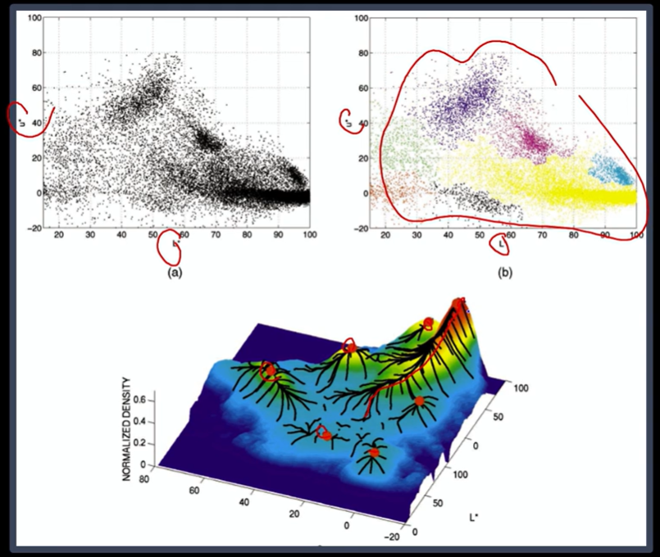
How Mean Shift works
1. Choose a neighbourhood
The bandwidth defines the radius around each candidate centre.
2. Move to the local mean
Repeat the shift until the candidate centre stabilises near a density peak.
3. Form the clusters
Merge nearby candidate centres and assign observations to the final centres.

Slide 7

Key parameters
bandwidth = None
Neighbourhood radius. None estimates it automatically. Smaller values often create more clusters.
bin_seeding = False
True uses grid-based starting locations and can speed fitting by reducing the number of seeds.
cluster_all = True
True assigns every point. False labels orphan points outside all final kernels as −1.
Bandwidth depends on feature scale. Reassess it whenever the input scale changes.

Slide 8
Strengths and limitations
Strengths
Discovers the number of clusters
Requires no specified distribution family
Provides centres for interpreting groups
Limitations
Bandwidth can merge or split groups
Large datasets can be expensive
Noise handling depends on cluster_all
Arbitrary-shape recovery is not guaranteed
Useful results need suitable features, a sensible bandwidth and validation.

Slide 9
Python implementation: Mean Shift
from sklearn.cluster import MeanShift
ms = MeanShift(
bandwidth=bandwidth,
bin_seeding=True,
cluster_all=True,
max_iter=300)
y_ms = ms.fit_predict(X_scaled)
print("Cluster labels:")
print(y_ms)
How to read the output
y_ms contains one cluster label for each row in X_scaled.
Before running the code
Prepare X_scaled and set bandwidth for that scale.
cluster_all=True assigns every observation to a cluster.
Setup: pip install scikit-learn

Slide 10
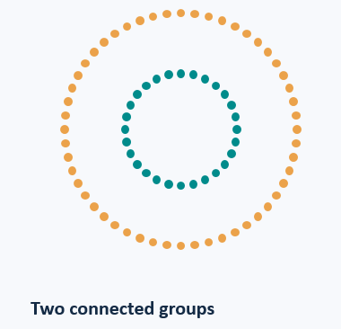
3.Spectral Clustering
Grouping data through similarity and connections
An unsupervised machine learning method that groups similar data points without predefined labels.
Especially useful for curved or irregular cluster shapes.

Slide 11

How Spectral Clustering works
Measure similarity
Compare how close or similar the data points are.
Build a graph
Represent each point as a node and connect similar points.
Transform the data
Use eigenvectors of a graph Laplacian to reveal its structure.
Create clusters
Usually apply K-Means to the transformed representation.

Slide 12
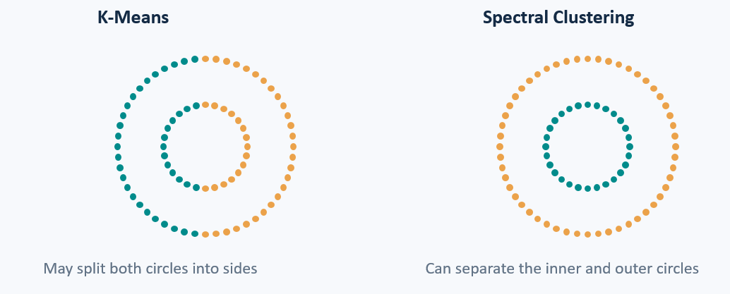
Example: two circles, one inside the other

Slide 13
K-Means and Spectral Clustering compared
Feature | K-Means | Spectral Clustering
Main Approach | Distance from cluster centers | Similarity and Connection
Best suited to | Compact, roughly spherical groups | Connected groups with complex shapes
Computational Cost | Usually lower | Usually higher
Number of Clusters | Usually specified beforehand | Usually specified beforehand
Spectral Clustering usually applies K-Means after transforming the data.

Slide 14
Python example
X, _ = make_circles(
n_samples=300, factor=0.5,
noise=0.04, random_state=42)
model = SpectralClustering(
n_clusters=2,
affinity="nearest_neighbors",
n_neighbors=10, random_state=42)
labels = model.fit_predict(X)
plt.scatter(X[:, 0], X[:, 1], c=labels)
plt.axis("equal")
plt.title("Spectral Clustering")
plt.show()
What the code does
Creates two circles, assigns a cluster label to each point, and colours the results.

Slide 15
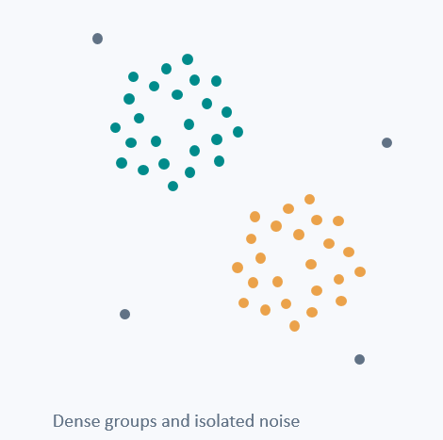
4.DBSCAN
Clustering by density
Density-based spatial clustering of applications with noise
An unsupervised method that groups densely connected points and labels isolated points as noise.
No preset number of clusters.
Can discover irregular cluster shapes.

Slide 16
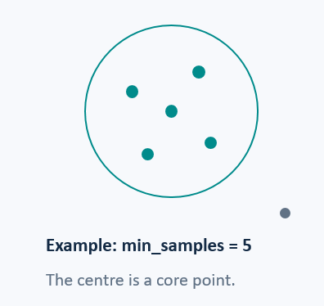
The two parameters that define density
eps: neighbourhood radius
Points within this distance count as neighbours.
min_samples: minimum point count
A core point needs at least this many points in its neighbourhood, including itself.
Example: min_samples = 5
The centre is a core point.
Small eps can create more noise. Large eps can merge groups.

Slide 17
Core, border and noise points
Core point
Enough neighbours within eps.
Expands the cluster.
Border point
Too few neighbours to be core,
but within eps of a core point.
Noise point
Neither core nor border.
Receives label −1.
DBSCAN connects core points and includes their border neighbours.

Slide 18
DBSCAN and K-Means compared
Feature | DBSCAN | K-Means
Number of Clusters | Emerges from density setting | User specifies K in advance
Cluster shapes | Can find irregular shapes | Favours compact, round groups
Outliers | Explicit noise label: -1 | Assigns every point to a cluster
Main limitation | Sensitive to setting and uneven cluster densities | Usually specified beforehand
Feature scaling matters because both methods use distances.

Slide 19
Python example
from sklearn.datasets import make_moons
from sklearn.cluster import DBSCAN
import matplotlib.pyplot as plt
X, _ = make_moons(
n_samples=300, noise=0.08,
random_state=42)
labels = DBSCAN(
eps=0.18, min_samples=5
).fit_predict(X)
plt.scatter(X[:, 0], X[:, 1], c=labels)
plt.axis("equal")
plt.title("DBSCAN: -1 means noise")
plt.show()
How to read the output
Non-negative labels identify clusters.
Label −1 identifies noise.

Slide 20
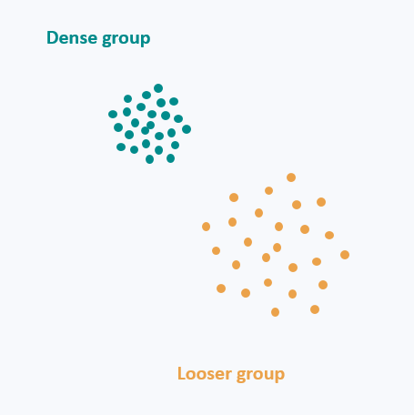
5.OPTICS exploring density structure
Ordering points to identify
The clustering structure
A density-based method that orders points to reveal groups at different density levels.
Closely related to DBSCAN.
Useful when one density threshold misses groups.

Slide 21

Core distance and reachability distance
Core distance
The smallest radius that contains min_samples points, including the point itself.
Reachability distance via core point p
For another point q, use the larger of:
core distance of p
distance between p and q
OPTICS uses these distances to build an ordered view of the data.

Slide 22
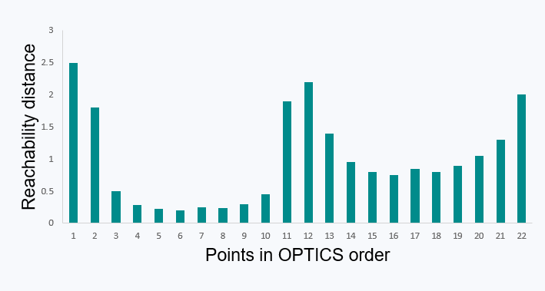
Reading a reachability plot
Low valleys
Denser connected regions.
Higher valleys
Looser connected regions.
Peaks
Possible boundaries or sparse regions.
Schematic values. Nested valleys can reveal groups within larger groups.

Slide 23
OPTICS and DBSCAN compared
Feature | DBSCAN | OPTICS
Density Setting | One eps for a clustering run | Explores neighborhood scales up to max_eps
Output | Flat cluster labels and noise | Point ordering, reachability. And extracted labels.
Cluster Extraction | Directly uses eps | Uses xi or a DBSCAN- style cut
Practical limitation | Uneven densities can be difficult | Extraction settings still matter. Runtime can be substantial.
min_samples defines density. xi controls boundary steepness for xi extraction.

Slide 24
Python example: groups with different densities
from sklearn.datasets import make_blobs
from sklearn.cluster import OPTICS
import matplotlib.pyplot as plt
X, _ = make_blobs(
n_samples=300,
centers=[[-3, 0], [3, 0]],
cluster_std=[0.3, 1.0], random_state=42)
model = OPTICS(min_samples=10, xi=0.05,
min_cluster_size=0.1)
labels = model.fit_predict(X)
plt.scatter(X[:, 0], X[:, 1], c=labels)
plt.axis("equal")
plt.title("OPTICS cluster labels")
plt.show()
Key settings
min_samples=10
Defines local density.
xi=0.05
Controls boundary steepness.
min_cluster_size=0.1
Minimum cluster size: 10% of points.
Label −1 means unassigned to an extracted leaf cluster.

Slide 25
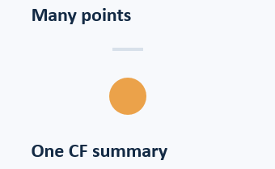
6.BIRCH clustering through compact summaries
Balanced iterative reducing and
Clustering using hierarchies
An unsupervised method that compresses nearby points into sub-clusters before optional global clustering.
Memory-efficient summaries support large datasets and incremental updates.

Slide 26

Clustering Feature: CF = (N, LS, SS)
N - Number of points
LS - Sum of point coordinates
SS - Sum of squared point lengths
Example: one-dimensional points 2, 4 and 6
N = 3 LS = 12 SS = 56 Centroid = LS / N = 4

Slide 27
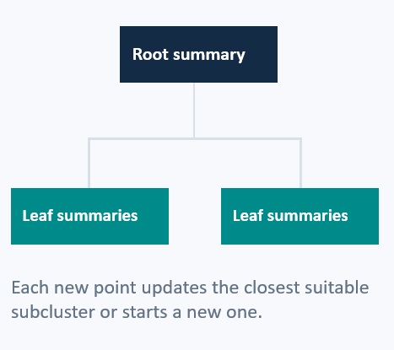
The CF tree and its main settings
A balanced hierarchy of sub-cluster summaries
threshold
Limits the merged sub-cluster radius. A smaller value tends to create more sub-clusters.
branching_factor
Maximum CF entries per node. Overflow causes node splitting.
Root summary
Each new point updates the closest suitable sub-cluster or starts a new one.

Slide 28

The BIRCH workflow and practical limits
1 Build the CF tree
Read points and update compact summaries.
2 Condense the tree
Optional in the original algorithm.
3 Global clustering
Group leaf summaries, or retain subclusters.
4 Refine assignments
Optional extra passes over the original data.
Best with scaled numeric features and compact groups.
Threshold tuning matters. scikit-learn BIRCH does not label noise.

Slide 29
Python example: summarizing and clustering points
from sklearn.datasets import make_blobs
from sklearn.preprocessing import StandardScaler
from sklearn.cluster import Birch
import matplotlib.pyplot as plt
X, _ = make_blobs(n_samples=300, centers=3,
cluster_std=0.6, random_state=42)
X = StandardScaler().fit_transform(X)
model = Birch(threshold=0.3,
branching_factor=50, n_clusters=3)
labels = model.fit_predict(X)
plt.scatter(X[:, 0], X[:, 1], c=labels)
plt.axis("equal")
plt.title("BIRCH cluster labels")
plt.show()
Key settings
threshold=0.3
Controls subcluster radius.
n_clusters=3
Requests three final groups.

