Slide 1
PennPalGPT:
ChatBot for students seeking research advisor
Grace Benner, Mikaela Spaventa, Natalie Gilbert, Yash Nakadi

Slide 2
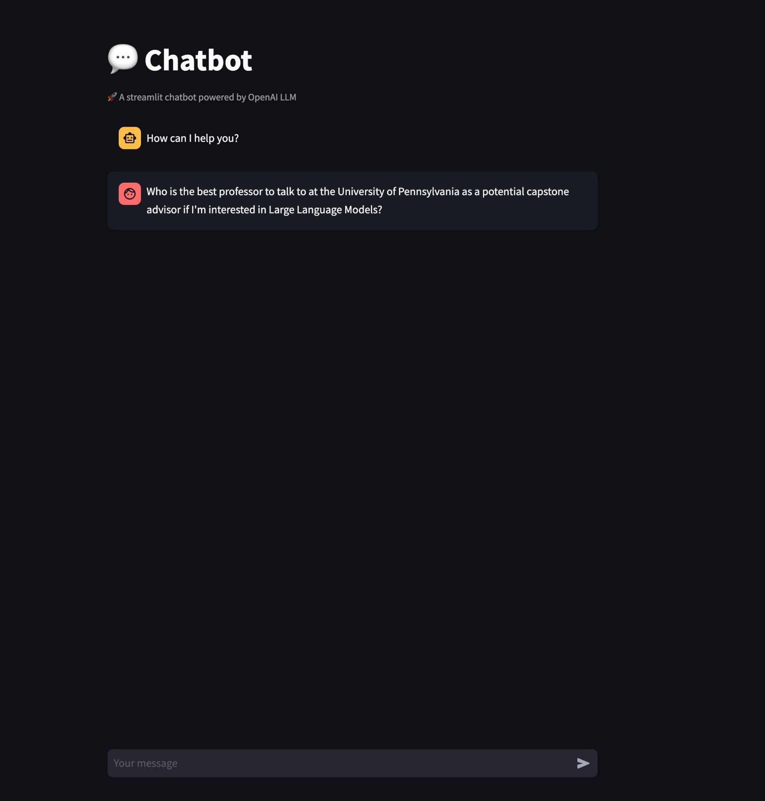
PennPalGPT
Function: Q&A ChatBot
Users: Penn students interested in research
Model: GPT-3.5 (Turbo 16k)
UI: Streamlit (Python library)

Slide 3
Motivation
Utility:
Many students at Penn are interested in research
Finding the right advisor for your research interests is crucial
NLP:
Popularity of chatbots has exploded in the past 12 months
Utilize knowledge of LLMs, applying BERT, GPT models in useful setting
What we learned:
Generating features
How to group similar professors together
Best practices for implementing models from research papers
Fine-tuning prompt to get desired output
Developing user-friendly UI

Slide 4
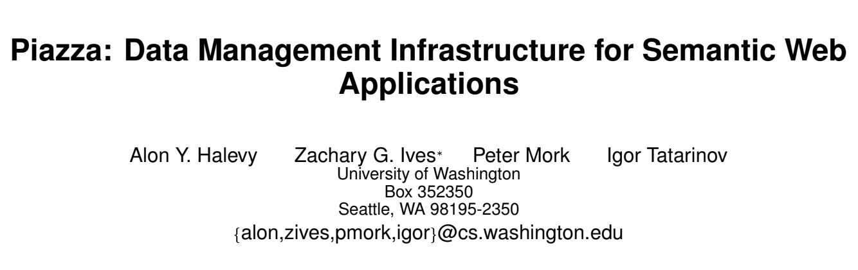
Training Data (Pretraining)
Academic papers, website bios, contact info, etc. for 100 Penn Engineering faculty in the CIS department (~2500 documents in total, not including metadata)
LangChain was used for text extraction
Research paper
Extraction via LangChain
Text file for pretraining
Document(page_content='The Piazza PeerData Mana gement Project\nIgor Tatarinov1,Zachar yIves2,JayantMadha van1,\nAlon Hale vy1,Dan Suciu1,Nilesh Dalvi1,Xin(Luna) Dong1,\nYana Kadiyska1,Gerome Miklau1,Peter Mork1\n1Depar tment ofComputer Science and Engineer ing\nUniv ersity ofWashington, Seattle ,WA98195\nfigor,jayant,alon,suciu,nilesh,lunadong,ykadiysk,gerome ,pmor kg@cs .washington.edu

Slide 5
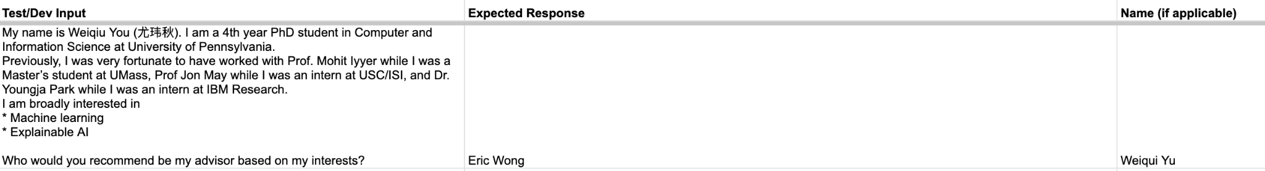
Dev/Test Data
Description: Each dataset contains 50 examples (input, answer)
Source: Research interests from PhD students at Penn (input), and their actual advisor (answer)
Dev set function: fine tuning
Test set function: evaluation

Slide 6

Evaluation Metrics
Quantitative:
Each answer is scored 1-5 depending on how semantically similar the chatbot answer is to the golden standard answer
Given our set of scores S = {s₁, s₂, … s_{n}} and the probability of each score is p(s_{i}), we calculate the final score as follows:
Qualitative:
Evaluating quality of the response
Understandable
Grammatically error-free
Valid answer
Interpretability (justification of choice)

Slide 7
Models
Simple Baseline
Model: GPT 3.5 Turbo, msmarco-bert-base-dot-v5 embeddings
Quality: relevant, grammatically correct, very unhelpful
Score: 0.458 (somewhat relevant answers received score ⅖)
Strong Baseline
Model: GPT 3.5 Turbo 16k, same embeddings
Quality: much more helpful and accurate
Score: 0.644 (most answers had score 3/5 or 5/5)
Concept Bottleneck Model (Yang et al., 2023)
Advantage: Increase interpretability of results, identifies key features
Disadvantage: Less accurate
Variations:
Random Forest: Score of 0.456
SVC: Score of 0.598
KNN: Score of 0.608
Notes:
Concept Bottleneck Inspiration source: Yang, Yue, et al. “Language in a Bottle: Language Model Guided Concept Bottlenecks for Interpretable Image Classification.” ArXiv.org, 25 Apr. 2023, arxiv.org/abs/2211.11158.

