Slide 1

SOCIALCLUBSMAPS
Independent. Verified. Built for people who want to do this right.
BARCELONA • WEEK 1 LAUNCH
Barcelona has clubs.
Most people get the
legal reality wrong.
That is exactly why SocialClubsMaps exists.
Not for hype. Not for shortcuts. For visitors who want clarity, context, and a better filter before they trust anything.
Do it right, not fast.
Launching officially today.
01 / 06
Read before you trust the wrong source.
4/20 launch

Slide 2
SOCIALCLUBSMAPS
Independent. Verified. Built for people who want to do this right.
WHY PEOPLE GET IT WRONG
Most advice online
collapses three
different things
Law
Practice
Policy
What Spanish law actually says, and where the risk begins.
What clubs, locals, and police often treat as normal.
What one specific club decides to allow, reject, or require.
When people confuse those three, they either get overconfident or get played.
02 / 06
The point is not fear. The point is a better read.
4/20 launch

Slide 3
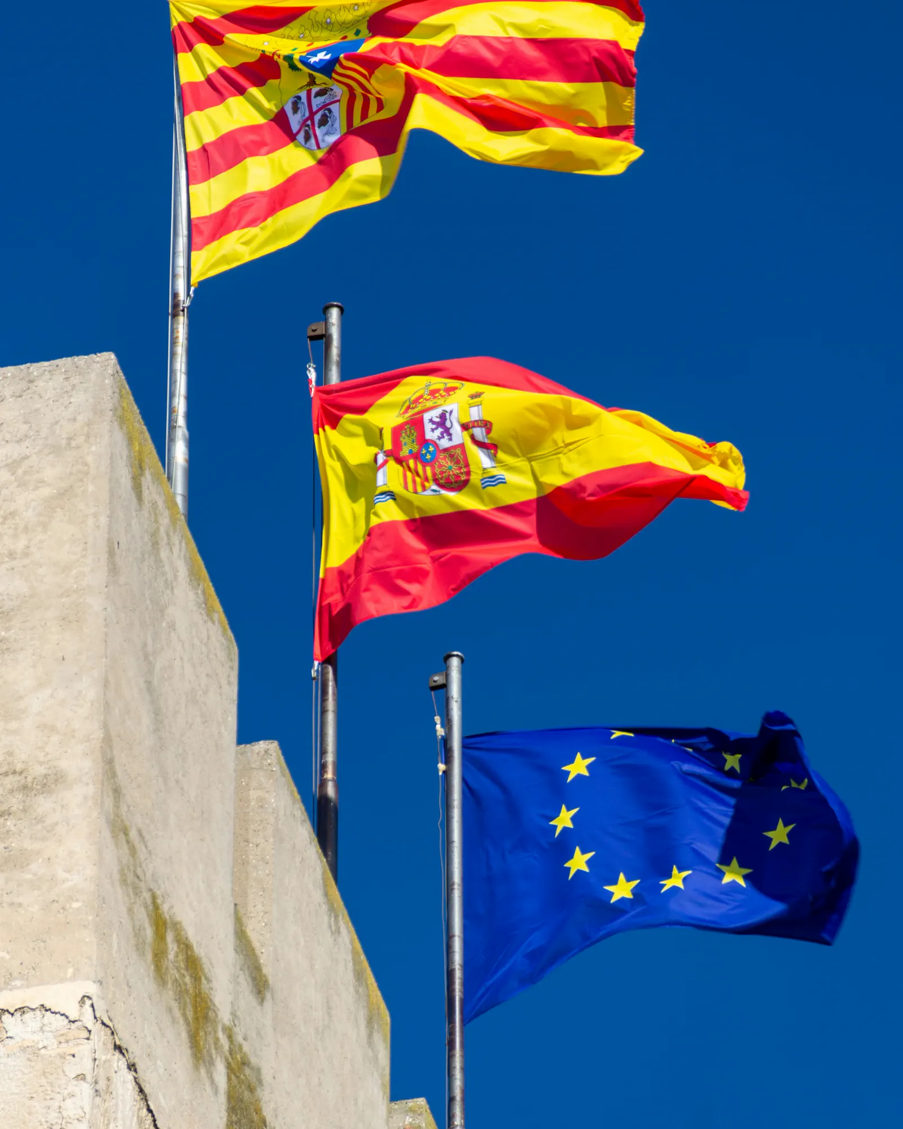
SOCIALCLUBSMAPS
Independent. Verified. Built for people who want to do this right.
THE LEGAL REALITY
Private is not public.
Tolerated is not
risk-free.
PUBLIC-SPACE FINES
BARCELONA 2024
MAIN RISK SIGNAL
EUR601-30000
30 closures
commercial look
commonly cited range for public possession / use
reported first closure orders in the city's campaign
tourist-business behavior raises exposure
SCM is built to help you separate useful information from false confidence.
Information, not legal advice. Always verify club status independently.
03 / 06
Clarity first. Confidence second.
4/20 launch

Slide 4
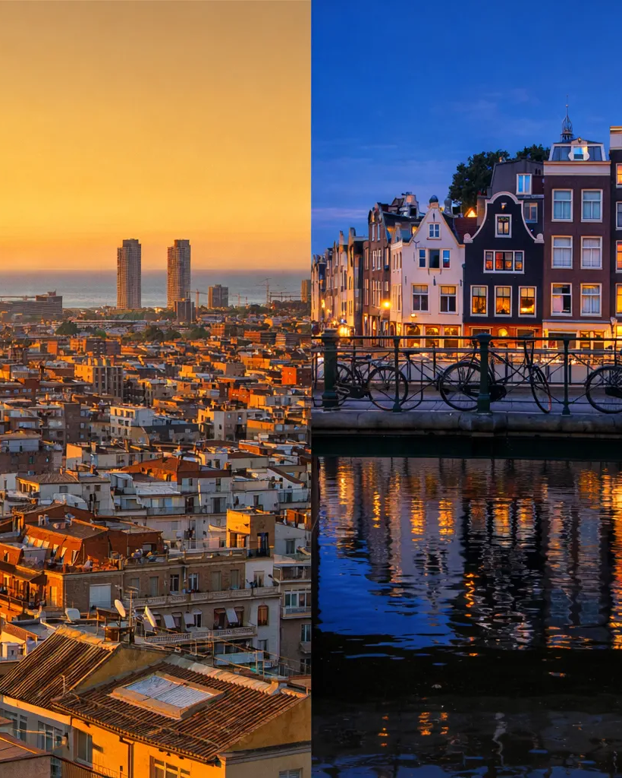
SOCIALCLUBSMAPS
Independent. Verified. Built for people who want to do this right.
BARCELONA IS NOT AMSTERDAM
This city sits inside
tourism pressure,
commercial pressure,
and local scrutiny.
What bad content does
What better content does
Turns clubs into entertainment products for passing tourists.
Explains the city, the tension, and why discretion matters.
That is the lane SCM is choosing from day one.
04 / 06
The category does not need more hype.
4/20 launch

Slide 5

SOCIALCLUBSMAPS
Independent. Verified. Built for people who want to do this right.
WHY SCM EXISTS
A small verified set
beats a giant
unvetted list.
Registry & statutes
Physical & access posture
Does the club still look like a private association, not a public-facing shop?
Does the place behave with discretion, controlled access, and basic seriousness?
Onboarding sanity
Ongoing trust
Does the process feel responsible, or does it scream shortcut culture?
Would we still feel good sending a careful visitor there tomorrow?
05 / 06
Selected, never bought.
4/20 launch

Slide 6
SOCIALCLUBSMAPS
Independent. Verified. Built for people who want to do this right.
OFFICIAL LAUNCH
Launching officially
today.
4/20 felt fitting.
If Barcelona is on your radar, start with the map built for people who want to do this right, not fast.
socialclubsmaps.com
Start with the Safety Kit. Then move smarter.
@socialclubsmaps
06 / 06
Built for people who want a better filter.
4/20 launch

