Slide 1
Welcome
M M Shaifur Rahman
ID#13301052
CSE, BRAC University
Supervised by
Moin Mostakim
Lecturer, BRAC University

Slide 2
Topic
Bangla License Plate Recognition System Using
Convolutional Neural Network(CNN)

Slide 3
What Does it Means ?
License Plate Recognition System
Convolutional Neural Network

Slide 4
Objective
Construct Dataset of Bangla License Plate (BLP)
Implement a System for BLP Recognition using Convolutional Neural Network

Slide 5
Our Approach
Dataset Construction Process
Image
Capture
License Plate Crop
32px X 32px character slicing
Figure: Dataset Construction Process

Slide 6
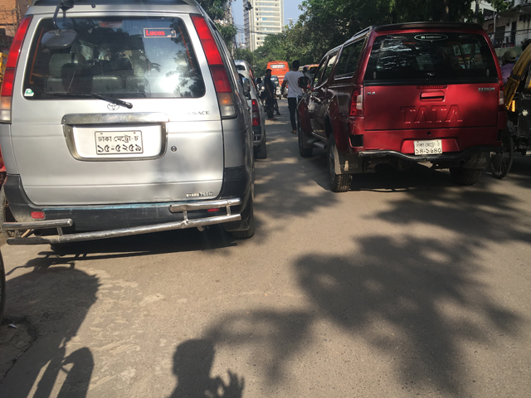
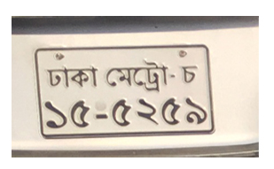









Post Processing Steps of Dataset

Slide 7
Overall System Workflow
Sliced Images as Training Dataset
Convolutional Neural Network Training
Test
Image
Layer-6 BLP CNN Recognition
Recognition of
Image class

Slide 8
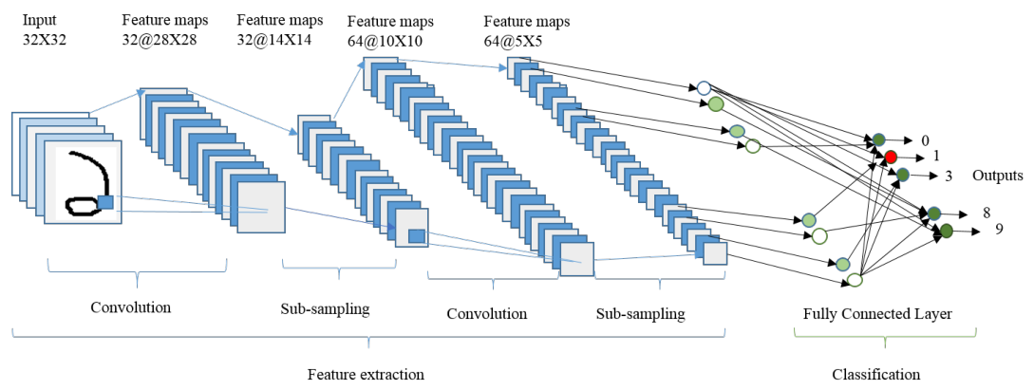
Convolutional Neural Network
Figure: Overall Architecture of the CNN Network used in this work

Slide 9
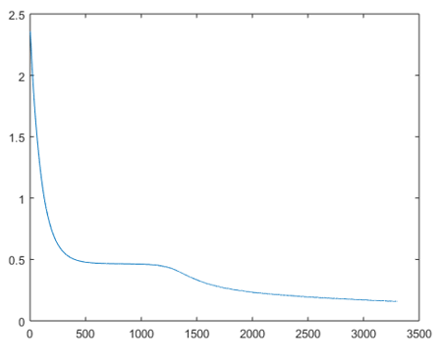
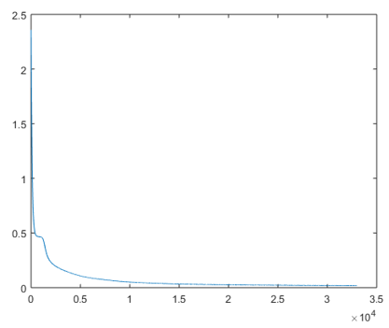
Experiment Result
100 Epoch 1000 Epoch
Figure: Iteration vs Error Graph

Slide 10
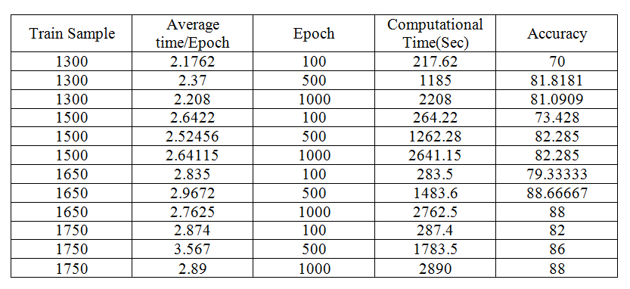
Result Analysis
Highest
Accuracy is
88.67%
Computational time is proposition to Number of Epoch

Slide 11
Conclusion
Implemented BLRPS using CNN
Benchmark Dataset Creation

Slide 12
Future Scope
Improvement on Dataset
Compare with Other Neural Network

Slide 13
Thank you !
Questions ?

