Slide 1
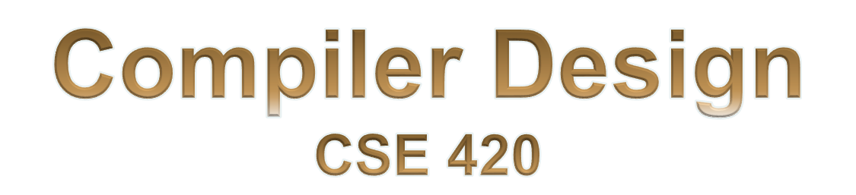

Slide 2
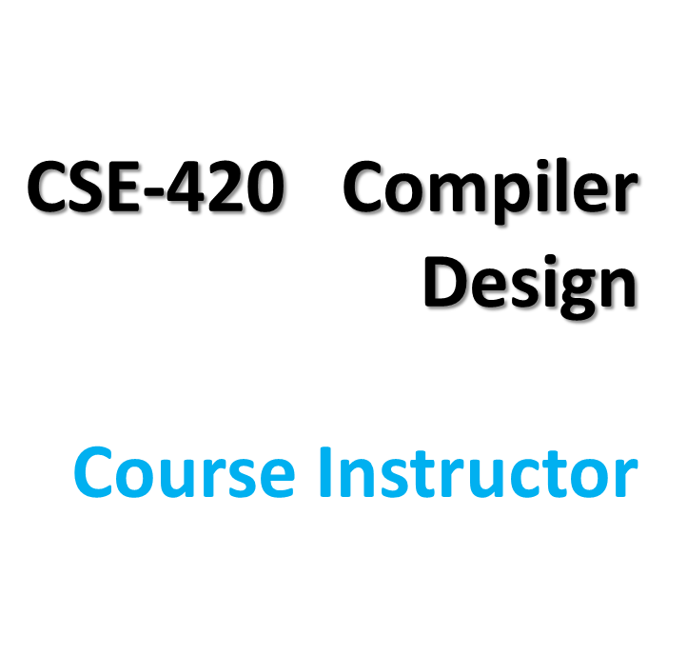
  Iffat Anjum (IFF)
  Formal Email:
    iffatanjum@cse.du.ac.bd
    iffat.16.cse@gmail.com
  Phone: 01814928290
  Piazza:
    piazza.com/university_of_dhaka/fall2017/cse420
    Access Code: cse420

Slide 3
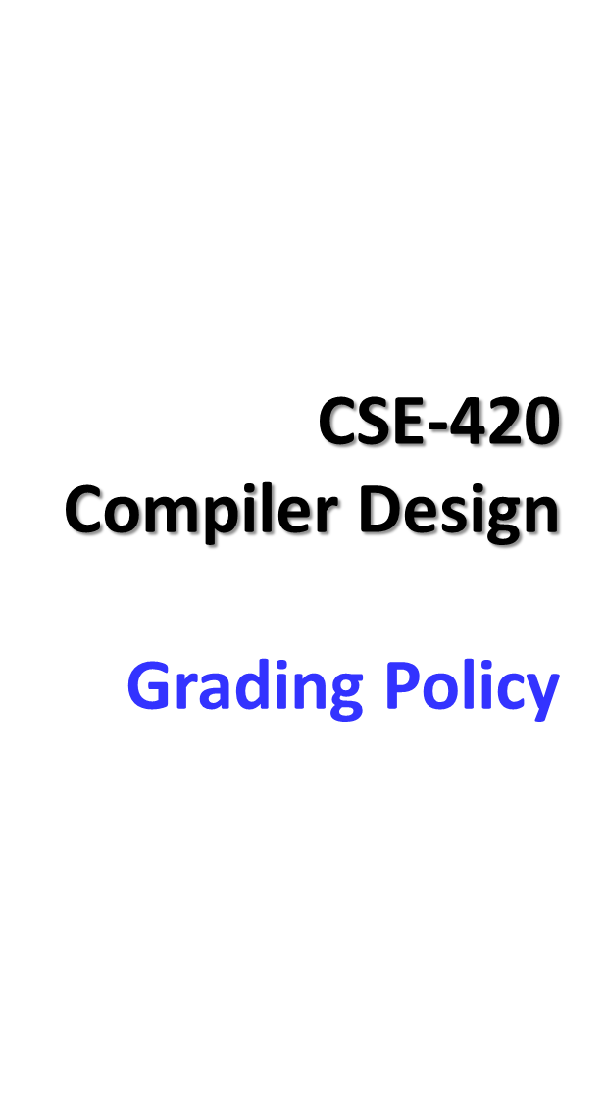
40% - Final Examination
20% - LAB performance
20% - MID Examination
5% - Assignment & Surprise Quizzes
10% - Declared Quizzes
5% - Attendance
No students will be allowed to sit for final examination if he/she has less than 70% attendance in LAB Class and less than 75% attendance in Theory Class

Slide 4
Surprise Quizzes
There will be surprise quizzes, given at the start of a lecture, during any lecture.
NO LATE or MAKEUP SURPRISE QUIZZES, under any circumstances whatsoever.
Surprise quizzes are completely individual efforts.
Your best strategy is to play it safe – attend every lecture.

Slide 5
Assignments
Assignments need to be hand-written. I will not accept typed up solutions.
Assignments are completely individual efforts.
  If two written solutions are the same or similar, both will be penalized (100% penalty for the entire assignment).
  If a written solution is similar or same as an online or other solution resource, you will be penalized (100% penalty for the entire assignment).

Slide 6
Playing it safe in
CSE-420
If you follow these 4 simple rules during the class, you'll make sure that you do well in the course:
Attend every Theory and LAB classes.
Read the course material (textbook sections assigned + slides).
Submit everything (Assignments, Quizzes, Exams) on time - don't be late.
Don't cheat.

Slide 7
Quizzes and Exams
Two Quizzes
Several Surprise Quizzes
Several Assignments
If you fail to attend any exam you will get 0 (zero) on that exam.
No makeup exams unless with documented medical emergency.
No late submission.

Slide 8
Pre-requisite Knowledge
Strong programming background in C, C++ or Java
Some background on Automata Theory (NFA, DFA, CFG) is recommended…… ……not mandatory
Assembly Language Programming and Machine Architecture

Slide 9

Become a better programmer(!)
  Insight into interaction between languages, compilers, and hardware
  Understanding of implementation techniques
  What is all that stuff in the debugger anyway?
  Better intuition about what your code does

Slide 10

Compiler techniques are everywhere
  Parsing (little languages, interpreters, XML)
  Database engines, query languages
  AI: domain-specific languages
  Text processing
    Tex/LaTex -> dvi -> Postscript -> pdf
  Hardware: VHDL; model-checking tools
  Mathematics (Mathematica, Matlab)

Slide 11

Fascinating blend of theory and engineering
  Direct applications of theory to practice
    Parsing, scanning, static analysis
  Some very difficult problems (NP-hard or worse)
    Resource allocation, “optimization”, etc.
    Need to come up with good-enough approximations/heuristics

Slide 12

Ideas from many parts of CSE
  AI: Greedy algorithms, heuristic search
  Algorithms: graph algorithms, dynamic programming, approximation algorithms
  Theory: Grammars, DFAs and PDAs, pattern matching, fixed-point algorithms
  Systems: Allocation & naming, synchronization, locality
  Architecture: pipelines, instruction set use, memory hierarchy management
A-<number>
Notes:
Au02: taken from one of Cooper’s slides

Slide 13
You might even write a compiler some day!
  You’ll almost certainly write parsers and interpreters in some context if you haven’t already
A-<number>

Slide 14

1950’s. Existence proof
  FORTRAN I (1954) – competitive with hand-optimized code
1960’s
  New languages: ALGOL, LISP, COBOL, SIMULA
  Formal notations for syntax, esp. BNF
  Fundamental implementation techniques
    Stack frames, recursive procedures, etc.

Slide 15

1970’s
  Syntax: formal methods for producing compiler front-ends; many theorems
Late 1970’s, 1980’s
  New languages (functional; Smalltalk & object-oriented)
  New architectures (RISC machines, parallel machines, memory hierarchy issues)
  More attention to back-end issues

Slide 16
1990s and beyond
  Compilation techniques appearing in many new places
    Just-in-time compilers (JITs)
    Software analysis, verification, security
  Phased compilation – blurring the lines between “compile time” and “runtime”
    Using machine learning techniques to control optimizations(!)
  Compiler technology critical to effective use of new hardware (RISC, Itanium, complex memory hierarchies)
  The new 800 lb gorilla - multicore

Slide 17
Recommended Books
Aho, Lam, Sethi, Ullman:
Compilers: Principles, Techniques, and Tools
(2nd Edition)

Slide 18
The Course covers
Compiler Basics
Lexical Analysis
Syntax Analysis
Semantic Analysis
Runtime environments
Code Generation
Code Optimization

Slide 19
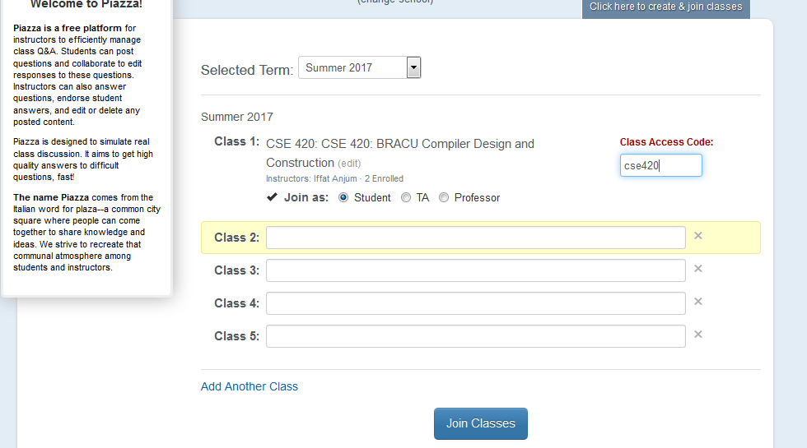

Slide 20
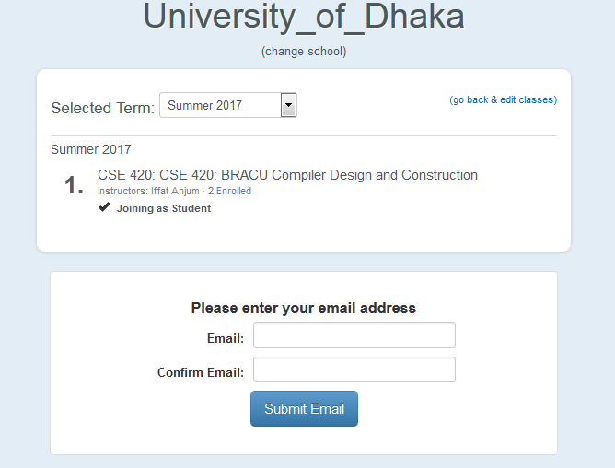

Slide 21
Question?

