Slide 1
Syntax Analysis
Or
Parsing
Lecture 04

Slide 2
Parsing
A.K.A. Syntax Analysis
  Recognize sentences in a language.
  Discover the structure of a document/program.
  Construct (implicitly or explicitly) a tree (called as a parse tree) to represent the structure.
  The above tree is used later to guide translation.

Slide 3
Parsing During Compilation
regular expressions
errors
lexical analyzer
token
rest of front end
intermediate representation
source program
parser
parse tree
get next token
symbol table
Collecting token information
Perform type checking
Intermediate code generation
uses a grammar to check structure of tokens
produces a parse tree
syntactic errors and recovery
recognize correct syntax
report errors

Slide 4
Parsing Responsibilities
Syntax Error Identification / Handling
Recall typical error types:
  Lexical : Misspellings
  Syntactic : Omission, wrong order of tokens
  Semantic : Incompatible types, undefined IDs
  Logical : Infinite loop / recursive call
Majority of error processing occurs during syntax analysis
NOTE: Not all errors are identifiable !!
    if x<1 thenn y = 5:
if ((x<1) & (y>5)))
if (x+5) then
    if (i<9) then ...
    Should be <= not <

Slide 5
Error Detection
Much responsibility on Parser
  Many errors are syntactic in nature
  Modern parsing method can detect the presence of syntactic errors in programs very efficiently
  Detecting semantic or logical error is difficult
Challenges for error handler in Parser
  It should report error clearly and accurately
  It should recover from error and continue..
  It should not significantly slow down the processing of correct programs
Good news is
  Common errors are simple and relatively easy to catch.
Errors don’t occur that frequently!!
    60% programs are syntactically and semantically correct
    80% erroneous statements have only 1 error, 13% have 2
    Most error are trivial : 90% single token error
    60% punctuation, 20% operator, 15% keyword, 5% other error

Slide 6
Adequate Error Reporting is Not a Trivial Task
Difficult to generate clear and accurate error messages.
Example
  function foo () {
  ...
  if (...) {
  ...
  } else {
  ...
  ...
  }
  <eof>
Example
  int myVarr;
  ...
  x = myVar;
  ...
Missing } here
Not detected until here
Misspelled ID here
Not detected until here

Slide 7
Error Recovery
After first error recovered
  Compiler must go on!
    Restore to some state and process the rest of the input
Error-Correcting Compilers
  Issue an error message
  Fix the problem
  Produce an executable
Example
  Error on line 23: “myVarr” undefined.
  “myVar” was used.
May not be a good Idea!!
  Guessing the programmers intention is not easy!

Slide 8
Error Recovery May Trigger More Errors!
Inadequate recovery may introduce more errors
  Those were not programmers errors
Example:
  int myVar flag ;
  ...
  x := flag;
  ...
  ...
  while (flag==0)
  ...
Too many Error message may be obscuring
  May bury the real message
  Remedy:
    allow 1 message per token or per statement
    Quit after a maximum (e.g. 100) number of errors
Declaration of flag is discarded
Variable flag is undefined
Variable flag is undefined

Slide 9
Error Recovery Approaches: Panic Mode
Discard tokens until we see a “synchronizing” token.
The key...
  Good set of synchronizing tokens
  Knowing what to do then
Advantage
  Simple to implement
  Does not go into infinite loop
  Commonly used
Disadvantage
  May skip over large sections of source with some errors
Example
  Skip to next occurrence of
  } end ;
  Resume by parsing the next statement

Slide 10
Error Recovery Approaches: Phrase-Level Recovery
Compiler corrects the program
  by deleting or inserting tokens
  ...so it can proceed to parse from where it was.
The key...
  Don’t get into an infinite loop
Example
  while (x==4) y:= a + b
  Insert do to fix the statement

Slide 11
Context Free Grammars (CFG)
A context free grammar is a formal model that consists of:
Terminals
  Keywords
  Token Classes
  Punctuation
Non-terminals
Any symbol appearing on the lefthand side of any rule
Start Symbol
Usually the non-terminal on the lefthand side of the first rule
Rules (or “Productions”)
  BNF: Backus-Naur Form / Backus-Normal Form
  Stmt ::= if Expr then Stmt else Stmt

Slide 12
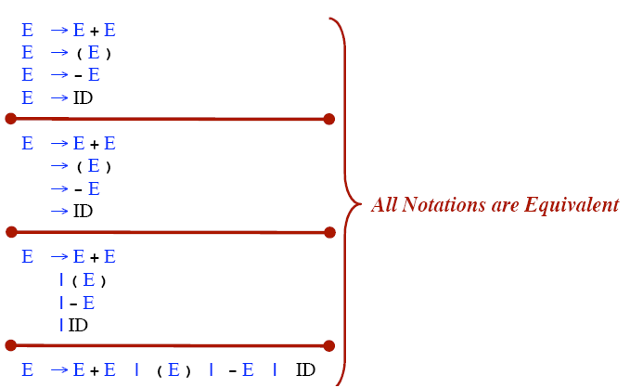
Rule Alternative Notations

Slide 13
Context Free Grammars : A First Look
assign_stmt → id := expr ;
expr → expr operator term
expr → term
term → id
term → real
term → integer
operator → +
operator → -
Derivation: A sequence of grammar rule applications and substitutions that transform a starting non-term into a sequence of terminals / tokens.

Slide 14
Derivation
Let’s derive: id := id + real – integer ;
using production:
assign_stmt assign_stmt → id := expr ;
→ id := expr ; expr → expr operator term
id := expr operator term; expr → expr operator term
id := expr operator term operator term; expr → term
id := term operator term operator term; term → id
id := id operator term operator term; operator → +
id := id + term operator term; term → real
id := id + real operator term; operator → -
id := id + real - term; term → integer
id := id + real - integer;

Slide 15
Example Grammar: Simple Arithmetic Expressions
expr → expr op expr
expr → ( expr )
expr → - expr
expr → id
op → +
op → -
op → *
op → /
op → ↑
9 Production rules
Terminals: id + - * / ↑ ( )
Nonterminals: expr, op
Start symbol: expr

Slide 16
Notational Conventions
Terminals
  Lower-case letters early in the alphabet: a, b, c
  Operator symbols: +, -
  Punctuations symbols: parentheses, comma
  Boldface strings: id or if
Nonterminals:
  Upper-case letters early in the alphabet: A, B, C
  The letter S (start symbol)
  Lower-case italic names: expr or stmt
Upper-case letters late in the alphabet, such as X, Y, Z, represent either nonterminals or terminals.
Lower-case letters late in the alphabet, such as u, v, …, z, represent strings of terminals.

Slide 17
Notational Conventions
Lower-case Greek letters, such as α, β, γ, represent strings of grammar symbols. Thus A→ α indicates that there is a single nonterminal A on the left side of the production and a string of grammar symbols α to the right of the arrow.
If A→ α₁, A→ α₂, …., A→ α_{k} are all productions with A on the left, we may write A→ α₁ | α₂ | …. | α_{k}
Unless otherwise started, the left side of the first production is the start symbol.
E → E A E | ( E ) | -E | id
A → + | - | * | / | ↑

Slide 18
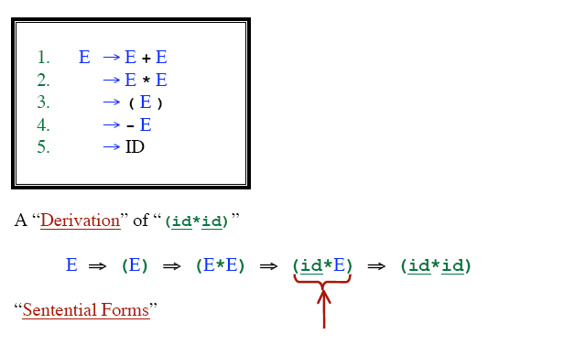
Derivations
Doesn’t contain nonterminals

Slide 19
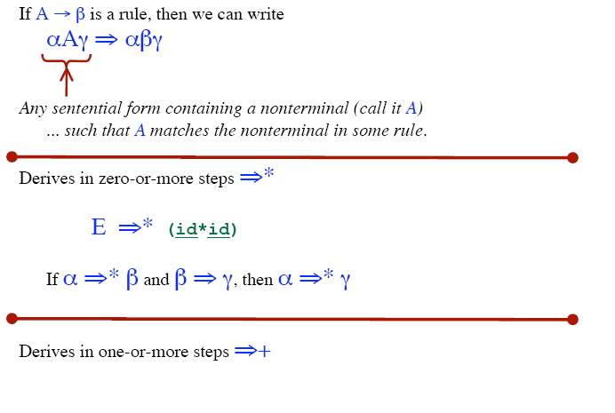
Derivation

Slide 20
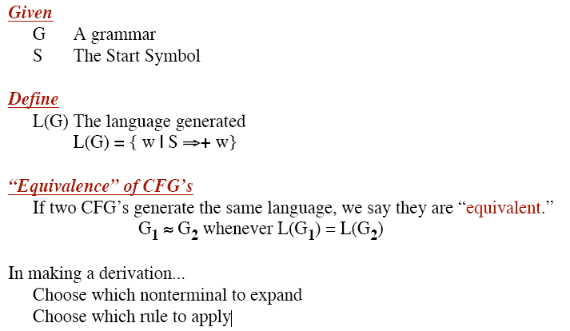

Slide 21
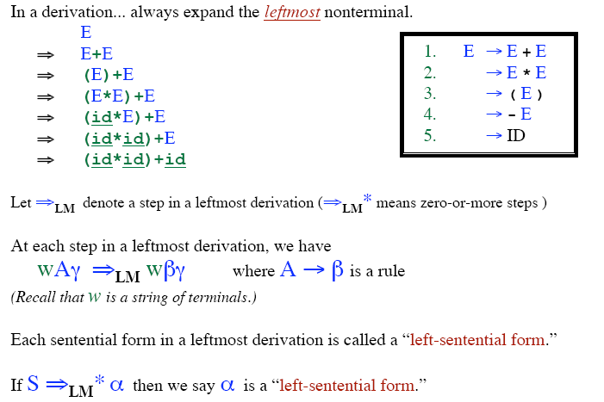
Leftmost Derivation

Slide 22
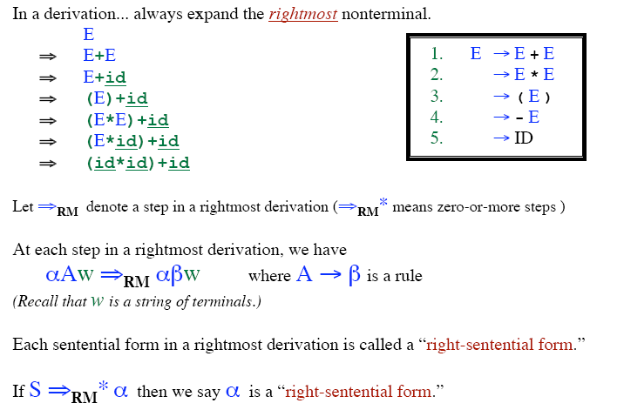
Rightmost Derivation

Slide 23
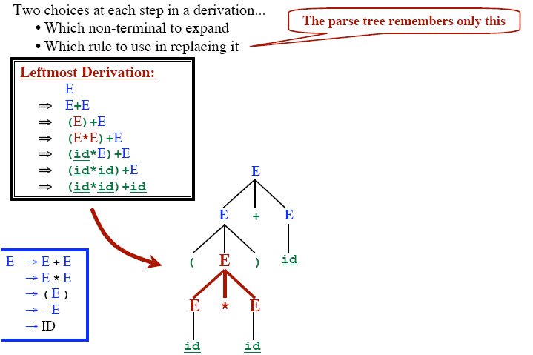
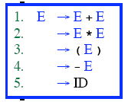
Parse Tree

Slide 24
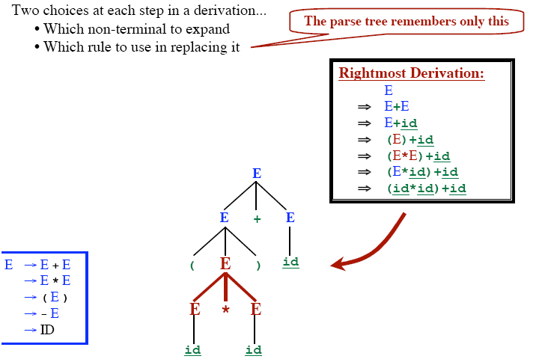
Parse Tree

Slide 25
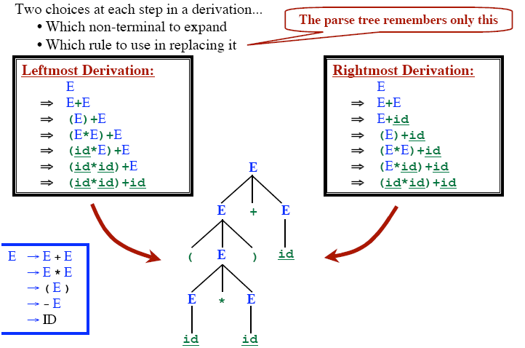
Parse Tree

Slide 26
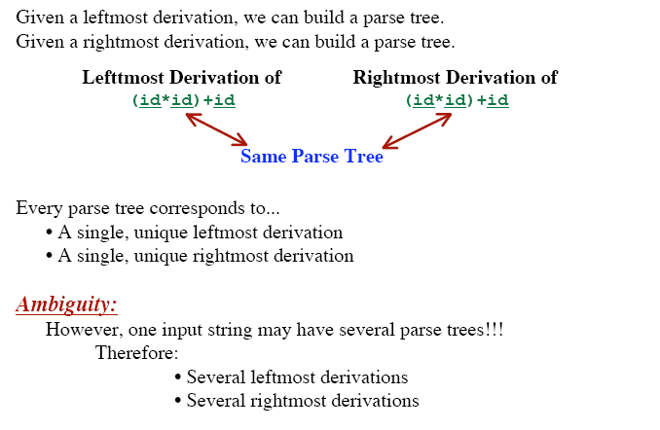
Parse Tree

Slide 27
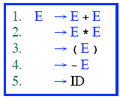
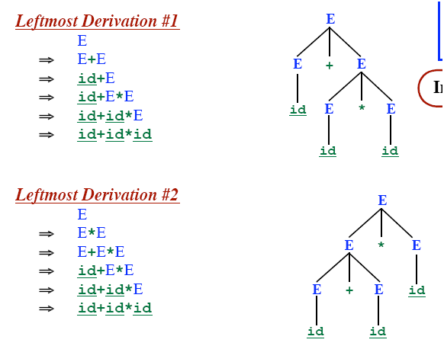

Ambiguous Grammar

Slide 28
Ambiguous Grammar
More than one Parse Tree for some sentence.
  The grammar for a programming language may be ambiguous
  Need to modify it for parsing.
Also: Grammar may be left recursive.
Need to modify it for parsing.

Slide 29
Elimination of Ambiguity
Ambiguous
A Grammar is ambiguous if there are multiple parse trees for the same sentence.
Disambiguation
Express Preference for one parse tree over others
  Add disambiguating rule into the grammar

Slide 30
Resolving Problems: Ambiguous Grammars
Consider the following grammar segment:
stmt → if expr then stmt
| if expr then stmt else stmt
| other (any other statement)
If E1 then S1 else if E2 then S2 else S3
simple parse tree:
stmt
if
expr
then
stmt
else
stmt
E₁
S₁
expr
then
stmt
else
stmt
if
E₂
S₂
S₃

Slide 31
Example : What Happens with this String?
If E₁ then if E₂ then S₁ else S₂
How is this parsed ?
if E₁ then
if E₂ then
S₁
else
S₂
if E₁ then
if E₂ then
S₁
else
S₂
vs.

Slide 32
Parse Trees: If E1 then if E2 then S1 else S2
Form 1:
stmt
if
expr
then
stmt
E₁
stmt
else
stmt
if
expr
then
E₂
S₁
S₂
Form 2:
stmt
if
expr
then
stmt
else
stmt
E₁
expr
then
stmt
S₂
if
E₂
S₁

Slide 33
Removing Ambiguity
Take Original Grammar:
stmt → if expr then stmt
| if expr then stmt else stmt
| other (any other statement)
Rule: Match each else with the closest previous unmatched then.
Revise to remove ambiguity:
stmt → matched_stmt | unmatched_stmt
matched_stmt → if expr then matched_stmt else matched_stmt | other
unmatched_stmt → if expr then stmt
| if expr then matched_stmt else unmatched_stmt

Slide 34
Resolving Difficulties : Left Recursion
A left recursive grammar has rules that support the derivation : A ⇒ Aα, for some α.
+
Top-Down parsing can’t reconcile this type of grammar, since it could consistently make choice which wouldn’t allow termination.
A ⇒ Aα ⇒ Aαα ⇒ Aααα … etc. A→ Aα | β
Take left recursive grammar:
A → Aα | β
To the following:
A → βA’
A’ → αA’ | ∈

Slide 35
Why is Left Recursion a Problem ?
Derive : id + id + id
E ⇒ E + T ⇒
Consider:
E → E + T | T
T → T * F | F
F → ( E ) | id
How can left recursion be removed ?
E → E + T | T What does this generate?
E ⇒ E + T ⇒ T + T
E ⇒ E + T ⇒ E + T + T ⇒ T + T + T
…
How does this build strings ?
What does each string have to start with ?

Slide 36
Resolving Difficulties : Left Recursion (2)
Informal Discussion:
Take all productions for A and order as:
A → Aα₁ | Aα₂ | … | Aα_{m} | β₁ | β₂ | … | β_{n}
Where no β_{i} begins with A.
Now apply concepts of previous slide:
A → β₁A’ | β₂A’ | … | β_{n}A’
A’ → α₁A’ | α₂A’ | … | α_{m} A’ | ∈
For our example:
E → E + T | T
T → T * F | F
F → ( E ) | id
E → TE’ E’ → + TE’ | ∈
T → FT’ T’ → * FT’ | ∈
F → ( E ) | id

Slide 37
Resolving Difficulties : Left Recursion (3)
Problem: If left recursion is two-or-more levels deep,
this isn’t enough
S → Aa | b
A → Ac | Sd | ∈
S ⇒ Aa ⇒ Sda
Algorithm:
Input: Grammar G with ordered Non-Terminals A₁, ..., A_{n}
Output: An equivalent grammar with no left recursion
Arrange the non-terminals in some order A₁=start NT,A₂,…A_{n}
for i := 1 to n do begin
for j := 1 to i – 1 do begin
replace each production of the form A_{i} → A_{j}γ
by the productions A_{i} → δ₁γ | δ₂γ | … | δ_{k}γ
where A_{j} → δ₁|δ₂|…|δ_{k} are all current A_{j} productions;
end
eliminate the immediate left recursion among A_{i} productions
end

Slide 38
Using the Algorithm
Apply the algorithm to: A₁ → A₂a | b| ∈
A₂ → A₂c | A₁d
i = 1
For A₁ there is no left recursion
i = 2
for j=1 to 1 do
Take productions: A₂ → A₁γ and replace with
A₂ → δ₁ γ | δ₂ γ | … | δ_{k} γ|
where A₁→ δ₁ | δ₂ | … | δ_{k} are A₁ productions
in our case A₂ → A₁d becomes A₂ → A₂ad | bd | d
What’s left: A₁→ A₂a | b | ∈
A₂ → A₂ c | A₂ ad | bd | d
Are we done ?

Slide 39
Using the Algorithm (2)
No ! We must still remove A₂ left recursion !
A₁→ A₂a | b | ∈
A₂ → A₂ c | A₂ ad | bd | d
Recall:
A → Aα₁ | Aα₂ | … | Aα_{m} | β₁ | β₂ | … | β_{n}
A → β₁A’ | β₂A’ | … | β_{n}A’
A’ → α₁A’ | α₂A’ | … | α_{m} A’ | ∈
A₁→ A₂a | b | ∈
A₂ → bdA₂’ | dA₂’
A₂’ → c A₂’ | adA₂’ | ∈
Apply to above case. What do you get ?

Slide 40
Removing Difficulties : ∈-Moves
Transformation: In order to remove A→ ∈ find all rules of the form B→ uAv and add the rule B→ uv to the grammar G.
Why does this work ?
A is Grammar ∈-free if:
It has no ∈-production or
There is exactly one ∈-production
S → ∈ and then the start symbol S does not appear on the right side of any production.
Examples:
E → TE’ E’ → + TE’ | ∈
T → FT’ T’ → * FT’ | ∈
F → ( E ) | id
A₁ → A₂ a | b
A₂ → bd A₂’ | A₂’
A₂’ → c A₂’ | bd A₂’ | ∈

Slide 41
Removing Difficulties : Cycles
How would cycles be removed ?
Make sure every production is adding some terminal(s) (except a single ∈ -production in the start NT)…
e.g.
S → SS | ( S ) | ∈
Has a cycle: S ⇒ SS ⇒ S
Transform to:
S → S ( S ) | ( S ) | ∈
S → ∈

Slide 42
Removing Difficulties : Left Factoring
Problem : Uncertain which of 2 rules to choose:
stmt → if expr then stmt else stmt
| if expr then stmt
When do you know which one is valid ?
What’s the general form of stmt ?
A → αβ₁ | αβ₂ α : if expr then stmt
β₁: else stmt β₂ : ∈
Transform to:
A → α A’
A’ → β₁ | β₂
EXAMPLE:
stmt → if expr then stmt rest
rest → else stmt | ∈

Slide 43
Any Question?

