Slide 1
Using Humans as Sensors: An Estimation-theoretic Perspective presented by Suraiya Tairin 0413052070

Slide 2
Authors
Dong Wang, Md Tanvir Amin, Shen Li, Tarek Abdelzaher, Siyu Gu, Chenji Pan University of Illinois at Urbana Champaign, Urbana, IL, USA
Lance Kaplan Networked Sensing and Fusion Branch, US Army Research Labs, Adelphi, MD, USA
Charu C. Aggarwal, Raghu Ganti IBM Research, Yorktown Heights, NY, USA
Xinlei Wang, Prasant Mohapatra University of California, Davis, CA,USA
Boleslaw Szymanski Rensselaer Polytechnic Institute, Troy, NY, USA
Hengchang Liu University of Science and Technology of China, Hefei, Anhui, China
Hieu Le Caterva, Inc. Champaign, IL, USA

Slide 3
Abstract
This paper models social networks as sensor networks.
In this model, individuals(humans) are represented by sensors (data sources).
Humans occasionally make observations (sense data) about the physical world.
These observations may be true or false

Slide 4
Abstract
The main problem is to determine the correctness of reported observations which is called reliable sensing problem.
This model is embedded into a tool called Apollo that uses Twitter as a “sensor network” for observing events in the physical world.
Twitter-based case-studies, shows good correspondence between observations deemed correct by Apollo and ground truth.

Slide 5
Why Interesting
Following problems are not well addressed/defined in traditional sensor network application:
Q1: What would happen if “sensors” are not known to the application a priori?
Q2: How to model a person as a “sensor”
Q3: How to assess the quality of the results without independent ways of verifying the reliability of sources and correctness of their measurements?
This paper address the above problems emerging in social sensing.

Slide 6
Related Work
Basic Model
Dong Wang, Lance Kaplan, Hieu Le, and Tarek Abdelzaher. "On Truth Discovery in Social Sensing: A Maximum Likelihood Estimation Approach.”
This paper described a maximum likelihood estimation approach to accurately discover the truth in social sensing applications where humans perform sensory data collection tasks.
MLE is a method of estimating the parameters of a statistical model, when applied to a data set and given a statistical model
Social (human-centric)sensing: A set of applications where data are collected from human sources or devices on their behalf.

Slide 7
Related Work
Accuracy & Bounds
Dong Wang , Lance Kaplan, Tarek Abdelzaher and Charu C. Aggarwal. "On Scalability and Robustness Limitations of Real and Asymptotic Confidence Bounds in Social Sensing .
This paper estimates new confidence bounds on source reliability in social sensing applications.
Dong Wang, Lance Kaplan, Tarek Abdelzaher and Charu C. Aggarwal. "On Credibility Tradeoffs in Assured Social Sensing.
This paper studied the fundamental accuracy trade-offs in source and claim credibility estimation in social sensing applications.

Slide 8
Related Work
Streaming Data
Dong Wang, Tarek Abdelzaher, Lance Kaplan and Charu C. Aggarwal. "Recursive Fact-finding: A Streaming Approach to Truth Estimation in Crowdsourcing Applications.”
This paper presents a streaming fact-finder approach that recursively updates previous estimates based on new data to solve the truth estimation problem in crowdsourcing applications.

Slide 9
Related Work
Claim Constraints
Dong Wang, Tarek Abdelzaher, Lance Kaplan and Raghu Ganti. "Exploitation of Physical Constraints for Reliable Social Sensing”
This paper develops and evaluates algorithms for exploiting physical constraints to improve the reliability of social sensing.

Slide 10
Problem Domain

Slide 11
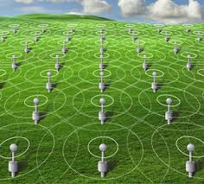

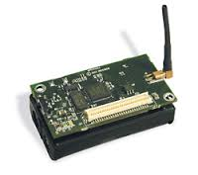
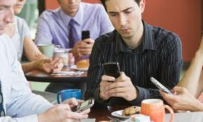
Humans as Sensors
Social Networks
Sensor Networks
Human
Sensor

Slide 12
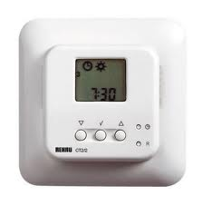

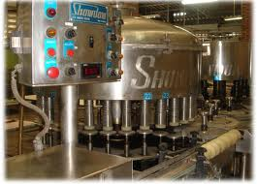

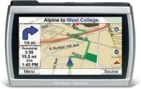



Sensing is Evolving
Platform
Sensors are increasingly used by everyday people
Smart Phone

Slide 13
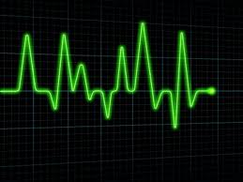
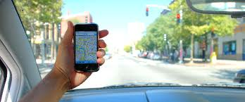
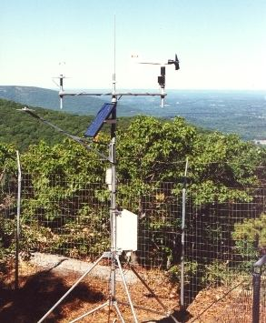
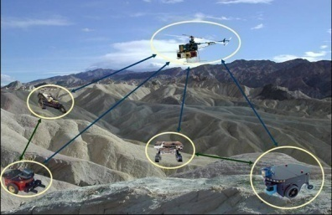


Sensing is Evolving
Platform
Sensors are increasingly used by everyday people
Smart Phone
Social (Human-Centric) Sensing is Emerging!
Application
Humans are getting into the Loop of Sensing.
Health Monitoring
Geotagging
Target Tracking
Environment
Monitoring
Smart House
Social Sensing

Slide 14
Examples of Social Sensing
Participatory sensing
interactive, participatory sensor networks that enable public and professional users to gather, analyze and share local knowledge.
Opportunistic sensing
the users may not be aware of active applications. Instead a user’s device (e.g., cell phone) is utilized whenever its state (e.g., geographic location, body location) matches the requirements of an application.

Slide 15
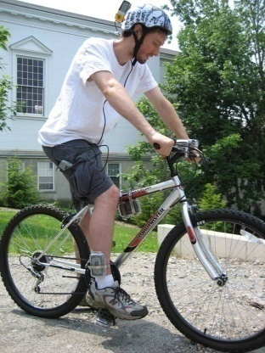


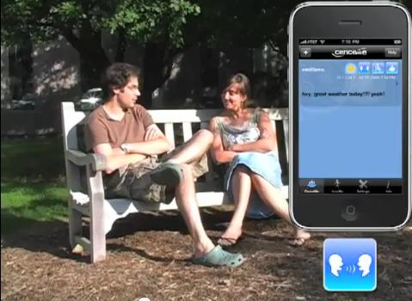
Examples of Social Sensing
Participatory Sensing
Geotagging
BikeNet
Opportunistic Sensing
CabSense
CenceMe

Slide 16
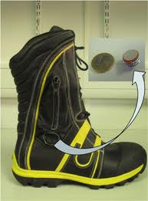
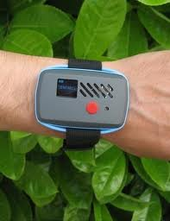
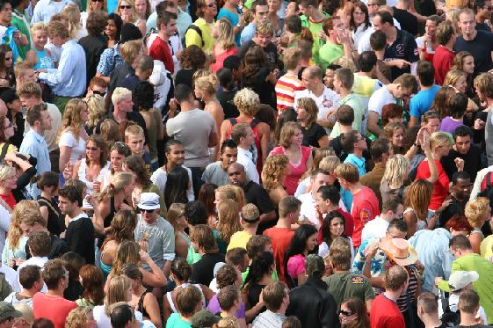




Human’s Role in Social Sensing
Human are sensor carriers
Human are sensor operators
Human are sensors themselves!

Slide 17

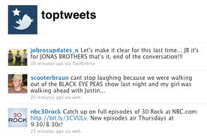


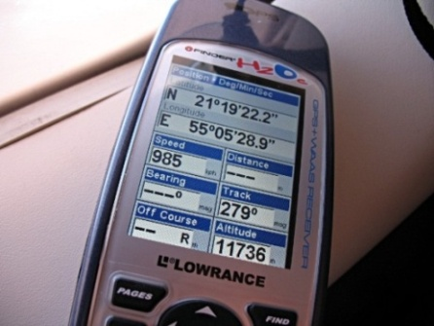
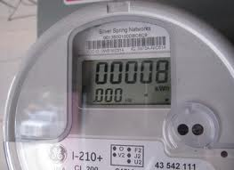
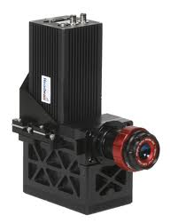

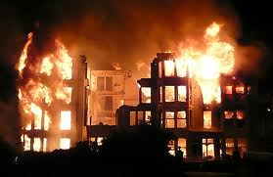
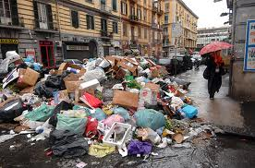


Data Reliability Problem in Social Sensing
Who to believe?
What to believe?
Text
Guaranteed Data Correctness!
1. How to Answer the above two questions?
People
Numeric data
2. How to Assess the Quality of our answers ?
Smart Devices
Images
Sources
Measurements

Slide 18
Binary Sensor Model
This paper model humans as sources of
(i) unknown reliability, generating
(ii) binary observations of
(iii) uncertain provenance.

Slide 19
Binary Sensor Model
The reliability of human observers is unknown and hence cannot be assumed.
Human observations is considered as measurements of different binary variables. They are binary because the observation reported can either be true or false.

Slide 20
Binary Sensor Model
This model generalize the participatory sensing.
Each human reports an arbitrary number of observations called claims.
Uncertain data provenance-a person to report observations they received from others, rumor spreading.

Slide 21
Binary Sensor Model
The physical world is just a collection of mention-worthy facts.
“Main Street is flooded”
“The BP gas station on University Ave. is out of gas”
“Police are shooting people on Market Square”

Slide 22
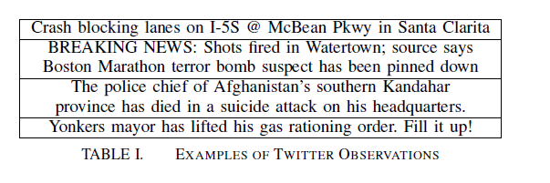

Slide 23
Solution Architecture

Slide 24
Solution Architecture
Collect data from the “sensor network”.
Structure the data for analysis (Source-Claim Graph)
Understand how sources are related (Social Dissemination Graph).
Use this collective information to estimate the probability of correctness of individual observations (Maximum Likelihood Estimation).

Slide 25
Solution Architecture
Collect data from the “sensor network” Twitter
Apollo can collect data from any participatory sensing front end, such as a smart phone application.
Tweets are collected through a long-standing query via the exported Twitter API to match given query terms (keywords) and an indicated geographic region on a map.
Apollo acts as the “base station” for a participatory sensing network.

Slide 26
Source-claim Graph
Collected Human observations are clustered based on a distance function.
This function, distance (t1, t2)
takes two reported observations, t1 and t2, as input
Returns a measure of similarity between them, represented by a logical distance.
The more dissimilar the observations, the larger the distance.

Slide 27
Source-claim Graph
In Twitter
individual tweets → individual observations
distance function that returns a measure of similarity based on the number of matching tokens in the two inputs.

Slide 28
Source-claim Graph
The set of input observations is transformed to a graph where vertices are individual observations and links represent similarity among them.
Cluster the graph, causing similar observations to be clustered together.
Each cluster is called a claim.

Slide 29
Source-claim Graph
Human Observations (tweets)
Claim (cluster)
Similarity between two tweets
Claim

Slide 30
Source-claim Graph
The claim represents a piece of information that several sources(humans) reported.
Construct graph where each claim(cluster) is connected to all sources who claimed it. This graph is a source-claim SC graph

Slide 31
Source-claim Graph
Source
C2
S3
C1
Claim
C3
S1
C2
C4
C2
S2

Slide 32
Source-claim Graph
Participant (or Source)
S₃
C₁₉
Claim [Binary: True or False]
S₁₈
C₂
Fact-Finding
S₁
C₁
…
…
S₆
C₈
S₂
C₂
Source Reliability
Claim Correctness
S₃
C₃
…
…
# of True claims /Total # of claims from a participant
Probability a claim is true
S_{i}C_{j}=1
S_{i}
C_{j}
S_{i}C_{j+1}=0
S_{i+1}
C_{j+1}
S_{M}
Observation Matrix
C_{N}

Slide 33
Social Dissemination Graph
Social information dissemination graph, SD, that estimates how information might propagate from one person to another.
We consider three types of SD graph.
Follower-Followee
Construct FF graph based on the follower-followee relationship.
A directed link (S_{i}, S_{k}) exists in the SD graph from source S_{i} to source S_{k} if S_{k} is a follower of S_{i}.

Slide 34
Social Dissemination Graph
Retweeting behavior of twitter users
Construct the graph RT from the retweeting behavior of twitter users.
a directed link (S_{i,} S_{k}) exists in the SD graph if source S_{k} retweets some tweets from source S_{i} .
Follower-Followee+ Retweeting
forming a RT+FF graph where a directed link (S_{i}, S_{k}) exists when either S_{k} follows S_{i} or S_{k} retweets what S_{i} said.

Slide 35

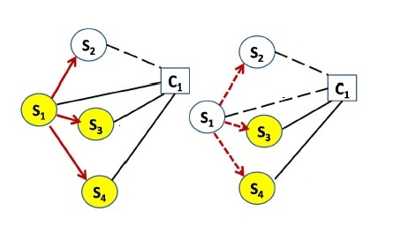
Social Dissemination Graph

Slide 36
Basics of Maximum Likelihood Estimation
Maximum Likelihood Estimation is a method of estimating the parameters of a statistical model, when applied to a data set and given a statistical model

Slide 37
Basics of Maximum Likelihood Estimation
A Simple Example:
A random number generator G(T):
It can generate a random integer in [1,T] with a uniform probability distribution
Question:
If T only has two possible values: 10 and 20, we run G(T) once, the generate number is 5. What is the most likely value of T?

Slide 38
Basics of Maximum Likelihood Estimation
A Simple Example:
A random number generator G(T):
It can generate a random integer in [1,T] with a uniform probability distribution
Question:
If T can be any integer value, we run G(T) once, the generate number is still 5. What is the most likely value of T?
MLE: Make the guess of the estimated parameters for which the observed data is least surprising!

Slide 39
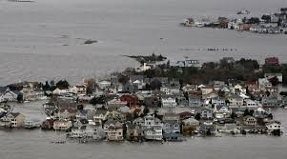
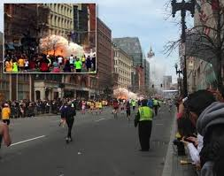

Maximum Likelihood Estimation
Measured Variables
# of True variables /Total # of variables a source reports
Events
Sources
Maximum Likelihood Estimation
Hurricane Sandy
Reliability of sources
Correctness of variables
Unknown a priori!
…
Boston Marathon
Explosion
Probability a measured variable is true
Attribute:
Reliability
Attribute:
True/False
Egypt President
Arrest

Slide 40
Maximum Likelihood Estimation
A maximum likelihood estimator finds the values of the unknowns that maximize the probability of observations, SC, given the social network SD.

Slide 41

Maximum Likelihood Estimation
Basic Definition
True Measured Variable
Reliability of Participant i
i
i
i
False Measured Variable
i
i
Speak Rate of Participant i
All
All

Slide 42
Maximum Likelihood Estimation
Basic Definition
True Measured Variable
False Measured Variable
d
ss
d= P(C_{j} = 1)
a_{i}
b_{i}

Slide 43




Maximum Likelihood Estimation
Find θ that maximizes, P(SC|SD, θ)
Vector θ
For S_{i} 1≤ i ≤m
Z={z₁, z₂, …z_{N}} where z_{j} =1 when assertion C_{j} is true and 0 otherwise
Solve this problem by Expectation maximization (EM) algorithm
Expectation Maximization
Estimation parameter
Observed data
Hidden Variable

Slide 44

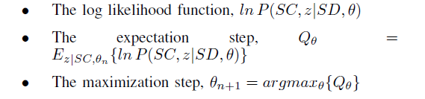
Expectation Maximization
Background and Problem Formulation
Expectation Maximization
EM algorithm starts with some initial guess for θ, say θ₀ and iteratively update it using the formula:
Above equation breaks down into 3 quantities that need to be derived:

Slide 45
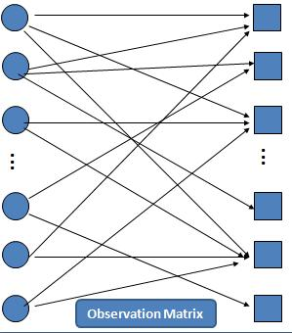

Expectation Maximization
Z={z₁, z₂, …z_{N}} where z_{j} =1 when assertion C_{j} is true and 0 otherwise
Observation Matrix
SC
Apply EM
Find MLE of estimation parameter and values of hidden variables
45

Slide 46
Maximum Likelihood Estimation
Source Reliability
Measured Variable Correctness
S₁
C₁
Find the “unknown” values of variables, θ, that maximize the probability of observations
S₂
C₂
S₃
C₃
…
…
S_{i}C_{j}=1
S_{i}
C_{j}
S_{i}C_{j+1}=0
S_{i+1}
C_{j+1}
S_{M}
C_{N}
Observation Matrix, SC

Slide 47

Maximum Likelihood Estimation
Source Reliability
Measured Variable Correctness
S₁
C₁
Find the “unknown” values of variables, θ, that maximize the probability of observations
S₂
C₂
S₃
C₃
…
…
S_{i}C_{j}=1
Maximize:
S_{i}
C_{j}
S_{i}C_{j+1}=0
S_{i+1}
C_{j+1}
Continuous unknowns that depend on discrete unknowns, z?
S_{M}
C_{N}
Observation Matrix, SC

Slide 48

Maximum Likelihood Estimation
Source Reliability
Measured Variable Correctness
S₁
C₁
Find the “unknown” values of variables, θ, that maximize the probability of observations
S₂
C₂
S₃
C₃
…
…
S_{i}C_{j}=1
Maximize:
S_{i}
C_{j}
S_{i}C_{j+1}=0
S_{i+1}
C_{j+1}
Continuous unknowns that depend on discrete unknowns, z?
S_{M}
C_{N}
Observation Matrix, SC

Slide 49

Maximum Likelihood Estimation
Source Reliability
Measured Variable Correctness
S₁
C₁
Find the “unknown” values of variables, θ, that maximize the probability of observations
S₂
C₂
S₃
C₃
…
…
Maximize:
S_{i}C_{j}=1
Variable correctness
Source reliability
S_{i}
C_{j}
S_{i}C_{j+1}=0
S_{i+1}
C_{j+1}
Continuous unknowns that depend on discrete unknowns, z?
S_{M}
C_{N}
Observation Matrix, SC

Slide 50

Maximum Likelihood Estimation
Joint probability of all observations involving claim Cj
The probability that source S_{i} makes claim Cj given that his parent S_{k} (in the social dissemination SD network) makes that claim.

Slide 51
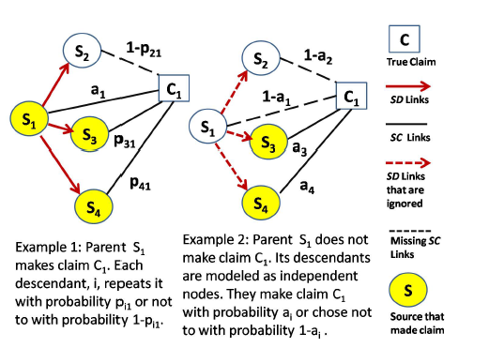
Maximum Likelihood Estimation
The joint probability that a parent Sp and its children Si make the same claim is

Slide 52
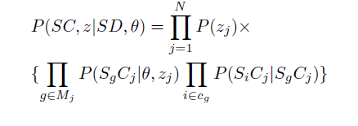
Maximum Likelihood Estimation
when considering claim Cj
sources can be divided into a set Mj of independent subgraphs,
where a link exists in subgraph g ϵ Mj between a parent and child only if they are connected in the SD graph & the parent claimed Cj
S_{g} denote the parent of subgraph g and c_{g} denote the set of its children, then likelihood function of EM

Slide 53
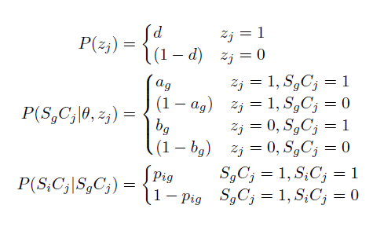
Maximum Likelihood Estimation

Slide 54




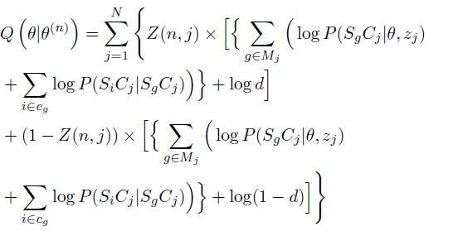
Expectation Maximization
Solution
Likelihood function of EM
Expectation Step (E-Step)
Z(n, j) is the conditional probability of claim Cj to
be true given the observed source claim subgraph SCj and current estimation on θ.

Slide 55
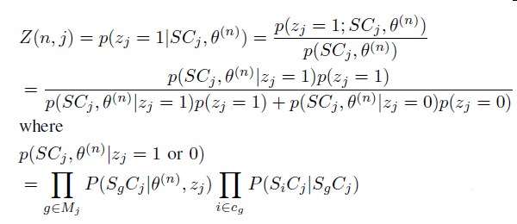
E-Step

Slide 56
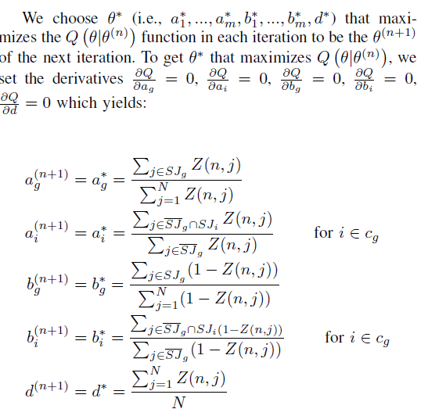
Maximization Step (M-Step)
where N is the total number of claims in the source claim
graph SC.
SJ_{g} denotes the set of claims the group parent Sg makes in SC,
SJ_{g} ʹ denotes the set of claims Sg does not make

Slide 57
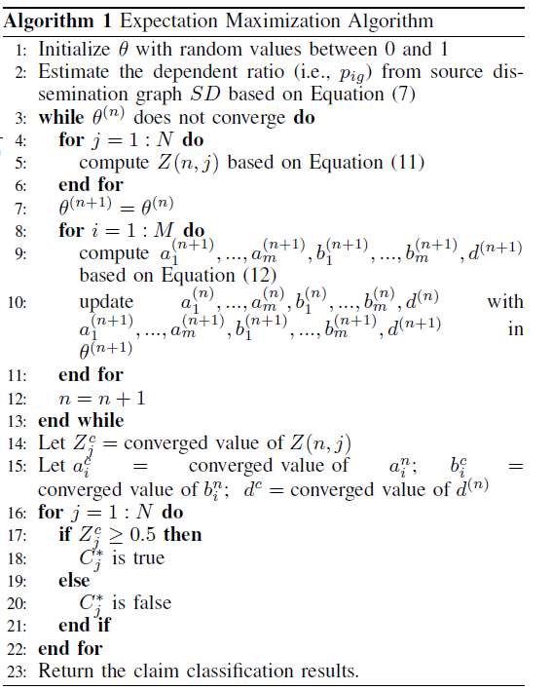
Algorithm

Slide 58
Performance Evaluation
Simulations:
Regular EM
Apollo-social FF
Apollo-social RT
Apollo-social FF+RT
Apollo-social EC
Voting
Voting No-RT
Regular EM-AD
Raw Tweets

Slide 59
Performance Evaluation
We select three such events of different sizes.
The first was collected by Apollo during and shortly after hurricane Sandy, from around New York and New Jersey in October/November 2012.
The second was collected during hurricane Irene, one of the most expensive hurricanes that hit the Northeastern United States in August 2011.
The third one was collected from Cairo, Egypt during the violent events that led to the resignation of the former president in February 2011.

Slide 60
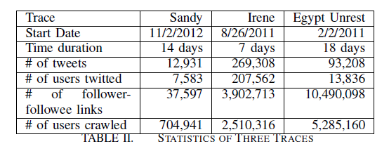
Performance Evaluation

Slide 61
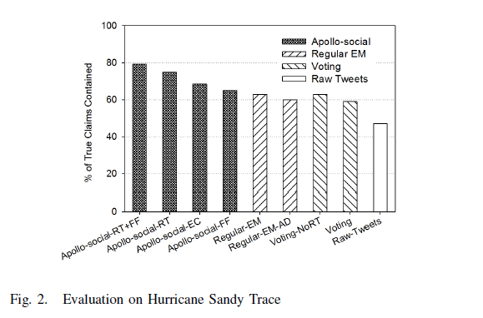
Perfornamce Evaluation

Slide 62
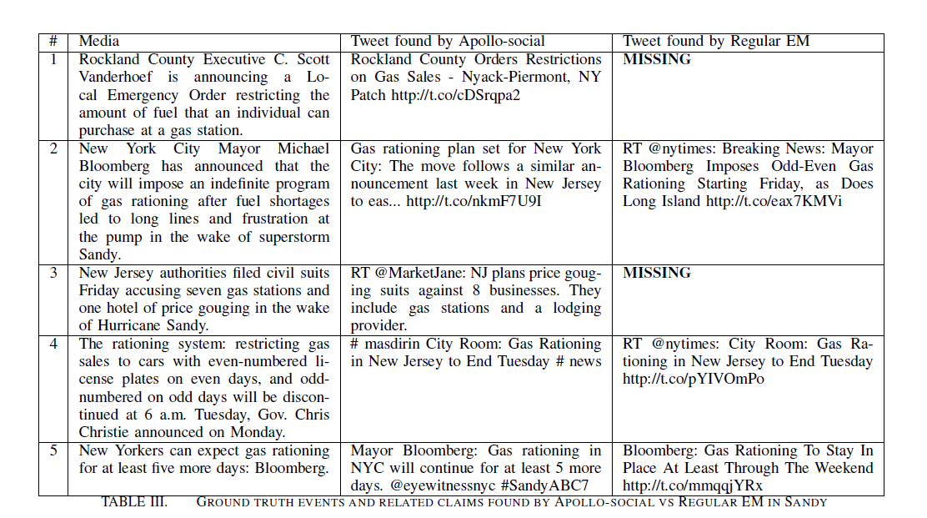

Slide 63
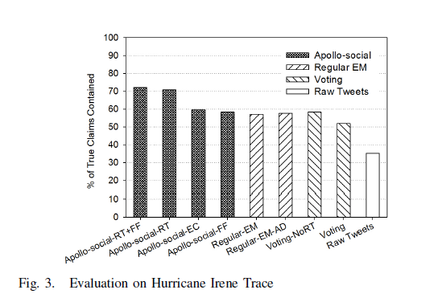
Performance Evaluation

Slide 64
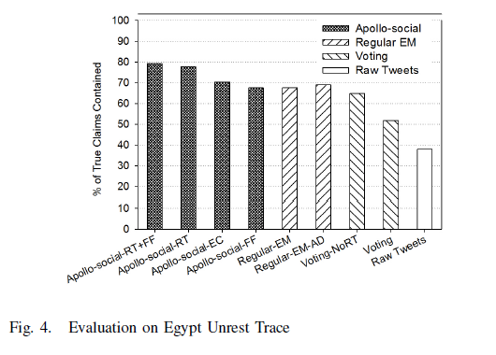
Performance Evaluation

Slide 65
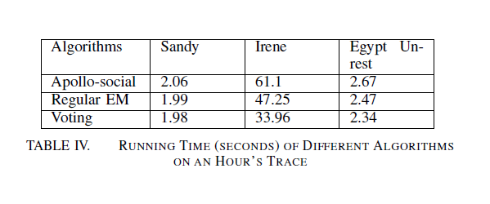
Performance

Slide 66
Limitations
Claims are assumed to be binary
Extend the framework to handle non-binary claims
Estimation framework explicitly model the claims that have multiple mutually exclusive values.
generalize model to better handle claims that have continuous values.
This model does not deal with dynamics.
When the network changes over time, how best to account for it in maximum likelihood estimation?

Slide 67
Conclusion
This paper presented an exercise in modeling social networks as sensor networks.
A minimalist model was presented and its performance was evaluated.
presented a maximum likelihood solution to the sensing problem that is novel in addressing both of the source reliability and claim correctness.
This model offers sufficient accuracy in properly ascertaining the correctness of claims of human sources

Slide 68
References
D. Wang, L. Kaplan, and T. Abdelzaher. Maximum likelihood analysis of conflicting observations in social sensing. ACM Transactions on Sensor Networks (ToSN), Vol. 10, No. 2, Article 30, January, 2014
D. Wang, L. Kaplan, H. Le, and T. Abdelzaher. On truth discovery in social sensing: A maximum likelihood estimation approach. In The 11th ACM/IEEE Conference on Information Processing in Sensor Networks(IPSN 12), April 2012.
D. Wang, L. Kaplan, T. Abdelzaher, and C. C. Aggarwal. On scalability and robustness limitations of real and asymptotic confidence bounds in social sensing. In The 9th Annual IEEE Communications Society Conference on Sensor, Mesh and Ad Hoc Communications and Networks (SECON 12), June 2012.
D. Wang, L. Kaplan, T. Abdelzaher, and C. C. Aggarwal. On credibility tradeoffs in assured social sensing. IEEE Journal On Selected Areas in Communication (JSAC), 2013

Slide 69
References
Dong Wang, Tarek Abdelzaher, Lance Kaplan and Charu C. Aggarwal. Recursive Fact-finding: A Streaming Approach to Truth Estimation in Crowdsourcing Applications. 33rd International Conference on Distributed Computing Systems (ICDCS 13) Philadelphia, PA, July 2013.
Dong Wang, Tarek Abdelzaher, Lance Kaplan and Raghu Ganti. Exploitationof Physical Constraints for Reliable Social Sensing, IEEE34th Real-Time Systems Symposium (RTSS’13)Vancouver, Canada, December, 2013
J. Burke et al. Participatory sensing. In Workshop on World-Sensor-Web (WSW): Mobile Device Centric Sensor Networks and Applications, pages 117134, 2006.
N. D. Lane, S. B. Eisenman, M. Musolesi, E. Miluzzo, and A. T. Campbell. Urban sensing systems: opportunistic or participatory? In Proceedings of the 9th workshop on Mobile computing systems and applications, HotMobile 08, pages 1116, New York, NY, USA, 2008.ACM.

Slide 70
Thank you

