Slide 1

Energy Efficient Local Search Based Target Localization in an UWSN
IEEE International Conference on Wireless and Mobile Computing, Networking and Communications (WiMob), NY, USA, 2016
Nazia Majadi, Mahmuda Naznin, Toufique Ahmed
Bangladesh University of Engineering and Technology
Bangladesh

Slide 2
Overview
Introduction
Motivation
Background Study
Problem Domain
Methodology
Experimental Results
Conclusion

Slide 3
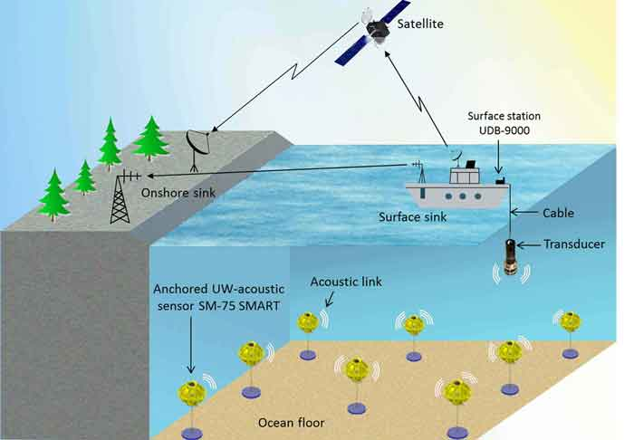
Under Water Sensor Network (UWSN)
In an UWSN, sensor nodes are deemed to enable various acoustic applications such as:
oceanographic data collection,
pollution monitoring,
offshore exploration,
disaster prevention,
navigation monitoring,
tactical surveillance applications, etc.
Characteristics of UWSN:
Under water deployment;
Communicate through acoustic medium;
Higher power consumption in underwater communication;
Sensors are relatively expensive and not replaceable.
Fig. 1: A typical scenario of UWSN [25]

Slide 4
Challenges of UWSN
Radio Frequency (RF) communication is impossible;
High propagation delay;
Bandwidth limitation;
Multi-path fading problems;
High error rates;
Limited battery power;
Underwater sensors are prone to failures.

Slide 5
Tracking a moving target in UWSN
It is a challenging task, because-
Resource constraints
if we want to track a target better, we have to keep more sensors active which ultimately consumes energy. On the contrary, if we want to save the energy of sensors by keeping more sensors in sleep mode, it may degrade tracking quality.
In this paper, we address this challenging problem, and provide an energy aware tracking method for UWSNs.

Slide 6
Problem Motivation
The research challenges are as follows:
Who will send data?
Is it realistic to keep all the sensors of the network area always active?
How many sensors are enough to keep active for tracking target?
What should be the criteria to select those sensors who will detect the target?
Is it possible to play different roles by the sensors based on the workload so that energy consumption can be minimized?

Slide 7
Background Study
In 2007, Zhou et al. [31] proposed a method to estimate the location of a low visibility moving target in an UWSN.
This method only detects the presence of the target
Their method is not energy efficient
Their method is applicable for only a low-visibility target
In 2008, Chang Ho Yu et al. [5] incorporated an energy saving scheme for detecting and tracking of a moving object in an UWSN.
They randomly select any sensor node as computing node which is not load balancing.
In 2011, Isbitiren and Akan [13] proposed an underwater target tracking algorithm to find the location of the target.
The authors keep the nodes near network boundary as active nodes. They detect the entrance of the target in the network area. Boundary nodes run out of power quickly which can cause network cut.

Slide 8
Research Objective
To design a load balanced tracking technique which reduces the energy consumption of UWSN;
To incorporate 3D features of the under water network for realistic target position estimation.

Slide 9
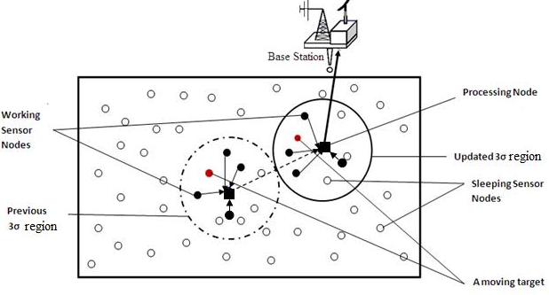
The System Model
A. Three-sigma (3σ) Region
For a normal distribution, nearly all values lie within 3 standard deviations of the mean.
B. Working Sensor Nodes (WN)
In 3σ region the selected sensor nodes to sense the target
The System Model

Slide 10
The System Model (contd.)
C. Processing Sensor Nodes (PN)
Selected based on the remaining energy
Less power consumption
Tasks:
Collection and fusion of the tracked data from all working sensor nodes in the 3σ region;
Transmission of the aggregated fused data to another node or to the base station.
D. Sleeping Sensor Node (SN)
Do not participate in the target detection and tracking and are in ‘sleep mode’
Fig. 2: 3σ Region, WNs, PNs and SNs

Slide 11
Assumptions
The following assumptions are considered for our research:
A target can enter into the sensing field from any point on the boundary;
All sensor nodes are capable to relay target information to the base station or to the other computational nodes.

Slide 12
Scenario of Tracking Target
G
F
C
A
D
B
E
Fig. 3: A target tracking scenario

Slide 13
Scenario of Tracking Target (contd…)
Estimate at t
G
F
C
D
B
E
A
A Tracking Framework

Slide 14
Scenario of Tracking Target (contd…)
Estimate at t+1
Estimate at t
G
F
C
D
B
E
A
A Tracking Framework

Slide 15
Scenario of Tracking Target (contd…)
Estimate at t+1
Updated Estimate at t+1
Estimate at t
G
F
C
D
E
A
B
F A target tracking scenario

Slide 16
Scenario of Tracking Target (contd…)
Estimate at t+1
Updated Estimate at t+1
Estimate at t
G
F
C
D
E
A
B
A Tracking Framework

Slide 17
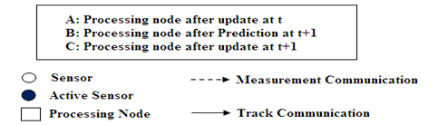
Scenario of Tracking Target (contd…)
Estimate at t+1
Updated Estimate at t+1
Estimate at t
G
F
C
D
E
A
B
A Tracking Framework

Slide 18
Energy-AwareTarget Tracking Methodology
Our proposed tracking technique (ETRACK) consists of the following major
Step 1: Selection of the PN
Step 2 : Selection of WNs
Step 3: Target location estimation by WNs
Step 4: WNs send their data to the PN
Step 5: The PN processed the data and forwards to the next PN or to the base station.

Slide 19
Energy Saving Scheme
Possible Working Nodes (WNs) Selection Phase
A feasible solution is built with WN.
The next WN to be added based on a greedy function that measures the near-term benefit of selecting each WN.
Possible WNs List (PWNL).
Local Search Phase
The solutions generated by the possible WNs phase are not guaranteed to be locally optimal.
Hence, it is almost always beneficial to apply a local search to improve each constructed solution.

Slide 20
An Example of Node Selection

Slide 21
An Example of Node Selection (contd…)
Possible WNs Selection Phase
A node is selected based on remaining energy. ‘Rectangle’ represents Processing Node (PN)
3σ

Slide 22
An Example of Node Selection (contd…)
Possible WNs Selection Phase
1
3
2
9
8
4
10
5
6
7

Slide 23
An Example of Node Selection (contd…)
Possible WNs Selection Phase or Feasible Solution Phase
Active Sensor List (ASL):
1
3
1
2
9
8
4
10
5
6
7

Slide 24
An Example of Node Selection (contd…)
Feasible Solution Phase
Active Sensor List (ASL) :
1
1
3
2
9
8
4
10
5
6
Possible Working Nodes List (PWNL):
7
3
6
7
5

Slide 25
An Example of Node Selection (contd…)
Feasible Solution Phase
Active Sensor List (ASL) :
1
1
3
2
9
8
4
10
5
6
Possible Working Nodes Node List (PWNL):
7
3
6
7
5

Slide 26
An Example of Node Selection (contd…)
Feasible Solution Phase
Active Sensor List (ASL) :
1
6
1
3
2
9
8
4
10
5
Let, Possible Working Nodes Node List (PWNL):
6
7
3
8
9
7

Slide 27
An Example of Node Selection (contd…)
Feasible Solution Phase
Active Sensor List (ASL) :
1
6
1
3
2
9
8
4
10
5
Possible Working Nodes Node List (PWNL):
6
7
3
8
9
7

Slide 28
An Example of Node Selection (contd…)
Feasible Solution Phase
Active Sensor List (ASL) :
1
6
3
1
3
2
9
8
4
10
5
Possible Working Nodes Node List (PWNL):
6
7
8
4
5
7

Slide 29
An Example of Node Selection (contd…)
Feasible Solution Phase
Active Sensor List (ASL) :
1
6
3
1
3
2
9
8
4
10
5
6
Possible Working Nodes Node List (PWNL):
7
8
4
5
7

Slide 30
An Example of Node Selection (contd…)
Feasible Solution Phase
Active Sensor List (ASL) :
1
6
3
5
1
3
2
9
8
4
10
5
6
7

Slide 31
An Example of Node Selection (contd…)
Local Search Phase
Active Sensor List (ASL) :
In the sensing range of Node 1, there is Node 8 that needs low power to track the target.
Therefore, Node 1 is replaced by Node 8.
1
6
3
5
1
3
2
9
8
4
10
5
6
7

Slide 32
An Example of Node Selection (contd…)
Local Search Phase
Active Sensor List (ASL) :
In the sensing range of Node 6, there is no other node.
Therefore, Node 6 is not replaced by any node.
8
6
3
5
1
3
8
2
9
4
10
5
6
7

Slide 33
An Example of Node Selection (contd…)
Local Search Phase
Active Sensor List (ASL) :
In the sensing range of Node 3, there are Node 2 and Node 4. Node 2 needs low power to track the target among Node 3 and Node 4.
Therefore, Node 3 is replaced by Node 2.
1
6
3
5
1
3
8
2
9
4
10
5
6
7

Slide 34
An Example of Node Selection (contd…)
Local Search Phase
Active Sensor List (ASL) :
In the sensing range of Node 5, there is Node 4 that needs low power to track the target than Node 5.
Therefore, Node 5 is replaced by Node 4.
1
6
2
5
1
3
8
2
9
4
10
5
6
7

Slide 35
An Example of Node Selection (contd…)
Local Search Phase
Active Sensor List (ASL) :
1
6
2
4
1
3
8
2
9
4
10
5
6
7

Slide 36
An Example of Node Selection (contd…)
Local Search Phase
After Feasible Solution
and Local Search phase
The Solution is:
1
2
3
8
9
4
1
6
2
4
10
5
6
7

Slide 37
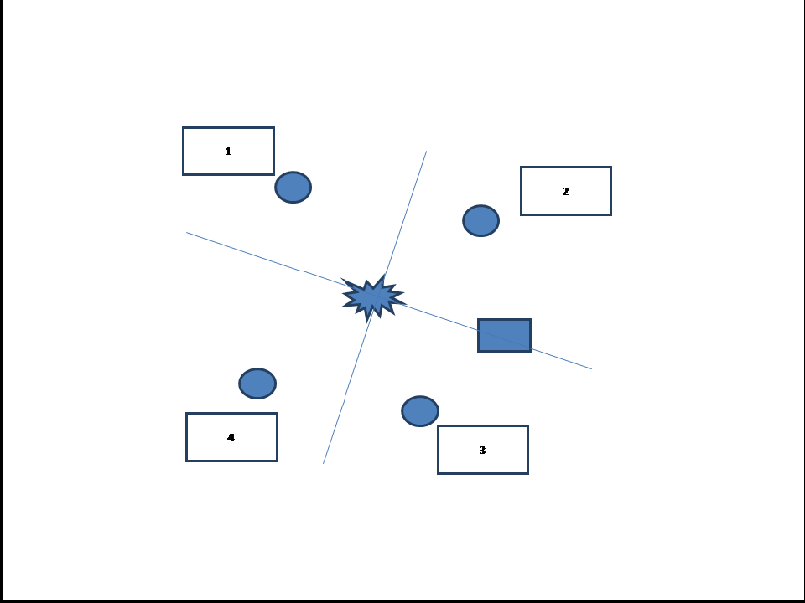
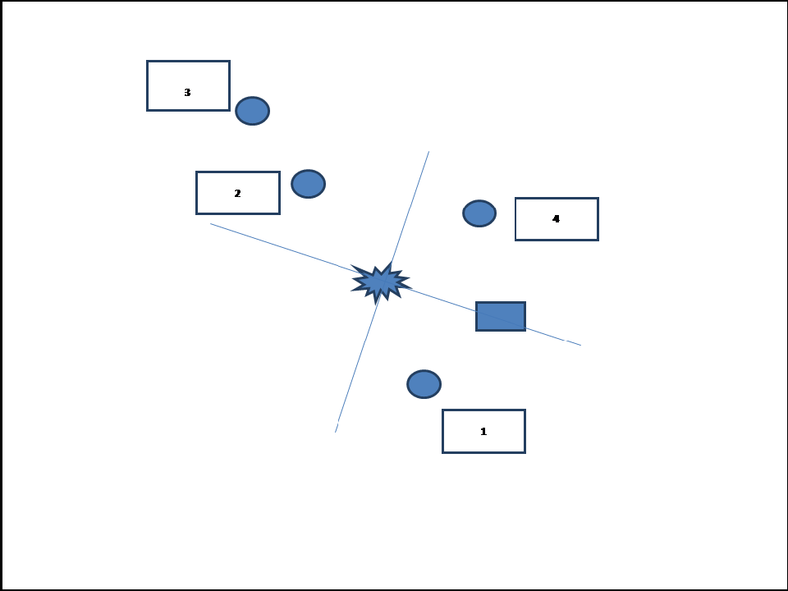
Observation
It is only possible to find the optimal
solution if the nodes in a convex
network area are uniformly
distributed.

Slide 38
Target Location Estimation
For estimating a moving target, we use Kalman Filter [14, 32].
It minimizes the mean squared error at each iteration
Why Kalman Filter (KF)?
Only the state mean and covariance are needed to be propagated from one processing node to the next processing node.
This requires less data transmission which provides the longer network lifetime.

Slide 39
Target Location Estimation (contd…)
At the k^{th} time step, the state vector X(k) is defined as [5],
where a target is located in (x, y, z) coordinate with (x’, y’, z’) velocity.
The state dynamics equation is given by [16],
X(k+1)=ФX(k)+τw(k)
where Ф is the state transition matrix, τ is the process noise matrix, and w(k) is the independent process noise with zero-mean, white, Gaussian probability distribution N(0,Q(k)).

Slide 40
Target Location Estimation (contd…)
The process noise covariance matrix is:
where q is the intensity of the process noise, and T is the time interval between two sampling instances.

Slide 41
Measurement Model
Sensors s₁,s₂,…,s_{N} provide the measurements z₁(k), z₂(k),…,z_{N}(k) at the k^{th} time step, the measurement model is given by
where H is a measurement function of sensor s_{i}, and v_{i}(k) is its measurement noise which is assumed to be independent with zero-mean, white, Gaussian probability distributions N(0, R_{i}(k))

Slide 42
Measurement Model (contd…)
We keep four sensors to active for target tracking.
Suppose, four sensor nodes s₁, s₂, s₃, s₄ provide the measurements z₁(k), z₂(k), z₃(k), z₄(k) at the k^{th} time step, the measurement model is given by,

Slide 43
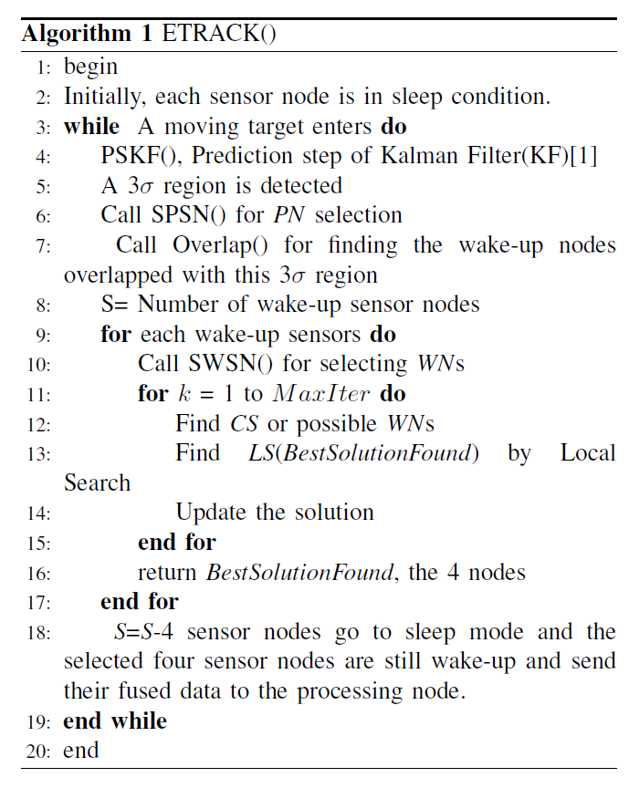
Algorithm of ETRACK
ETRACK Algorithm

Slide 44
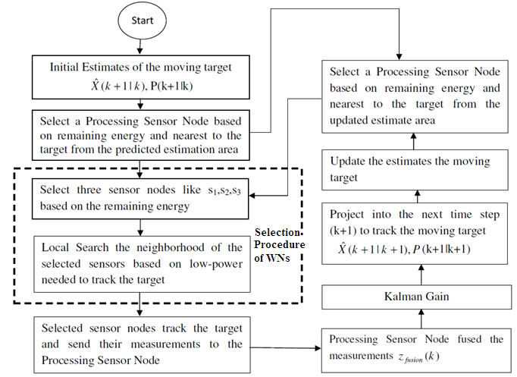
ETRACK in details

Slide 45
Experimental Setup
Parameters | Value
Network dimension | 600m x 600m x 600m
Number of sensor nodes | 200
Deployment of nodes | Uniform random
Node frequency | 20 kHz
Simulation type | Discrete-event driven
Target intrusion point | User defined
Data rate | 1000 bits/sec
Wave length | 4 meters
Wave height | 100 meters
Wave period | 5 seconds
Initial energy | 100J
Signal propagation speed | 1500m/s
Used OMNET++ for simulating the network model and our method ETRACK

Slide 46
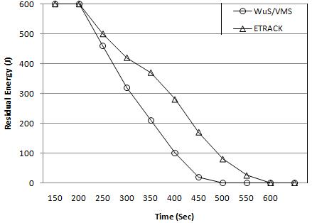
Experimental Results
ETRACK has less energy consumption since only four are used for tracking.
Comparison on the basis of the residual energy of the network.

Slide 47
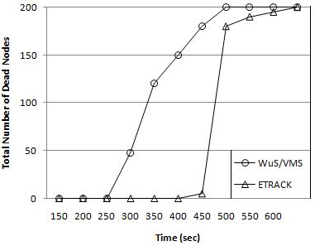
Experimental Results (Contd.)
ETRACK has less number of dead nodes since less nodes are used in tracking.
Comparison on the basis of the number of the dead nodes

Slide 48
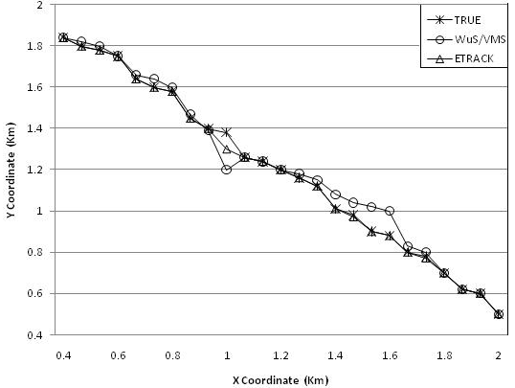
Experimental Results (Contd.)
ETRACK matches better since less nodes are dying out.
Target trajectory comparison

Slide 49
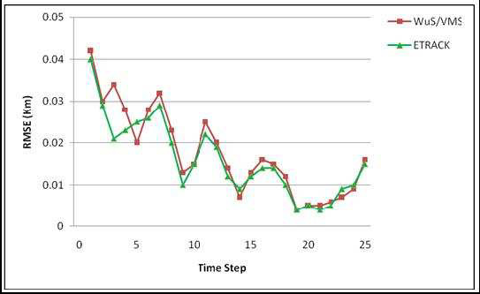
Experimental Results (Contd.)
ETRACK has less error since it is based on 3D modeling.
Root Mean Square Error comparison

Slide 50
Conclusion
We develop a load balanced strategy for target tracking which ensures the energy efficiency as well as the longer lifetime of the UWSN.
Our results depict that about 36% energy is saved in our method compared to a popular tracking method in UWSNs.
We also compare the estimation of our targets position with the true target trajectory and we find that our detected trajectory matches with the true trajectory.

Slide 51
Future Work
Underwater sensor networks (UWSNs), being a relatively new field in computing, still has plenty of room for further network research. The scope of our thesis also provides the direction for its exploration.
We would like to extend our tracking approach to multiple targets tracking problem.

Slide 52
References
[1] “\Mixim,” Available: http://mixim.sourceforge.net/, visited on: September 25, 2016.
[2] “\Omnet++,” Available: http://www.omnetpp.org/, visited on: September 25, 2016.
[3] A. D.Waite,” SONAR for Practicing Engineers,” 3rd edition, Wiley Publisher, 2001.
[4] B. Scheuermann, C. Lochert, M. Mauve, “Implicit hop-by-hop congestion control in wireless multihop networks,” Ad Hoc Network, vol. 6, pp. 260-286, 2008.
[5] C. H. Yu, K. H. Lee, J. W. Choi and Y. B. Seo, “Distributed Single Target Tracking in Underwater Wireless Sensor Networks,” SICE Annual Conference, vol. 1, pp. 1351-1356, August 2008.
[6] D. Eickstedt, M. Benjamin, H. Schmidt, and J. Leonard, “Adaptive tracking of underwater targets with autonomous sensor networks,” Journal of Underwater Acoustics, vol. 56, pp. 465-495, 2006.
[7] D. L. Codiga, J.A. Rice, P.A. Baxley, “Networked acoustic modems for realtime data delivery from distributed subsurface instruments in the coastal ocean: Initial system development and performance,” Journal of Atmospheric and Oceanic Technology, vol. 21, pp. 331-346, 2004.
[8] D. Pompili and I. F. Akyildiz, “Overview of networking protocols for underwater wireless communications,” IEEE Communication Magazine, vol. 47, no. 1, pp. 97-102, 2009.
[9] D. Pompili, T. Melodia and I. F. Akyildiz, “A CDMA-Based Medium Access Control for Underwater Acoustic Sensor Networks,” IEEE Transactions on Wireless Communications, vol. 8, no. 4, pp. 1899-1909, 2009.
[10] E. Dalberg, A. Lauberts, R. K. Lennartsson, M. J. Levonen, and L. Persson, “Underwater target tracking by means of acoustic and electromagnetic data fusion,” in Proceedings of the 9th International Conference on Information Fusion, vol. 1, pp. 1-7, July 2006.
[11] E. Sozer, J. Proakis, M. Stojanovic, J. Rice, A. Benson, and M. Hatch, “Direct sequence spread spectrum based modem for underwater acoustic communication and channel measurements,” in Proceedings of MTS/IEEE Conference Exhibition Ocean Engineering, Science Technology (OCEANS), vol. 1, pp. 228-233, 1999.
[12] G. Holland, N. Vaidya, “Analysis of TCP performance over mobile ad hoc networks,” in Proceedings of the 5th Annual ACM/IEEE International Conference on Mobile Computing and Networking, vol. 1, pp. 219-230, 1999.
[13] G.Isbitiren and O. B. Akan, “Three-Dimensional Underwater Target Tracking with Acoustic Sensor Networks,” in Proceedings of IEEE Transactions on Vehicular Technology, vol. 60, no. 8, pp. 3897-3906, 2011.
[14] G. Welch and G. Bishop, “An Introduction to the Kalman Filter,” UNCChapel Hill, TR 95-041, July 2006.
[15] H. Yan, ZJ Shi, J. Cui, “DBR: depth-based routing for underwater sensor networks,” in Proceedings of the 7th International IFIP-TC6 Networking Conference on Adhoc and Sensor Networks, vol. 1, pp. 72-86, 2008.
[16] I. F. Akyildiz, D. Pompili, and T. Melodia, “Challenges for Efficient Communication in Underwater Acoustic Sensor Networks,” ACM SIGBED Review - Special Issue on Embedded Sensor, vol. 1, no. 2, pp. 3-8, 2004.
[17] I. F. Akyildiz, W. Su, Y. Sankarasubramanium, and E. Cayirci,“Wireless Sensor Networks: A Survey,”Computer Networks, vol. 38, pp. 393-422 , 2002..
[18] I. F. Akyildiz, D. Pompili, T. Melodia,”Underwater Acoustic Sensor Network: Research Challenges,” Ad Hoc Networks (Elsevier), vol. 3, no. 4, pp. 257-279, 2005.
[19] L. Arienzo , and M. Longo,“An Energy Efficient Strategy for Target Tracking through Wireless Sensor Netwoks,” GTTI, vol. 1, pp. 1-8, 2008.
[20] M. Asif, M. Rizal Arshad, and A. Yahya, “An active contour for underwater target tracking and navigation,” in Proceedings of International Conference on Man-Machine Systems, vol. 1, pp. 1-6, 2006.
[21] M. Ayaz, A. Abdullah, “Underwater Wireless Sensor Networks: Routing Issues and Future Challenges,” in Proceedings of the 7th International Conference on Advances in Mobile Computing and Multimedia, vol. 1, pp. 370-375, 2009.
[22] M. Ayaz, I. Baig, A. Abdullah, I. Faye, “A survey on routing techniques in underwater wireless sensor networks,” Journal of Network and Computer Applications, vol. 34, no.6, pp. 1908-1927, 2011.
[23] M. Erol, LFM Vieira, M. Gerla, “Localization with Dive’N’Rise (DNR) beacons for underwater acoustic sensor networks,” in Proceedings of the 2th Workshop on Underwater Networks, vol. 1, pp. 97-100, 2007.
[24] M. Erol, S. Oktug, “A Localization and Routing Framework for Mobile Underwater Sensor Networks,” in Proceedings of the IEEE INFOCOM Workshops, vol. 1, pp. 1-3, 2008.
[25] “Wireless Networks and Embedded Systems Lab,” Available: http://www.ece.neu.edu/wineslab/underwater_testbed.php, visited on: September 25, 2016.

Slide 53
THANK YOU

