Slide 1
CSE 330: Numerical Methods
Lecture 10 Regression Analysis
For Slides Thanks to
Dr. S. M. Lutful Kabir Visiting Professor, BRAC University
& Professor, BUET

Slide 2
What is regression analysis?
Regression analysis gives information on the relationship between a response (dependent) variable and one or more predictor (independent) variables
The goal of regression analysis is to express the response variable as a function of the predictor variables
The goodness of fit and the accuracy of conclusion depend on the data used
Hence non-representative or improperly compiled data result in poor fits and conclusions

Slide 3
A Regression Model
An example of a regression model is the linear regression model which is a linear relationship between response variable, y and the predictor variable, x_{i} where i=1,2,.....n, of the form
(1)
where,
are regression coefficients (unknown model parameters), and
is the error due to variability in the observed responses.

Slide 4
Example 1
In the transformation of raw or uncooked potato to cooked potato, heat is applied for some specific time.
One might postulate that the amount of untransformed portion of the starch (y) inside the potato is a linear function of time (t) and temperature (θ) of cooking. This is represented as
The linear regression refers to finding the unknown parameters, β₁ and β₂ which are simple linear multipliers of the predictor variable.

Slide 5
Uses of Regression Analysis
Three uses for regression analysis are for
model specification
parameter estimation
prediction

Slide 6
Model specification
Accurate prediction and model specification require that
all relevant variables be accounted for in the data
the prediction equation be defined in the correct functional form for all predictor variables.

Slide 7
Parameter Estimation
Parameter estimation is the most difficult to perform because not only is the model required to be correctly specified, the prediction must also be accurate and the data should allow for good estimation
For example, multi-linear regression creates a problem and requires that some variables may not be used
Thus, limitations of data and inability to measure all predictor variables relevant in a study restrict the use of prediction equations

Slide 8
Prediction
Regression analysis equations are designed only to make predictions.
Good predictions will not be possible if the model is not correctly specified and accuracy of the parameter not ensured.

Slide 9
Considerations for Effective Use of Regression Analysis
For effective use of regression analysis, one should
investigate the data collection process,
discover any limitations in data collected
restrict conclusions accordingly

Slide 10
Linear Regression
Linear regression is the most popular regression model. In this model, we wish to predict response to n data points (x₁,y₁),(x₂,y₂)..... (x_{n},y_{n})by a regression model given by
y = a₀ + a₁x (1)
where, a₀ and a₁ are the constants of the regression model.

Slide 11
Measure of Goodness of Fit
A measure of goodness of fit, that is, how well predicts the response variable is the magnitude of the residual at each of the data points. (2)
Ideally, if all the residuals are zero, one may have found an equation in which all the points lie on the model.
Thus, minimization of the residual is an objective of obtaining regression coefficients.
The most popular method to minimize the residual is the least squares methods, where the estimates of the constants of the models are chosen such that the sum of the squared residuals is minimized, that is minimize

Slide 12
Minimization of the Error
Let us use the least squares criterion where we minimize
(3)
where, S_{r} is called the sum of the square of the residuals.
Differentiating Equation (3) with respect to a₀ and a₁ we get
(4)
(5)

Slide 13
Minimization of the Error (continued)
Using equation (4) and (5), we get
(6)
(7)
Noting that
(8)
(9)

Slide 14
Minimization of the Error (continued)
Solving the above equations (8) and (9) gives
(10)
(11)

Slide 15
Example 2
The torque T needed to turn the torsional spring of a mousetrap through an angle, θ is given below
Find the constants and of the regression model
Angle θ, Radians | Torque, T
0.698132 | 0.188224
0.959931 | 0.209138
1.134464 | 0.230052
1.570796 | 0.250965
1.919862 | 0.313707

Slide 16
Tabulation of data for calculation of needed summations
i | θ | T | θ² | Tθ
 | Radians | N-m | radians | N-m
1 | 0.698132 | 0.188224
2 | 0.959931 | 0.209138
3 | 1.134464 | 0.230052
4 | 1.570796 | 0.250965
5 | 1.919862 | 0.313707
 | 6.2831 | 1.1921 | 8.8491 | 1.5896

Slide 17
The values of constants
=9.6091 X 10⁻² N-m/rad k₁ = 1.1767 X 10-1 N-m
=2.3842 X 10⁻² N-m
=9.6091 X 10⁻² N-m/rad

Slide 18
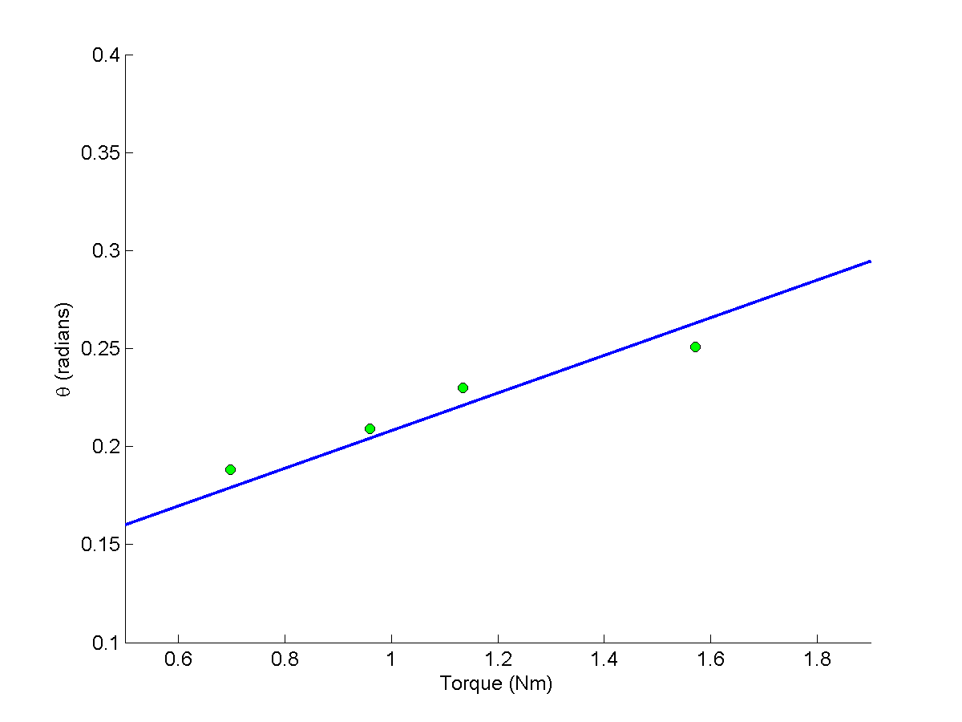
Linear regression of torque vs. angle data

Slide 19
A Class Exercise
For the following points, find a regression for
(a) 1st order
(b)2nd order
x | Y
1 | 0.11
2 | 0.2
3 | 0.32
4 | 0.38
5 | 0.53

Slide 20
Least Square Fitting - Polynomial
Generalizing from a stright line (i.e. First degree polynomial) to a kth degree polynomial
y=a₀+a₁x+a₂x²+a₃x³+.....+a_{k}x^{k}
The residual is given by

Slide 21
Least Square Fitting – Polynomial (continued)
The partial derivatives are:

Slide 22
In matrix form
[C]
[A]
[B]

Slide 23
Flow chart for formation of [C] matrix
i = 1
j= j + 1
j = 1
<
j : k+1
c(i,j) = 0.0
>
i= i + 1
m= 1
<
c(i,j) = c(i,j)+x(m)^(i-1+j-1)
i : k+1
>
m = m+1
<
m : n
>

Slide 24
Flow chart for formation of [B] matrix
Class exercise

Slide 25
Program
% Regression Analysis
% k-> order of polynomial
% n-> number of points
clear all
clc
k=1;
n=5;
x=[0.6981, 0.9600, 1.1345, 1.5708, 1.9199];
y=[0.1882, 0.2091, 0.2301, 0.2510, 0.3137];

Slide 26
Program (continued)
% Determination of [C] matrix
for i=1:k+1
for j=1:k+1
c(i,j)=0.0;
for m=1:n
c(i,j) = c(i,j) + x(m)^(i-1+j-1);
end
end
end
c
% Inversion of [C] matrix
ci=inv(c);
ci

Slide 27
Program (continued)
% Determination of [A] matrix
for i=1:k+1
a(i)=0.0;
for j=1:k+1
a(i)=a(i)+ci(i,j)*b(j);
end
end
a
% Determination of [B] matrix
for i=1:k+1
b(i)=0.0;
for m=1:n
b(i)=b(i)+y(m)*x(m)^(i-1);
end
end
b

Slide 28
Thanks

