Slide 1
CSE 330 : Numerical Methods
Lecture 16: Numerical Integration -
Simpson’s Rule
For Slides thanks to:
Dr. S. M. Lutful Kabir

Slide 2
Basis of Simpson’s 1/3rd Rule
Trapezoidal rule was based on approximating the integrand by a first
order polynomial, and then integrating the polynomial in the interval of
integration. Simpson’s 1/3rd rule is an extension of Trapezoidal rule
where the integrand is approximated by a second order polynomial.
Hence
Where is a second order polynomial.

Slide 3
Basis of Simpson’s 1/3rd Rule
Choose
and
as the three points of the function to evaluate a₀, a₁ and a₂.

Slide 4
Basis of Simpson’s 1/3rd Rule
Solving the previous equations for a₀, a₁ and a₂ give

Slide 5
Basis of Simpson’s 1/3rd Rule
Then

Slide 6
Basis of Simpson’s 1/3rd Rule
Substituting values of a₀, a₁, a ₂ give
Since for Simpson’s 1/3rd Rule, the interval [a, b] is broken
into 2 segments, the segment width
Hence
Because the above form has 1/3 in its formula, it is called Simpson’s 1/3rd Rule.

Slide 7
Example 1
The distance covered by a rocket from t=8 to t=30 is given by
a) Use Simpson’s 1/3rd Rule to find the approximate value of x
b) Find the true error,
c) Find the absolute relative true error,

Slide 8
Solution
a)

Slide 9
Solution (cont)
b) The exact value of the above integral is
True Error
c) Absolute relative true error,

Slide 10
Multiple Segment Simpson’s 1/3rd Rule

Slide 11
Multiple Segment Simpson’s 1/3rd Rule
Just like in multiple segment Trapezoidal Rule, one can subdivide the interval
[a, b] into n segments and apply Simpson’s 1/3rd Rule repeatedly over
every two segments. Note that n needs to be even. Divide interval
[a, b] into equal segments, hence the segment width
where

Slide 12
Multiple Segment Simpson’s 1/3rd Rule
f(x)
. . .
x
x₀
x₂
x_{n-2}
x_{n}
Apply Simpson’s 1/3rd Rule over each interval,

Slide 13
Multiple Segment Simpson’s 1/3rd Rule
Since

Slide 14
Multiple Segment Simpson’s 1/3rd Rule
Then

Slide 15
Multiple Segment Simpson’s 1/3rd Rule

Slide 16
Example 2
Use 4-segment Simpson’s 1/3rd Rule to approximate the distance
covered by a rocket from t= 8 to t=30 as given by
Use four segment Simpson’s 1/3rd Rule to find the approximate value of x.
Find the true error, for part (a).
Find the absolute relative true error, for part (a).

Slide 17
Solution
a)
Using n segment Simpson’s 1/3rd Rule,
So

Slide 18
Solution (cont.)

Slide 19
Solution (cont.)
cont.

Slide 20
Solution (cont.)
b)
In this case, the true error is
c)
The absolute relative true error

Slide 21
Solution (cont.)
Table 1: Values of Simpson’s 1/3rd Rule for Example 2 with multiple segments
n | Approximate Value | E_{t} | |Є_{t} |
2 4 6 8 10 | 11065.72 11061.64 11061.40 11061.35 11061.34 | 4.38 0.30 0.06 0.01 0.00 | 0.0396% 0.0027% 0.0005% 0.0001% 0.0000%

Slide 22
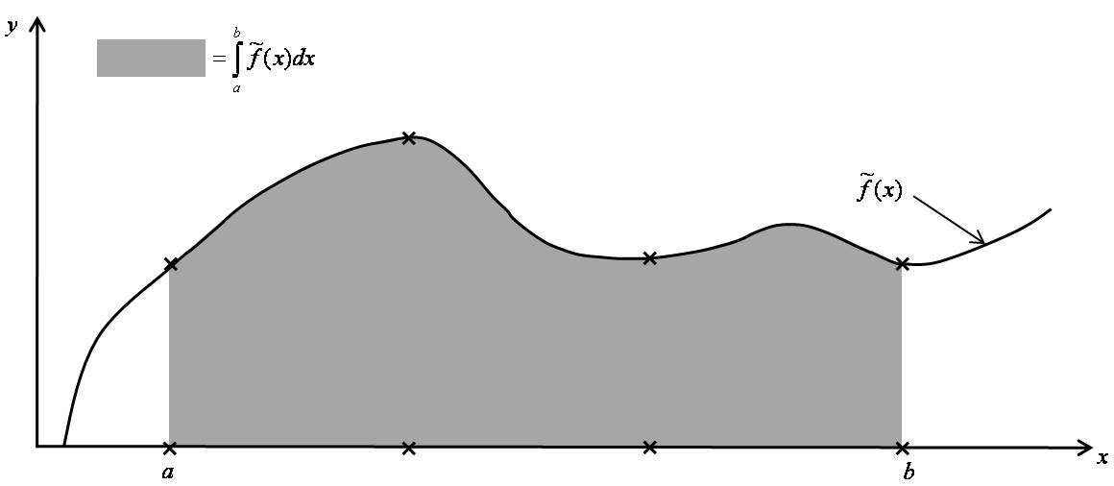
Simpson’s 3/8 Rule of Integration
In a similar fashion, Simpson 3/8 rule for integration can be derived by approximating the given function f(x) with the 3rd order (cubic) polynomial f₃(x)

Slide 23
Simpson’s 3/8 Rule of Integration
Using Lagrange interpolation, the cubic polynomial function that passes through 4 data points can be explicitly given as
Following the same procedure of Simpson’s 1/3 rule, the expression of the Integral results,

Slide 24
Multi Segments for Simpson’s 3/8 Rule
Similarly the expression for the multi segment Simpson’s Rule can be derived as follows:

Slide 25
Exercise
Find the distance covered by the rocket in between t=8sec and t=30 sec using the expression of previous examples. Apply Simpson’s 3/8 rule and use six segments for finding the distance.

Slide 26
Thanks

