Slide 1
CSE 340 Computer Architecture Summer 2017 Introduction
Thanks to Dr. MaryJaneIrwin for the slides.

Slide 2
Course Content
Content
Principles of computer architecture: CPU datapath and control unit design (single-issue pipelined, superscalar, VLIW), memory hierarchies and design, I/O organization and design, advanced processor design (multiprocessors and SMT)
Course goals
To learn the organizational paradigms that determine the capabilities and performance of computer systems. To understand the interactions between the computer’s architecture and its software so that future software designers (compiler writers, operating system designers, database programmers, …) can achieve the best cost-performance trade-offs and so that future architects understand the effects of their design choices on software applications.

Slide 3
Major High-Level Goals of This Course
Understand the principles
Understand the precedents
Based on such understanding:
Enable you to evaluate tradeoffs of different designs and ideas
Enable you to develop principled designs
Enable you to develop novel, out-of-the-box designs
The focus is on:
Principles, precedents, and how to use them for new designs

Slide 4
Role of The (Computer) Architect
Look backward (to the past)
Understand tradeoffs and designs, upsides/downsides, past workloads. Analyze and evaluate the past.
Look forward (to the future)
Be the dreamer and create new designs. Listen to dreamers.
Push the state of the art. Evaluate new design choices.
Look up (towards problems in the computing stack)
Understand important problems and their nature.
Develop architectures and ideas to solve important problems.
Look down (towards device/circuit technology)
Understand the capabilities of the underlying technology.
Predict and adapt to the future of technology (you are designing for N years ahead). Enable the future technology.

Slide 5
Takeaways
Being an architect is not easy
You need to consider many things in designing a new system + have good intuition/insight into ideas/tradeoffs
But, it is fun and can be very technically rewarding
And, enables a great future
E.g., many scientific and everyday-life innovations would not have been possible without architectural innovation that enabled very high performance systems
E.g., your mobile phones
This course will teach you how to become a good computer architect

Slide 6
So, I Hope You Are Here for This
“Programming language” as
a model of computation
CSE110/111
How does an assembly program end up executing as digital logic?
What happens in-between?
How is a computer designed using logic gates and wires to satisfy specific goals?
Programmer’s view of how
a computer system works
Architect/microarchitect’s view:
How to design a computer that
meets system design goals.
Choices critically affect both
the SW programmer and
the HW designer
HW designer’s view of how
a computer system works
CSE260
Digital logic as a
model of computation

Slide 7
Crossing the Abstraction Layers
As long as everything goes well, not knowing what happens in the underlying level (or above) is not a problem.
What if
The program you wrote is running slow?
The program you wrote does not run correctly?
The program you wrote consumes too much energy?
What if
The hardware you designed is too hard to program?
The hardware you designed is too slow because it does not provide the right primitives to the software?
What if
You want to design a much more efficient and higher performance system?

Slide 8
Crossing the Abstraction Layers
Two key goals of this course are
to understand how a processor works underneath the software layer and how decisions made in hardware affect the software/programmer
to enable you to be comfortable in making design and optimization decisions that cross the boundaries of different layers and system components

Slide 9
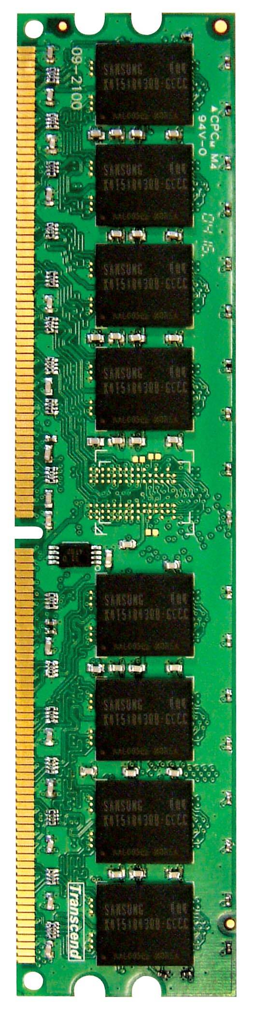
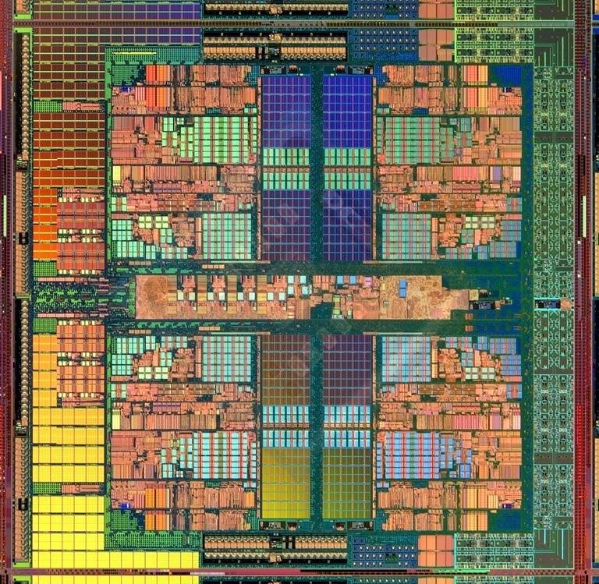
An Example: Multi-Core Systems
Multi-Core
Chip
CORE 0
L2 CACHE 1
CORE 1
L2 CACHE 0
SHARED L3 CACHE
DRAM INTERFACE
DRAM MEMORY CONTROLLER
DRAM BANKS
L2 CACHE 2
CORE 3
CORE 2
L2 CACHE 3
*Die photo credit: AMD Barcelona
9

Slide 10
What is Computer Architecture?
The science and art of designing, selecting, and interconnecting hardware components and designing the hardware/software interface to create a computing system that meets functional, performance, energy consumption, cost, and other specific goals.

Slide 11
Why Study Computer Architecture?
Enable better systems: make computers faster, cheaper, smaller, more reliable, …
By exploiting advances and changes in underlying technology/circuits
Enable new applications
Life-like 3D visualization 20 years ago?
Virtual reality?
Personalized genomics? Personalized medicine?
Enable better solutions to problems
Software innovation is built into trends and changes in computer architecture
> 50% performance improvement per year has enabled this innovation
Understand why computers work the way they do

Slide 12
Computer Architecture Today (I)
Today is a very exciting time to study computer architecture
Industry is in a large paradigm shift (to multi-core and beyond) – many different potential system designs possible
Many difficult problems motivating and caused by the shift
Power/energy constraints → multi-core?
Complexity of design → multi-core?
Difficulties in technology scaling → new technologies?
Memory wall/gap
Reliability wall/issues
Programmability wall/problem
Huge hunger for data and new data-intensive applications
No clear, definitive answers to these problems

Slide 13
Computer Architecture Today (II)
These problems affect all parts of the computing stack – if we do not change the way we design systems
Problem
Many new demands
from the top
(Look Up)
Algorithm
Program/Language
User
Fast changing
demands and
personalities
of users
(Look Up)
Runtime System
(VM, OS, MM)
ISA
Microarchitecture
Many new issues
at the bottom
(Look Down)
Logic
Circuits
Electrons

Slide 14
… but, first …
Let’s understand the fundamentals…
You can change the world only if you understand it well enough…
Especially the past and present dominant paradigms
And, their advantages and shortcomings – tradeoffs
And, what remains fundamental across generations
And, what techniques you can use and develop to solve problems

Slide 15
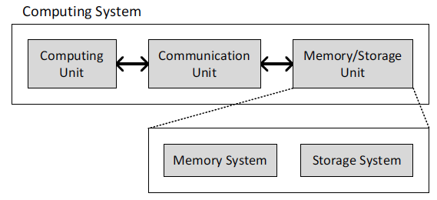
What is A Computer?
Three key components
Computation
Communication
Storage (memory)
15

Slide 16
What is A Computer?
We will cover all three components
Processing
Memory
(program
and data)
I/O
control
(sequencing)
datapath
16

Slide 17
Instruction Set Architecture (ISA)
ISA: An abstract interface between the hardware and the lowest level software of a machine that encompasses all the information necessary to write a machine language program that will run correctly, including instructions, registers, memory access, I/O, and so on.

Slide 18
Instruction Set Architecture (ISA)
Instruction Set Architecture (ISA)
Usually defines a “family” of microprocessors
Examples: Intel x86 (IA32), Sun Sparc, DEC Alpha, IBM/360, IBM PowerPC, M68K, DEC VAX
Formally, it defines the interface between a user and a microprocessor
ISA includes:
Instruction set
Rules for using instructions
Mnemonics, functionality, addressing modes
Instruction encoding
ISA is a form of abstraction
Low-level details of microprocessor are “invisible” to user

Slide 19
ISA Type Sales
Millions of Processor
Notes:
Only includes 32- and 64-bit processors
Others includes Samsung, HP, AMD, TI, Transmeta (same ISA as IA-32), …

Slide 20
Where is the Market?
Millions of Computers
Notes:
For “definitions” of desktop, servers, supercomputers (100’s to 1000’s of processors, Gbytes to Tbytes of main memory, Tbytes to Pbytes of secondary storage), and embedded systems (cell phones, automobile control, video games, entertainment systems (digital TVs), PDAs, etc.).
The computer (IT) industry is responsible for almost 10% of the GNP of the US.
The embedded market has shown the strongest growth (40% compounded annual growth compared to only 9% for desktops – where do laptops fit?). This chart/number does not include the low-end 8-bit and 16-bit embedded processors that are everywhere!
This is a good slide to talk about the other performance metrics in addition to speed (or see if the students can come up with them) including
Power, space/volume, memory space, cost, reliability

Slide 21
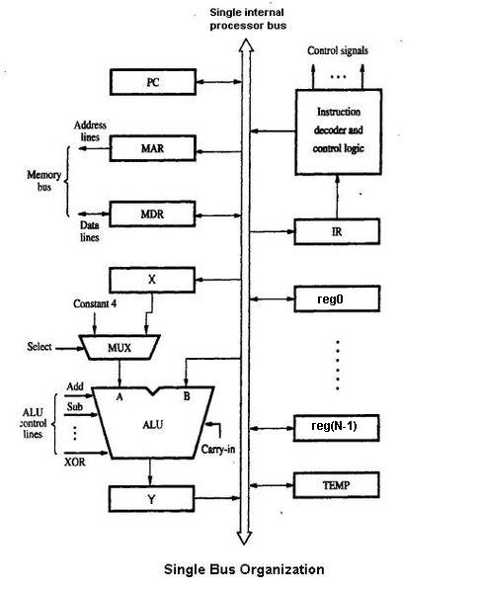
Datapath
A datapath is a collection of functional units, such as arithmetic logic units or multipliers, that perform data processing operations. It is a central part of many central processing units (CPUs) along with the control unit, which largely regulates interaction between the datapath and the data itself, usually stored in registers or main memory. [http://en.wikipedia.org/wiki/Datapath]

Slide 22
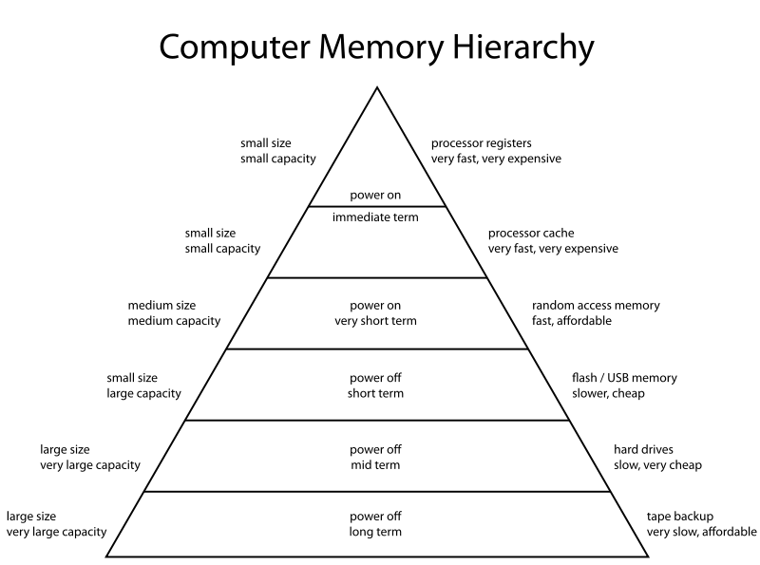
Memory hierarchy
The term memory hierarchy is used in computer architecture when discussing performance issues in computer architectural design, algorithm predictions, and the lower level programming constructs such as involving locality of reference. A "memory hierarchy" in computer storage distinguishes each level in the "hierarchy" by response time. Since response time, complexity, and capacity are related, the levels may also be distinguished by the controlling technology. [http://en.wikipedia.org/wiki/Memory_hierarchy]

Slide 23
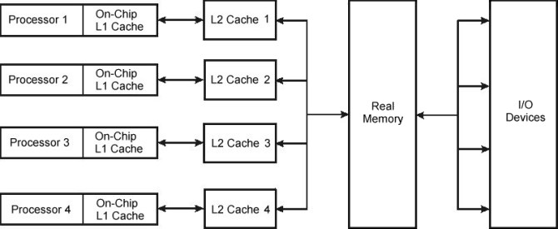
Multiprocessor
A multiprocessor is a tightly coupled computer system having two or more processing units (Multiple Processors) each sharing main memory and peripherals, in order to simultaneously process programs.
[http://en.wikipedia.org/wiki/Multiprocessor]

Slide 24
Moore’s Law
In 1965, Gordon Moore predicted that the number of transistors that can be integrated on a die would double every 18 to 24 months (i.e., grow exponentially with time).
Amazingly visionary – million transistor/chip barrier was crossed in the 1980’s.
2300 transistors, 1 MHz clock (Intel 4004) - 1971
16 Million transistors (Ultra Sparc III)
42 Million transistors, 2 GHz clock (Intel Xeon) – 2001
55 Million transistors, 3 GHz, 130nm technology, 250mm² die (Intel Pentium 4) - 2004
140 Million transistor (HP PA-8500)
As of 2012, the highest transistor count in a commercially available CPU is over 2.5 billion transistors, in Intel's 10-core Xeon Westmere-EX. [http://en.wikipedia.org/wiki/Transistor_count]
Notes:
Tbyte = 2^40 bytes (or 10^12 bytes)
Note that Moore’s law is not about speed predictions but about chip complexity

Slide 25
Processor Performance Increase
Intel Pentium 4/3000
DEC Alpha 21264A/667
DEC Alpha 21264/600
Intel Xeon/2000
DEC Alpha 5/500
DEC Alpha 4/266
DEC Alpha 5/300
DEC AXP/500
IBM POWER 100
HP 9000/750
IBM RS6000
MIPS M2000
SUN-4/260
MIPS M/120
Here performance is given as approximately the number of times faster than VAX-11/780
Notes:
Another powerpoint “comic” – note that the y axis is log !
x/y where x is the model number and y is the speed in MHz
Rate of performance improvement has been between 1.5 and 1.6 times per year – how much longer will Moore’s Law hold?

Slide 26
DRAM Capacity Growth
512M
256M
128M
64M
16M
4M
1M
256K
64K
16K
Notes:
Memories have quadrupled capacity every 3 years (up until 1996) – a 60% increse per year for 20 years. Now is doubling in capacity every two years.

Slide 27
Impacts of Advancing Technology
Processor
logic capacity: increases about 30% per year
performance: 2x every 1.5 years
Memory
DRAM capacity: 4x every 3 years, now 2x every 2 years
memory speed: 1.5x every 10 years
cost per bit: decreases about 25% per year
Disk
capacity: increases about 60% per year
Notes:
For class handout

Slide 28
Impacts of Advancing Technology
Processor
logic capacity: increases about 30% per year
performance: 2x every 1.5 years
Memory
DRAM capacity: 4x every 3 years, now 2x every 2 years
memory speed: 1.5x every 10 years
cost per bit: decreases about 25% per year
Disk
capacity: increases about 60% per year
ClockCycle = 1/ClockRate
500 MHz ClockRate = 2 nsec ClockCycle
1 GHz ClockRate = 1 nsec ClockCycle
4 GHz ClockRate = 250 psec ClockCycle
Notes:
For lecture

Slide 29
The Von Neumann Model/Architecture
Also called stored program computer (instructions in memory). Two key properties:
Stored program
Instructions stored in a linear memory array
Memory is unified between instructions and data
The interpretation of a stored value depends on the control signals
Sequential instruction processing
One instruction processed (fetched, executed, and completed) at a time
Program counter (instruction pointer) identifies the current instr.
Program counter is advanced sequentially except for control transfer instructions
When is a value interpreted as an instruction?

Slide 30
The Von Neumann Model (of a Computer)
MEMORY
Mem Addr Reg
Mem Data Reg
PROCESSING UNIT
INPUT
OUTPUT
ALU
TEMP
CONTROL UNIT
IP
Inst Register

Slide 31
The Harvard Architecture (1)
Harvard architecture is a computer architecture with physically separate storage and signal pathways for instructions and data.

Slide 32
The Harvard Architecture (2)
In a computer with a von Neumann architecture (and no cache), the CPU can be either reading an instruction or reading/writing data from/to the memory.
Both cannot occur at the same time since the instructions and data use the same bus system.
In a computer using the Harvard architecture, the CPU can read both an instruction and perform a data memory access at the same time, even without a cache.
A Harvard architecture computer can thus be faster for a given circuit complexity because instruction fetches and data access do not contend for a single memory pathway.

Slide 33
The Harvard Architecture (3)
In a Harvard architecture, there is no need to make the two memories share characteristics. In particular, the word width, timing, implementation technology, and memory address structure can differ.
In some systems, instructions can be stored in read-only memory while data memory generally requires read-write memory.
Instruction memory is often wider than data memory.
For more please read: http://www.inf.fu-berlin.de/lehre/WS94/RA/RISC-9.html

Slide 34
RISC vs. CISC
Complex instruction set computer (CISC):
many addressing modes;
many operations.
Reduced instruction set computer (RISC):
load/store;
pipelinable instructions.
For detail please go through risccisc.ppt in the tsr

Slide 35
MIPS R3000 Instruction Set Architecture Microprocessor without Interlocked Pipeline Stages
Registers
Instruction Categories
Load/Store
Computational
Jump and Branch
Floating Point
coprocessor
Memory Management
Special
R0 - R31
PC
HI
LO
3 Instruction Formats: all 32 bits wide
OP
rs
rt
rd
sa
funct
OP
rs
rt
immediate
OP
jump target

Slide 36
MIPS R3000 Instruction Set Architecture
The R3000 found much success and was used by many companies in their workstations and servers . Users included:
Ardent Computer
Digital Equipment Corporation (DEC) for their DECstation workstations and multiprocessor DECsystem servers
MIPS Computer Systems for their MIPS RISC/os Unix workstations and servers.
Prime Computer
Pyramid Technology
Seiko Epson
Silicon Graphics for their Professional IRIS, Personal IRIS and Indigo workstations, and the multiprocessor Power Series visualization systems
Sony for their PlayStation and PlayStation 2 (clocked at 37.5 MHz for use as an I/O CPU and at 33.8 MHz for compatibility with PlayStation games) video game consoles, and NEWS workstations, as well as the Bemani System 573 Analog arcade unit, which runs on the R3000A.
Tandem Computers for their NonStop Cyclone/R and CLX/R fault-tolerant servers
Whitechapel Workstations for their Hitech-20 workstation
Comparison between instruction sets:
http://en.wikipedia.org/wiki/Comparison_of_instruction_set_architectures
http://en.wikipedia.org/wiki/R3000

Slide 37
Next Lecture and Reminders
Next lecture
MIPS ISA Review
Reading assignment – PH, Chapter 2

