Slide 1
Investigation of two CFD validation test cases for turbulent mixing of different gaseous species (fuel and oxidizer) in typical laboratory flame configurations
Student : Malav M Soni
Supervisor : Dr. Thorsten Möller
Date : 12/10/2015

Slide 2
Content
Objectives of present work
Turbulence and its theory
Turbulence models (RANS) used for investigation
Test case I (Sandia National Laboratory Propane Jet)
Experimental Data
Computational Domain
Quality Criteria
Conclusion
Test case II (Sydney Bluff Body Jet)
Experimental Data
Computational Domain
Quality Criteria
Conclusion

Slide 3
Objectives of the present work
Aim :
      To study and investigate the flow structure and the turbulent mixing behind the bluff body, in the absence of complex combustion chemistry and heat release i.e. isothermal, with different RANS models
      ANSYS CFX 16.1 and ANSYS Fluent 17.0
      This study is divided in to parts:
        Part I : Investigation of the Sandia National Laboratory Propane Jet (quasi-2d)
        Part II : Investigation of Sydney Bluff Body Jet Flame (full 3d)

Slide 4
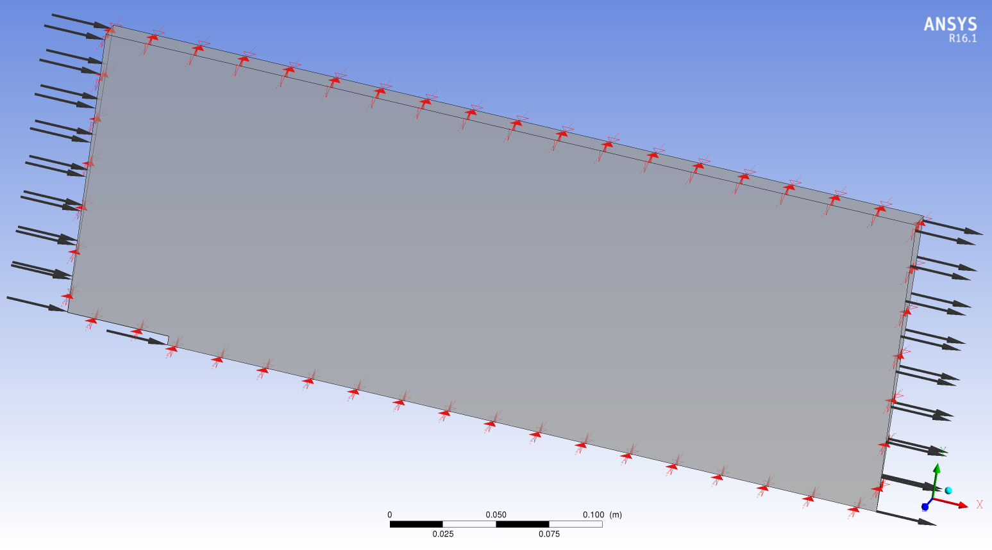
Computational Domain
No Slip Wall
Outer wall
Co-Flow Air Inlet
Monitoring Points
Pressure Outlet
Propane Jet Inlet
No Slip Wall
Front & back surfaces of the Comp. Domain are Symmetry planes

Slide 5
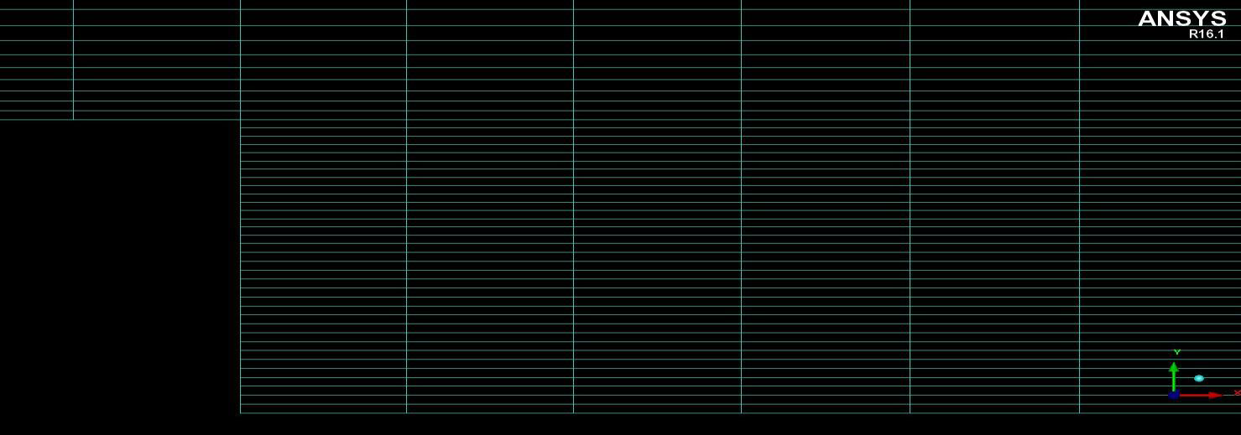
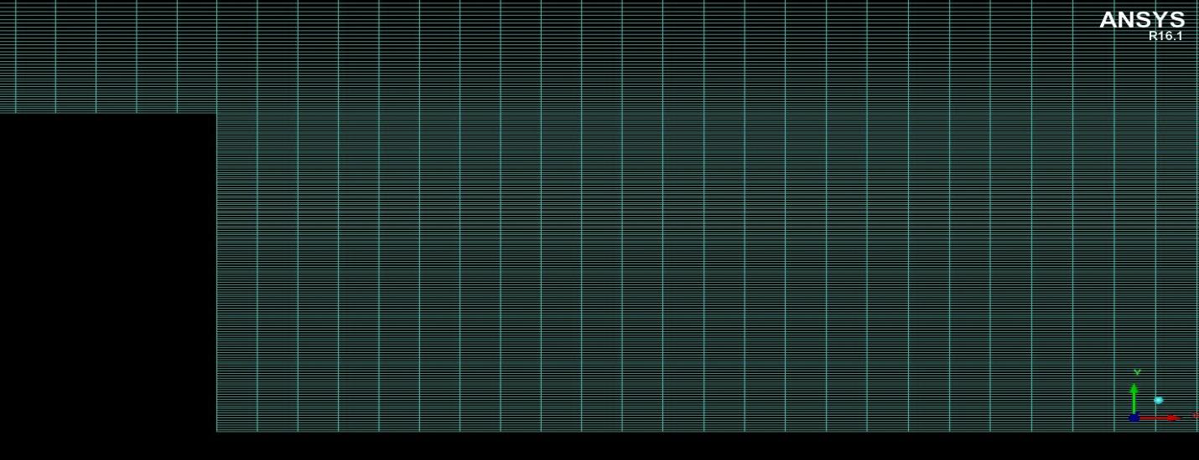
Computational Mesh
Parameter | Mesh 1 | Mesh 2 | Mesh 3 | Mesh 4
Type of Mesh | Hexahedral | Hexahedral | Hexahedral | Hexahedral
Number of Nodes | 3736 | 15568 | 63532 | 256660
Number of Elements | 7665 | 31530 | 127860 | 514920
Max Aspect Ratio | 22.57 | 24.54 | 25.59 | 26.52
Min Angle | 90° | 90° | 90° | 90°
Mesh 2
Mesh 4

Slide 6
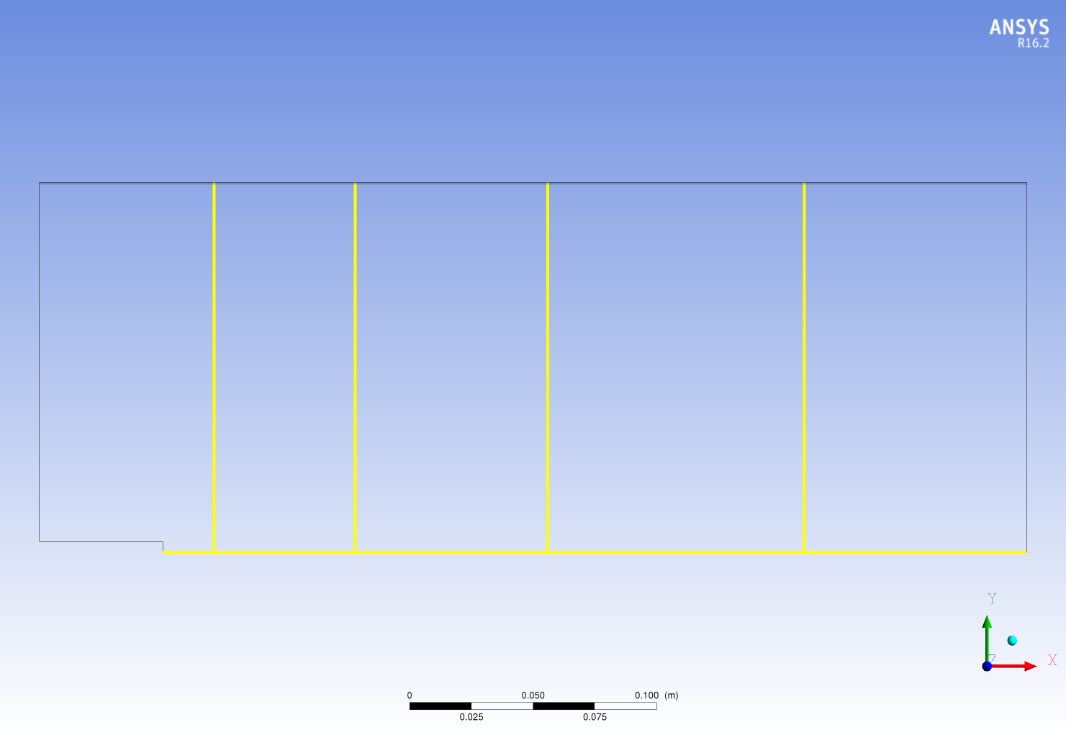
Measured Quantities and Measurement locations
  Mean radial and axial velocity component (U, V)
  Mean mixture fraction
X/D = 4
X/D = 15
X/D = 30
X/D = 50
Y/D = 0

Slide 7
Boundary Condition
Surface Name | Boundary condition for ANSYS CFX 16.1 | Boundary condition for ANSYS Fluent 17.0
Co-flow inlet | Normal Velocity = 9.2 [m/s] Turbulent Intensity = 0.5% Turbulent viscosity ratio = 10 | Normal Velocity = 9.2 [m/s] Turbulent Intensity = 0.5% Turbulent viscosity ratio = 10
Fuel jet inlet | u, v, w, k, ԑ and ω interpolated from the imported fully developed pipe flow profile | u, v, w, k, ԑ and ω interpolated from the imported fully developed pipe flow profile
Outlet | Average static pressure Relative pressure = 0 [Pa] Pressure profile blend = 0.05 | Average static pressure Gauge pressure = 0 [Pa] Pressure profile blend = 0.05
Bluff body | No slip wall | No slip wall
Outer wall | Free slip wall | Free slip wall
Symmetry 1 & 2 | Symmetry | Symmetry

Slide 8
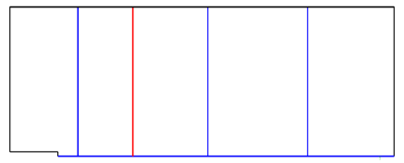
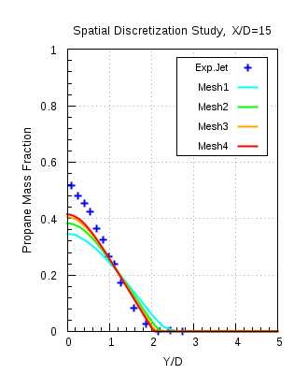
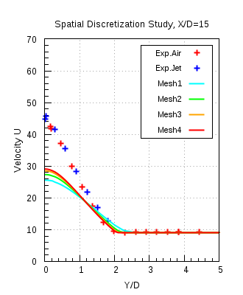
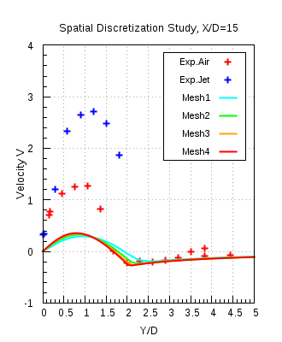
Spatial Discretisation Study (Mesh independency)
ANSYS CFX 16.1,
K-ω SST
Mesh 4 is chosen for further investigations

Slide 9
Conclusion
In this test case the investigation of the turbulent mixing of species in the recirculation zone behind the bluff body was carried out with isothermal and steady state flow conditions
K-ω SST model would be the recommended turbulence model. Both k-ε models give almost the same level of accuracy in this investigation, but with more difficulties in obtaining a converged solution
Differences observed in the axial velocity profiles is due to the simplifying assumptions made in the RANS turbulence models and also due to the round jet anomaly
Modification in the model constants is not suggested
      improves comparison of velocity profiles
      but at the price of deteriorated Propane mass fraction profiles
Turbulent Schmidt number (Sc_{t}) for the transport equation of species should be 0.9
If desired, higher accuracy results can be obtained with e.g. Large Eddy Simulation (LES) or hybrid models, but at much higher computational costs

Slide 10
Thank you for your attention!

