Slide 1

1
19L038 - DEEP LEARNING
PERSONALIZED EDUCATION
PRESENTED BY,
21L136 – Mohamed Suhail M

Slide 2
2
PROBLEM STATEMENT
Traditional Education is often one-size-fits-all which doesn’t meet individual student needs. This can lead to low engagement, missed learning opportunities and reduced retention.
Develop a personalized education platform using machine learning to tailor learning experiences in real time. By analyzing student data, the system adapts lessons, suggests resources and sets the right difficulty levels to boost engagement and academic success.

Slide 3
3
DATASET
Student ID | Age | Gender | Learning Style | Math Score | Science Score | Literature Score | Attention Span | Parental Involvement | Study Hours | Technology Use | Intervention | Outcome
S0001 | 10 | Female | Visual | 70 | 73 | 98 | Short | Medium | 2 | Weekly | Online Learning | Improved
S0002 | 16 | Female | Auditory | 93 | 73 | 80 | Short | Low | 11 | Daily | Tutoring | Improved
S0003 | 12 | Female | Visual | 93 | 96 | 89 | Medium | High | 15 | Daily | Peer Collaboration | Stable
S0004 | 11 | Female | Auditory | 69 | 93 | 89 | Medium | High | 10 | Daily | Online Learning | Stable
S0005 | 15 | Male | Auditory | 79 | 93 | 99 | Long | Medium | 9 | Rarely | Tutoring | Improved
S0006 | 15 | Male | Kinesthetic | 71 | 59 | 53 | Medium | Low | 2 | Daily | Peer Collaboration | Stable
S0007 | 11 | Female | Reading/ Writing | 77 | 99 | 61 | Long | Medium | 12 | Rarely | Peer Collaboration | Improved
S0008 | 14 | Other | Kinesthetic | 100 | 86 | 88 | Long | Medium | 6 | Daily | Online Learning | Stable
S0009 | 15 | Female | Reading/ Writing | 100 | 94 | 56 | Medium | Medium | 4 | Daily | Tutoring | Stable
S0010 | 15 | Female | Auditory | 61 | 87 | 50 | Long | Medium | 7 | Weekly | Tutoring | Improved
S0011 | 18 | Other | Reading/ Writing | 54 | 79 | 81 | Short | High | 2 | Weekly | Online Learning | Declined
S0012 | 13 | Other | Visual | 71 | 65 | 54 | Medium | Medium | 7 | Daily | Online Learning | Declined

Slide 4
4
FLOWCHART
START
LOAD DATASET
PRE-PROCESS DATA
LABEL ENCODE
CATEOGORICAL DATA
SELECT FEATURES AND TARGETS
MAKE PREDICTION FOR NEW STUDENT (OPTIONAL)
CALCULATE ACCURACY
MAKE PREDICTIONS
TRAIN LSTM MODEL
TRAIN – TEST SPLIT
END

Slide 5
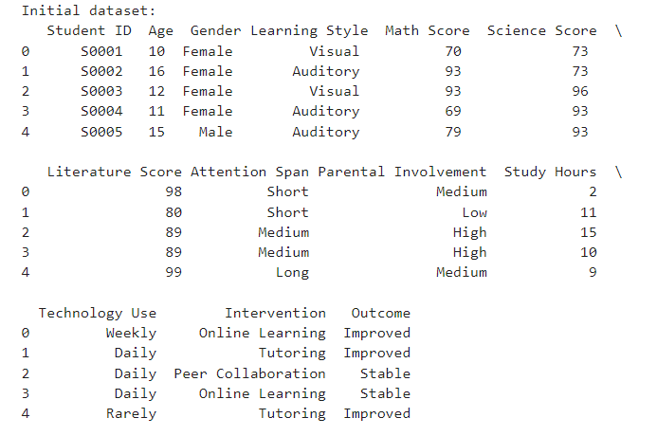
5
INITIAL DATASET
# Load the dataset
df = pd.read_csv('personalized_education_
simulated_dataset.csv’)
# Inspecting the dataset (optional)
print("Initial dataset:\n", df.head())

Slide 6
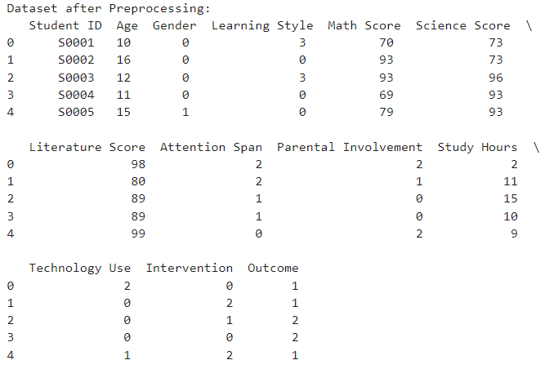
6
PRE-PROCESSING THE DATASET
# Encoding categorical features to numerical values
label_encoders = {}for column in ['Gender', 'Learning Style', 'Attention Span', 'Parental Involvement', 'Technology Use', 'Intervention', 'Outcome']:
le = LabelEncoder()
df[column] = le.fit_transform(df[column]) label_encoders[column] = le
print("\nDataset after Preprocessing:\n", df.head())

Slide 7
7
MODEL INSTANTIATION
input_size = X_train.shape[2] # Number of features
hidden_size = 64 # Hidden layer size
num_layers = 2 # Number of LSTM layers
output_size = 1 # Binary classification (0 or 1)
# Instantiate the model, define the loss function and optimizer
model = CustomLSTMModel(input_size, hidden_size, num_layers, output_size)
criterion = nn.BCELoss() # Binary cross-entropy loss for binary classification
optimizer = optim.Adam(model.parameters(), lr=0.001)

Slide 8
8
CUSTOM LSTM MODEL
class CustomLSTMModel(nn.Module):
def __init__(self, input_size, hidden_size, num_layers, output_size):
super(CustomLSTMModel, self).__init__()
self.hidden_size = hidden_size
self.num_layers = num_layers
# Define LSTM layer
self.lstm = nn.LSTM(input_size, hidden_size, num_layers, batch_first=True)
# Define a fully connected output layer
self.fc = nn.Linear(hidden_size, output_size)
def forward(self, x):
# Initialize hidden and cell states (num_layers, batch_size, hidden_size)
h0 = torch.zeros(self.num_layers, x.size(0), self.hidden_size).to(x.device)
c0 = torch.zeros(self.num_layers, x.size(0), self.hidden_size).to(x.device)
# Forward propagate the LSTM
out, _ = self.lstm(x, (h0, c0))
# Pass through fully connected layer
out = self.fc(out[:, -1, :])
# Output from last time step
return torch.sigmoid(out)

Slide 9
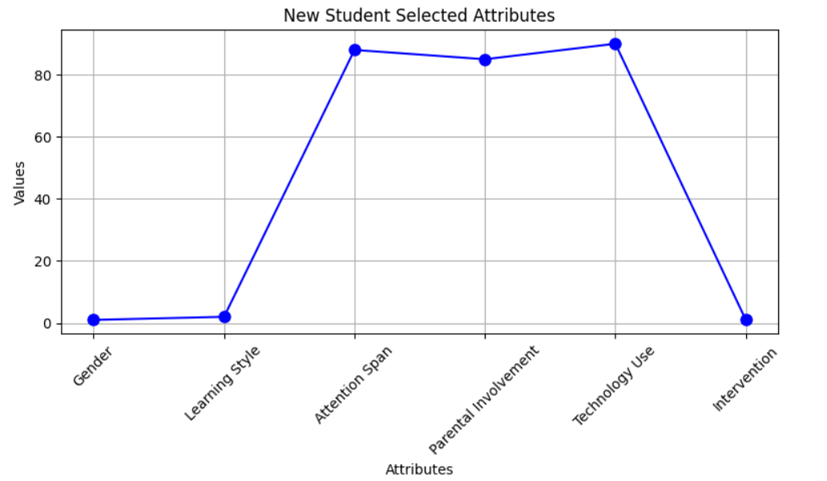
9
OUTPUT

Slide 10
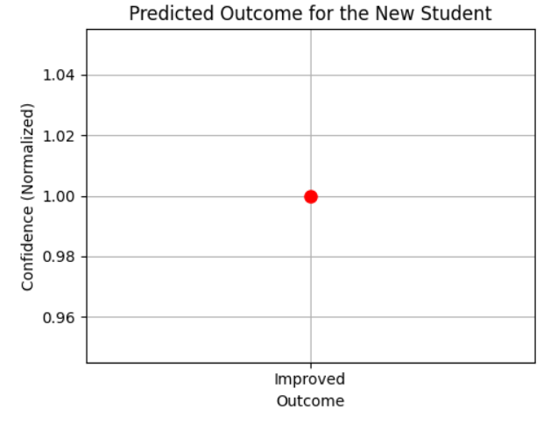
10
OUTPUT
OUTPUT | INFERENCE
0 | DECLINED
1 | IMPROVED
2 | STABLE

Slide 11
11
REFERENCE
Ian Goodfellow, YoshuaBengio, Aaron Courville , "Deep Learning", MIT Press, USA, 2016.
Adam Gibson, Josh Patterson , "Deep Learning A practitioner's approach", O'Reilly, USA, 2016.

Slide 12
12
THANK YOU

