Slide 1

Snowflakes
Mimicking Particles Under Microscope Ming-hwei Carol Sun

Slide 2
Snowflakes
Description
The initiation of data research was to get images with non-organic metal particles taken under microscope since the company I am working for wants to have a way of categorizing the particles in images taken under microscope.
Problem Statement
The problem was that this type of images were not found on the internet. The closest one only had less than 300 images which is not enough to do different machine learning tests. By searching image datasets, many interesting image datasets were found, and the snowflakes dataset ironically looked even closer to the images taken in the company than the one found with insufficient numbers.
Dataset
Through search engines, over 25,000 human-classified images of snowflakes were found by Colorado State University.

Slide 3
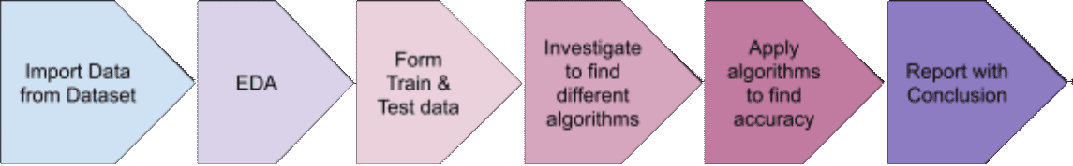
Snowflakes
Approach/ Methodology
Using snowflake images in the dataset to make training data and test data for supervised machine learning. Use different algorithms to see how long it takes and how accurate the result would be.
Evaluation Parameters (potential)
Accuracy - the accuracy of using each algorithm
Time took to run - Time took to run the algorithm to see if there is a trade of between accuracy and time

Slide 4
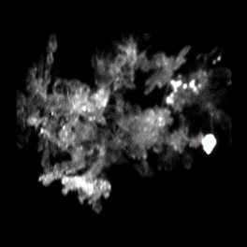
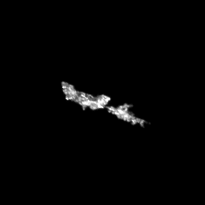
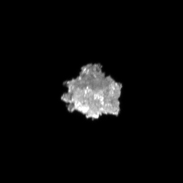
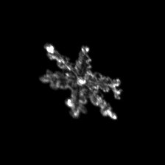
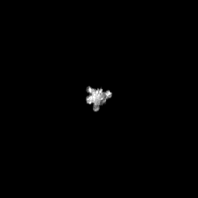
Snowflakes or Particles
The images were sorted into the following categories:
AG (aggregate) | CC (columnar crystal) | GR (graupel) | PC (planar crystal) | SP (small particle).
The only problem with the snowflake images is that they are all with black backgrounds and white subjects. The particle images taken in the company are sometimes with white background and black subjects to indicate if the subject is an indentation or a raised particle.
This problem is resolved to alter the images in the snowflakes dataset to have the reversed color. The Categories then became:
{'AG':'group', 'CC':'fiber', 'GR':'raised', 'PC':'peel', 'SP':'bubble', 'GRT': 'indentation', 'SPT': 'small-indent’}
Instead of
{'AG':'aggregate', 'CC':'columnarcrystal', 'GR':'graupel', 'PC':'planarcrystal', 'SP':'smallparticle', 'GRT': 'grapel-trans', 'SPT': 'small-trans'}

Slide 5
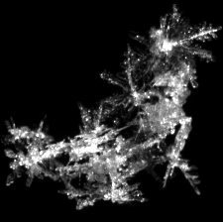
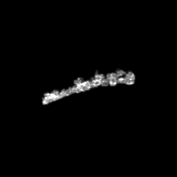
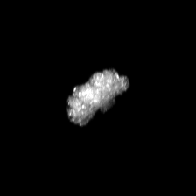

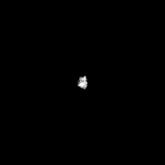
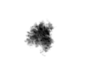
Particles?
Group Particle | Fiber | Raised | Li Peeling | Bubbles
Indentation
225 x 225 pixels images in 7 categories
AG 4538
CC 4521
GR 4500
PC 4514
SP 4626
GRT 4500

Slide 6
Objective/Methodology
The task of this project is to use the snowflakes images to see which machine learning algorithm is the most accurate in detecting its categories. If it is successful, this process may be able to detect similar images that contain particles under a microscope in the future.
1000 Training Data form each category and 100 Test Data. Total 7000 Training Data and 700 Test Data
What is considered success/ failure? Find the best algorithm detecting the categories of the snowflakes. If the accuracy rate is above 90%, it is considered a success. Evaluation Parameters Accuracy - Final result of evaluation of test data after the model was trained with training data.

Slide 7
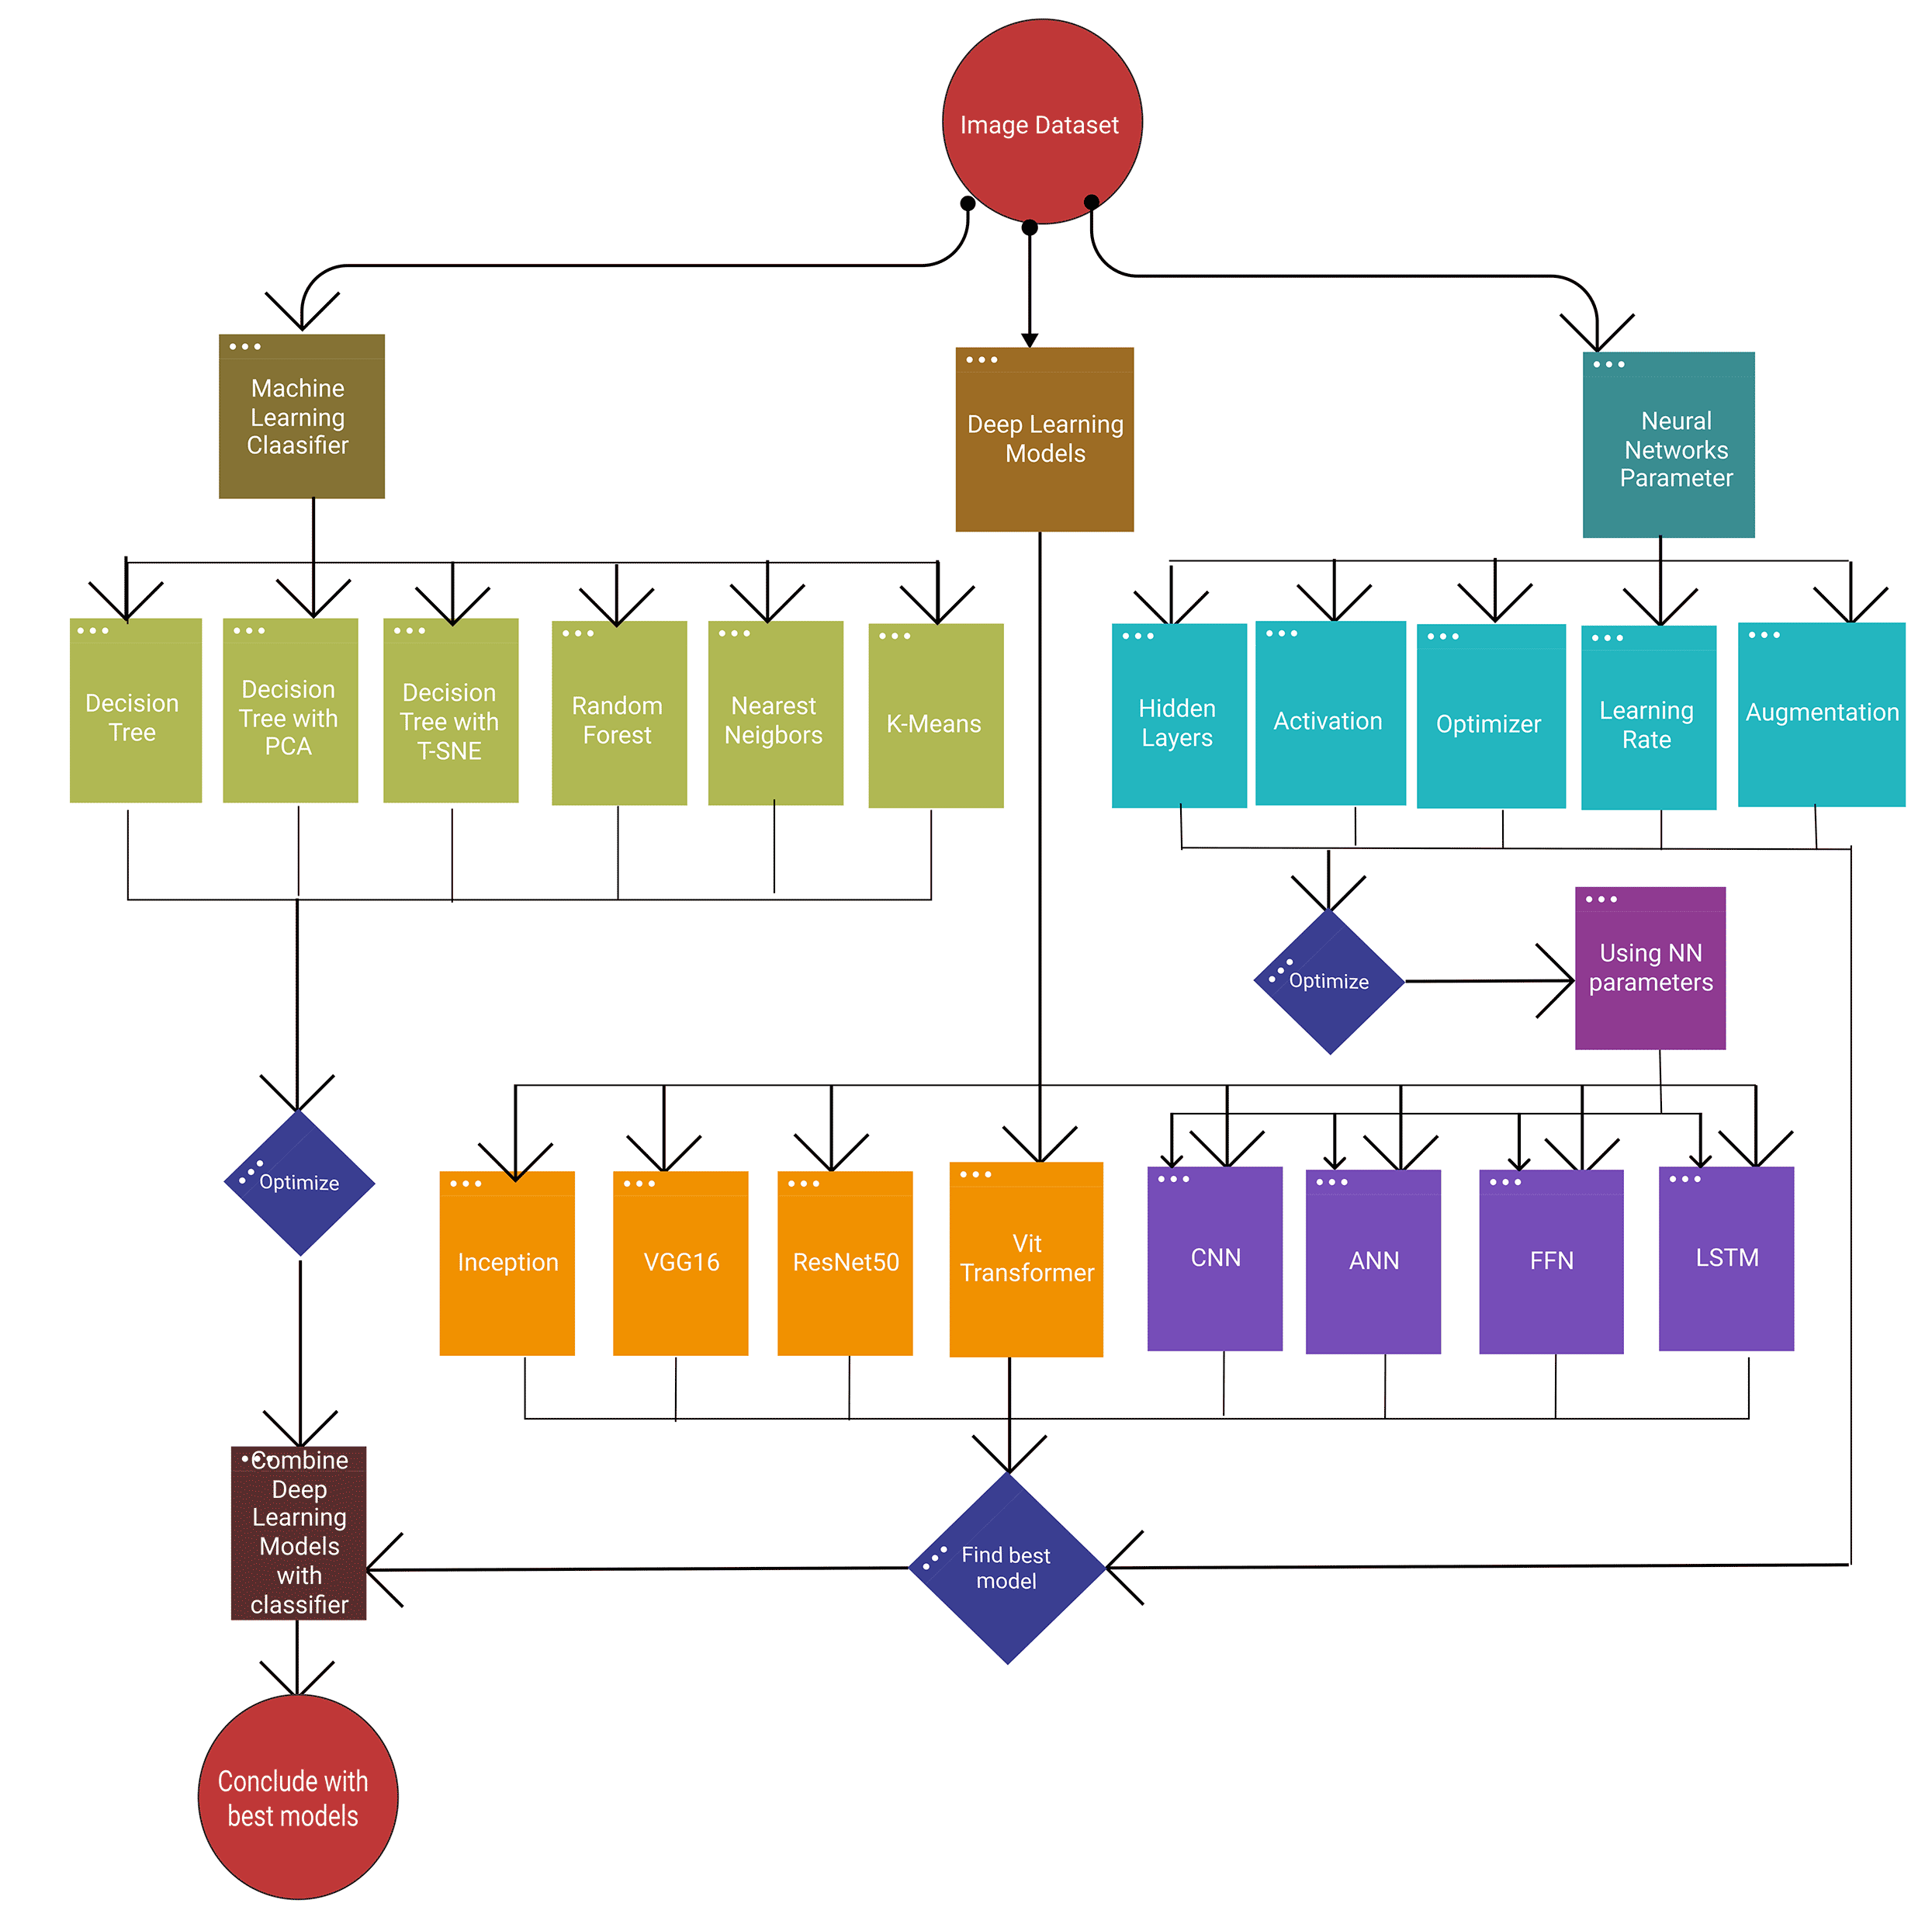
Experiments
The data is experimented with three types of process
Machine learning classifiers
Neural network parameters
Deep Learning models
With optimized models of (b) neural network parameters and (c) deep learning models stack them to create new models.
With the top of the neural network models and stacked models combine with the top machine learning classifiers to see if it improves the performance.

Slide 8
Machine Learning Classifier Results
Decision Tree with PCA
Decision Tree with T-SNE
Plain Decision Tree

Slide 9
Machine Learning Classifier Results
Decision Tree has the simplest algorithm which produces medium good results. The altered data produced the worst result since the images may have less information that was necessary for the calculation. The best result is random forest.
Random Forest

Slide 10
Neural Network model with different parameters
The parameter with tanh/SGD has worse accuracy than some of the machine learning classifiers. With relu/Adam got the medium result like the classifiers. With hidden layers, the accuracy increased a bit but still stayed in the range of 65% to 70% accuracy.

Slide 11
Convolutional Neural Network and Parameters
The results of CNN are basically higher than just neural networks. The baseline 61.5% accuracy rate is with (5,5) kernel size, (1,1) strides, (2,2) pool size, 0.01 learning rate with 1 epoch and 64 batch size. 83% accuracy is the best result with 1 epoch and 64 batch size baseline. The parameters of the models are either (3,3) kernel size plus (2,2) pool size or (5,5) kernel size plus (3, 3) pool size. Fine tuning of the model used (3,3) kernel size and (2, 2) pull size as the baseline and ran with different epochs. 10 epochs got the best result with 86.67% accuracy.

Slide 12
Different Neural Networks Models
The baseline of all models without CNN layers result in the lowest accuracy rate of the model. The highest accuracy ANN model had was built with [64, 128, 256] CNN layers. The highest accuracy FFN model was built with [64, 128, 256] layers and with [64, 128, 256] CNN layers.The highest accuracy LSTM model was built with [64, 128, 256] CNN layers. ANN and FFN got the same top accuracy of 90% and LSTM got 89%.

Slide 13
Transfer Learning and Transformer
All the models have very low accuracies compared to the neural networks and VGG16 has the highest accuracy among them with the least parameters. Vit Transformer has higher accuracy than the transfer learning models. From looking the the transfer learning models, all of them except VGG16 suffered from over-fitting problems since the training accuracy is much higher than the test accuracy.

Slide 14
Model stacking using Random Forest Classification and Deep Learning models
The best models that reached 91% accuracy include CNN + LSTM model and CNN + ANN model. The CNN model by itself increased 3% accuracy and reached 90%. The other models that reached 90% accuracy are CNN + LSTM and CNN + FFN. The best models are using hidden layers of [64, 128, 256] both on its own hidden layers and CNN hidden layers.

Slide 15
Model stacking using Random Forest Classification and Deep Learning models
The best models that reached 91% accuracy include CNN + LSTM model and CNN + ANN model. The CNN model by itself increased 3% accuracy and reached 90%. The other models that reached 90% accuracy are CNN + LSTM and CNN + FFN. The best models are using hidden layers of [64, 128, 256] both on its own hidden layers and CNN hidden layers.

Slide 16
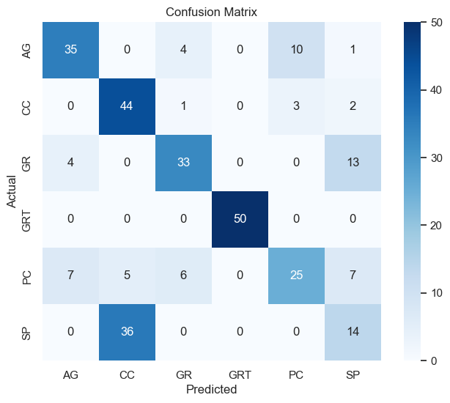
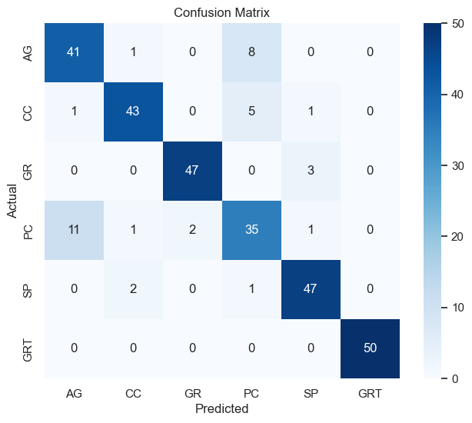
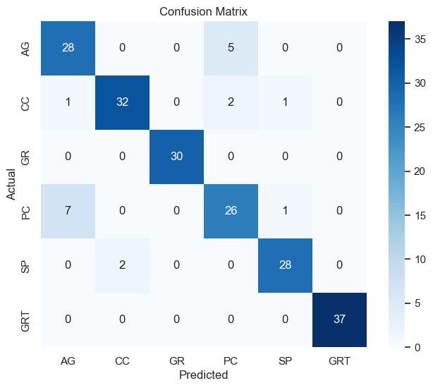
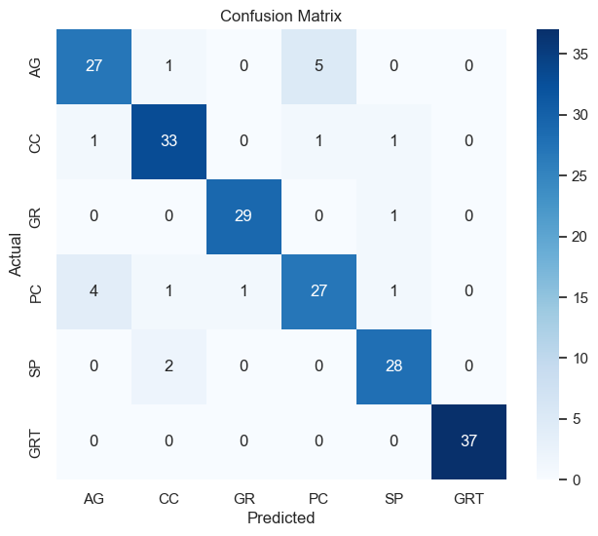
Foot steps of improving
K-Means : Accuracy 67%
Random Forest: Accuracy 88%
CNN + LSTM Random Forest: 91% Accuracy
CNN + ANN Random Forest: 91% Accuracy

Slide 17
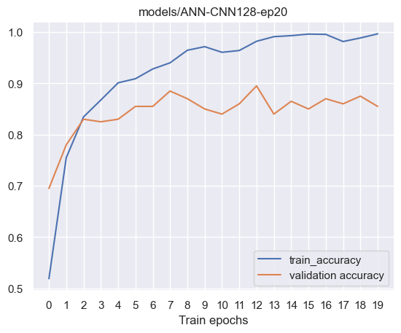
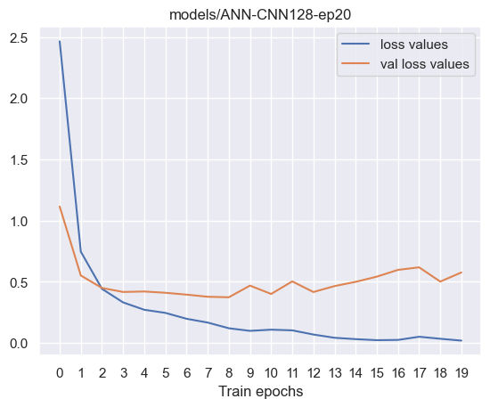
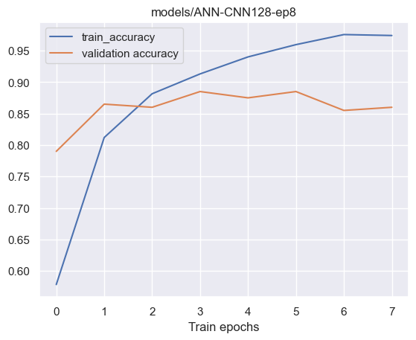
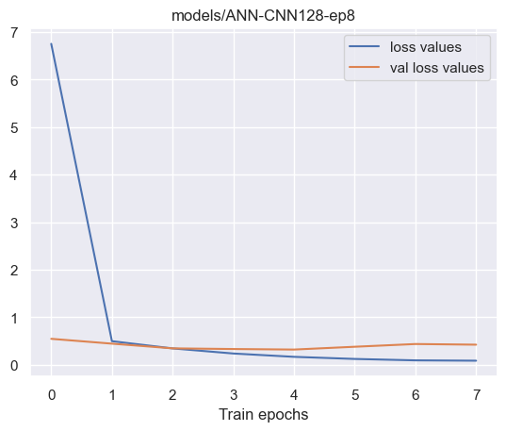
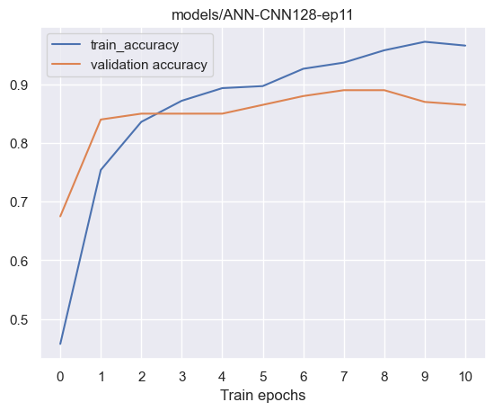
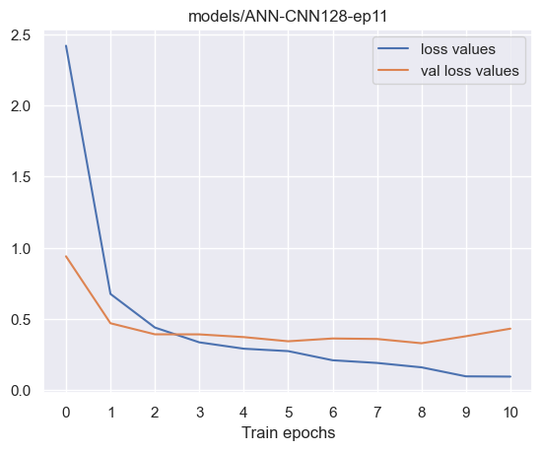
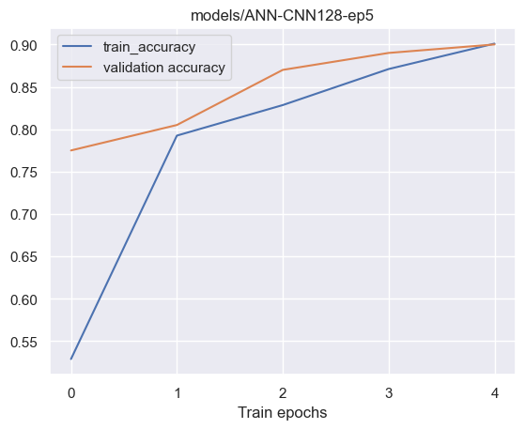
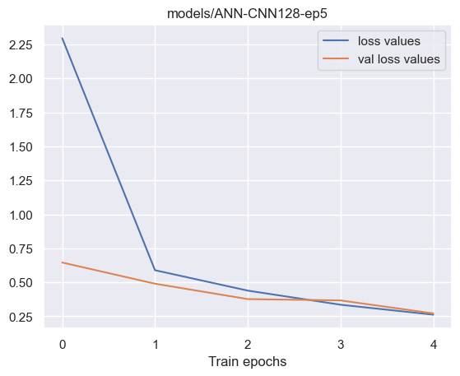
Accuracy and Loss with epochs fine tuning
CNN + ANN with 20 epochs
CNN + ANN with 20 epochs
CNN+ANN with 11 epochs
CNN+ANN with 5 epochs

Slide 18
Model stacking using Random Forest Classification and Deep Learning models
Constraints
Training time
The dataset
The model
Standards
Python: jupyter, py python file
Plotform: python version 3.10. on Visual Studio Code
Modeling: TensorFlow, Keras and Sklearn.
Plot: Pyplot from matplotlib
Data manipulation and storage: Pandas dataframe, os, csv and pickle
Comparison
Top machine learning classifier: random forest
Top models: Stacking of neual network models and random forest.
Limitations of the Study
School materials
Online research
.
Future Work
Particle Identification and classification on top of batteries
.

