Slide 1

Snowflakes
Mimicking Particles Under Microscope Ming-hwei Carol Sun

Slide 2
Snowflakes
Description
The initiation of data research was to get images with non-organic metal particles taken under microscope since the company I am working for wants to have a way of categorizing the particles in images taken under microscope.
Problem Statement
The problem was that this type of images were not found on the internet. The closest one only had less than 300 images which is not enough to do different machine learning tests. By searching image datasets, many interesting image datasets were found, and the snowflakes dataset ironically looked even closer to the images taken in the company than the one found with insufficient numbers.
Dataset
Through search engines, over 25,000 human-classified images of snowflakes were found by Colorado State University.

Slide 3
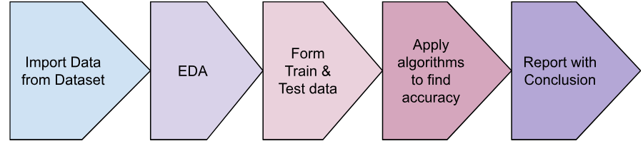
Snowflakes
Approach/ Methodology
Using snowflake images in the dataset to make training data and test data for supervised machine learning. Use different algorithms to see how long it takes and how accurate the result would be.
Evaluation Parameters (potential)
Accuracy - the accuracy of using each algorithm
Time took to run - Time took to run the algorithm to see if there is a trade of between accuracy and time

Slide 4
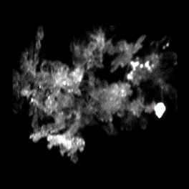
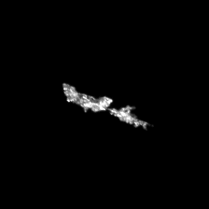
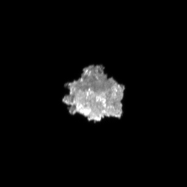
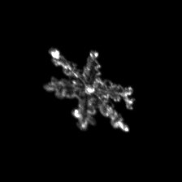
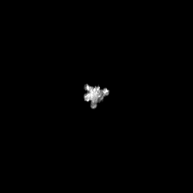
Snowflakes or Particles
The images were sorted into the following categories:
AG (aggregate) | CC (columnar crystal) | GR (graupel) | PC (planar crystal) | SP (small particle).
The only problem with the snowflake images is that they are all with black backgrounds and white subjects. The particle images taken in the company are sometimes with white background and black subjects to indicate if the subject is an indentation or a raised particle.
This problem is resolved to alter the images in the snowflakes dataset to have the reversed color. The Categories then became:
{'AG':'group', 'CC':'fiber', 'GR':'raised', 'PC':'peel', 'SP':'bubble', 'GRT': 'indentation', 'SPT': 'small-indent’}
Instead of
{'AG':'aggregate', 'CC':'columnarcrystal', 'GR':'graupel', 'PC':'planarcrystal', 'SP':'smallparticle', 'GRT': 'grapel-trans', 'SPT': 'small-trans'}

Slide 5
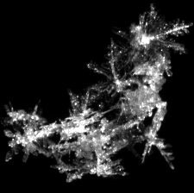
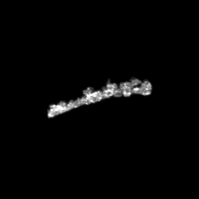
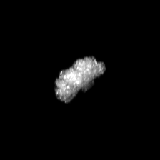

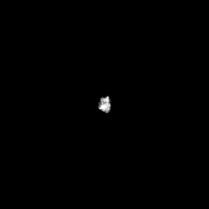
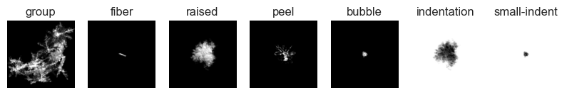
Particles?
Group Particle | Fiber | Raised | Li Peeling | Bubbles
Indentation | Small indent
225 x 225 pixels images in 7 categories
AG 4538
CC 4521
GR 4500
PC 4514
SP 4626
GRT 4500
SPT 4626

Slide 6
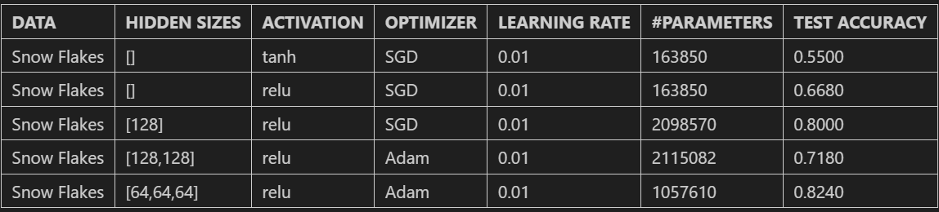
Objective/Methodology
The task of this project is to use the snowflakes images to see which machine learning algorithm is the most accurate in detecting its categories. If it is successful, this process may be able to detect similar images that contain particles under a microscope in the future.
1000 Training Data form each category and 100 Test Data. Total 7000 Training Data and 700 Test Data
Baseline: Neural Network

Slide 7
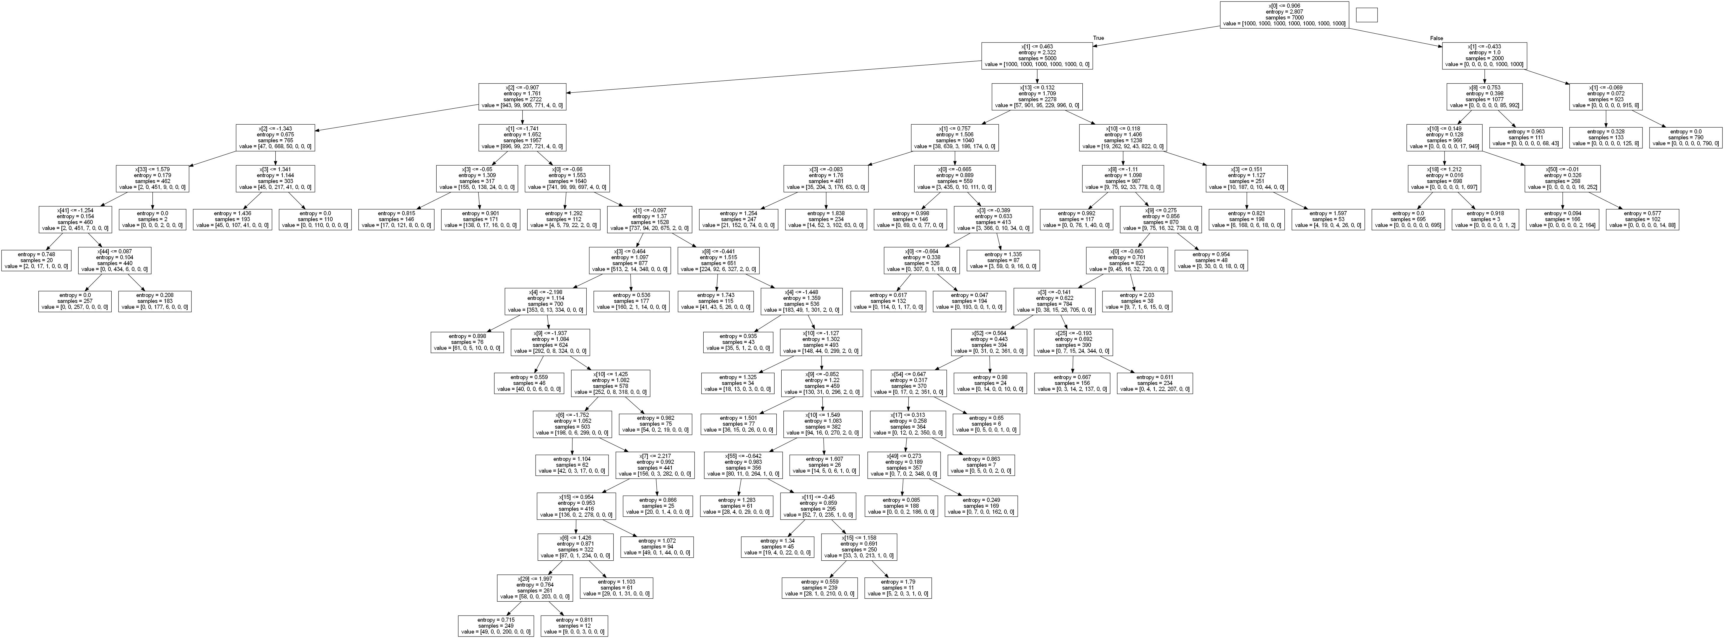
Decision Tree
criterion='entropy'
min_samples_split = 250
PCA images to 64 features
Accuracy: 0.70
Max Depth: 15
Node Count: 115

Slide 8
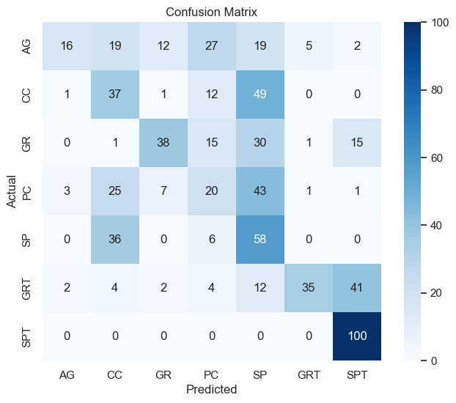
Nearest Neighbors classifier
PCA images to 64 features
Accuracy: 0.4342857142857143

