Slide 1

by AnonTech
Smart Redaction & Editing—Powered by AI, on Mobile
ANON
DOCS
PRIVACY TECH
AI POWERED
MOBILE SCANNER
Project Proposal for Anon Docs – Secure Mobile Scanning

Slide 2
🧑‍💻 SAKKA Mohamad-Mario
Role: Developer
Description: Builds and maintains the mobile app and backend infrastructure.
🤖 ZAFAR Azzam
Role: AI Specialist
Description: Develops the AI engine that detects and redacts sensitive data.
🎨 AL-KHALIDY Essam
Role: UI/UX Designer
Description: Designs the user interface for a smooth and intuitive experience.
by AnonTech
MEET THE TEAM
DEVELOPER
AI SPECIALIST
UI/UX DESIGNER

Slide 3
PROJECT BACKGROUND
Individuals Regularly Share Sensitive Files
(ID cards, certificates, contracts, etc.)
Manual Redaction is Error-Prone & Time-Consuming
(Traditional tools aren't efficient or mobile-native.)
Why We Need This App
In today's digital world, people often need to share documents that contain sensitive personal or financial data. Manual redaction tools are slow, inaccurate, and not mobile-friendly. With growing legal pressure around privacy laws like GDPR and HIPAA, there’s a clear need for a fast, smart, and secure solution.
Privacy Regulations Demand Better Tools
(GDPR, HIPAA, and other laws require secure data handling.)

Slide 4
ADVANTAGES
AI-Powered Redaction for Accuracy & Speed (Automatically detects sensitive or relevant fields which the user wants to edit)
Why Anon Docs Stands Out
In a world where documents travel everywhere via our phones, handling sensitive information shouldn’t slow you down. Traditional tools are clumsy, error-prone, and leave you juggling multiple apps. With AI-powered on-device processing, AnonDocs instantly detects, edits, and redacts text—so you can import, review, and export secure PDF, Word, or Excel files with a single tap. Mobile-first, privacy-first, and effortlessly easy.
Preserves Original Document Layout & Formatting (No more messy exports or reformatting)
Export as Word, PDF, or Excel Instantly (Gives users flexibility and control across formats)

Slide 5
Smart Document Scanner
(Mobile-based capture of physical documents)
APP FEATURES
Remote (Paid Subscription) or Local AI-Powered Redaction Engine
Export to Word, PDF, or Excel
(Maintains original layout/formulas for editing or sharing)
Key Functions of Anon Docs
Anon Docs combines document scanning with smart AI-powered redaction. It helps users protect sensitive data in seconds — directly from their phone — while preserving formatting and offering flexible export options.
Cloud Upload & Secure Sharing
(Sync with Google Drive, Dropbox, or share directly)

Slide 6
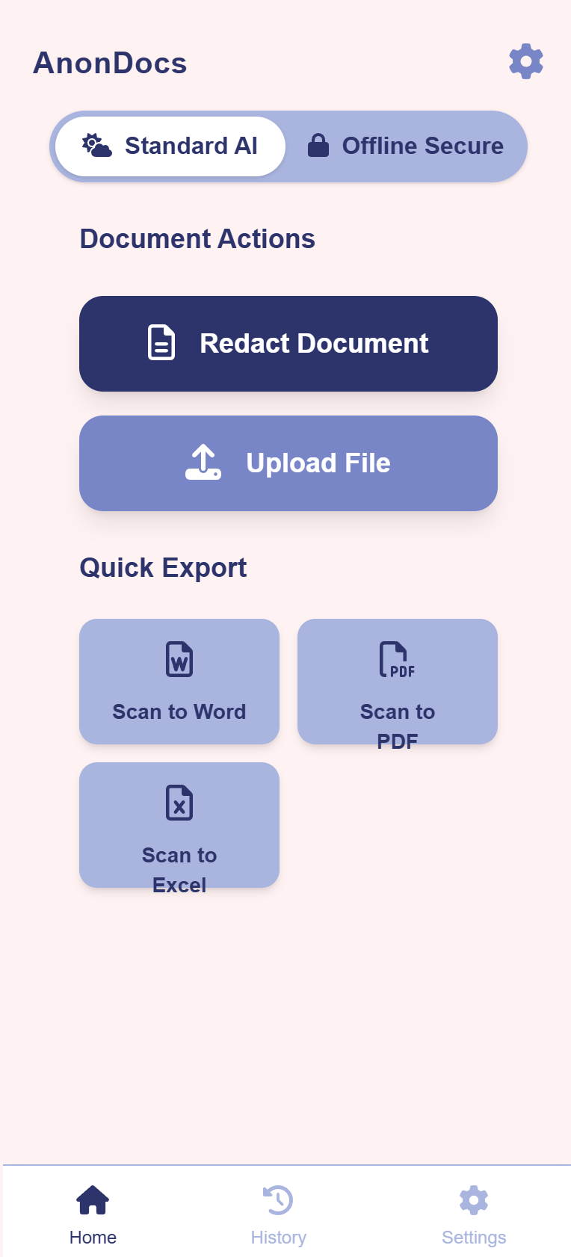
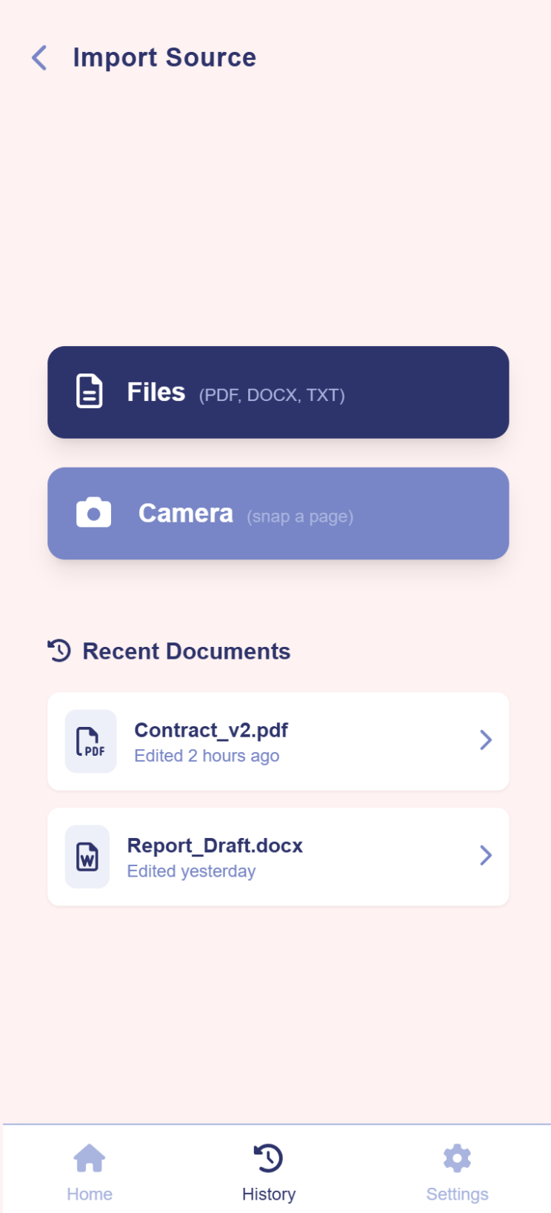
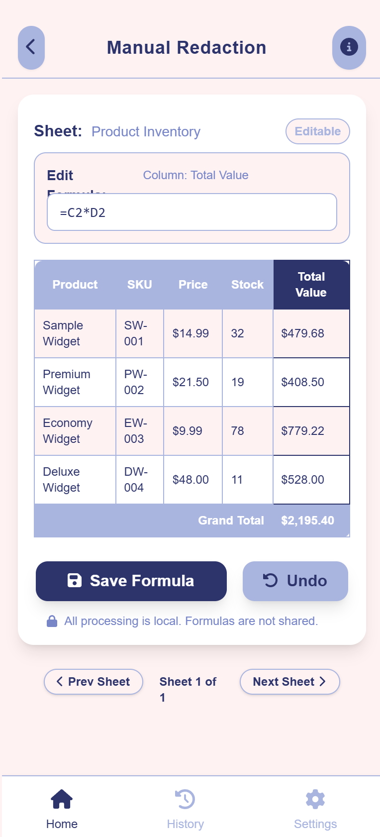
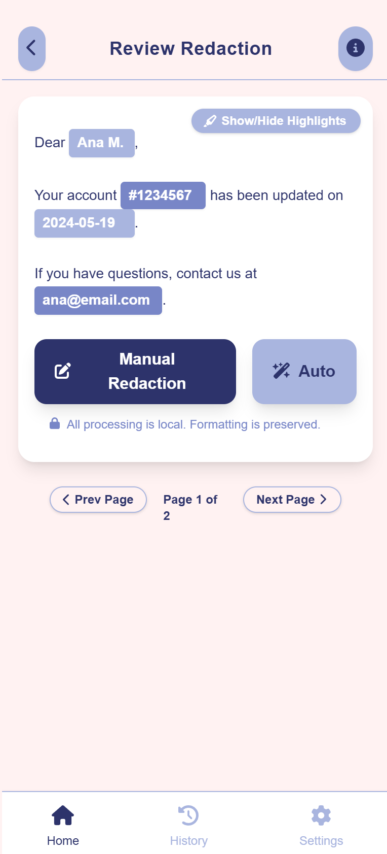
Some snippets

Slide 7
Interviewed 4 target users across legal, academic, and retail workflows
USER TRACTION & EARLY VALIDATION
Built 3 detailed personas & POVs directly from user feedback
Confirmed strong demand for offline secure redaction, mobile OCR to Excel, and multi-format exports
Users described AnonDocs as “intuitive”, “generous” and “incredibly useful”

Slide 8

TARGET AUDIENCE
Need to redact client records, contracts, invoices, or patient files on the go—while maintaining full auditability and compliance.
Share transcripts, recommendation letters, research papers, or grading rubrics securely—preserving layouts and enabling easy peer/professor feedback.
Who Will Use It?
Anon Docs is built for professionals and individuals who frequently share documents and must ensure sensitive data is redacted securely and efficiently. As privacy regulations tighten, the demand for smart document protection grows across industries.
HR staff, consultants, and admins who handle PII daily require a trustable, mobile tool to sanitize documents and generate editable reports in PDF, Word, or Excel formats.

Slide 9
COMPETITOR COMPARISON
Why We're Better
Feature | Anon Docs | Adobe Acrobat Pro | CamScanner | PDFfiller
Mobile Redaction | ✅ | ❌ | ✅ | ✅
AI-Powered Redaction | ✅ | ❌ (manual only) | ❌ | ❌
Preserves Formatting | ✅ | ❌ | ❌ | ❌
Exports to DOCX/Excel /PDF | ✅ | PDF only | PDF only | PDF only
Cloud Integration | ✅ | ✅ | ✅ | ✅
Free Tier Available | ✅ | ❌ (trial only) | ✅ | ✅

Slide 10
BUSINESS MODEL
How We Plan to Grow & Monetize
Phase 1
Phase 2
Phase 3
Phase 4
FREEMIUM MODEL
PREMIUM SUBSCRIPTION
ENTERPRISE LICENSING
Add-Ons & Micro-Subs
Users can scan and redact single documents for free with limited exports (e.g., only PDF).
Monthly/annual plans unlock batch redaction, export to Word, PDF & Excel, and cloud integrations.
Scalable, compliant solutions for law firms, medical centers, HR platforms, and financial institutions.
One-time and small subscription packs for OCR credits, watermark removal, extra export formats, and compliance reports.

Slide 11
PROJECT FUNDING
Product Development & AI R&D – $220K Mobile app engineering (iOS/Android): $120K AI model licensing & on-device optimization: $70K– UX/UI & prototyping (Figma → development handoff): $30K
Cloud & DevOps Infrastructure – $80K
CI/CD pipelines, testing & staging servers: $30K
Secure sandbox & on-device model distribution: $20K Monitoring, analytics & scalability buffer: $30K
Marketing & User Acquisition – $120K
Digital ads & content marketing: $60K
Partnerships (legal/academic communities): $30K
Launch events & PR: $30K
What We Need to Make It Happen
Use of Funds: Build MVP mobile app, train and optimize AI models for on-device redaction & OCR, secure regulatory compliance, and acquire first 1,000 paying users.
Operations, Legal & Compliance – $80K
GDPR/HIPAA compliance audit & documentation: $40K Legal fees (IP, terms, privacy policy): $20K
General ops (accounting, administrative): $20K

Slide 12
“AI-Powered Doc Control in Your Pocket”
“AI-Powered Doc Control in Your Pocket”
by AnonTech
AI-Powered Doc Control in Your Pocket
THANK
YOU!
📧essam@anontech.com
📞 +40 728 461 015

