Slide 1



Email Order Processing Automation
Automating email orders into a restock spreadsheet using Outlook and UiPath
SAKKA Mohamad Mario • MAHMOUD MIRGHANI Abdelrahman
ZAFAR Azzam • AL KHALIDY Essam
Notes:
We're here today to present our systems engineering project focused on automating a critical business function: email order processing. This automation project directly addresses the time-consuming, error-prone task of manually moving order data from an email inbox into a restock spreadsheet. We've leveraged the power of UiPath and Microsoft Outlook to create a seamless, end-to-end solution. This system is designed to provide immediate, tangible value by integrating with the tools you already use every day. But before we dive into the solution, let's clearly define the operational pain points we are solving.

Slide 2

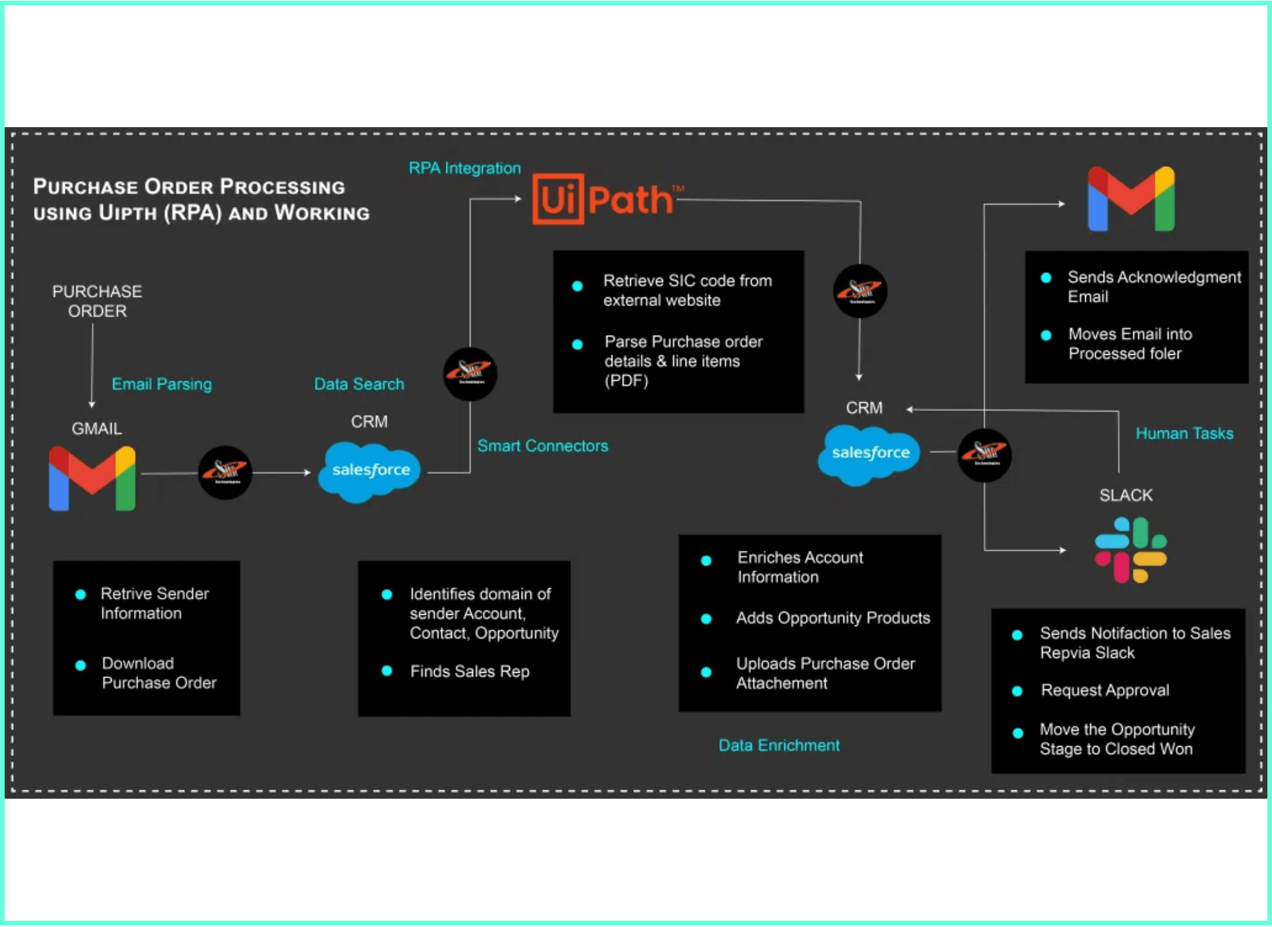
The Problem: Manual Bottlenecks
Manual order processing creates significant operational challenges that hinder business growth and efficiency.
High manual effort required for reading emails and extracting data.
Accuracy risks associated with manual data entry into Excel sheets.
Traceability gaps in tracking processed orders and attachments.
Response delays for high-value orders due to manual queues.
Notes:
The core problem we identified is the manual processing bottleneck that slows down the entire order fulfillment cycle. Staff currently spend excessive time reading emails, extracting product lines, and downloading attachments, which is a massive drain on resources. This manual data entry into Excel introduces significant accuracy risks, leading to misread quantities and calculation errors that impact inventory. And critically, the lack of a consistent log creates traceability gaps, making it difficult to track which orders have been processed and where the data resides. These challenges directly translate into response delays for high-value orders, which is unacceptable for customer satisfaction. We need to eliminate these manual steps to free up staff and ensure data integrity. So, how exactly does our automated system solve these critical issues?

Slide 3

The Solution: Automated Processing
A robust RPA-based automation framework designed to transform manual email order handling into a seamless, local workflow.
Automated detection of order emails using keywords.
Screenshot Placeholder
Insert screenshot of the automation workflow
or the final restock spreadsheet here.
Reliable extraction from Labeled, CSV, and Pipe formats.
Instant updates to the local restock spreadsheet.
Intelligent routing to Processed or Priority folders.
Notes:
Our solution is a robust Robotic Process Automation framework that transforms that manual process into a seamless, local workflow. The system starts with automated detection, monitoring the Outlook inbox and identifying order emails using specific keywords. Once detected, it reliably extracts the order lines, even handling variations in format like Labeled, CSV, and Pipe-separated data. This extracted data instantly updates the local restock spreadsheet, ensuring inventory visibility is always current. Finally, the system intelligently routes the processed emails into specific folders, flagging high-priority orders for immediate attention. This end-to-end automation replaces human error with machine precision. But you might be asking, why choose this specific approach over other industry tools?

Slide 4
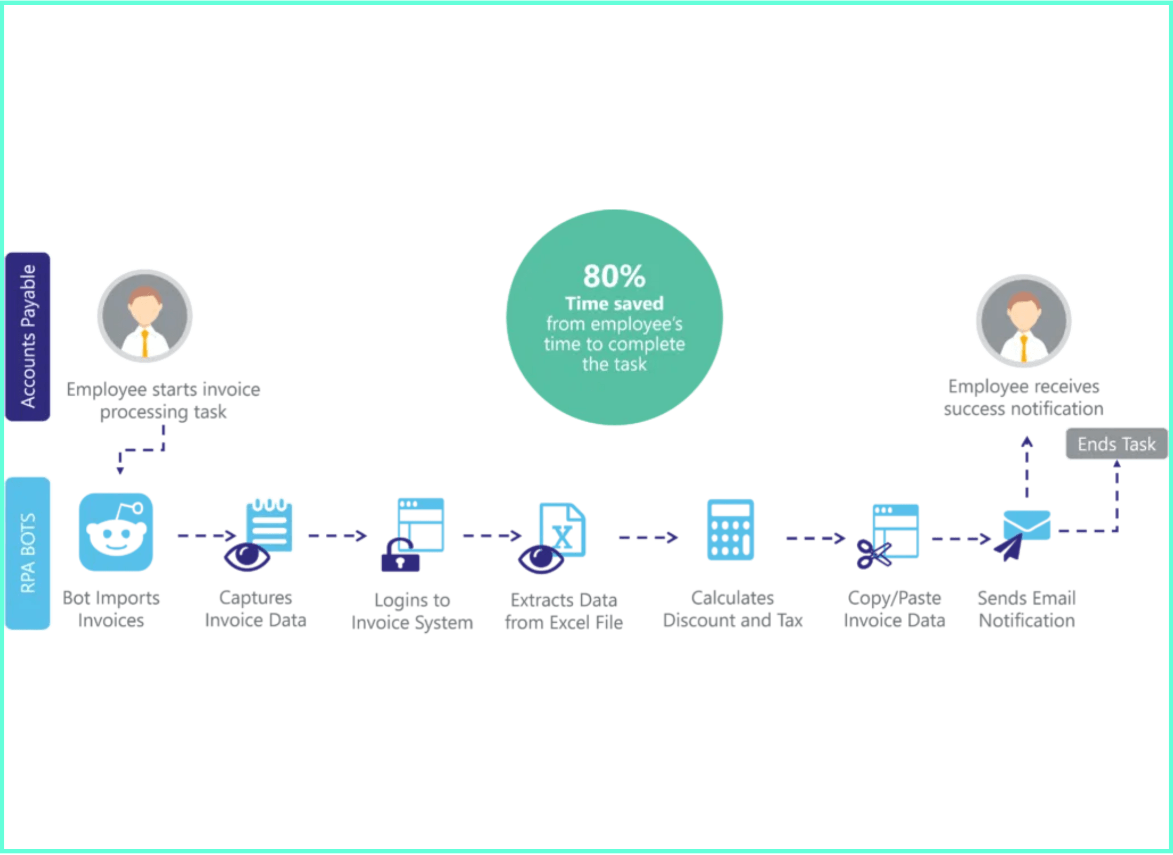
Strategic Comparison
RPA offers a strategic advantage by automating existing local workflows without the need for complex cloud migrations or rigid templates.
Handles variations in email bodies that standard templates cannot.
Avoids high implementation costs and complex integration of cloud portals.
Provides a robust, configuration-driven framework easier to maintain than custom scripts.
Leverages existing UI/Desktop apps, ideal for local Outlook and Excel environments.
Notes:
When we look at industry alternatives, RPA offers a clear strategic advantage because it works with your existing local environment. Unlike complex cloud solutions, our system handles the variations in email bodies that rigid, template-based systems often fail to manage. We completely avoid the high implementation costs and complex integration required by new cloud portals or enterprise resource planning systems. Instead, we provide a robust, configuration-driven framework that is much easier to maintain than fragile custom scripts. This approach is ideal because it leverages your existing desktop applications, specifically Outlook and Excel, without requiring a massive infrastructure overhaul. This local focus is key to our implementation strategy.

Slide 5

Implementation: Local Automation Stack
The system leverages a robust, local technology stack to ensure high performance, security, and seamless integration with existing desktop tools.
UiPath Studio:
The core engine used to build modular and stable automation sequences.
Outlook Classic:
Direct local integration for fetching unread order emails and routing.
Microsoft Excel:
Local storage and management of the restock spreadsheet and audit logs.
Local Security:
All data processing and storage remain on the workstation for maximum control.
Notes:
Our implementation relies on a powerful, local automation stack designed for high performance and security. We selected UiPath Studio as the core engine because it allows us to build modular and stable automation sequences quickly. The system integrates directly with Outlook Classic, allowing it to seamlessly fetch unread order emails and route them to the correct folders after processing. All the critical data, including the restock spreadsheet and the audit logs, is managed locally within Microsoft Excel. This is important because all data processing and storage remain on the workstation, giving you maximum control and security. Now that we've covered the technology, let's dive into the specific business logic that drives the system's decisions.

Slide 6
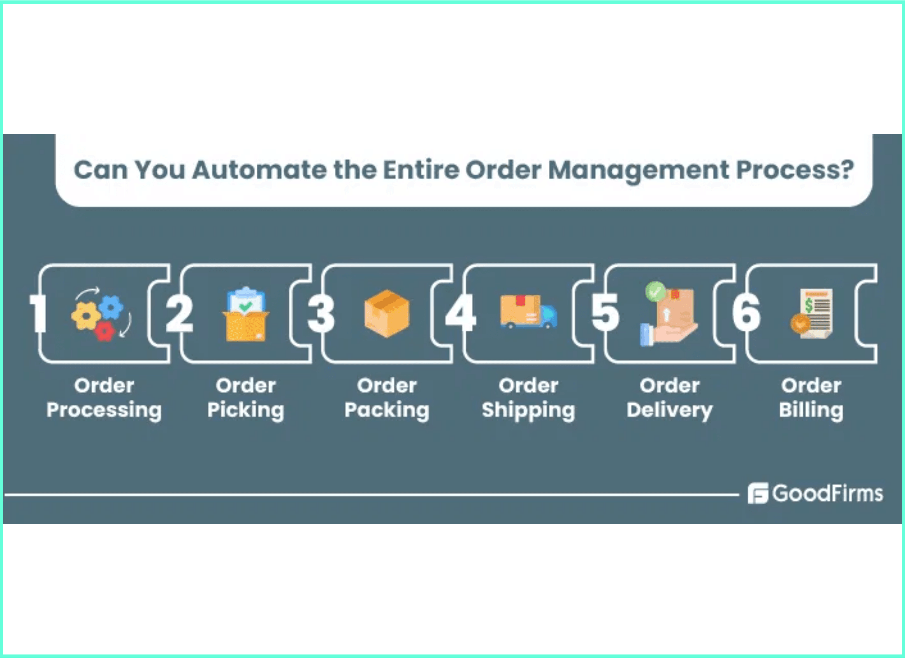
Business Logic: Priority & Routing
The system applies deterministic rules to categorize orders and manage email workflow automatically.
HighPriority is assigned when order totals exceed the "Fast Delivery" price threshold.
Standard status is the default for all other valid, parseable orders.
NeedInfo Routing flags ambiguous orders for manual review to prevent data loss.
Outcome Folders ensure clear separation between Processed, HighPriority, and Manual Review items.
Notes:
We've established the technical foundation, and now we're diving into the core business logic that drives the automation's value. This slide shows how we apply deterministic rules to categorize orders and manage the email workflow automatically. High-value orders are immediately flagged as High Priority when they exceed a specific price threshold, ensuring they get fast-tracked. The system also uses NeedInfo Routing to flag ambiguous orders for manual review, which prevents data loss and ensures no order is silently dropped. This automated routing into specific Outcome Folders like Processed and HighPriority gives our team clear separation and immediate visibility into the status of every incoming order. This intelligent routing is critical because it directly feeds into how we calculate delivery times, which we'll cover next.

Slide 7
Business Logic: Delivery & ETA
The system automatically computes delivery estimates to provide customers with accurate and timely order fulfillment information.
Fast Delivery:
Today plus Fast days (applied to all HighPriority orders).
Slow Delivery:
Today plus Slow days (applied to orders with high item quantities).
Standard Delivery:
Today plus Standard days (the default estimate for all other orders).
Automated Communication:
Estimates are included in the instant email reply sent to the customer.
Notes:
Building on the priority logic, this is where the automation directly impacts the customer experience by providing accurate, instant delivery estimates. The system uses the order's priority and quantity to assign one of three delivery tiers: Fast, Slow, or Standard. High Priority orders automatically receive Fast Delivery, while orders with excessively high quantities are assigned Slow Delivery to manage warehouse expectations. Standard Delivery is the default for all other valid orders. This calculated estimate is then included in the instant email reply sent back to the customer, providing immediate and reliable communication. Now that we've covered the core business rules, let's look at how we ensure the entire system remains reliable and accountable.

Slide 8
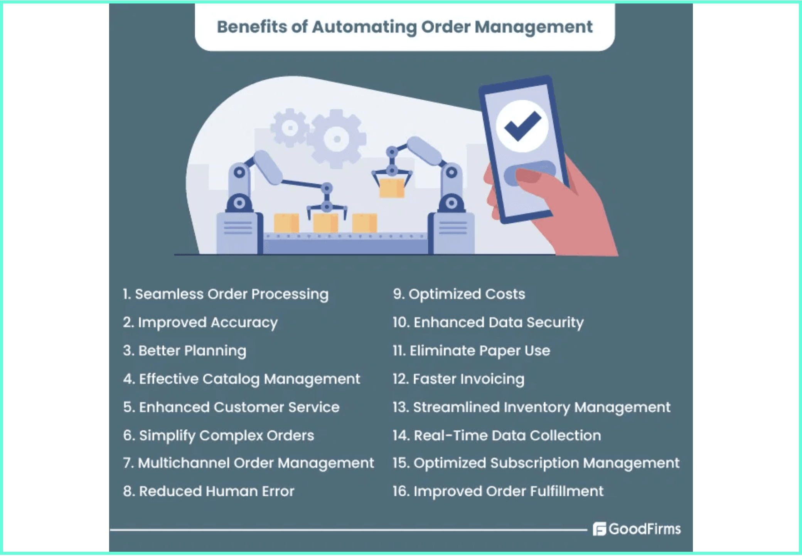
Reliability: Exception Handling
The system ensures data integrity and operational continuity through intelligent exception management and comprehensive logging.
NeedInfo Routing: Flagging ambiguous orders for manual review.
Failed Folder: Isolating system errors for immediate troubleshooting.
Attachment Organization: Timestamped subfolders for instant retrieval.
Outcome Folders: Clear separation between Processed and Priority items.
Audit Logs: Local CSV recording of every transaction for traceability.
Notes:
The true measure of a robust system is not just what it does right, but how it handles exceptions and maintains accountability. We've built in several layers of reliability, starting with the NeedInfo Routing we discussed, which ensures ambiguous orders are never lost. We also have a dedicated Failed Folder that isolates system errors for immediate troubleshooting by IT. For every transaction, we generate comprehensive Audit Logs, which are local CSV recordings that provide full traceability with timestamps and order status. This combination of intelligent routing and detailed logging ensures data integrity and operational continuity, even when things don't go perfectly. This strong foundation of reliability makes us ready to discuss how we can expand the system's capabilities in the future.

Slide 9

Future Potential: Scaling & Enhancements
The project roadmap focuses on expanding system capabilities and transitioning to more robust data management architectures.
Multi-Format Expansion:
Adding support for PDF attachments and more diverse email layouts.
Advanced Analytics:
Generating local reports on order trends and processing efficiency from audit logs.
Database Transition:
Moving from Excel to a local SQLite database for improved data integrity and concurrency.
Enhanced Validation:
Real-time checks against product availability and customer account status.
Notes:
We've delivered a stable, high-value solution, but the architecture is designed for growth, not just for the current scope. Our immediate roadmap includes Multi-Format Expansion, adding support for parsing orders from PDF attachments and handling more diverse email layouts. A key enhancement will be transitioning from Excel to a local SQLite Database, which will significantly improve data integrity and concurrency for multiple users. Finally, we plan to implement Enhanced Validation, adding real-time checks against product availability and customer account status to reduce fulfillment errors. These enhancements will ensure the system continues to scale effectively as the business grows. And with that, we've covered the full scope of the project and its future.

Slide 10
Thank You
Questions & Answers
A robust, local RPA solution that transforms manual order processing into a streamlined, automated workflow using Outlook and Excel.
Final Screenshot Placeholder
Insert a final "Success" screenshot or a team photo here.
Notes:
We've successfully implemented a robust, local RPA solution that transforms manual order processing into a streamlined, automated workflow using Outlook and Excel. This project has delivered significant efficiency gains, eliminated manual entry errors, and provided full traceability for every order. We've moved from a manual bottleneck to a reliable, automated system that is ready for future scaling. We're now happy to take any questions you have about the system design, the business logic, or the implementation process. Thank you for your time.

