Slide 1
App: FitPlanner
By: Mo Syed

Slide 2
Summary
A fitness application (“FitPlanner”) in which users enter their statistics (such as height, age, weight, and their goals) and the application outputs a meal and workout plan. The user can then decide which meals and exercises they would like to use.
Uses a formula to calculate tdee calories and compare the TDEE calories with the total calories of the chosen meals, just to ensure that the data/stats match up and make sense.

Slide 3
Preliminary list of functional requirements & technical features
Functions: userinput, showmeals, showexercises, calculateusercalories, calculateworkout
Technical features: 5 MVCs: user input, decide meals, decide exercises, compare and show results, use dictionaries to store pre sorted data, use TDEE formula to calculate calories, store users data to process information and segue to send data, login through firebase, table view and table picker views

Slide 4
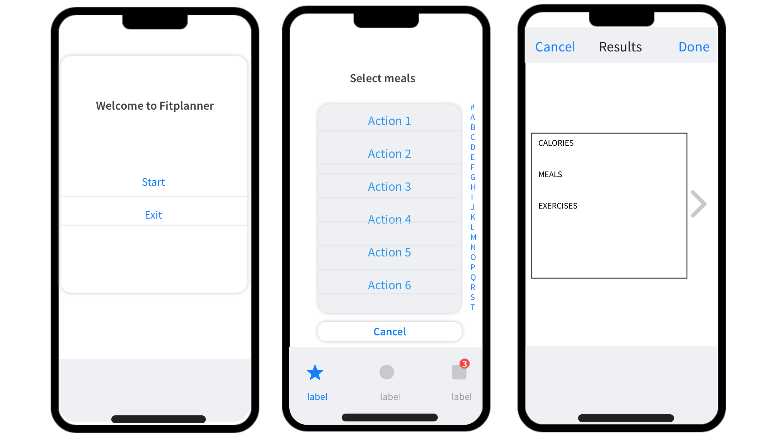
SAMPLE VIEWS / Wireframe

Slide 5
COMPETITIVE ANALYSIS
Competitors: Myfitnesspal, foodtracker, workout planner
My app provides customizability and lets the user to make their own routines by selecting different parts of it from our presorted lists according to their preference.
It’s like your own personal trainer / nutritionist.

Slide 6
Final report:
I was able to add all functions and implement multiple MVCs, table views, pickerviews, and used a list instead of dictionary to store data.
Layout was kept simple and minimalistic.
App uses a calculated formula to calculate user’s required calories every day. And uses that as a baseline to calculate a recommendation a/c to their goal
App takes into consideration user’s goals, meal & exercise preferences and gives a sample plan accordingly.

