Slide 1

Predicting Corn, Wheat and Soybean Yield
Maura Tokay | UMBC DATA606
Notes:
My name is Maura Tokay and for my capstone project I am proposing to use machine learning to predict corn, wheat and soybean yield using meteorological data and compare feature importance among cultures.

Slide 2
Exploratory Data Analyses
This dataset is part of the Farming System Project at USDA, Beltsville MD https://www.ars.usda.gov/northeast-area/beltsville-md-barc/beltsville-agricultural-research-center/sustainable-agricultural-systems-laboratory/docs/farming-systems-project/
This data is not available online on the USDA website but can be found on my GitHub https://github.com/mmtokay/DATA606/tree/master/datasets
Data is split in 2 files: crop and weather information
Notes:
The dataset used comes from the Farming System Project at the USDA in Beltsville, Maryland. If you would like to learn more about the project you can visit this link. The data is not available at the USDA website but can be found on my github. My data consists of 2 files, one with daily weather data and one with crop data.

Slide 3
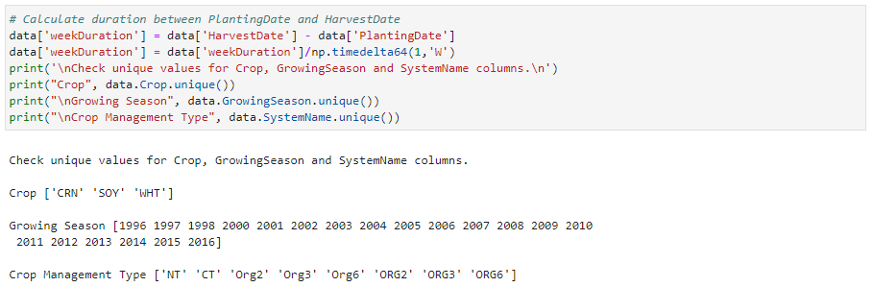
Exploratory Data Analyses
There is no crop data for 1999, this year Maryland had a drought and because the project did not use irrigation, crops never matured.
Notes:
Let’s talk about the exploratory data analyses that was done. There is no crop data for 1999. Maryland had a drought this year and because the project didn’t use irrigation, crops never matured.

Slide 4


Exploratory Data Analyses
Duplicate crop management system.
Notes:
Crop management type had duplicate labels and to solve that I uppercased all crop management labels. I also created a new feature called SystemNameType where I grouped management type in conventional for nt and ct and organic for org2, org 3 and org6.

Slide 5
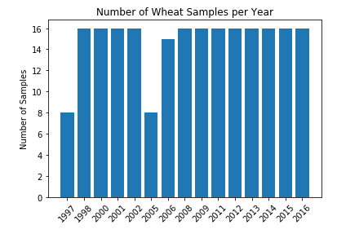
Exploratory Data Analyses
Wheat does not have crop data for 1996, 1999, 2003, 2004, 2007, 2010.
Notes:
Wheat does not have crop data for 1996, 1999, 2003, 2004, 2007, 2010.

Slide 6
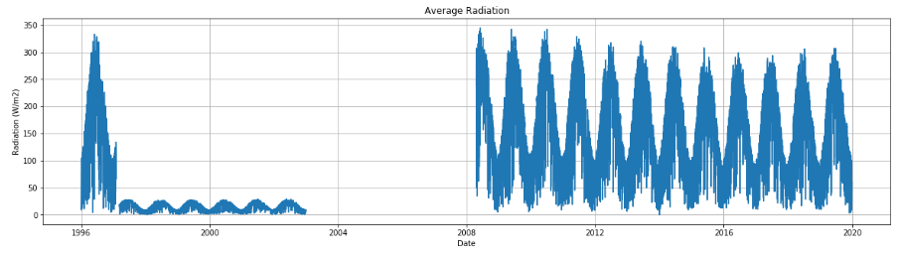
Exploratory Data Analyses
Average radiation will not be used because data is missing for years 2003-2008.
Notes:
Average radiation will not be used because data is missing for years 2003-2008 and data for 1997-2003 doesn’t follow the pattern for the remaining years.

Slide 7


Feature Engineering
Week duration
weekDuration = $\frac{\left(harvestDate−plantingDate\right)}{7}$
Minimum week duration for corn, soybean and wheat are respectively, 16, 15 and 31 weeks.
Notes:
Feature Engineering. I created a variable called weekDuration to calculate how many weeks are in between plantingdate and harvestdate. To calculate week duration we subtract planting date from harvest date and divide by 7. The minimum week duration is 16 weeks for corn, 15 weeks for soybean and 31 weeks for wheat.

Slide 8

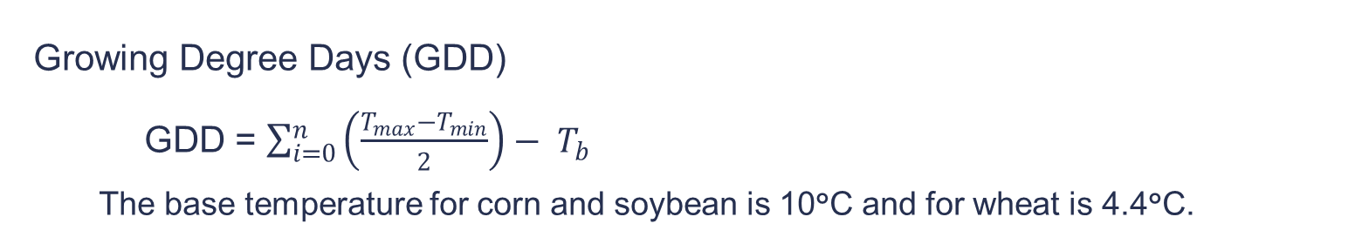
Feature Engineering
Growing Degree Days (GDD)
GDD = $\sum_{i=0}^{n}{\left(\frac{T_{max}−T_{min}}{2}\right)− T_{b}}$
The base temperature for corn and soybean is 10°C and for wheat is 4.4°C.
Notes:
GDD variable was created. GDD is growing degree days that are used to estimate the growth and development of plants and insects during the growing season. The basic concept is that development will only occur if the temperature exceeds some minimum development threshold, or base temperature. The base temperatures are determined experimentally and are different for each organism. The base temperature for corn and soybean are the same which is 10oC and the base temperature for wheat is 4.4oC.

Slide 9
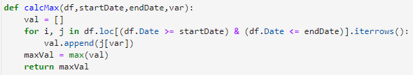
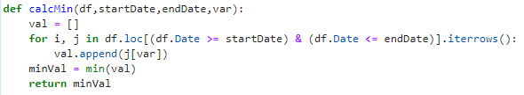
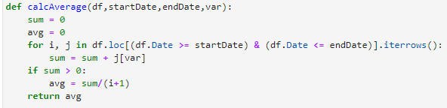

Feature Engineering
Four functions were created to group daily weather data to weekly.
Notes:
I created 4 functions to group daily weather into weekly. The functions created are calcMax to calculate maximum value, calcMin to calculate minimum value, calAverage to calculate average value and calcSum to calculate the summation of all values.

Slide 10
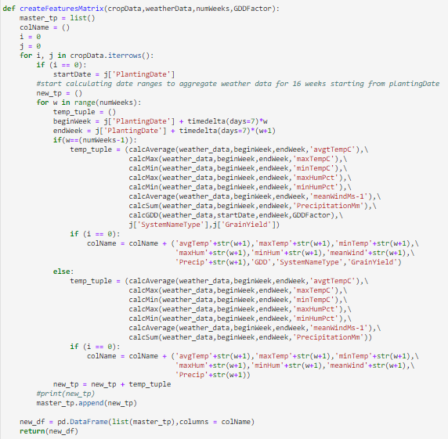
Feature Engineering
Create a matrix with weather features and the target data that it is yield.
Notes:
Create Feature Matrix function was created to combine the weekly weather data with GDD, systemnametype and crop yield (that is the target data) into a matrix to be saved in a file to create the input for the models.

Slide 11
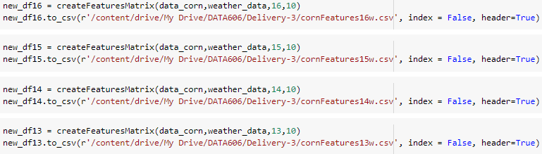
Data Files - Corn
A function was created to build the file with weather features and target data (crop yield).
Corn (390 rows)
16 weeks
114 features + 1 target columns
15 weeks
107 features + 1 target columns
14 weeks
100 features + 1 target columns
13 weeks
93 features + 1 target columns
Notes:
The minimum week duration for corn was 16 weeks but I decided to create input files using 15, 14 and 13 weeks as well to check for any performance difference in my regression models. I had 390 rows of corn data and for each input file the features varied from 93 to 114 features plus the target column.

Slide 12
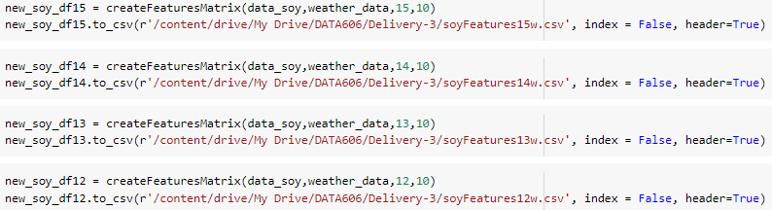
Data Files - Soybean
A function was created to build the file with weather features and target data (crop yield).
Soybean (500 rows)
15 weeks
107 features + 1 target columns
14 weeks
100 features + 1 target columns
13 weeks
93 features + 1 target columns
12 weeks
86 features + 1 target columns
Notes:
The minimum week for soybean was 15 weeks and using the same methodology used for corn I created input files using 15, 14, 13 and 12 weeks. I had 500 rows of soybean data and for each input file the features varied from 86 to 107 features plus the target column.

Slide 13
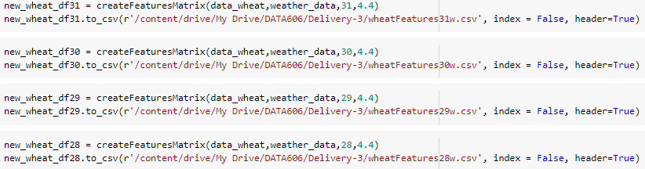
Data Files - Wheat
A function was created to build the file with weather features and target data (crop yield).
Wheat (223 rows)
31 weeks
219 features + 1 target columns
30 weeks
212 features + 1 target columns
29 weeks
205 features + 1 target columns
28 weeks
198 features + 1 target columns
Notes:
The minimum week for wheat was 31 weeks, so I created input files using 31, 30 and 29 weeks. I had 223 rows of wheat data and for each input file the features varied from 205 to 219 features plus the target column.

Slide 14
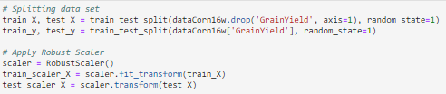
Model Construction – Data Normalization
Used RobustScaler to better handle the outliers. The algorithm removes the median and scales the data using the 1st and 3rd quartile for each feature independently.
Notes:
To normalize the data I used RobustScaler to better handle the outliers. To do that the algorithm removes the median and scales the data using the 1st and 3rd quartile for each feature independently. The Python library used was Scikit-learn.

Slide 15
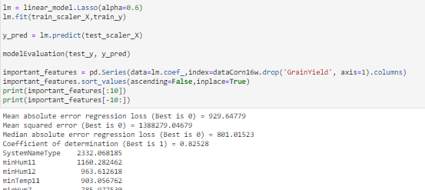
Regression Algorithm - Lasso
Lasso regression performs L1 regularization, which adds a penalty equal to the absolute value of the magnitude of coefficients.
Notes:
First I tried Lasso regression. Lasso regression performs L1 regularization, which adds a penalty equal to the absolute value of the magnitude of coefficients. This type of regularization can result in sparse models with few coefficients. Some coefficients can become 0 and eliminated from the model. Larger penalties result in coefficient values closer to zero, which is the ideal for producing simpler models.

Slide 16
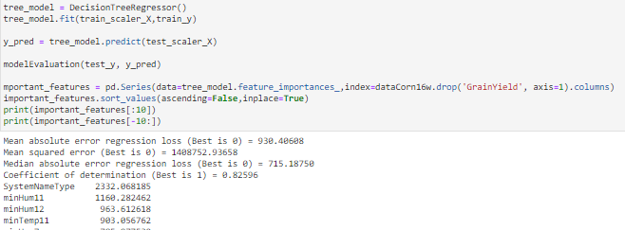
Regression Algorithms – Decision Tree Regressor
Decision tree regression builds a classification model in the form of a tree structure. The topmost decision node in a tree corresponds to the best predictor called root node.
Notes:
Then I tried decision tree regression that builds a classification model in the form of a tree structure. It breaks down a dataset into smaller and smaller subsets while at the same time an associated decision tree is incrementally developed. The topmost decision node in a tree corresponds to the best predictor called root node.

Slide 17
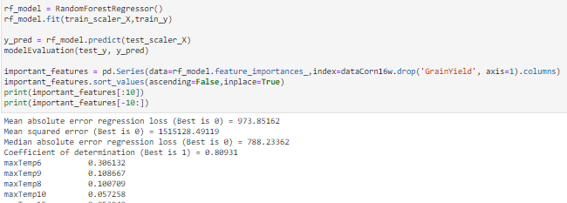
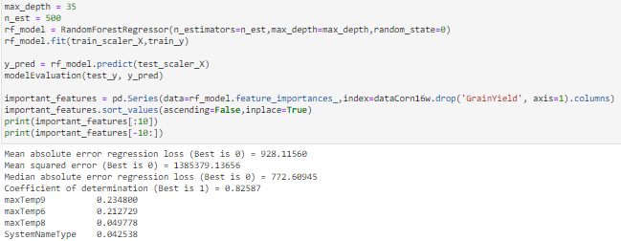
Regression Algorithms – Random Forest Regressor
Random Forest Regressor is a meta estimator that fits a number of classifying decision trees on various sub-samples of the dataset and uses averaging to improve the predictive accuracy and control over-fitting.
Notes:
Next, I tried Random Forest Regressor that is a meta estimator that fits a number of classifying decision trees on various sub-samples of the dataset and uses averaging to improve the predictive accuracy and control over-fitting. First, I used the default setting then I tried the model with max depth of 35 and 500 estimators. After applying all models to my datasets I found that…

Slide 18
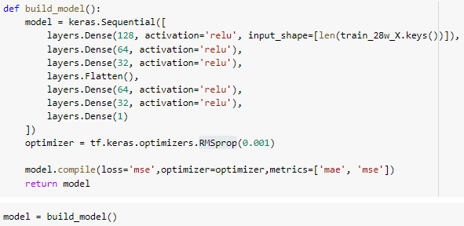
Regression Algorithms – Neural Networks
Neural Network was used building a Sequential model using seven densely connected hidden layers, and an output layer that returns a single value. The optimizer used was RMSprop algorithm.
Notes:
Finally, I tried Neural Network that was used building a Sequential model using seven densely connected hidden layers, and an output layer that returns a single value. The optimizer used was RMSprop algorithm.

Slide 19
Regression Algorithms – Neural Networks
Neural Network was used building a Sequential model using seven densely connected hidden layers, and an output layer that returns a single value. The optimizer used was RMSprop algorithm.
Notes:
Finally, I tried Neural Network that was used building a Sequential model using seven densely connected hidden layers, and an output layer that returns a single value. The optimizer used was RMSprop algorithm.

Slide 20
Model Evaluation
The model evaluation was done using:
Median Absolute Error (MAE) - accuracy
Coefficient of Determination (R²) – confidence level.
Notes:
The model evaluation was done using Median Absolute Error (MAE) and Coefficient of Determination (R²). The median absolute error “is calculated by taking the median of all absolute differences between the target and the prediction” which measures accuracy. The coefficient of determination “is a statistic that will give some information about the goodness of fit of a model. In regression, the R² coefficient of determination is a statistical measure of how well the regression predictions approximate the real data points which gives us the confidence level.

Slide 21
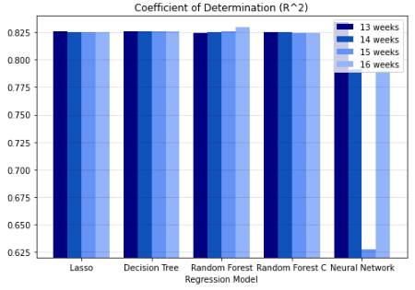
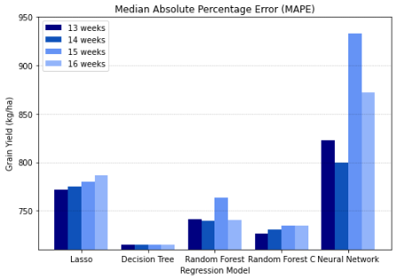
Model Results - Corn
Decision Tree using 13 weeks of weather data with a confidence level of 82.6% and accuracy of ±715.2 kg/ha. The top five features for corn yield prediction using 13 weeks of weather data are maxTemp10, SystemNameType, minHum3, minTemp9 and minTemp7.
Notes:
the best model to predict corn was Decision Tree using 13 weeks of weather data with a confidence level of 82.6% and for the remaining results the accuracy was between ±715.2 kg/ha. The coefficient of determination is the same when running decision tree for 13, 14, 15 and 16 weeks of weather data. This shows that the model does not give weight for variables in weeks 14, 15 and 16 and therefore these weather parameters did not contribute for corn growth significantly. The top five features for corn yield prediction using 13 weeks of weather data are maxTemp10, SystemNameType, minHum3, minTemp9 and minTemp7. It is interesting that temperature and humidity has more influence than precipitation on corn yield prediction.

Slide 22
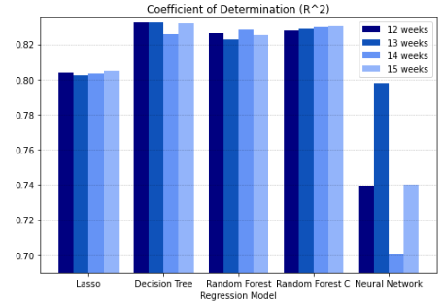
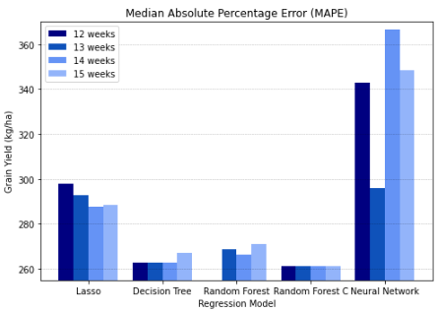
Model Results - Soybean
Random Forest Regressor using 15 weeks of weather data with 400 estimators and 30 depth with a confidence level of 83% and accuracy of ±261kg/ha. The top five features were minTemp12, maxTemp7, minTemp5, Precip10 and minTemp1.
Notes:
The best model for soybean was Random Forest Regressor with 400 estimator 30 depth using 15 weeks of weather data with a confidence level of 83% and for the remaining results the accuracy was between ±261kg/ha. The top five features were minTemp12, maxTemp7, minTemp5, Precip10 and minTemp1. The temperature and precipitation had more influence on soybean yield prediction.

Slide 23
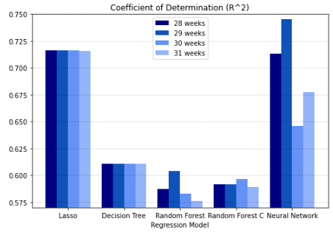
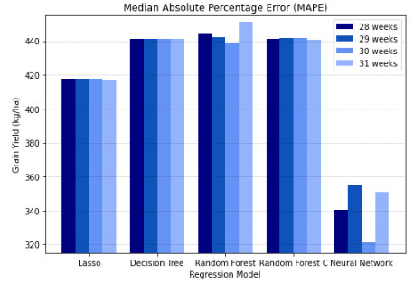
Model Results - Wheat
The best model for wheat was Neural Networks with 7 hidden layers using RMSprop optimizer using 29 weeks of used weather data with a confidence level of 74.5% and for the remaining results the accuracy was between ±354.6kg/ha.
Notes:
The best model for wheat was Neural Networks with 7 hidden layers using RMSprop optimizer using 29 weeks of used weather data with a confidence level of 74.5% (Fig. 5) and for the remaining results the accuracy was between ±354.6kg/ha (Fig. 6).

Slide 24
Model Results
Overall performance of all the models was rated as good (74% to 83%) but it could be better if more data were available to train the models.
The best crop yield model for each crop was unique.
Relative humidity is more important than precipitation for crop prediction. The temperature play an important role on crop prediction.
Climate change will have an impact on crop yield. The increase in temperature is often accompanied by drought and flooding conditions. For a future study, a sensitivity analyses can be performed to understand the climate anomalies on yield prediction.
Notes:
Overall performance of all the models was rated as good (74% to 83%) but it could be better if more data were available to train the models. A model that fits all was not true for this study, the best crop yield model for each crop was unique. It is important to test more than one model when using machine learning algorithms.
Other interesting finding was that relative humidity is more important than precipitation for crop prediction. The assumption that temperature would play an important role on crop prediction was confirmed. Climate change will have an impact on crop yield. The increase in extreme weather is a well-known signal of climate change. The increase in temperature is often accompanied by drought and flooding conditions. The climate anomalies, departures from norms, have significant impact on long-term climate trends. For a future study, a sensitivity analyses can be performed to understand the climate anomalies on yield prediction.

Slide 25
Acknowledgment
Questions?
Michel Cavigelli, PhD, USDA
Anne E Conklin, USDA
More Information
https://github.com/mmtokay/DATA606
Contact Maura Tokay at matokay1@umbc.edu
Notes:
I would like to acknowledge Dr. Michel Cavigelli and Ms. Anne Conklin for providing the data that will be used in this project. If you have any questions or suggestions please contact me on the email listed here. If you want more information about the project, please visit my github account. Thank you for taking your time to watch my capstone pitch presentation.

