Slide 1
BPReveal workshop
Charles McAnany

Slide 2
Syllabus
Network architecture
Data preparation
Solo training
Validation
Interpretation
Bias theory
Joint training
Joint interpretation
Practical

Slide 3
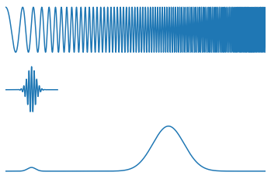
Neural networks: 80% math, 10% guessing, and 10% buzzwords.
Deep Network:
  A neural network with multiple layers in it.
Convolutional filter/layer:
  A pattern finder that scans some input
  and responds where its pattern is detected.
Loss function:
  A measure of how badly a network performs.
  (Minimized during training)
Artificial Intelligence
  What people in marketing call machine learning.

Slide 4
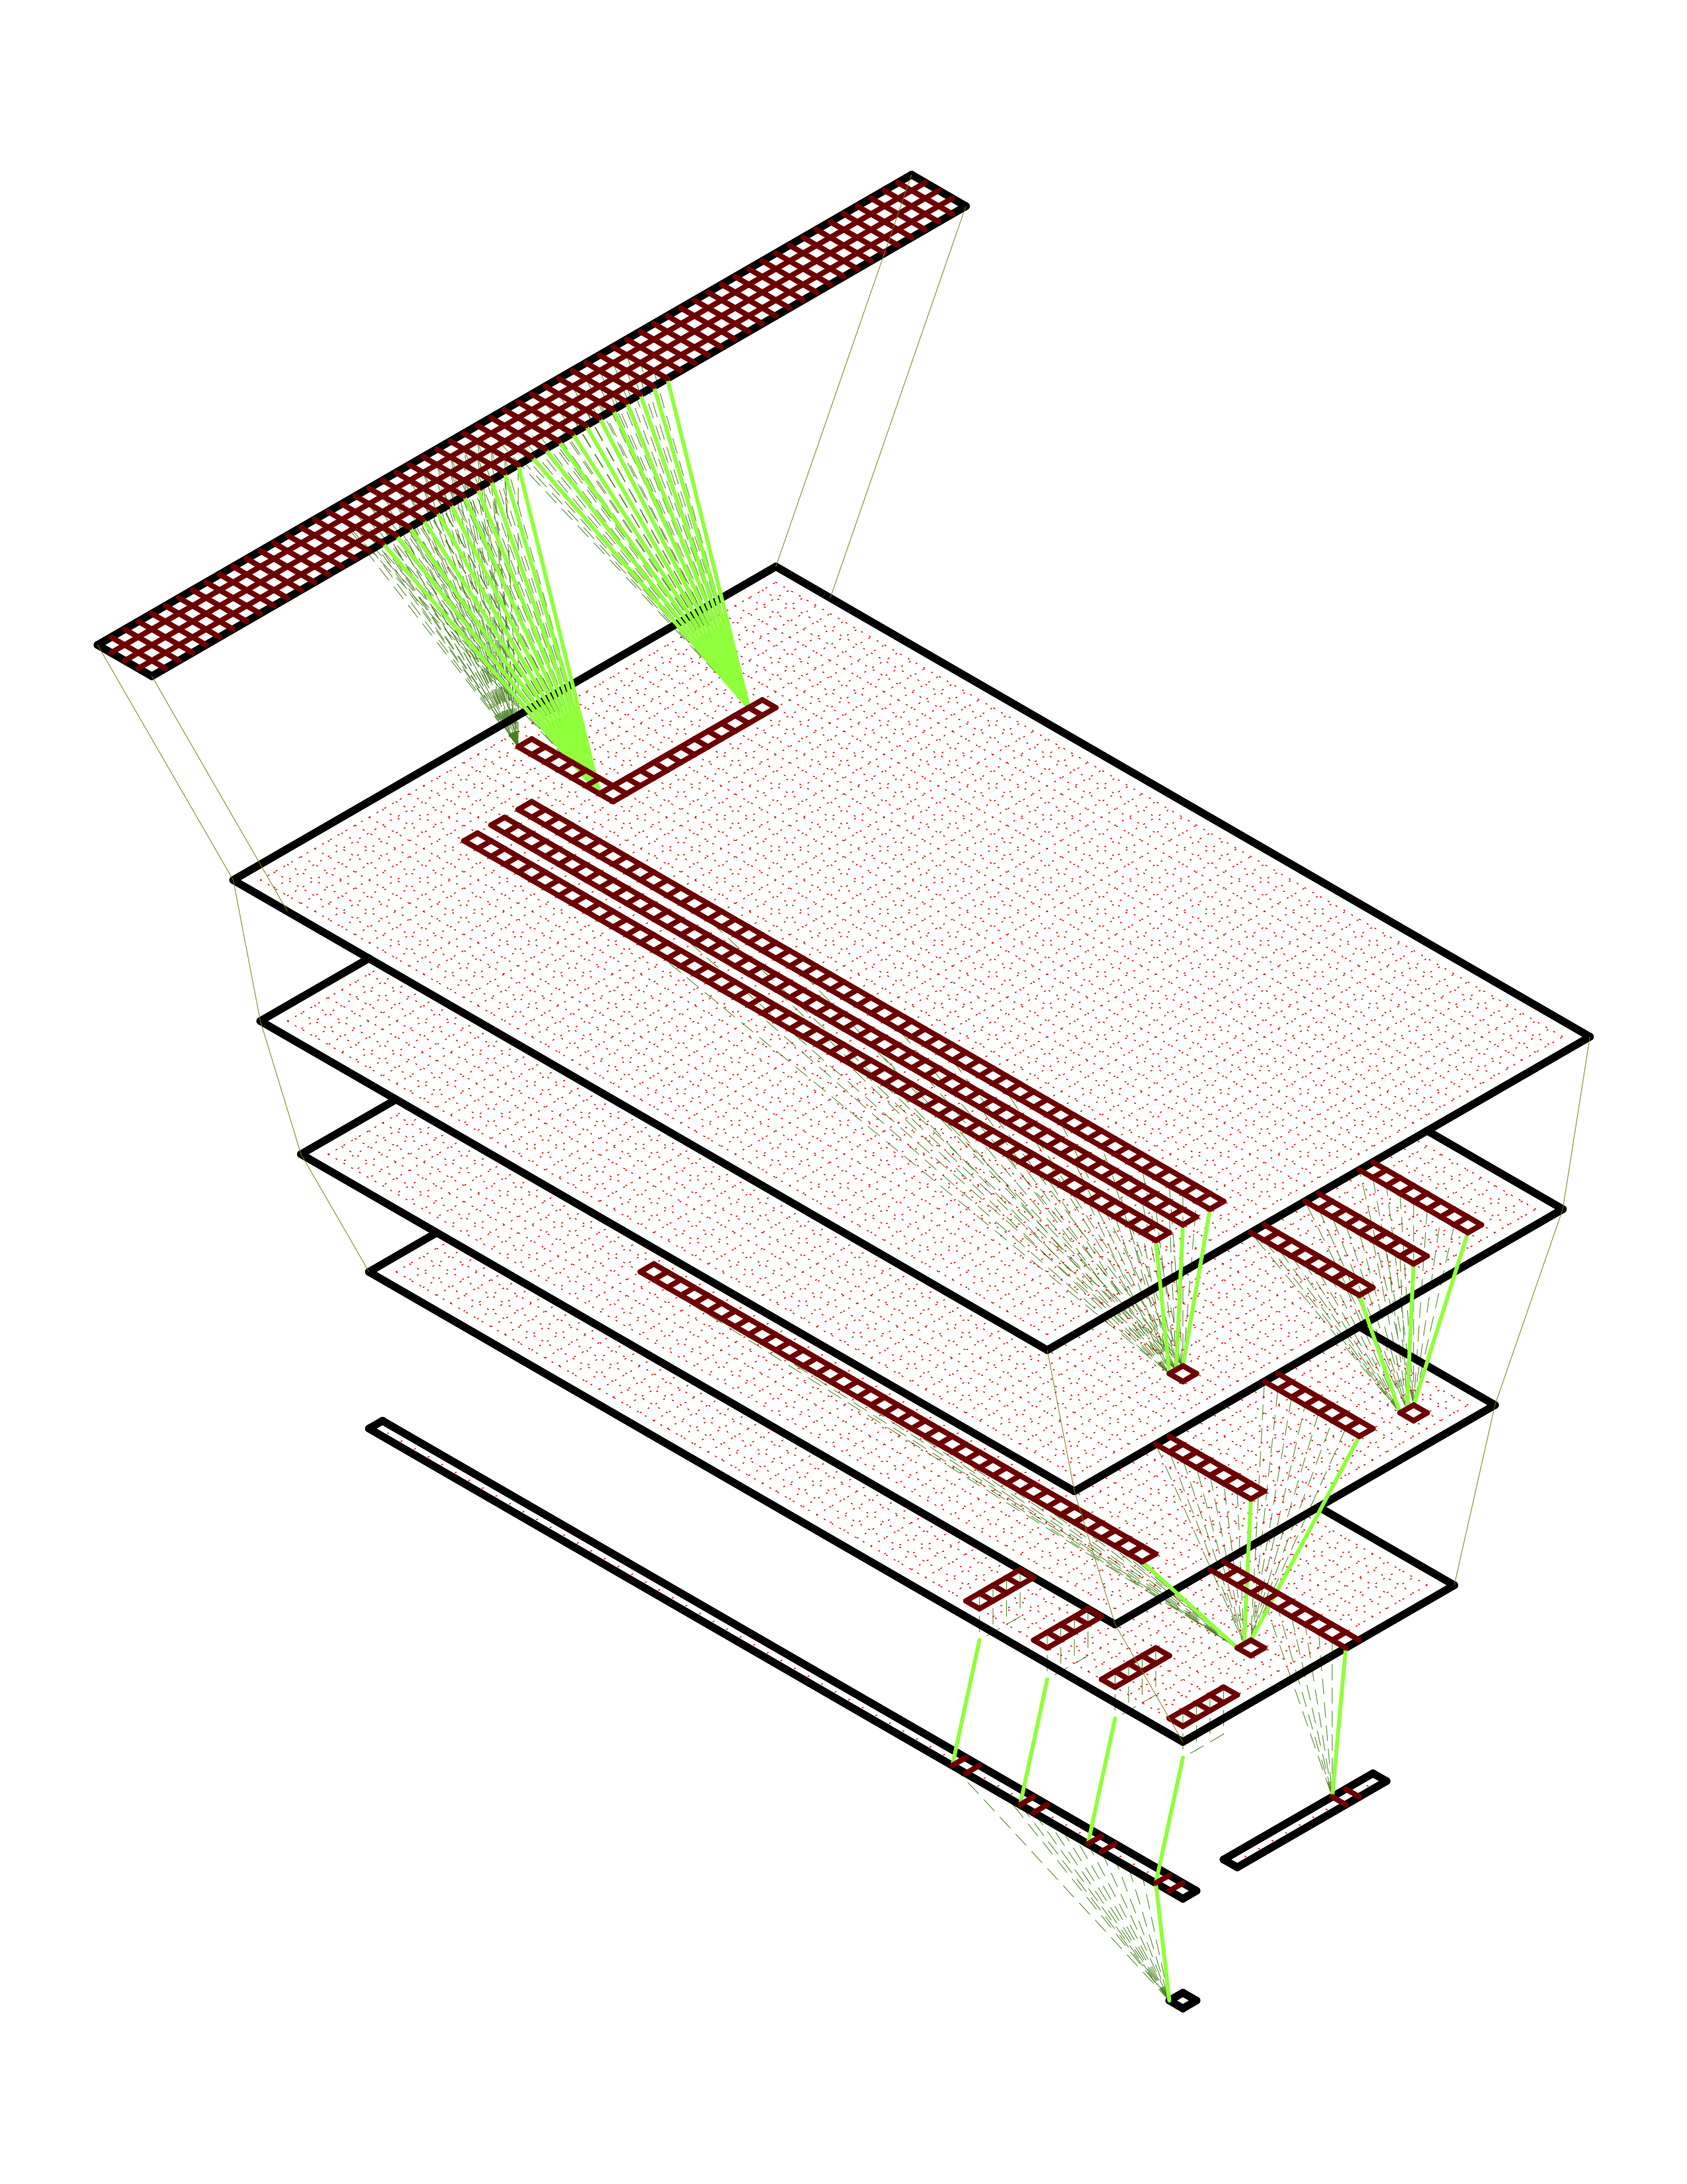

Slide 5

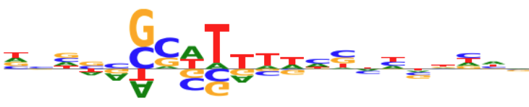
Input: 3 kB of DNA, one-hot encoded
Neuron scanning for
Neuron scanning for
Neuron scanning for

Slide 6
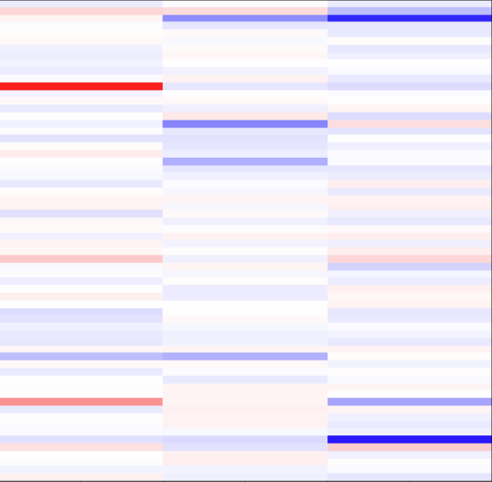

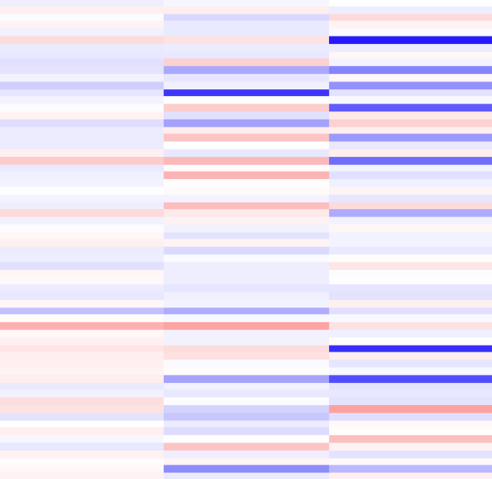

DNA-scanning neurons
(64 filters, scanning for same patterns at each position)
Neuron scanning meta-meta-pattern
Neuron scanning meta-pattern
When seen on the right, this motif suppresses this neuron.
When seen on the left, this motif activates this neuron.

Slide 7
Neurons near the top of the network look at nearby patterns.
Neurons look at progressively wider areas deeper in the network.

Slide 8
This profile neuron combines the highest-order patterns around its location and calculates a probability of seeing a read at that point.
Each position in the predicted profile has one output neuron.
We take the average activation of each of the highest-order patterns over the whole output window
A single counts neuron uses the average values of each highest-order pattern and predicts the total number of reads that will be in this region.

Slide 9
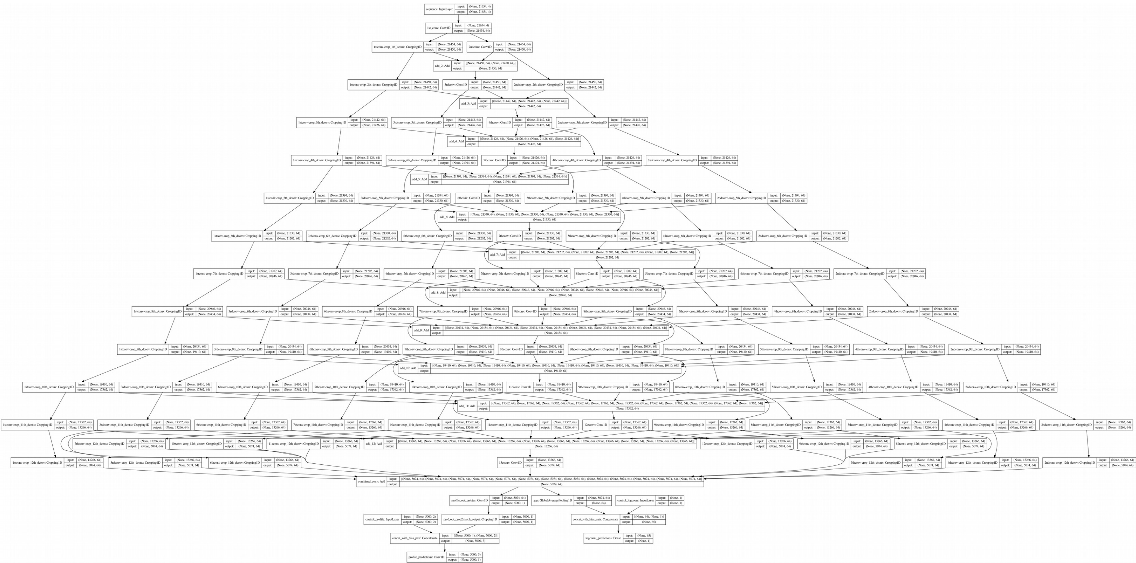
Genomic Sequence (3 kb)
Total reads
Probability distribution (1 kb)
BPReveal is okay at predicting how many reads there will be in a region.
BPReveal is excellent at predicting where reads will be seen in a given region.
Predicted Profile (1 kb)

Slide 10
Predicting multiple experiments: heads and tasks.
A head represents a single experimental dataset.
A head has one or more tasks, each task represents a different part of the data from one experiment.
Not sure which to use? Separate heads.
Sequence
Nanog + probs
Oct4 + probs
Nanog - probs
Oct4 - probs
Nanog counts
Oct4 counts

Slide 11
Data preparation
Need (sequence→profile) pairs. Typically, this will be a genome and a bigwig.
Profiles must be non-empty, sequences must be known (i.e., no N nucleotides)
Data needs to be partitioned into train, validation, and test splits, often by chromosome.
Profile length is on the order of 1 kb. Sequence length is determined by the model’s receptive field.

Slide 12
Data considerations
How long-range do you expect your effects to be? This determines the receptive field of the network.
Are there regions you need to reject? For example, transposons, repetitive regions, very high counts, …
Background regions are good.
Input
Prediction

Slide 13
Choosing an architecture
The initial convolution determines how wide the very first filters are. We get good results anywhere from 7 to 25.
The profile kernel size determines how broad the final convolution is. We get good results around 25.
The number of layers determines the receptive field. The field grows exponentially with number of layers. The published BPNet paper uses 9 layers.
lengthCalc.py calculates the input length needed.
:)./lengthCalc.py
--output-len 1000
--n-dil-layers 9
--conv1-kernel-size 7
--profile-kernel-size 25
3074
Input
Prediction

Slide 14
Preparing input bed files
You can, of course, manually create files with the regions you want to train, validate, and test on. But for convenience, I’ve added a prepareBed.py script.
Requires:
bigwigs,
bed of regions
splits (by chromosome, bed, or regex),
genome,
input and output lengths,
jitter
cutoff settings (max and min, quantile or counts)
Performs:
Partitions the regions according to splits
Resizes the regions to output length
Removes regions that have N bases in their inputs
Removes regions that exceed the cutoffs.
Produces:
Bed files for train, validation, and test splits.

Slide 15
Preparing input files for training
The training scripts expect hdf5 files with sequence→profile pairs.
The prepareTrainingData.py script makes this, but you can also make it yourself if you’re doing something special.
Requires:
bigwigs, organized by head
bed of output regions
genome
input and output lengths
jitter
Performs:
Extracts genomic sequences, one-hot encodes them
Extracts profiles from bigwigs, arranges them according to architecture
Produces:
hdf5-format training file, with datasets for each head, and one dataset for the sequences.

Slide 16
Training a model
trainSoloModel.py is used to train a sequence→profile model without bias correction.
Requires:
input train and validation hdf5 files
network architecture
  input and output lengths
  jitter
  layers, filters
  heads configuration
training parameters
  learning rate, plateau
  batch size, epochs
Performs:
Trains up a model to predict profiles in the training dataset.
When performance on validation dataset plateaus, stops training.
Produces:
a Keras Model object, saved to disk
a history json showing training progress

Slide 17
Making predictions
Two scripts, makePredictionsBed.py and makePredictionsFasta.py, depending on if you have a genome and regions to predict on (bed mode) or just sequences (fasta mode).
Requires:
(genome and regions) or fasta file
input and output length
trained model file
Performs:
Runs the model on the given sequences
Produces:
A single hdf5 file containing the predictions for all tasks and heads. If run in bed mode, also contains coordinates for each prediction.

Slide 18
Viewing predictions
predictToBigwig.py is a simple script that will extract the predictions from the hdf5 and save them as a bigwig. Only works if the prediction script was run from a bed file.
Requires:
predictions hdf5
head and task ID
Performs:
Extracts the predictions from the hdf5, and calculates values based on the --mode flag, if --mode profile, then saves predicted counts at each base.
Produces:
A single bigwig file for the given head and task IDs. If your model has multiple outputs, you will run this script for each of them.

Slide 19
Measuring model performance
metrics.py calculates a variety of metrics to compare experimental and predicted data.
mnll is the multinomial log-likelihood, which is the calculation performed in the loss function.
jsd is the Jensen-Shannon distance, an information-theoretic measure of the similarity of two probability distributions.
pearsonr and spearmanr are the Pearson and Spearman correlations between the experimental and predicted datasets.
Counts pearson and Counts spearman are the correlation between the predicted and experimental total counts values for each region.
The metrics are reported in quantiles, so the median value is in the 50% column.
Requires:
two bigwig files, one experimental and one predicted.
a bed file of regions to look at.
Performs:
The calculations listed above
Produces:
Writes plain text to stdout with a table of results.

Slide 20
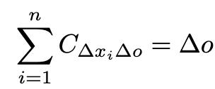
Input
Neurons
1. Run your network on your sample input.
2. Run the network on one or more reference inputs.
3. Compute the difference-from-reference at the output neuron.
4. Backpropagate to determine which changes in the input caused the change in the output.
Network
Output
Neuron

Slide 21
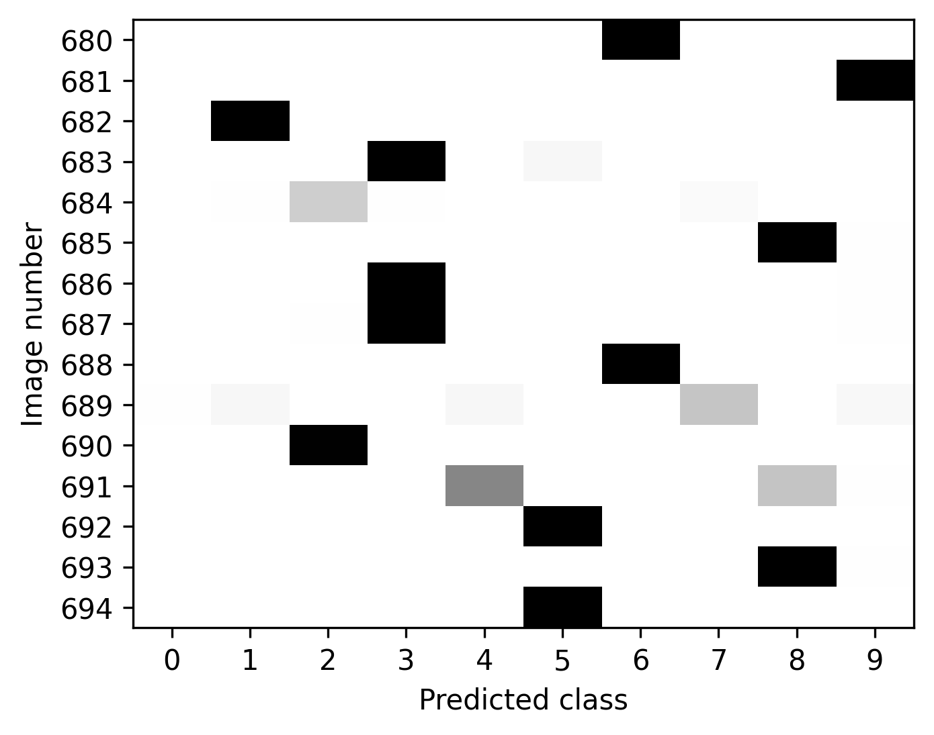
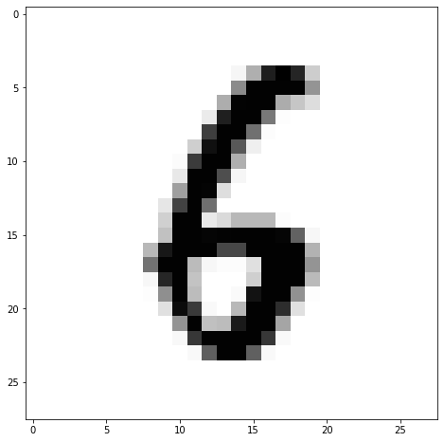
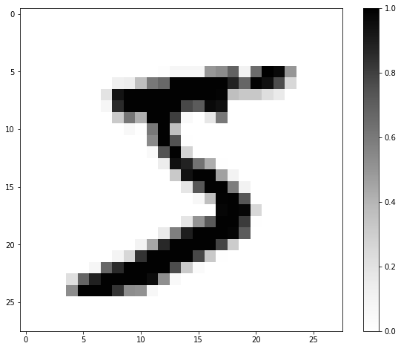
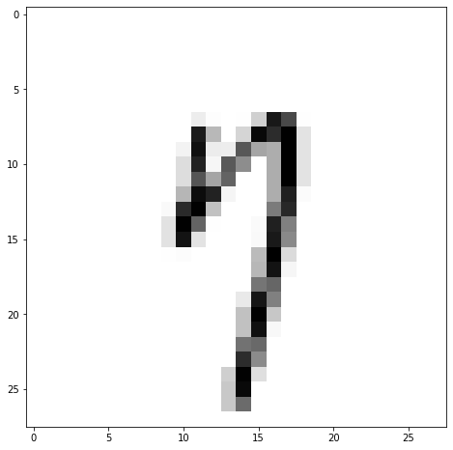
Exploring Shap using MNIST data
MNIST is a data set of pictures of handwritten digits. For each picture, we are also given the correct digit that it should be identified as.
MNIST is a classic introductory exercise in deep learning.
This is a 5.

Slide 22
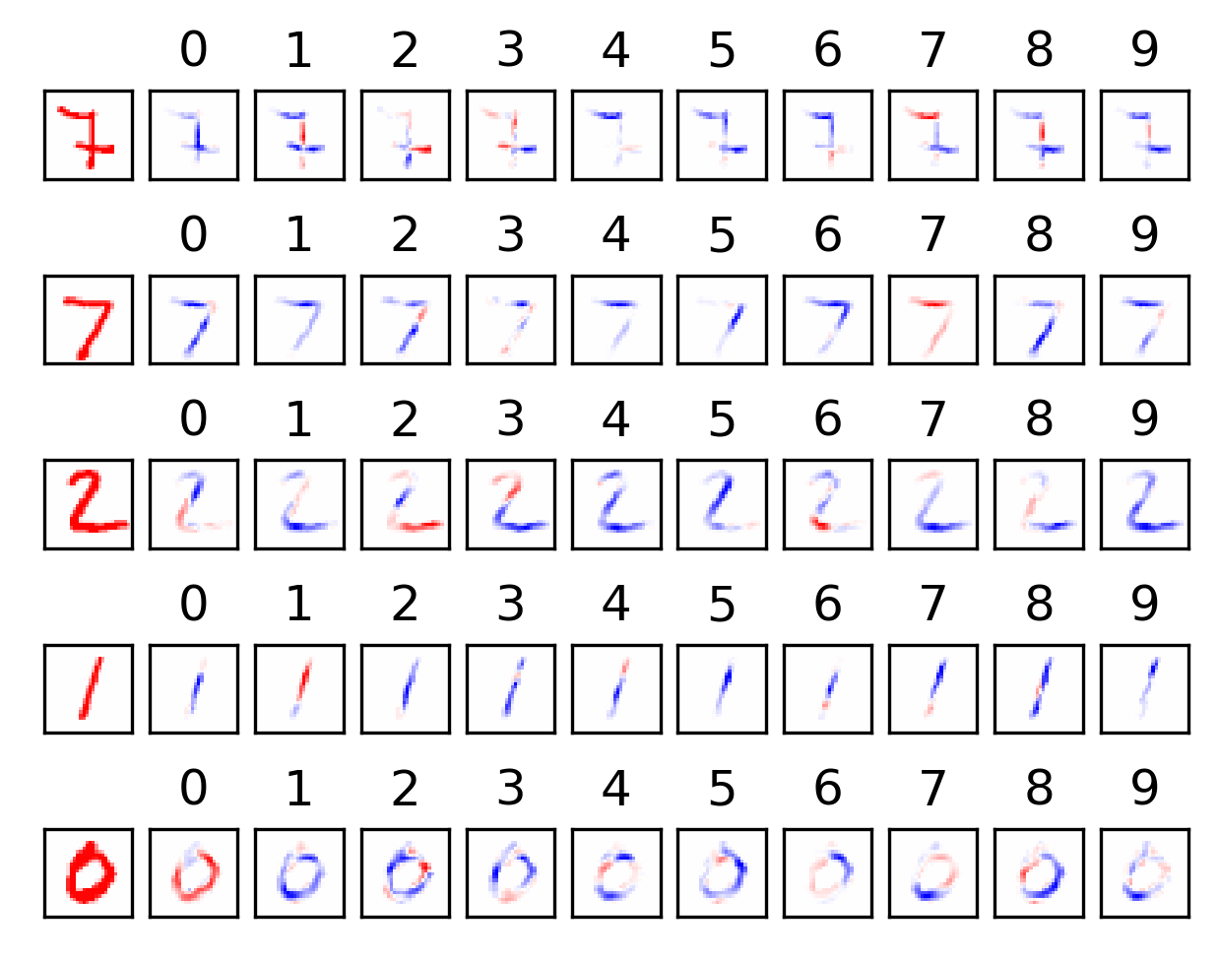
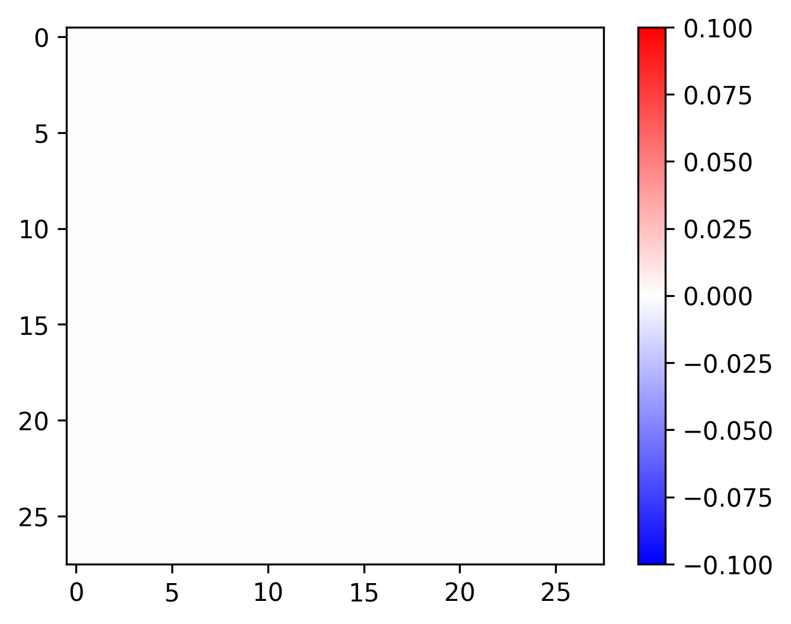
Choosing a bad reference
With an all-zero reference, only non-zero pixels can be assigned importance. The lack of a pixel cannot have any shap score.

Slide 23
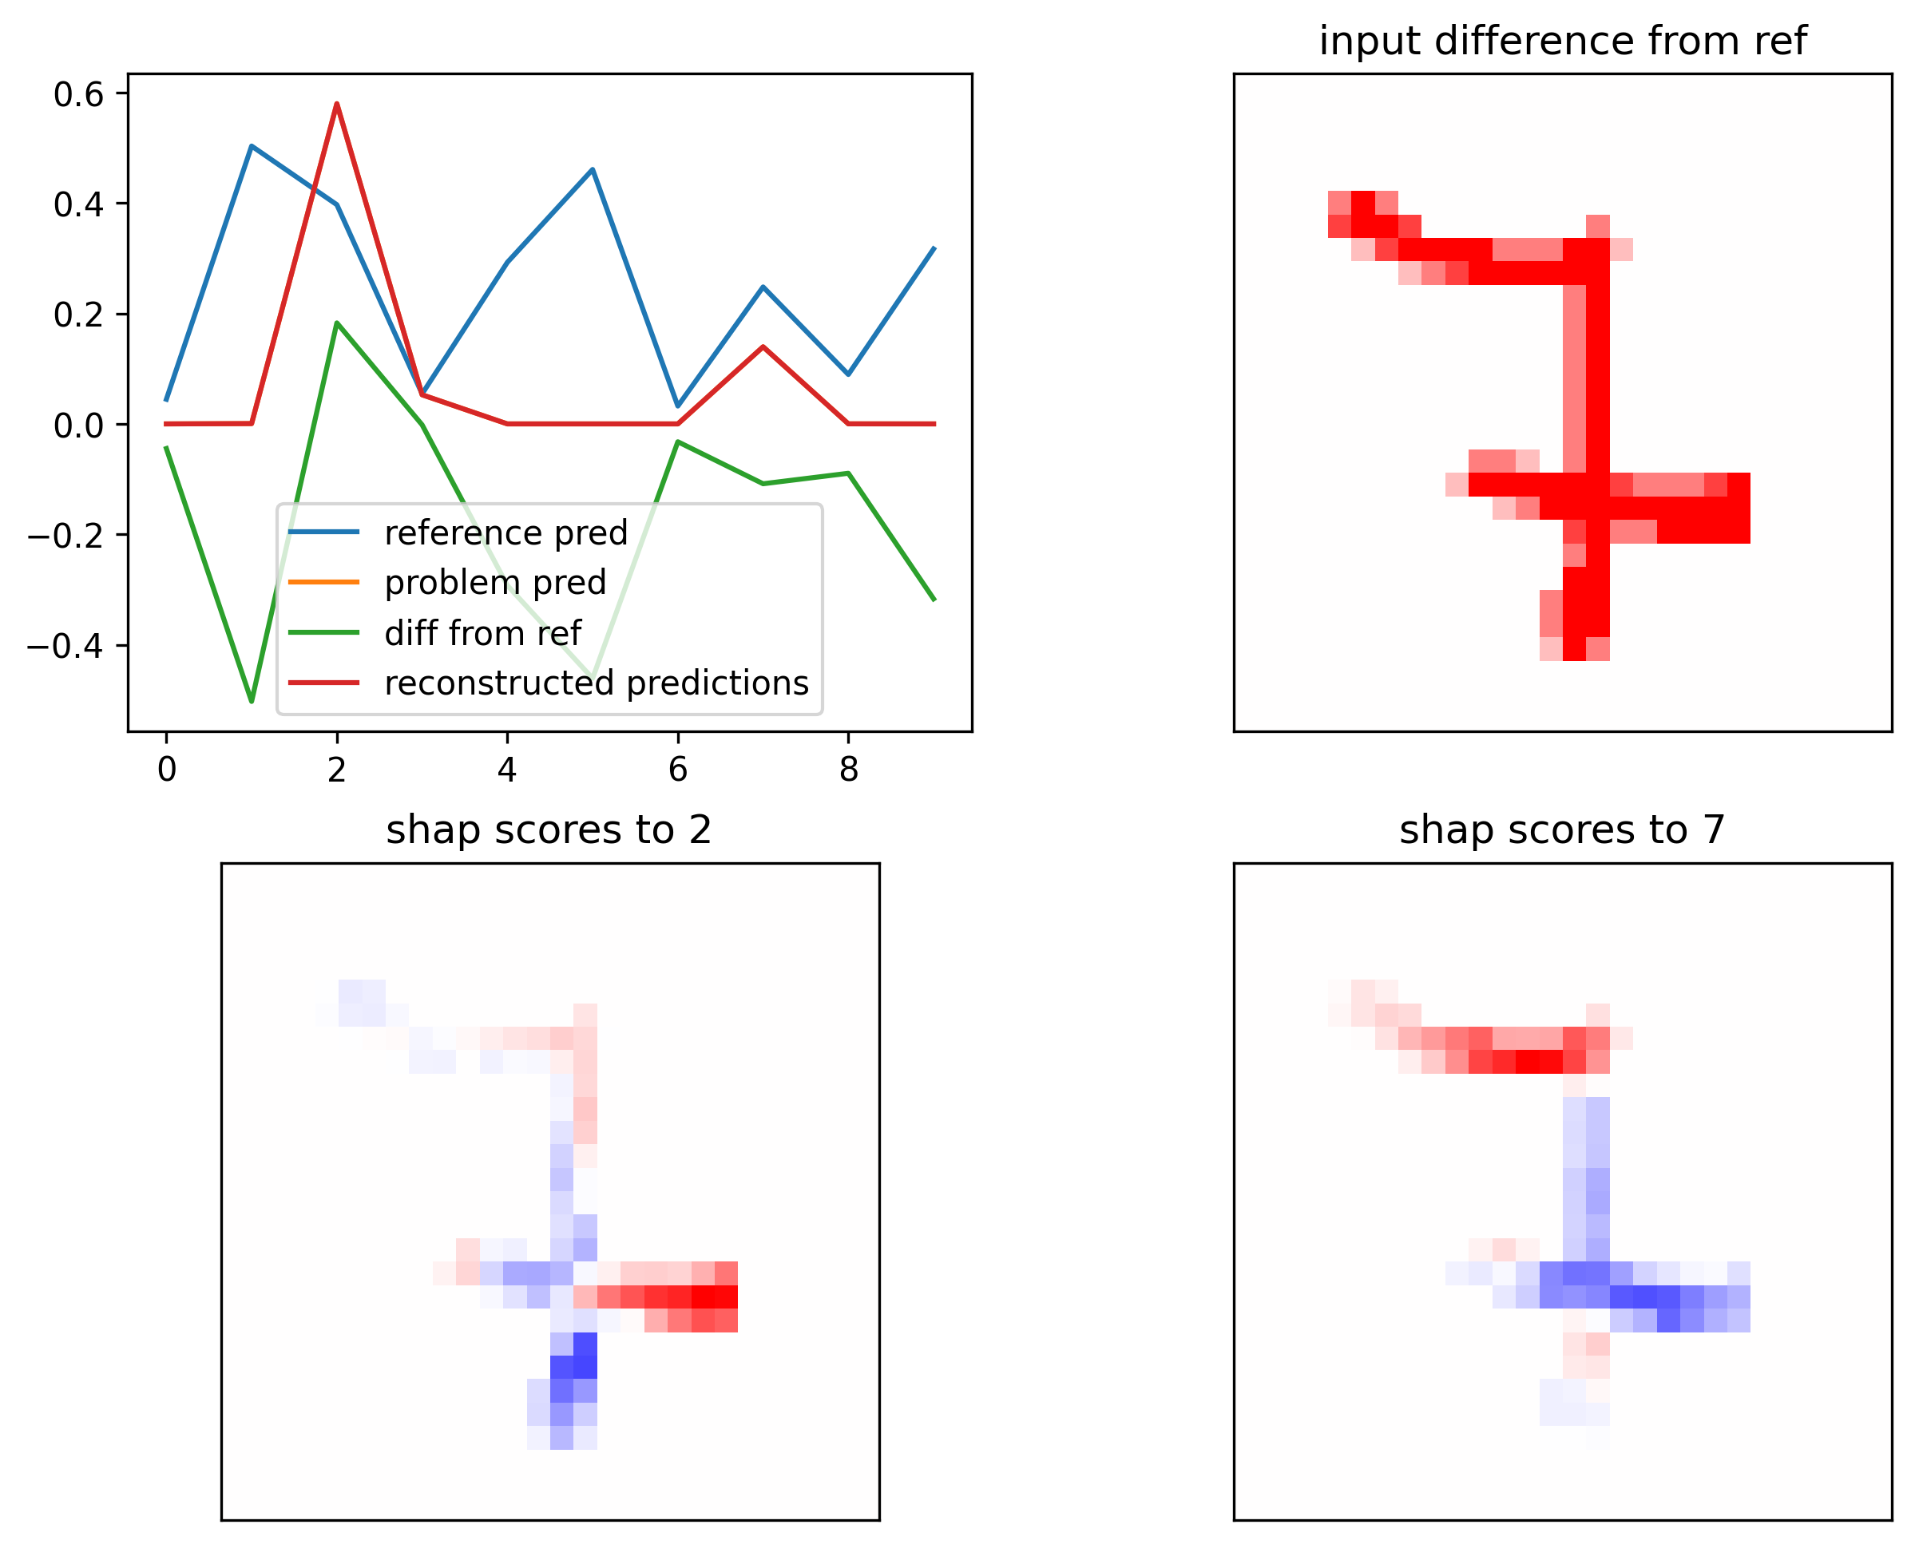
The reference must be bland.

Slide 24
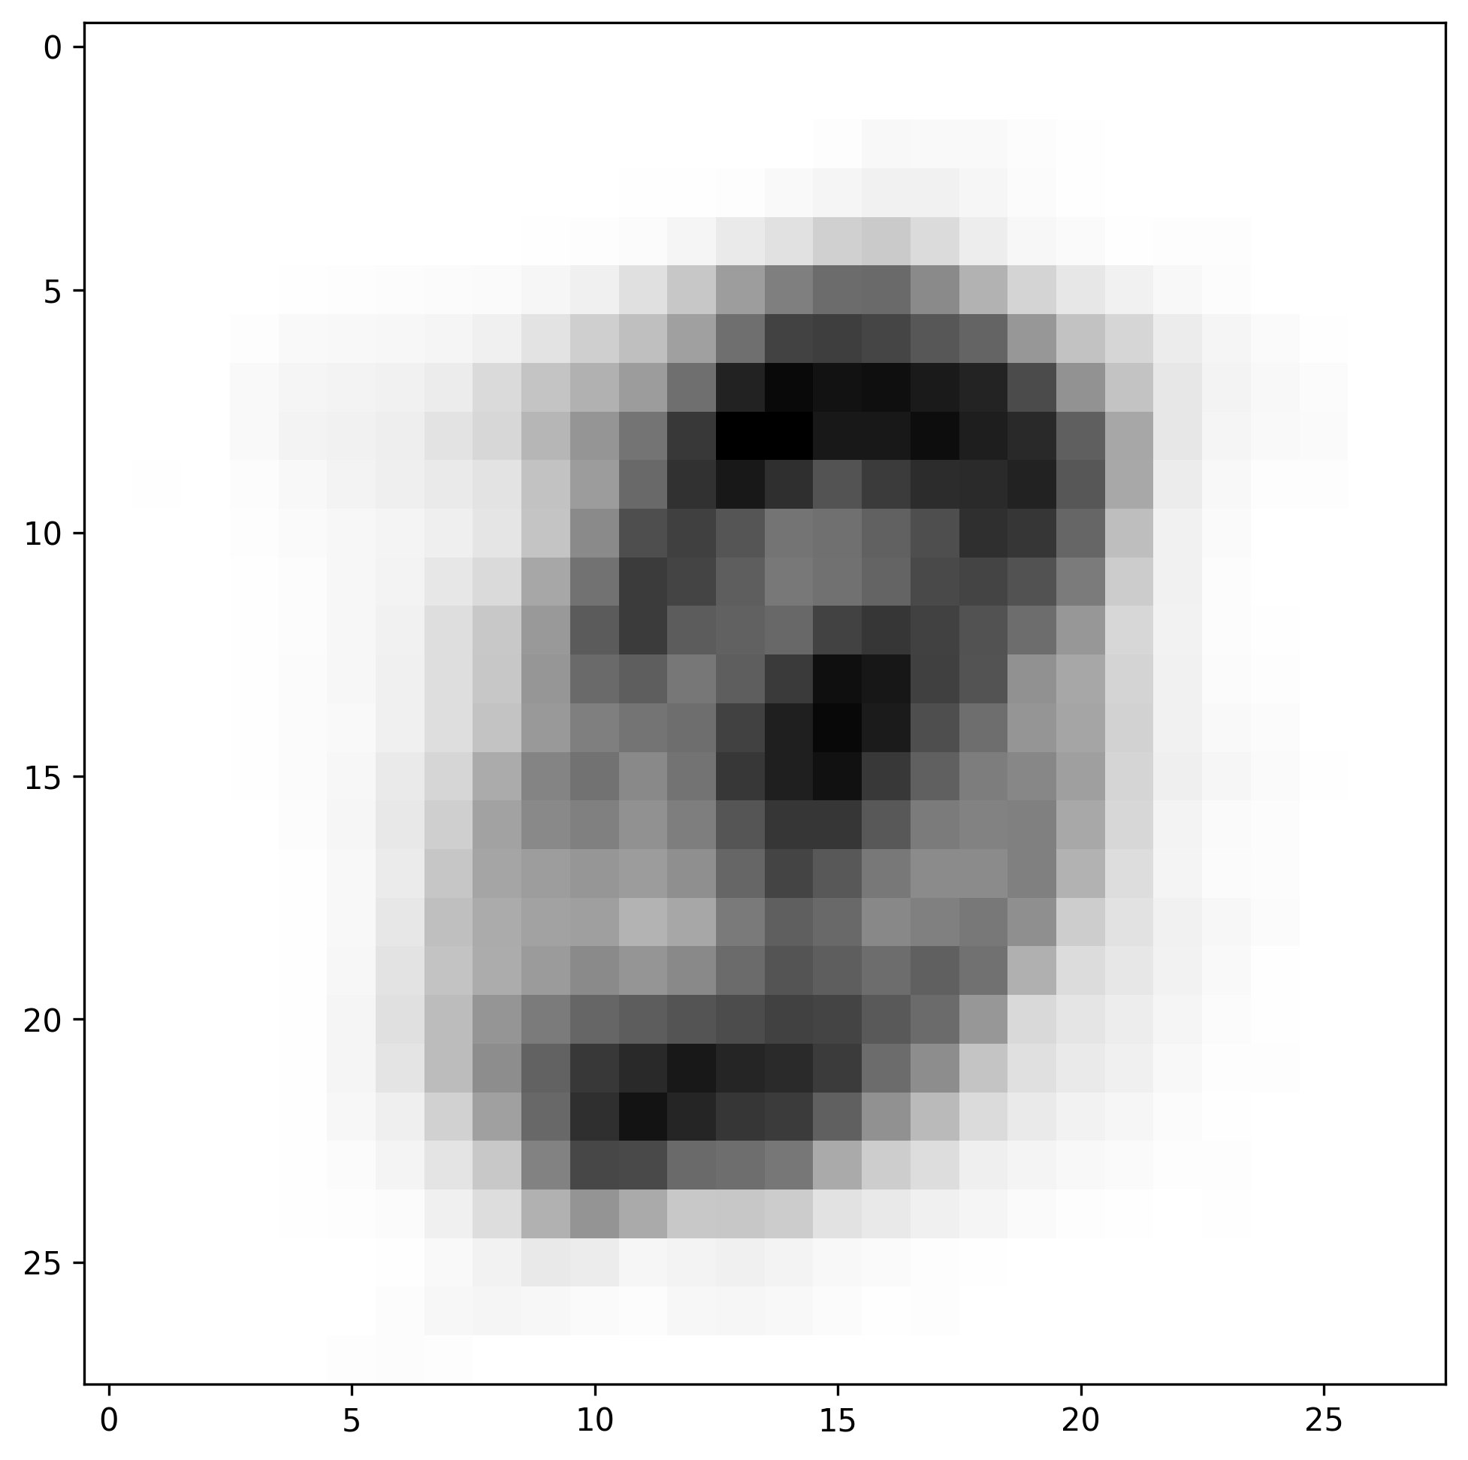
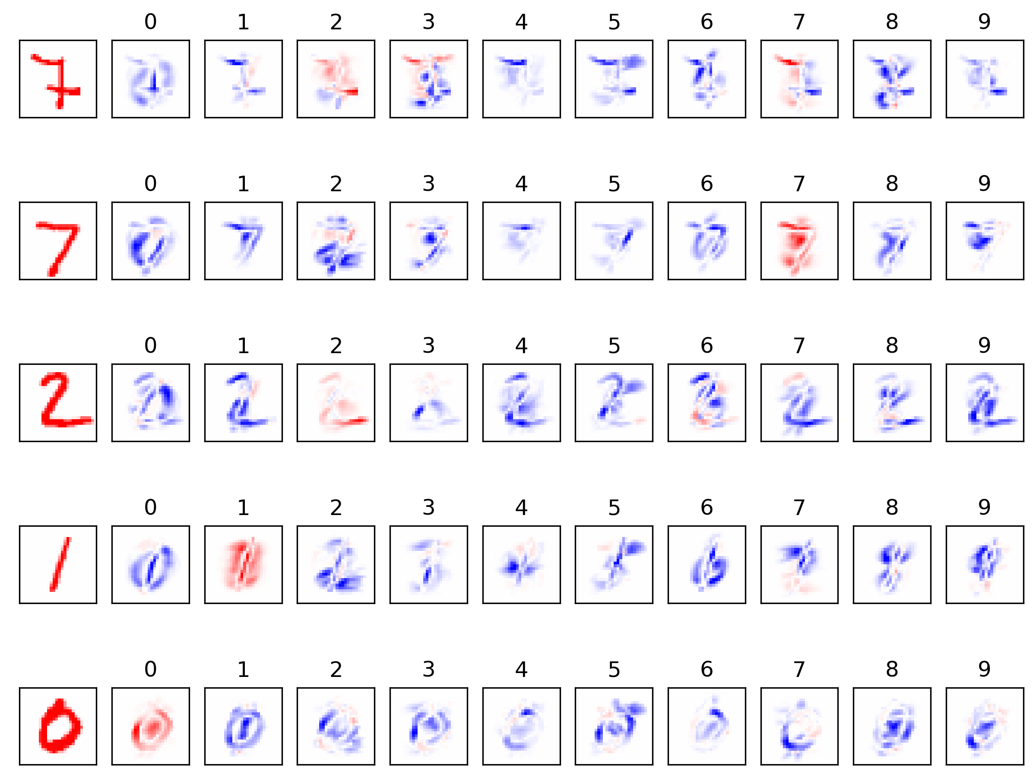
Choosing a good reference

Slide 25
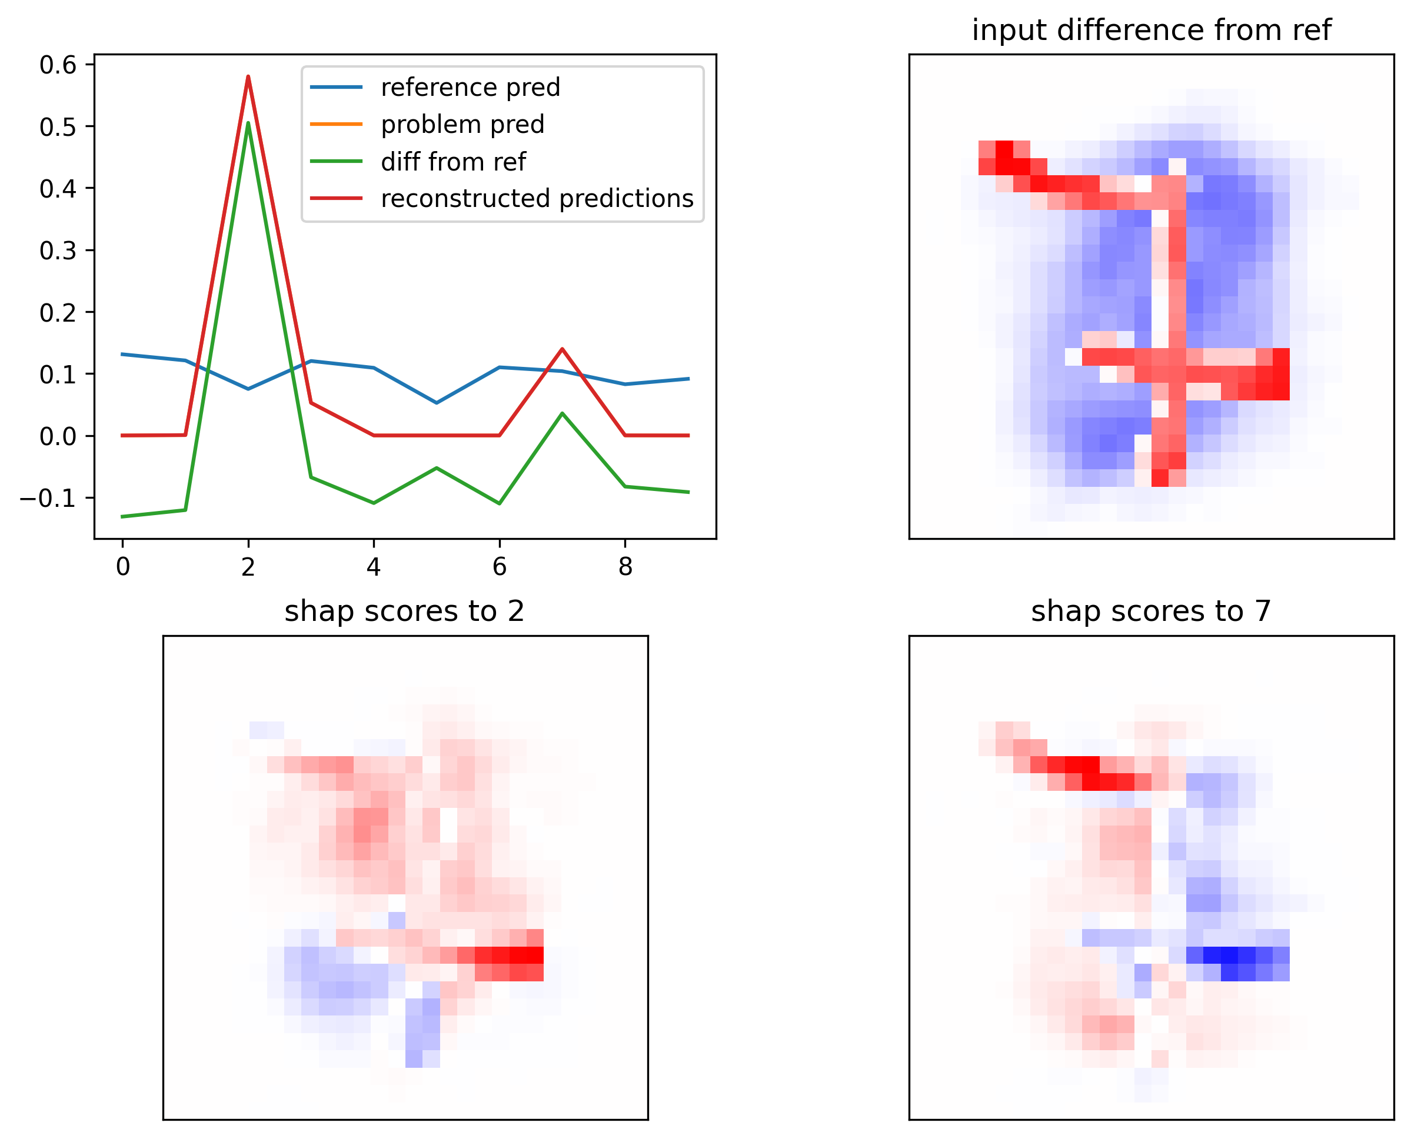

Slide 26
Assigning importance scores - flat
interpretFlat.py assigns importance scores to each base for one head (any combination of tasks in that head).
Scores are reported for profile (shape) and counts.
Requires:
genome
bed file of regions
model
head and tasks
Performs:
Propagates importance to each base in the input with lots of math
Produces:
Two hdf5-format files, one with profile scores and one with counts scores.

Slide 27
Viewing importance scores - flat
shapToBigwig.py converts the interpretation hdf5 file into a bigwig.
Requires:
An interpretation hdf5 with position information (added by interpretFlat.py automatically)
Performs:
Extracts the values, resolves overlapping windows.
Produces:
A bigwig file with importance scores.

Slide 28
Preparing to run modisco
shapToNumpy.py converts the interpretation hdf5 file into two numpy arrays that can be passed to tfmodisco-lite.
Requires:
An interpretation hdf5 with position information
Performs:
Just extracts the data
Produces:
Two .npy files, one with one-hot encoded sequences, one with the importance scores.

Slide 29
PISA interpretation
Pairwise Interaction Shap Analysis measures the contribution of each base to the profile at every other base, unlike flat shap analysis which measures the contribution of each base to the total profile over the region.
PISA allows you to see the extent of effects, effects that are oscillatory, cooperativity, and local biases.
Requires:
Either a fasta file of sequences, or a bed file of regions and a genome file
A trained model
Input and output lengths
A head and task selection
Performs:
Calculates pairwise importances for each base in each region (if bed file provided) or the leftmost output base of each fasta sequence
Produces:
An hdf5-format file, containing the input sequence and PISA scores
fasta mode: model predictions, shuffled predictions, sequence names
bed mode: coordinates

Slide 30
Philosophy of bias & mixing
When we perform an experiment, there is an actual biological signal of interest, and a signal intrinsic to the experiment. These signals are combined to create the experimental readout.
BPReveal assumes the combination is
f(bias) * biology = experiment

Slide 31
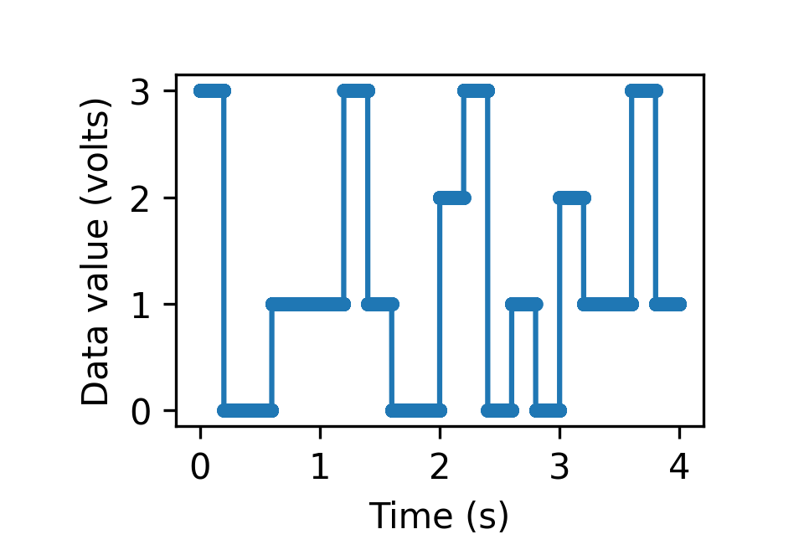
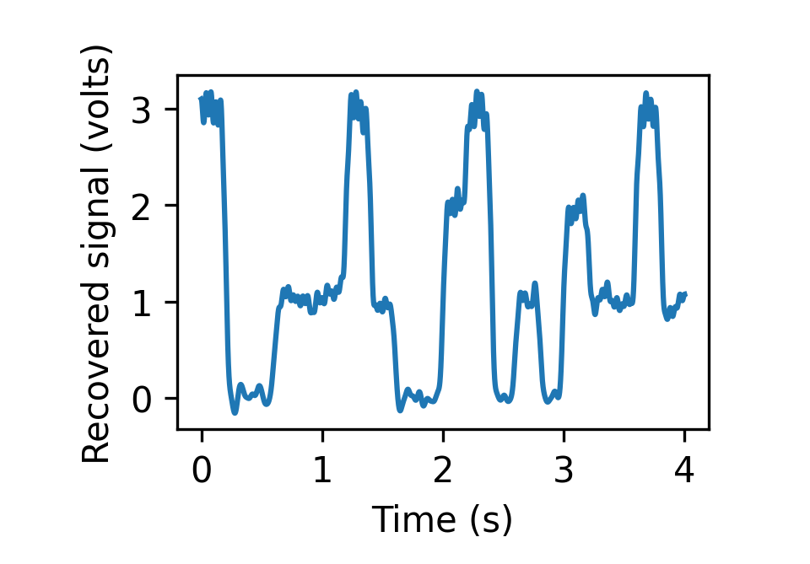
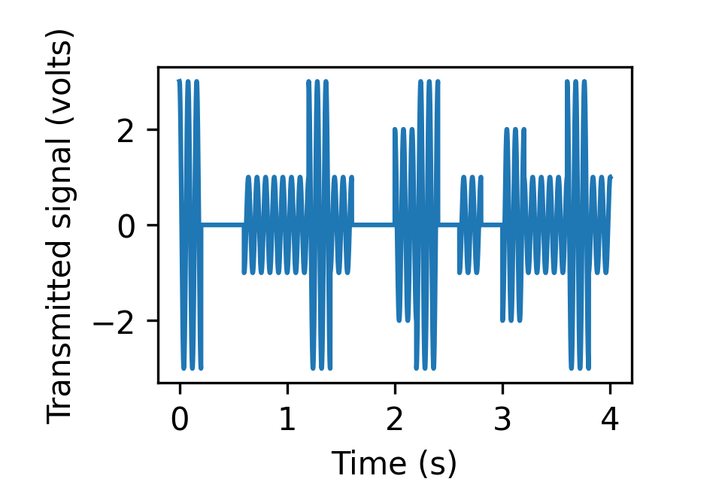
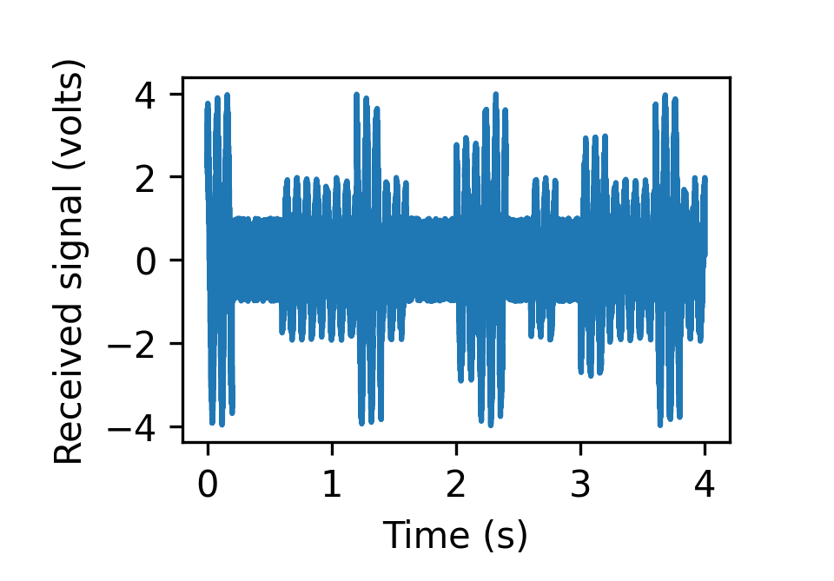
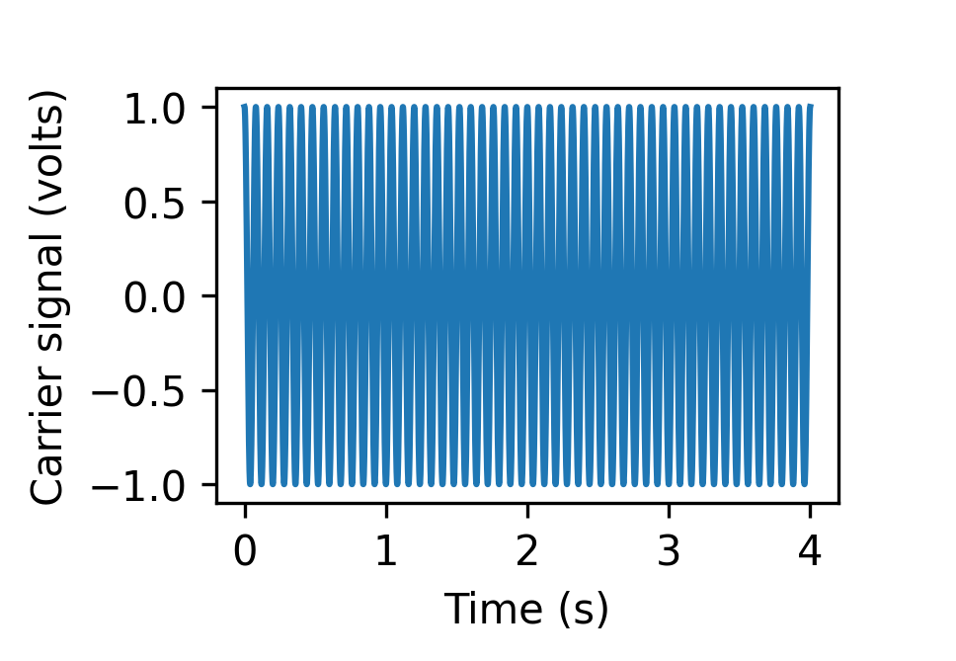

Slide 32
Sequence
Solo model
Regression model
Bias
Unbiased
Transformation
Experiment
Modulation
Experiment
Data flow
(No learning)
Model
(learning)
Inactive
Data

Slide 33
Sequence
Solo model
Regression model
Bias
Unbiased
Transformation
Experiment
Modulation
Experiment
Data flow
(No learning)
Model
(learning)
Inactive
Data

Slide 34
Sequence
Solo model
Regression model
Bias
Unbiased
Transformation
Experiment
Modulation
Experiment
Data flow
(No learning)
Model
(learning)
Inactive
Data

Slide 35
Sequence
Solo model
Regression model
Bias
Unbiased
Transformation
Experiment
Modulation
Experiment
Data flow
(No learning)
Model
(learning)
Inactive
Data

Slide 36
Choosing a bias dataset
Separate experiment, same cell type - PAtCh-Cap for ChIP-nexus
Same experiment, different cell type - unmodified cells for chemical mapping
Same experiment, different regions - ATAC-seq

Slide 37
Training a bias model
Exactly the same as training a solo model, but make sure it doesn’t learn motifs.

Slide 38
Training a transformation model
The transformation model applies a few simple transformations to the bias model output to better match the experimental data.
Requires:
A solo model
Training parameters
Transformation parameters for profile and counts heads
Experimental data
Performs:
Regresses the solo (bias) model to best match the experimental data.
Produces:
A Keras model file and training history

Slide 39
Training a combined model
This is much the same as training the transformation model, except that the model is much more complex, and the models are combined near the output rather than one being the input to the other.
Requires:
A transformation model
Training parameters
Model parameters
Experimental data
Performs:
Creates a model which, when modulated by the transformation model, matches the experimental data.
Produces:
Two Keras model files: One for the combined model, and one for the residual model.
Training history

Slide 40
Practical
Prepare a conda environment
Given a data file (bigwig) and a set of regions,
  Prepare input files
  Train a solo model
  Perform flat interpretation

