Slide 1
Behavior Driven Development using Cucumber JVM

Slide 2
table of contents
Introduction
Gherkin basics
Sample project with Cucumber-JVM setup and covering various Gherkin keywords
References

Slide 3
Introduction

Slide 4
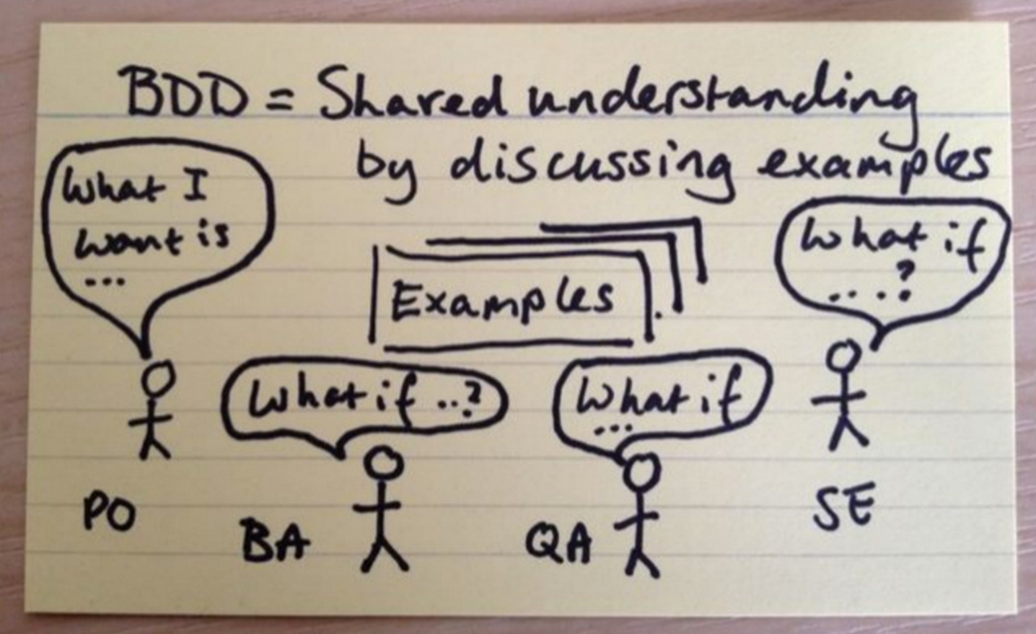
What is BDD?
BDD is a second-generation, outside-in, pull-based, multiple-stakeholder, multiple-scale, high-automation, agile methodology. It describes a cycle of interactions with well-defined outputs, resulting in the delivery of working, tested software that matters.
Inspires collaboration. TDD evolved
Behavior vs Implementation
Living Documentation
Ubiquitous language

Slide 5
What is Cucumber?
Software starts as an idea and needs to be communicated. Collaboration among team members requires high-quality communication and it is critical for success.
These tests are different from unit tests, which are aimed at developers and help them to drive out and check their software designs. It’s sometimes said that unit tests ensure you build the thing right, while acceptance tests ensure you build the right thing.
Cucumber helps facilitate the discovery and use of a ubiquitous language within the team, by giving the two sides of the linguistic divide a place where they can meet true value of acceptance tests: as a communication and collaboration tool.

Slide 6
Gherkin Basics

Slide 7
What is Gherkin?
Cucumber tests are expressed using a syntax called Gherkin. Gherkin files are plain text and have a .feature extension.
Keywords
Feature
Background
Scenario
Given
When
Then
And
But
*
Scenario Outline
Examples
Scenarios

Slide 8
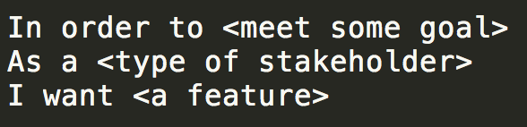
Feature
This is the feature title
This is the description of the feature, which can span multiple lines. You can even include empty lines, like this one:
In fact, everything until the next Gherkin keyword is included in the description.
Feature Injection template:
Feature: Contact Management service In order to manage my contacts As a user I want to add/edit/view my contacts

Slide 9
Background
A background section in a feature file allows you to specify a set of steps that are common to every scenario in the file. Instead of having to repeat those steps over and over for each scenario, you move them up into a Background element.
There are a couple of advantages to doing this:
If you ever need to change those steps, you have to change them in only one place.
The importance of those steps fades into the background so that when you’re reading each individual scenario, you can focus on what is unique and important about that scenario

Slide 10
Scenario
To actually express the behavior we want, each feature contains several scenarios.
Each scenario is a single concrete example of how the system should behave in a particular situation. If you add together the behavior defined by all of the scenarios, that’s the expected behavior of the feature itself.
Each scenario must make sense and be able to be executed independently of any other scenario.
Given I have the following details: | firstName | lastName | phoneNum | | maria | testcase | 510-123-1234 | #Data Tables #Sometimes steps in a scenario need to describe data that doesn’t easily fit on #a single line of Given, When, or Then. Gherkin allows us to place these details in #a table right underneath a step. Data tables give you a way to extend a Gherkin #step beyond a single line to include a larger piece of data. When I create contact Then the contact is created When I lookup contact with first name "maria" And I see contact created with following values: | firstName | lastName | phoneNum | | maria | testcase | 510-123-1234 |

Slide 11
Scenario Outline
Sometimes you have several scenarios that follow exactly the same pattern of steps, just with different input values or expected outcomes.
It is followed by Examples or Scenarios element
Scenario Outline: Create multiple contacts Given I have the following details: | firstName | lastName | phoneNum | | <fname> | <lname> | <phoneNum> | #Data Tables #Sometimes steps in a scenario need to describe data that doesn’t easily fit on #a single line of Given, When, or Then. Gherkin allows us to place these details in #a table right underneath a step. Data tables give you a way to extend a Gherkin #step beyond a single line to include a larger piece of data. When I create contact Then the contact is created When I lookup contact with first name "<fname>" And I see contact created with following values: | firstName | lastName | phoneNum | | <fname> | <lname> | <phoneNum> | Examples: | fname | lname | phoneNum | | janet | testcase | 510-123-1233 | Scenarios: | fname | lname | phoneNum | | james | testcase | 510-123-1233 |

Slide 12
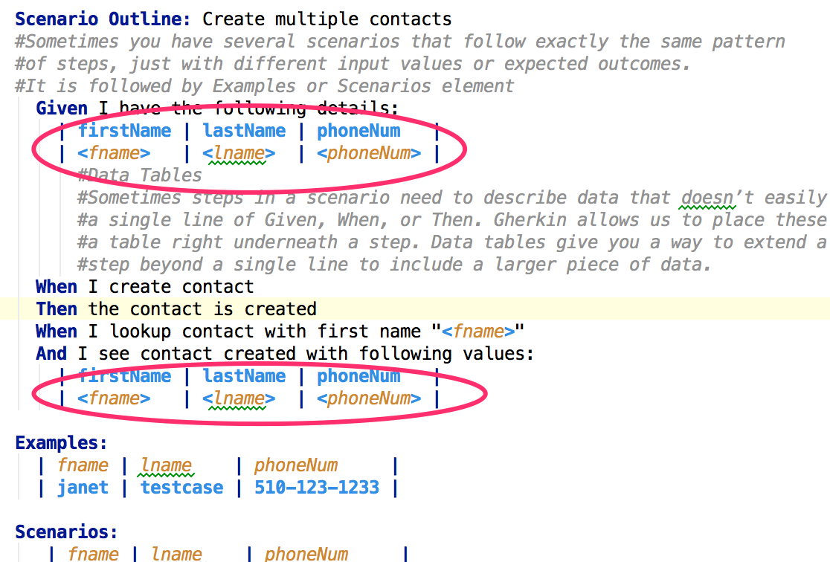
Data Tables
Sometimes steps in a scenario need to describe data that doesn’t easily fit on a single line of Given, When, or Then.
Gherkin allows us to place these details in a table right underneath a step. Data tables give you a way to extend a Gherkin step beyond a single line to include a larger piece of data.

Slide 13
Sample project with Cucumber JVM setup covering various Gherkin keywords

Slide 14
Sample project with Cucumber JVM setup
Sample project can be accessed at https://github.com/mmuduganti/contact-app
It is gradle project and can be imported into either Eclipse or Intellij
Please follow the READEME instruction to execute the project locally.

Slide 15
Cucumber JVM dependencies
compile "info.cukes:cucumber-core:${cucumberCoreVersion}" compile "info.cukes:cucumber-java:${cucumberJavaVersion}" compile "info.cukes:cucumber-junit:${cucumberJunitVersion}"
cucumberCoreVersion=1.2.0 cucumberJavaVersion=1.2.0 cucumberJunitVersion=1.2.0

Slide 16
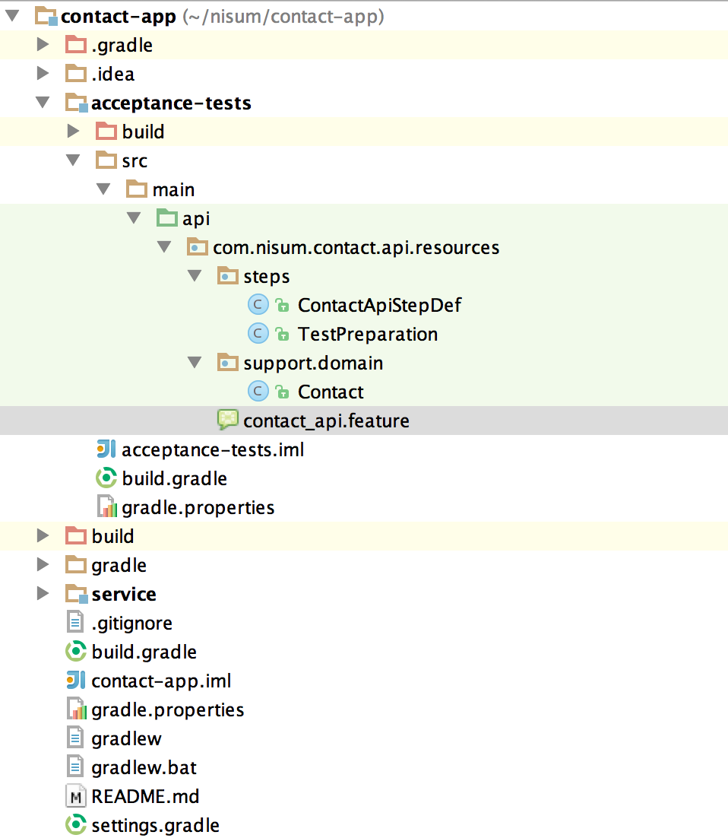
Project Structure

Slide 17
Reference

Slide 18
Thanks! Please reach out if you have questions.

