Slide 1
Zombie Zero
Technical Demo

Slide 2
Project Goals
Create a production ready game deployed online
Should be fun to play
No proof on concept, an actual game
Playable by everyone (Cross Platform)

Slide 3
Team Distribution
Aniq Nasir
GitHub Profile
Worked on Core Game Logic, Core Game Systems …
Hasham Tanveer
GitHub Profile
Worked on Game UI, High Scores and Weapon Systems
Muhammad Mujtaba
GitHub Profile
Worked on Game Engine

Slide 4
Game Overview
Genre
Top-Down Shooter
Objective
Clear all zombies in the city
Availability
Windows
MacOS
Linux

Slide 5
Architecture Overview
Use Java as main Language
Uses JavaFX’s FXML & CSS for UI
Built using a Custom Game Engine using JavaFX
Architecture heavily inspired from Unity Game Engine
Consists of two separate independent modules
Engine
Game

Slide 6
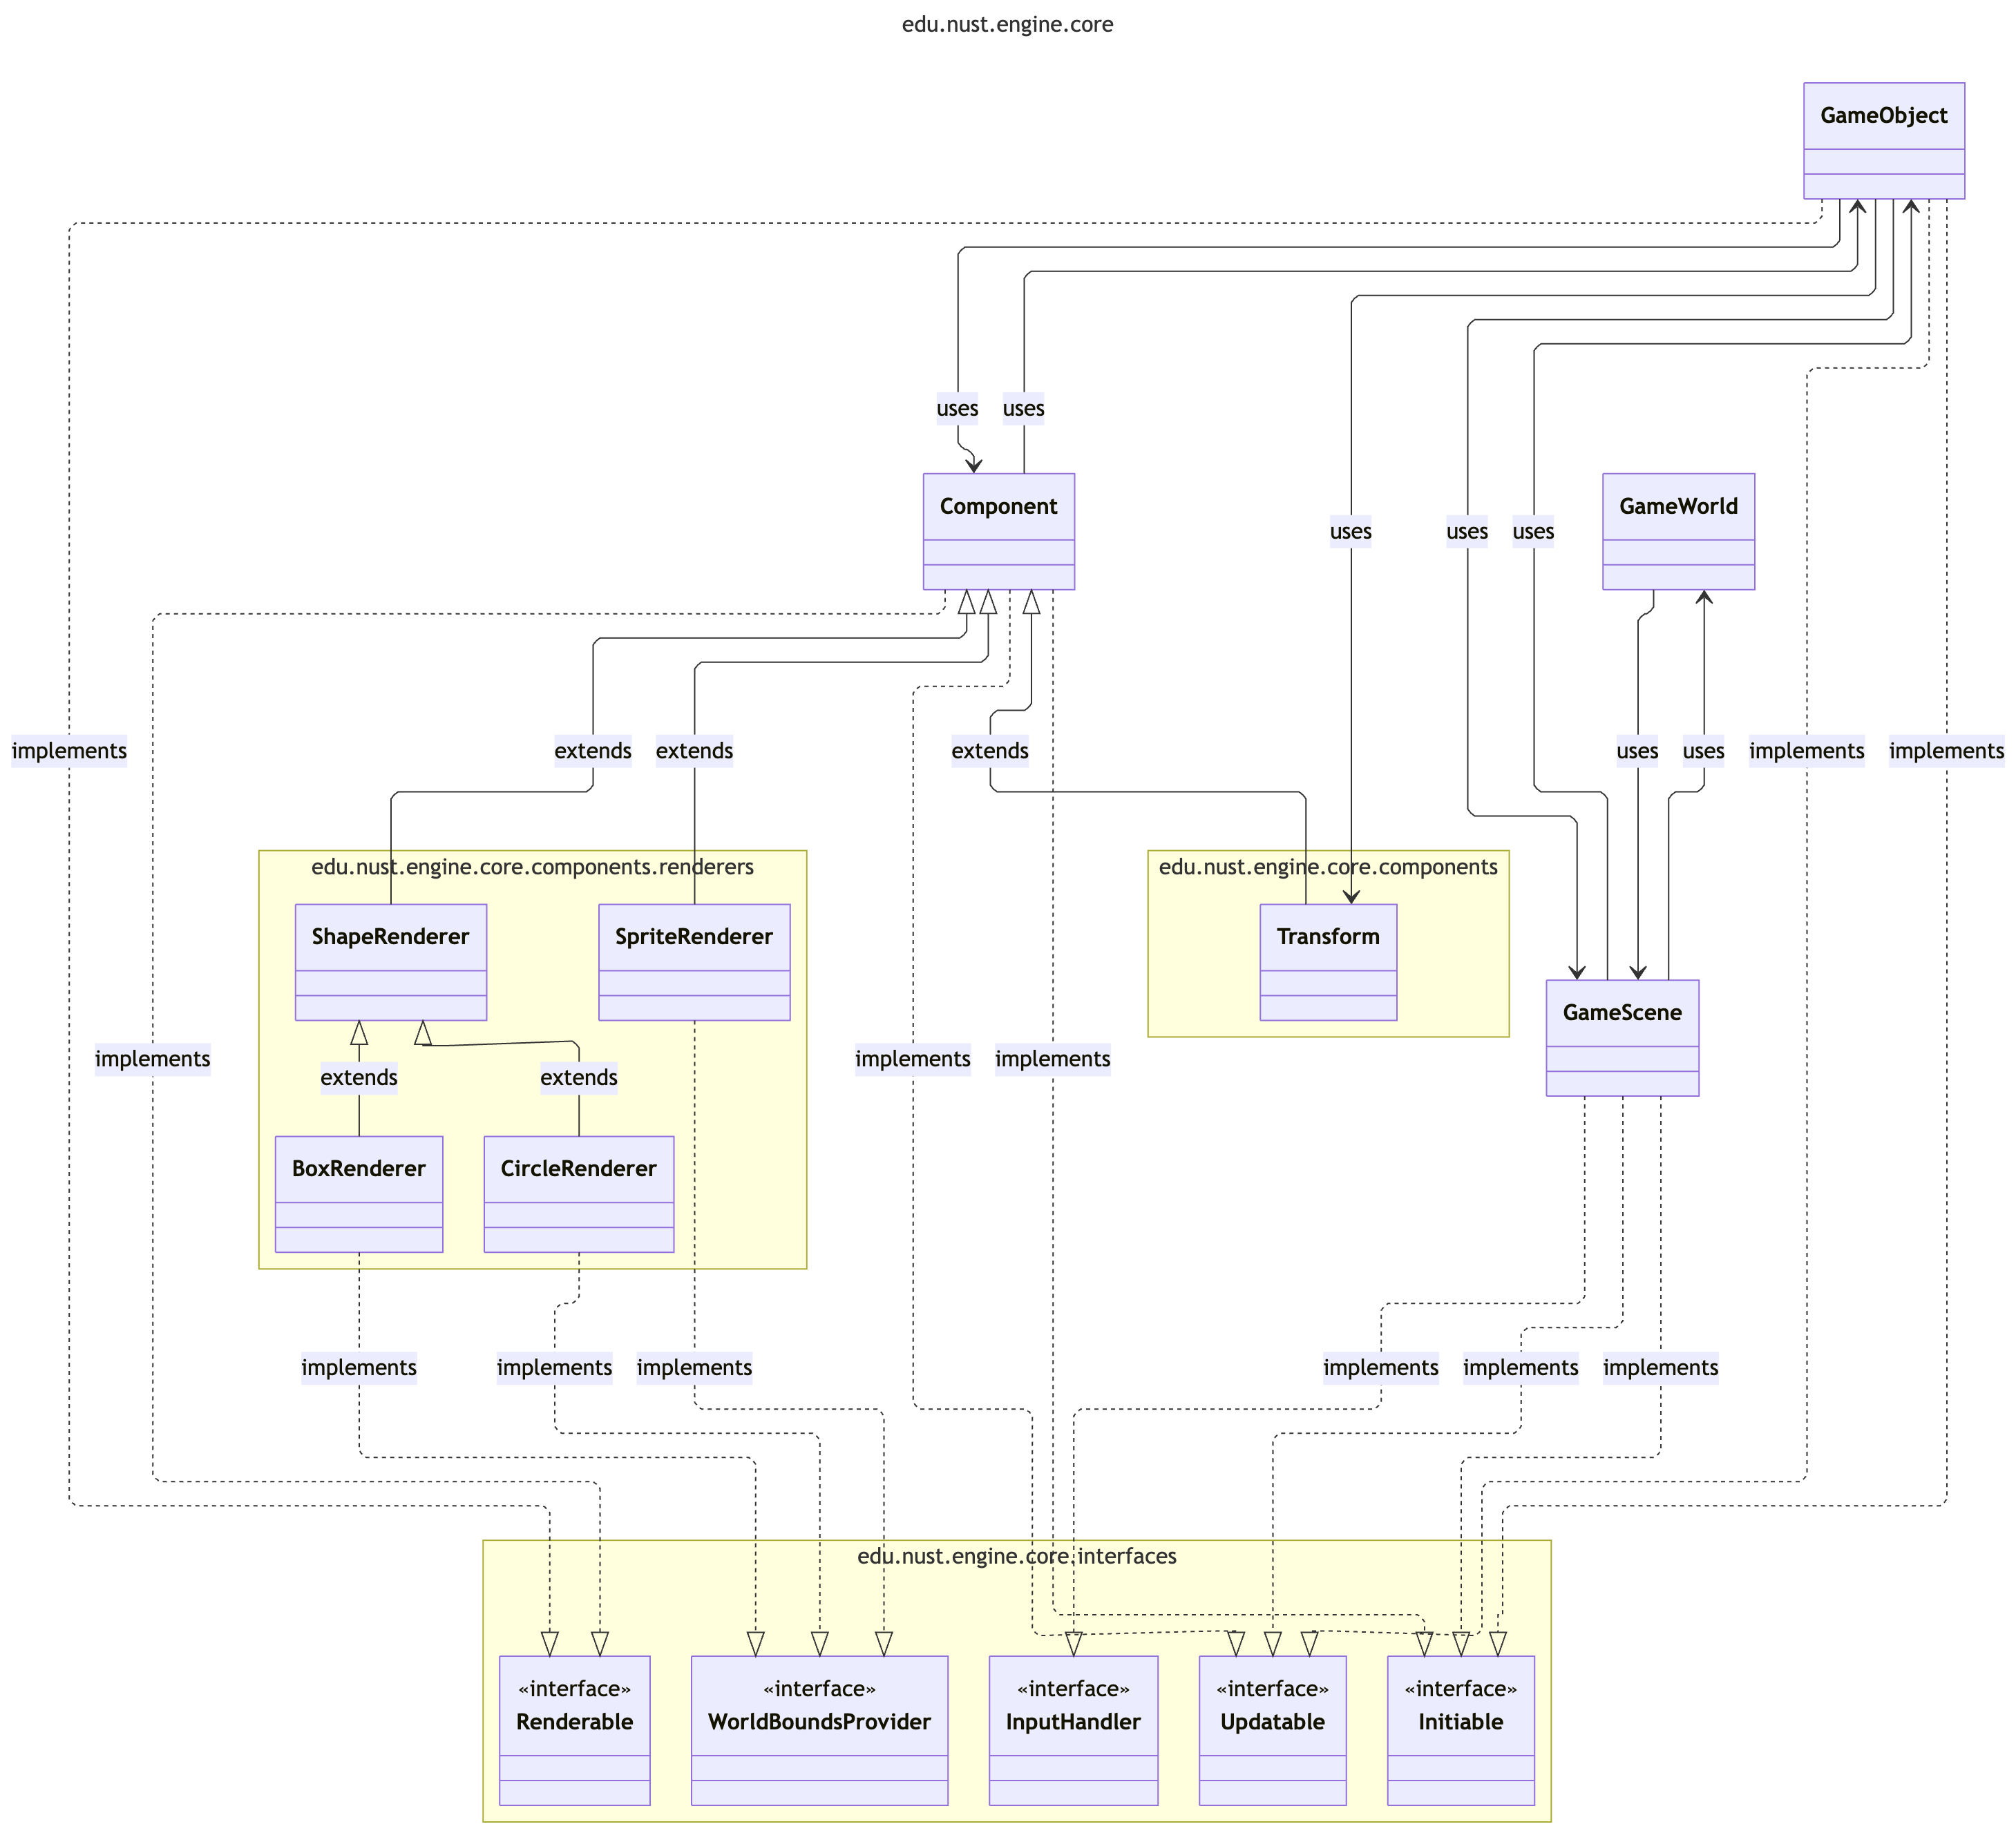
Game Engine High Level Overview
Start
Initialize
Start Game Loop
Hand Off to game module
End Game Loop
Clean Up
Exit

Slide 7
Game Engine
Deep Dive

Slide 8
GameWorld
GameWorld owns the JavaFX Stage and Scene
Drives the AnimationTimer loop for main Game Loop
Delegates each frame to the active GameScene
Switches scenes by swapping root children (world + UI)
Usage:
MainWorld in game module

Slide 9
GameScene
Represents a single scene in the game
Implements Initable, Updatable
Owns the game object list, the world canvas, and the FXML UI
Has separate layers for GameObject rendering, UI Rendering, DevConsoleRendering
Abstracts input hooks from JavaFX into overridable methods.
Usage:
All Scenes

Slide 10
GameScene (LifeCycle)
Init
Loads Mandatory layout.fxml from edu/nust/game/scenes/[CLASS_NAME]/layout.fxml
Loads Optional style.ss from edu/nust/game/scenes/[CLASS_NAME]/style.css
Initialize GameCamera
Initailize DevConsole
Setup Input Handler
Game Loop (Received from GameWorld)
Update self
Update GameObjects
LateUpdate self
LateUpdate GameObjects
Update Camera
Remove queued GameObjects
Render Objects In View
Render Debug Shapes

Slide 11
GameScene (GameCamera)
Can change camera zoom
Can follow a given position
For Movement the Canvas is moved, thus all GameObjects moves when camera is moved
Can Shake
Depends upon given intensity
Consecutive calls increase shake intensity
Working
Stores 2 positions (actual position and render position)

Slide 12
GameScene (Render Order And Culling)
Objects are sorted by renderLayer and culled by camera bounds.
Object bounds are provided by renderer components using WorldBoundsProvider interface
renderLayer by default is 0, if two objects has same renderLayer, then the one added last takes precedence for rendering

Slide 13
GameScene (Debug Rendering)
Grid, mouse location, and timed/frame debug shapes can be rendered on the world canvas on top of all gameobjects.
Grid renders a grid, was used in blank scenes when scene background hadn’t created
Mouse Location shows a red crosshair at the mouse, highlighting the world coordinates of that point
Timed shapes stored in a set and cleared after the given TimeSpan
Frame-only shapes cleared each frame

Slide 14
GameObject
Represents any and all objects in the game
Implements Initable, Updatable and Renderable
Can be added or removed at runtime
Composes of Components with their own lifecycle
Can have multiple Tags
A Tag is simply a class extending the Tag class, the class itself is used as a tag rather than a string

Slide 15
Component
Represents behavior of a GameObject
Implements Initable, Updatable and Renderable
Can be added or removed at runtime
Can be added to multiple different GameObjects, but only one instance can exist on a GameObject at a given time

Slide 16
Component (Transform - Pre Existing)
Guaranteed to be present on any GameObject
Used to represent position, rotation and anchor of this object
Anchor can be set using a Vector2D, predefined helpers for setting anchor to center, top left, bottom, center etc.

Slide 17
Component (Transform - Pre Existing)
Guaranteed to be present on any GameObject
Used to represent position, rotation and anchor of this object
Anchor can be set using a Vector2D, predefined helpers for setting anchor to center, top left, bottom, center etc.

Slide 18
Component (BoxRenderer - Pre Existing)
Renders a Box with the given size
Position is fetched from Transform component of attached GameObject
Can be rotated as well
Is affected by anchor positioning
Can be filled, stroked
Corner radius can be applied
Properties can be changed at runtime

Slide 19
Component (CircleRenderer - Pre Existing)
Renders a circle with the given radius
Position is fetched from Transform component of attached GameObject
Is affected by anchor positioning
Can be filled, stroked
Properties can be changed at runtime

Slide 20
Component (SpriteRenderer - Pre Existing)
Draws a sprite or sprite sheet with the given frame counts
Position is fetched from Transform component of attached GameObject
Can be rotated and affected by anchor positioning
Supports tint and opacity
Supports Animation by setting animation time, after the given time the frame is automatically changed
Can be flipped
Properties can be changed at runtime

Slide 21
Rendering Pipeline
Handled by GameScene
worldLayer is a Canvas
Renders GameObjects
uiLayer loaded from FXML and CSS
Renders JavaFX nodes
consoleLayer stacked on top
Renders DevConsole, above everything

Slide 22
Input Handling
Handled in GameScene by overriding methods given in InputHandler interface
Has the following events
onKeyPressed
onKeyReleased
onMousedPressed
onMouseReleased
onMouseMoved
onMouseDragged

Slide 23
DevConsole
Can be opened in any scene by pressing “Shift + `”, and exit by pressing “Esc”
Commands to modify game behaviour at runtime
Supports suggestions and history
Displays the following stats
Game FPS
Total Objects added
Objects being Rendered (objects not visible are culled)

Slide 24
DevConsole (Command)
Commands stored in a map with normalized names
Executors return strings shown in console output
Every GameScene can register commands that can be executed in that scene
Shows suggestion with command usage realtime, can press tab to autocomplete the command
Preserves History of Previously Executed Commands in this session
Show output of previos commands as well

Slide 25
DevConsole (Default Commands)
/help
Shows Registered Commands
/debugGrid [true|false|number|empty]
Toggle grid, with given size if number specified
/debugMouseLocation [true|false|empty]
Toggle world mouse crosshair + coordinates.
/setCameraZoom [number]
Set camera zoom
/toggleUI [true|false|empty]
Toggle FXML UI visibility (excluding dev console).

Slide 26
Resources Management (Resources)
Path for resouces are resolved relative to /edu/nust/game/ in resources directory
resources directory is bundled with the executable by Java
Supports optional Resources and mandatory resources by tryGetResource(...) and getResourceOrThrow(...) respectively
Utility for loading a JavaFX Image from the given path, assumes loading image is mandatory
Used extensively to get every kind of resource including, text, image, or any other type

Slide 27
Math Library
Primitive classes to represent positions, velocity, time, areas etc.
All of Below has methods for arithmetic operations and more
Contains
Vector2D
A container for 2 numbers
Used to represent positions, velocities etc.
D stands for double, represents the data type used for storing numbers
TimeSpan
Used to represent a said amount of time
Used instead of int, double etc. to remove confusion regarding unit of time
Constructor is privatized, instead factory methods are used that explicitly mention the unit, e.g TimeSpan.fromSeconds(10).
Getting the time value also require explicit unit e.g. deltaTime.asMilliseconds()
Has methods for interconversion between units ranging from nanosecond to day
Internally stores the time in the form of nanoseconds
Rectangle
Used to represent an area covered by a Rectangle
Is Axis Aligned, i.e. cannot be rotated
Can be shrunk and grown
Queries for intersection between rectangles, containing a given point etc.
Angle
Used to represent a certain angle
Constructor is privatized, instead factory methods are used that explicitly mention the unit, e.g Angle.fromDegrees(10).
Getting the time value also require explicit unit e.g. rotation.getRadians()
Has methods for interconversion between radians and degrees

Slide 28
GameLogger
Wraps SLF4J Logger with custom color prefixes and formatting for each level
Writes each log to its own file in logs/latest.log, and archives the old logs based on timestamp logs/archived/
Logging disabled in packaged versions
Logs can be filtered by one global level
Level Types in order:
Trace
Intended to represent function calls to visually trace the program
Debug
Intended for debug only
Info
Default Log Type
Success
Intended to represent a successful operation
Warn
Intended for warnings, i.e. optional things not loaded
Error
Can throw or not based on user preference
LogProgress
Intended to represent a progress that can be started, reported on, and ended
Gives color to the prefix

Slide 29
Audio Management
AudioReference stores the audio URL and common metadata
Created internally by GameAudioManager of GameScene
Two Types
SoundEffectReference
Represents short bursts of sounds like bullet shots etc.
Cannot be paused or have granular control, but can have overlapping instances of same reference
Uses JavaFX Clip internally
MusicTraceReference
Represents long sounds, musics mainly
Can be paused and has granular control, but cannot have overlapping instances of same reference
Uses JavaFX MediaPlayer internally

Slide 30
Audio Management (GameAudioManager)
Manages all in-game audio
Can load and unload an AudioReference
Controls Global Volume for muting, same global volume for both Effects and Tracks
Linked to the GameWorld
Loaded Effects are only unloaded when game exits
AudioReferences persists when switching scenes
All loaded references are cached by full relative path; loading the same asset twice returns the existing reference
All paths are resolved relative to edu/nust/game/assets/audio/

Slide 31
Systems & Misc
Deep Dive

Slide 32
Asset Manager
Singleton that loads assets once and reuses them
Uses an enum interface for Asset Type
Has a cache of loaded images
Used to loads images for character, enemy and boss etc.

Slide 33
Collision Manager
Collects Damageable, Damaging, and Concrete objects and resolves collisions
Three types of Collision
Concrete
Damaging
Damageable
Notifies the objects that the collision has occurred with reference to other

Slide 34
Collision Manager (Interactions)
When Bullet hits enemy, increase the follow radius of the enemy
Award kill score when an enemy dies
Separate for each enemy type

Slide 35
Collision Manager (Hitbox)
Performs AABB collision checks
Supports debug visualization
Separate methods for collision with each sides of the AABB rectangle

Slide 36
Path finder (MapNodeSetter – Initialization)
First creates a grid of nodes using native fixed size 2D array in MapNodeSetter
Loops over the the Level Collision Mask to determine walkable area
A* search ready to calculate path from any given point to another one

Slide 37
TODO: Path finder (A*)
Explanation of Algo, include Node class also

Slide 38
TODO: Weapon System
Explanation of the working of weapon system
How weapons work
Ammo working
How UI changes
Bullets logic

Slide 39
TODO: HUD Bars
Explanation of HUD Bars

Slide 40
Audio Management In Game
Audios
Exposes methods for sound effects and music refrences
Randomized sound effect selection
Usage: Audios.clickNeutralRef().ifPresent(SoundEffectReference::play)
MusicManager
Uses Music references from Audios
Transitions to the music of the given scene
Does by fading out the old one, and fading in the new one

Slide 41
Gradle Tasks
packageWindows
Packages into an exe installer
packageMac
Packages into an dmg installer
packageLinux
Packages into linux installer
buildExecutableJar
Builds a jar that can be opened by JRE
run
Runs the application with full logging (Maxiumum log level defined in Main class)
runNoLogs
Runs the application with no logging
runTestLogger
Runs a test that tests the logger of all formats, error message etc

Slide 42
UML Generation Pipeline (Misc.)
Requires Python & Mermaid CLI in npm
Generate UML using a python script
Uses mermaid for to scaffold structure, then renders using the mermaid renderer
AI Generation Disclosure

Slide 43
Scenes
Breakdown of each scene

Slide 44
StartScene
Main entry point of the game
Routes to main game and high scores along with exit game button

Slide 45
LevelScene
The main level of the game
Objective is to clear out all zombies

Slide 46
LevelScene (Collision Mask)
Defines a list of rectangles that are used to defined unwalkable areas
IMAGE 1: showing code ss of a rectangle start point
IMAGE 2: showing that point in game using dev console

Slide 47
LevelScene (Enemy Spawning)
Spawns when the game is loaded
Generates spawn points across a grid with random offsets and validation.
Avoids non-spawnable area
Validates with collision mask and movement checks

Slide 48
LevelScene (Objects placement)
Parses placement file lines into StaticObject instances
Can regenerate placements via builder helpers

