Slide 1
Associative Container
MAP

Slide 2
WHY STL?
It will save you days, if not months of work
Low level languages, toil and drudge
Why reinvent the wheel?
Elegant, Efficient, and Versatile
Vector is the most useful STL
Map is the second most useful STL
STL containers (map, vector, list, etc.) and algorithms (sort, find, accumulate, etc.) give excellent methods for dealing with a lot of data

Slide 3
Examples of problems
Sort words in dictionary order.
Find the highest temperature.
Find the first occurrence of 70.
Find the highest temperature for each day in a month.
Find the top ten best sellers in a month.
Find a number in a phone book, given a name

Slide 4
Associative container → map
What is a Map?
STL implementation is a balanced binary search tree
An ordered container of (key, value) pairs
Elements are put in order of key
Tree is built from nodes
A node holds a key, its corresponding value,
and pointers to its descendant nodes
After vector, the most useful STL is the map
For Every Node:
Its left sub-node has a key that is less than the nodes key
The nodes key is less that the key of its right sub-node
Trees grow downward from their roots
Map uses a balanced tree (on next slide)

Slide 5
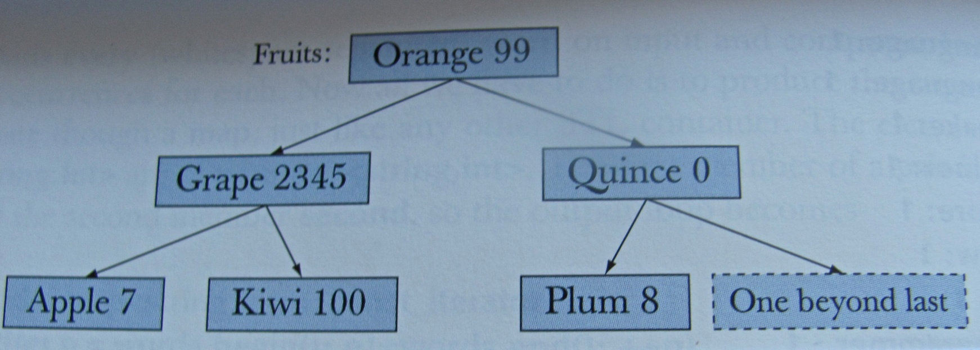
The map → a Balanced tree

Slide 6
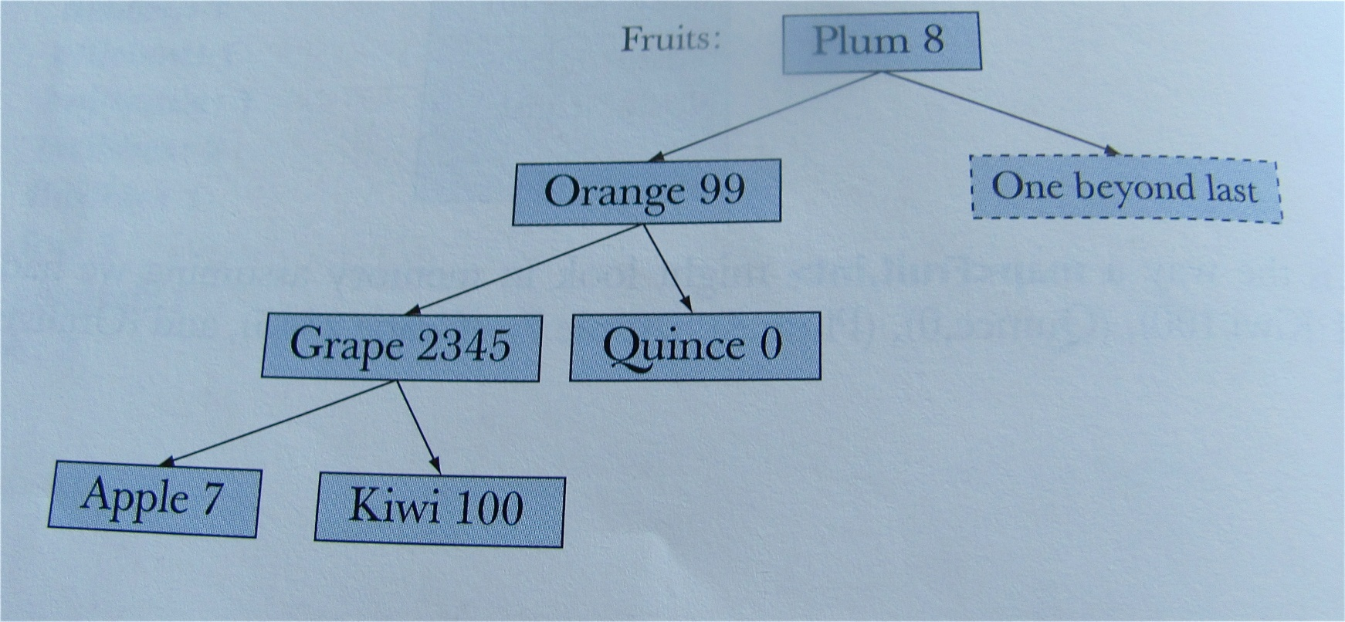
Unbalanced tree

Slide 7
Sets and multisets
Set is a map where you are not interested in values
Fruits without the number
You can use the value of the iterator directly because there is only one value
set<Fruit>::const_iteraor p;
for(p=inventory.begin();p!=inventory.end();p++) cout<<*p<<endl;

