Slide 1
Inheritance
Jackie Kuehn
CS 140

Slide 2
Inheritance
Key element of OOP is inheritance which allows you to derive a new class from an existing one.
After classes, inheritance is the most powerful feature of OOP.
New class automatically inherits (or gets) the data members and member functions of an existing class.
Inheritance is the process of creating new classes, called derived classes, from existing or base classes.
Derived class inherits all the capabilities of the base class but can add embellishments and refinements of its own.
Its big payoff is that it permits code reusability.
Advantage of reusing code is: time, money, and it increases the programs reliability.
Ease of distributing class libraries: A programmer can use a class created by another person or company, and without changing the original class derive classes for particular situations. Very COOL!!!!

Slide 3
Inheritance
In the following diagram think of the arrow as a “derived from” arrow.
Feature D is defined in derived class.
Base Class
Feature A
Feature B
Feature C
Derived Class
Feature D
Feature A
Feature B
Feature C

Slide 4
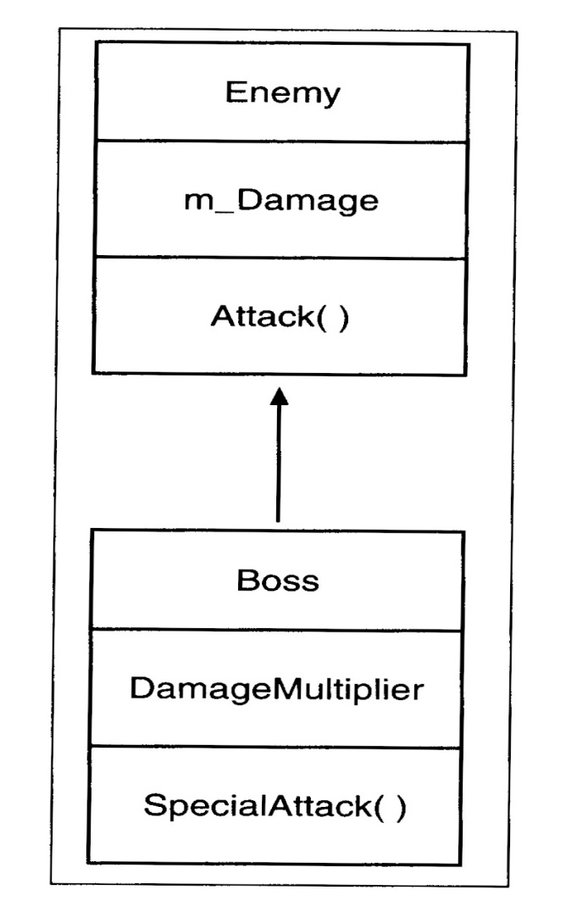
Inheritance Example →Boss Inherits from Enemy (simple_boss.cpp)
Boss is the derived class. Boss inherits Attack() and m_Damage from Enemy. Boss defines SpecialAttack() and m_DamageMultiplier.

Slide 5
Deriving From a Base Class simple_boss.cpp
class Boss : public Enemy
Enemy is the base class or superclass
Boss is the derived class or subclass
public is the access specifier and it determines how the derived class inherits from the base class.
Boss inherits and can directly access m_damage and Attack() in Boss.
There are actually a few base class member functions that are not inherited by a derived class. They are:
-Constructors
-Destructors
-Copy Constructors
-Overloaded Assignment Operators

Slide 6
Instantiating Objects simple_boss.cpp
Enemy enemy1;
Output: Attack inflicts 10 damage points.
Boss boss1;
After this line of code I have a boss object with the following:
m_damage=10 and m_DamageMultiplier=3
How did this happen?
Constructors and destructors are not inherited from a base class?
*!*A base class constructor is called before the derived class constructor.
This is so the derived class gets its base values.
Ouput: boss1.Attack();
Attack inflicts 10 damage points.
Ouput: boss1.SpecialAttack;
Special Attack inflicts 30 damage points.
Destructors are called in the reverse order: First Derived, then Base

Slide 7
Controlling Access to Data Members
Public class members are accessible to all code in a program
Private class members are only accessible in their own class, which means they are not accessible to any derived class.
Protected class member are accessible only in their own class and certain derived classes. Family Secrets☺

Slide 8
Access Modifiers
class D: access specifier class B
The access specifier can be either public, protected, or private.
Public is the most common.
Example
class B{ public: int x;
protected : int y;
private: int z;
};
Three cases
1. public (most used case)
class D: public B
{ public: int r;};
Data members of D:
-> public: r and x
-> protected y
-> z is not accessible to D
2. Protected
class D: protected B
{ public: int r:};
Data members of D:
->public: r
->protected: y and x
->z is not accessible to D
Private
class D: private B
{ public: int r:};
Data members of D
-> public: r
-> private: y and x
-> z is not accessible to D

Slide 9
Derived Class Size
Regardless of the derived classes access specifier, the class has a full copy of its parent members.
Assume an int takes 4 byes of storage.
#include <iostream>
using namespace std;
class B{
private: int z;
protected: int y;
public: int x
};
class D: public B
{ public: int r; };
int main()
{
D dummy;
B best;
cout<<“Size of Base”
<<sizeof(dummmy)<<endl;
cout<<“Size of Derived”
<<sizeof(best)<<endl;
return 0
}
What will be the output?

Slide 10
Advantages of Inheritance
Less Work. There is no need to redefine functionality you already have.
Fewer Errors. Once you have a bug-free class, you can reuse it without errors cropping up.
Cleaner Code. Because the functionality of base classes exist once in a program, you don’t have to wade through the same code repeatedly, which makes programs easier to understand and modify.

