Slide 1
Cognitive Decline Trajectories in MCI/Dementia Patients
Kayla Bell

Slide 2
Data Summary
Research questions:
What is the rate of memory decline in healthy vs. early onset MCI/dementia patients?
Does memory decline happen prior to year four of MCI/dementia diagnosis?
Dataset:
11 variables total
216 patients with varying numbers of longitudinal data
145 (67.1%) patients without MCI/dementia diagnosis vs. 71 (32.9%) with MCI/dementia diagnosis
Outcomes of Interest:
Wechsler Memory Scale Logical Memory I Story A
Wechsler Memory Scale Logical Memory II Story A
Category fluency for animals
Wechsler Adult Intelligence Scale-Revised Block Design

Slide 3
Data Summary
Missing or limited data (<3 OBS):
Wechsler Memory Scale Logical Memory I Story A (24 subjects)
Wechsler Memory Scale Logical Memory II Story A (24 subjects)
Category fluency for animals (29 subjects)
Wechsler Adult Intelligence Scale-Revised Block Design (24 subjects)

Slide 4
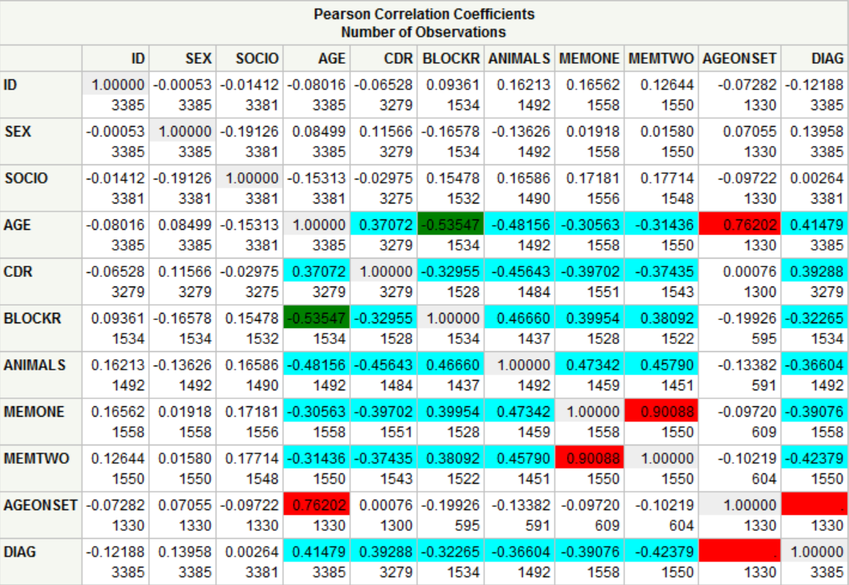
Analysis Plan
Appropriate descriptive statistics
Mixed model regression analysis
Estimates of average rates of decline for each of the four outcomes
Model includes appropriate covariates (i.e. age, age of onset, gender, socioeconomic status, and CDR score)
Appropriate plots to show rates of decline

