Slide 1
Cognitive Decline Trajectories in MCI/Dementia Patients
Kayla Bell

Slide 2
Data Summary
Research questions:
What is the rate of memory decline in healthy vs. early onset MCI/dementia patients?
Does memory decline happen prior to year four of MCI/dementia diagnosis?
Dataset:
11 variables total
216 patients with varying numbers of longitudinal data
145 (67.1%) patients without MCI/dementia diagnosis vs. 71 (32.9%) with MCI/dementia diagnosis
Outcome of Interest: category fluency for animals
Primary explanatory variables: age and MCI-dementia classification
Covariates: socioeconomic status, sex, change point (four years prior to MCI-dementia onset)
Missing data: MNAR (due to clinician timeliness, patient inability to complete study procedures due to fatigue or health condition
Exclusion: Patients with fewer than three ANIMALS measures longitudinally

Slide 3
Data Summary & Analysis
Missing or limited data (<3 OBS):
Wechsler Memory Scale Logical Memory I Story A (24 subjects)
Wechsler Memory Scale Logical Memory II Story A (24 subjects)
Category fluency for animals (29 subjects)*
Wechsler Adult Intelligence Scale-Revised Block Design (24 subjects)
Univariate tests, frequency and mean procedures
Mixed model linear regression analysis
Estimates of average rates of decline for each of the four outcomes
Model includes appropriate covariates (i.e. age, sex, socioeconomic status, and MCI-dementia classification)
Accounting for subject-to-subject variation and between subject variation in the model
Spaghetti plot to show rates of decline (subject-to-subject and between subjects)

Slide 4
Results
MCI-Dementia patients tend to be older, female, have a slightly lower SES, and score significantly lower in cognitive tests than healthy controls
Differences between baseline and year-7 between groups are not notable

Slide 5
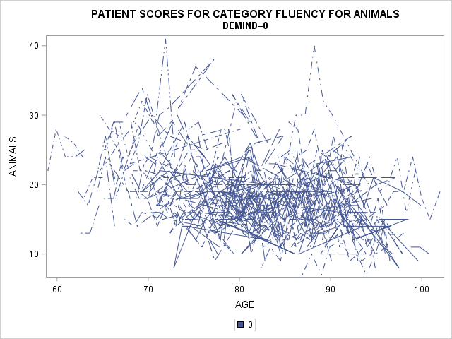
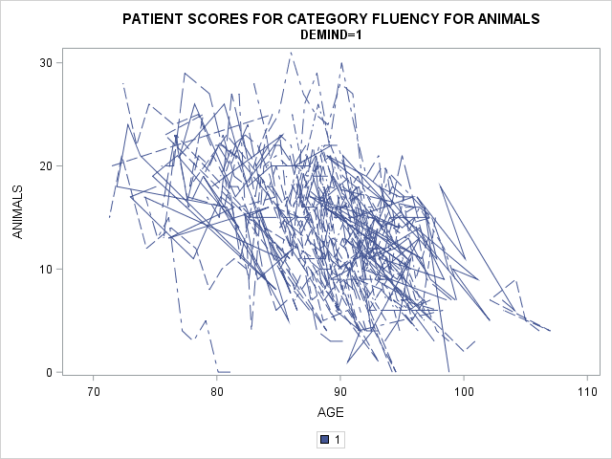
Results
Final model with random intercept:
Variance between subjects (19.76)
Variance within subject (9.54)
Estimated ANIMALS score for those with MCI-dementia (17.34 ± 1.88) / p < 0.0001
Estimated difference in ANIMALS score between healthy control and MCI-dementia patients (1.17 ± 1.56)
Change point is significantly associated with the ANIMALS measure (p < 0.0001)

Slide 6
Discussion
Overall decline in cognitive measures (BLOCKR and MEM1) over time for both groups (i.e. healthy controls v. MCI-dementia patients)
Overall similar score in cognitive measure MEM2 over time for both groups
Cognitive measure ANIMALS score decreases in both groups over time, but drops significantly for those with MCI-dementia diagnosis four years prior to diagnosis
Analyze all four outcomes for a more generalizable rate of cognitive decline in the MCI-dementia population
Limitations: loss to follow-up, population differences, missing data

