Slide 1
HAART Effectiveness in Drug/Non-Drug Users
Kayla Bell

Slide 2
Research Question
How does treatment response two years after initiating HAART differ between subjects who use hard drugs at baseline and those that do not?
Hypotheses:
Treatment response differs between baseline drugs users and baseline non-drugs users two years post-initiation of HAART
Treatment response does not differ between baseline drugs users and baseline non-drugs users two years post-initiation of HAART

Slide 3
Data Summary and Analysis
HAART Dataset (n=3935)
HAART Dataset up to Year 2 observations (n=1746)
HAART Baseline (Year 0) Dataset (n=715)
HAART Final (Year 2) Dataset (n=506)
HAART Clean Dataset (merged) with missing outcome observations removed (n=397)

Slide 4

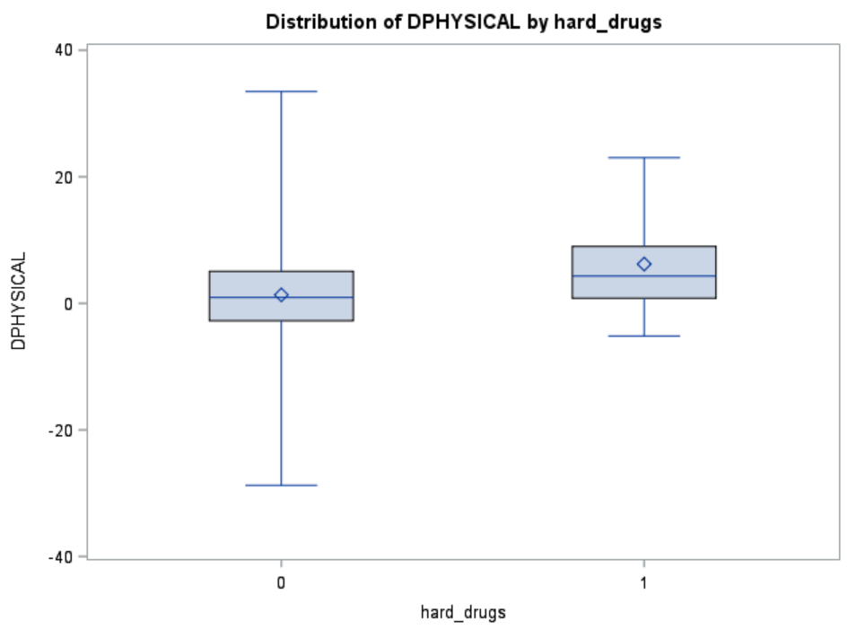
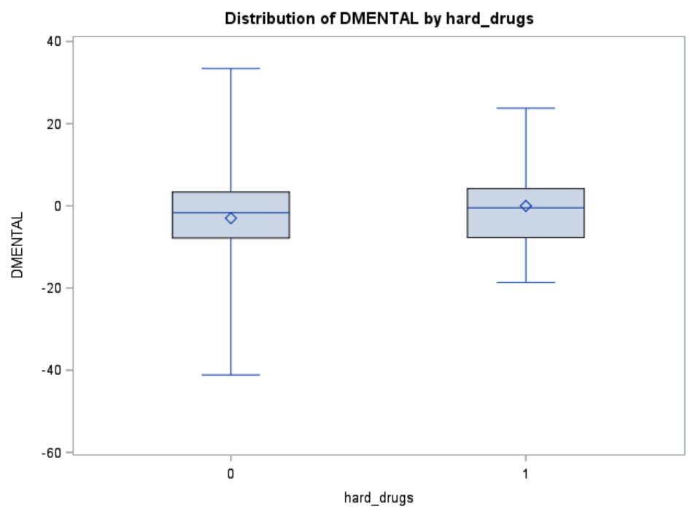
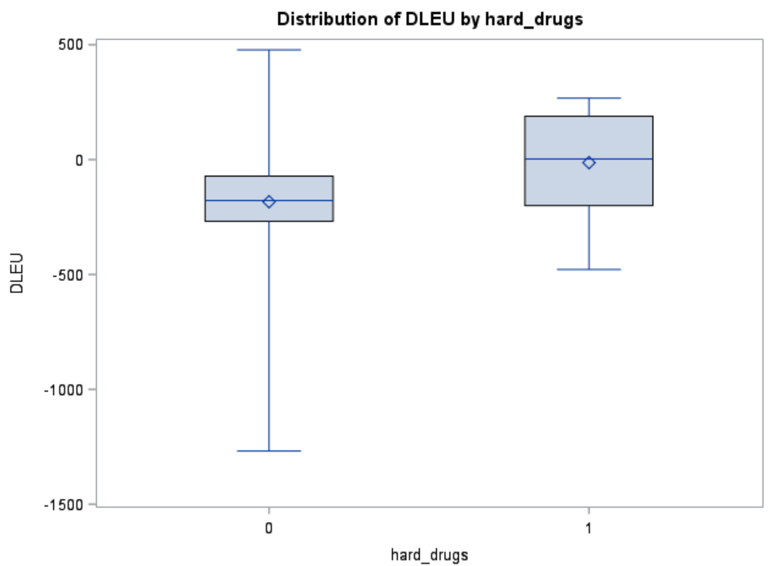
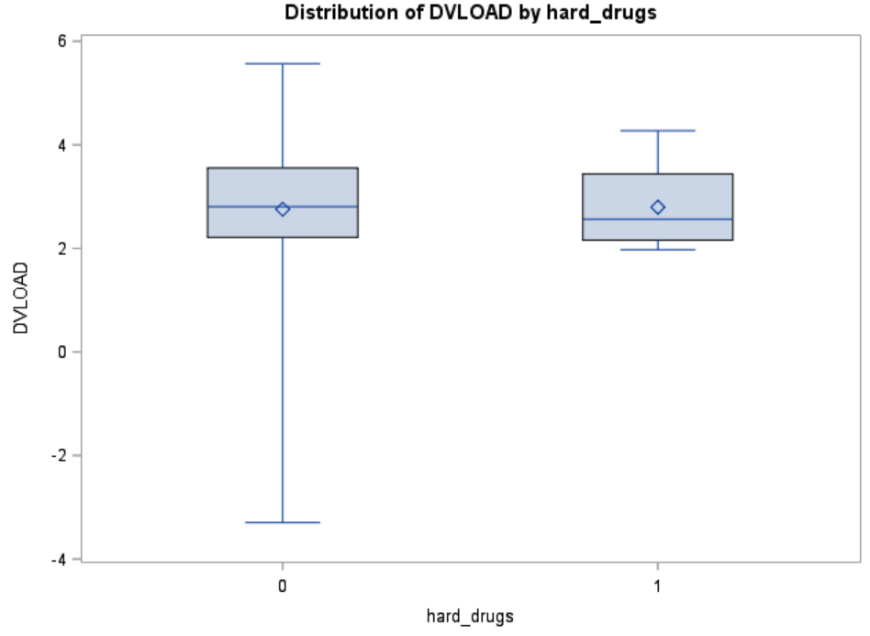

Data Summary and Analysis
Variables were recoded per investigator specifications
Two missing data patterns (all present vs. salary missing n=16)
Four final models (multivariable regression) using the difference between baseline and year 2 values

Slide 5
Results

Slide 6
Implications and Limitations
Significant unequal distribution between hard-drug users and non hard-drug users
Loss to follow-up
ART adherence

