Slide 1
Predicting Gross Revenue with CMS Cost Reports
Marissa Munoz-Ruiz

Slide 2
Capstone Outline
* Background on CMS Hospital Cost Reports
* Importing data via CMS API
* Preprocessing data
* Model comparison

Slide 3
CMS Hospital Cost Reports
* Submitted annually by Medicare-certified institutional providers
* Contains facility characteristics, utilization data, & financial data
* Available to the public at data.cms.gov
* https://data.cms.gov/provider-compliance/cost-report/hospital-provider-cost-report

Slide 4
CMS Access API
* Each annual report is accessed via a JSON URL
* 2018 Report:
https://data.cms.gov/data-api/v1/dataset/90869abf-c649-4d65-84b3-4d6a1b568b69/data
* 2018 UUID:
90869abf-c649-4d65-84b3-4d6a1b568b69
* API Docs for the Dataset provides UUID for each annual report

Slide 5
Data Science Platform
* Databricks
* Web-based/cloud platform
* Automatic distributed & parallel computing
* Multiple programming languages can be used in the same notebook
* Capstone Project
* Databricks community edition (free)
* Pyspark & Python

Slide 6
Web Scraping API Docs
* BeautifulSoup Error
* "Need to enable JavaScript to run app"
* Did not work in Jupyter/Anaconda
* Unique issue to CMS API Docs website
* Selenium
* Requires access to chromedriver.exe file (dbfs issue)
* Worked in Jupyter/Anaconda

Slide 7
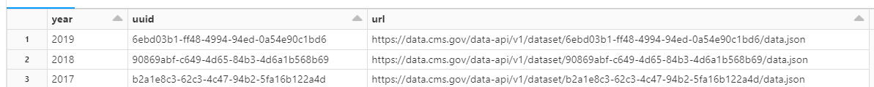
Importing Data
* Used Jupyter/Anaconda to retrieve & export UUIDs as csv file
* Imported csv file into Databricks
* Used UUID to import JSON data (2011 – 2019)
* Combined JSON data with the same columns across all years

Slide 8
Preprocessing
* Removed categorial columns
* ex: "rural versus urban"
* Removed numerical columns related to total columns
*ex: "total days (v + xviii + xix + unknown)"
* Removed columns that had 25% null values
* Removed rows with null values for DV - "gross revenue"
* Data size (rows: 55,789 -> 53,508, columns: 116 -> 32)
Notes:
Number of rows: 55789 Number of cols: 116

Slide 9
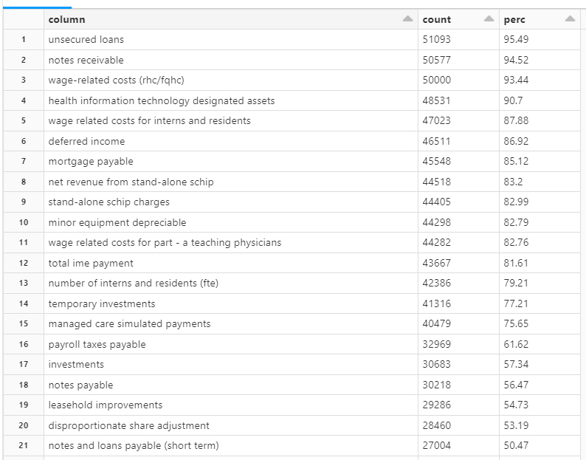
Null Values
Notes:
Number of rows: 55789 Number of cols: 116

Slide 10
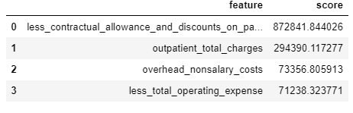
Feature Selection
* Scikit-Learn ML library – SelectKBest Class
* Linear correlation scores
* https://machinelearningmastery.com/feature-selection-for-regression-data/
* Used features with scores greater than the average

Slide 11
ML Regression Models
* Models
* Multiple Linear Regression (MLR)
* Gradient boosted decision trees (XGBoost)
* Neural Network (NN)
* 80% training, 20% testing, 5-fold cross-validation
* Performance Metric – RMSE

Slide 12
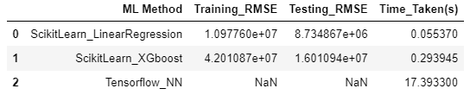
Model Comparison
* Removed columns that had 25% null values

Slide 13
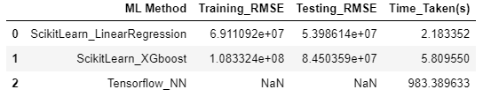
Model Comparison
* Removed columns that had 50% null values

Slide 14
Thank You
* SLU Health Data Science Program
* Dr. Mudigonda
* Dr. Subramaniam
* Dr. Buchanan
* Paul Boal

Slide 15
Questions?

