Slide 1
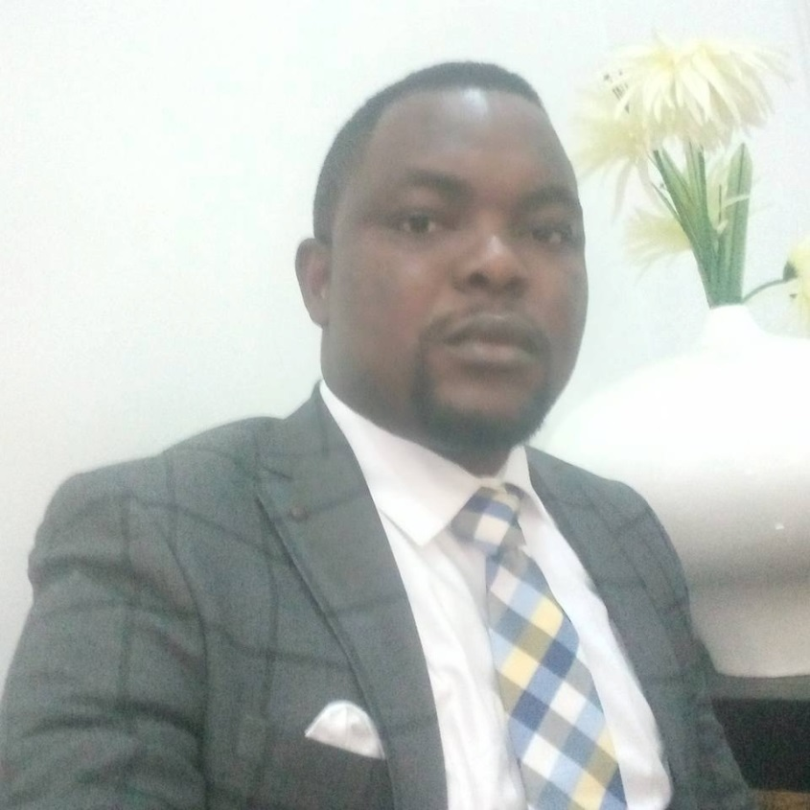
DR. CHRIS IMUMOLEN
Christopher Imumolen is an amazing and successful serial entrepreneur. His adventure began in the oil and gas industry where he did great exploits in reforming and reviving the health and safety policies of the industry. He is a strategic business consultant with undying passion towards helping individuals and organizations to achieve their goals through coaching, capacity development, networking and empowerment opportunities. His keen interest is in international expansion; taking ordinary businesses to global ranking. He is a guru in diversification, investment, project management, industrial health and safety and total quality management. He is currently the West African Representative for Wealth Fitness America, Western Africa Representative for International Standards Organization (ISO) and the Technical adviser to Akwa Ibom State on Oil and Gas Matters.

Slide 2
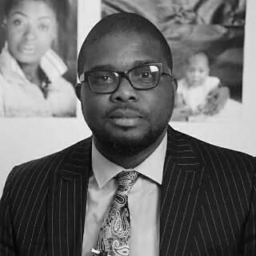
DR. OLANREWAJU PHILLIPS
Olanrewaju Phillips is an outstanding business consultant whose career started in the Sales/Marketing profession. His experience spans over 20 years in the FMCG, Banking and Telecommunications industry. He has thrived in intellectually stimulating and dynamic work environments that have ensured growth and development. He has worked as a consultant on diverse projects such as the World Bank's WomenX, Cherie Blaire Foundation's Road to Growth and facilitates several entrepreneurial courses with the Enterprise Development Centre. He has also served as an Independent Monitor in the Federal Government's YouWIN programme aimed at selecting qualifying business plans for grants in Nigeria and Business Innovation and Growth of World Bank in conjunction with Ministry of Finance, Nigeria. Olanrewaju has an unusual passion for the growth of organizations through the development of human capacity and implementation of sound business strategies which translate into operational excellence. He has indepth wealth of experience working with businesses of different sizes across the globe and has trained extensively on Small Business Development, Vocational Training, Organizational Behaviour, Strategy, Personal Development, Leadership, Business Branding, Team Building, Customer Care, Sales Techniques and Entrepreneurship. He possesses sound analytical, numerical and communication skills and is result oriented and charismatic.

Slide 3
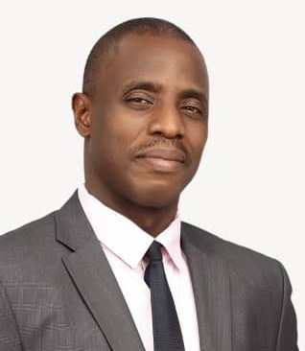
MR. MOROLAYO IGELEKE
Morolayo Igeleke is a conscientious self-motivated Business Strategist/Analyst, Economist and Administrator with over 15 years quality experience in Business Planning & Strategy, Forecasting & Modeling, Pricing Strategy, Product Development & Management, Excellent Office Administration with HR touch, Business Case Development & Performance Evaluation, Marketing Stratagems Development & Formulation, Quality experience in the telecoms industry. A strategic thinker, with the ability to form and give balanced views on the business as a whole, articulate the holistic analysis of various business options and demonstrate clarity of strategic thought and decision making, highly analytical, coupled with high level co-ordination skills.

Slide 4
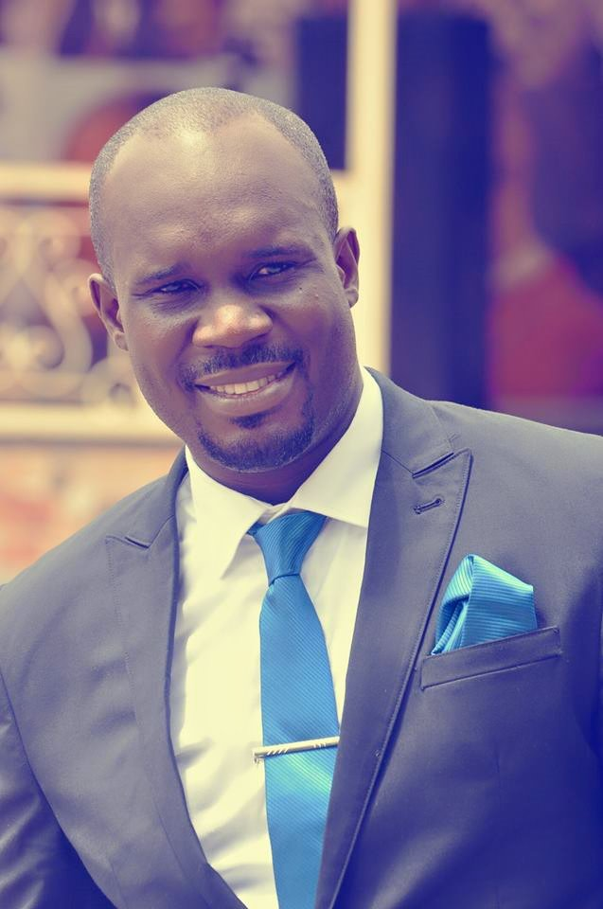
Engr. Sylvester Akpan
Sylvester Akpan is a safety and quality expert with over ten years experience and the principal consultant with Pinnacle Couterie International. He holds masters degree in environmental management with first degree in chemical engineering and professional certification in Industrial Health Safety and Environment. He is a member of Industrial Security and Safety Institute of Nigeria.

Slide 5
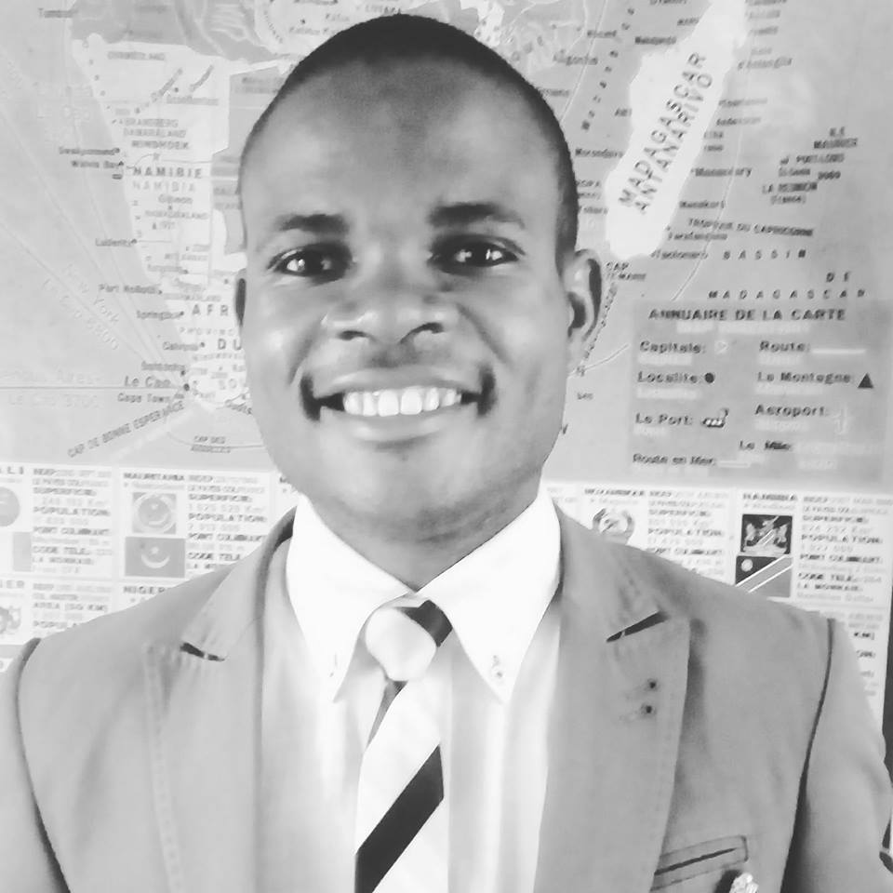
EBURUCHE OBINNA BANITO
Eburuche Obinna Banito is a multi-faceted professional with key competencies in management, business, entrepreneurship and leadership development. He is a high performance business strategist with unequalled leadership and communication skills. He has excellent skills and working experience in marketing, organizational design and development, behavior modeling, customer relations, strategic management, occupational health and safety and executive leadership development. He specializes in helping businesses develop thriving business strategies and capacity development to meet up with the pace of change in the present day economy while coaching and mentoring career persons and start-up entrepreneurs. He has worked in the FMCG, engineering, consulting and telecommunication industries. In a sentence, he is a high performance consultant, value-driven trainer, prolific writer and transformational speaker. He is currently the programme director of the Integrated Institute of Professional Management.

Slide 6
BARR. PETER NWACHUKWU (ESQ)
Peter Nwachukwu started his career in the telecommunication industry where he worked as the deputy human resources manager for the then Nigerian Telecommunications. He has over 25 years of experience in human resources management, leadership development and organizational design and development. He is an astute high-performance strategy consultant with clear mission to help organizations and individuals discover their strengths and weaknesses and working with them through mentorship and coaching to move them to their peak performance. He focuses on business optimization while helping organization build efficient and effective business systems.

Slide 7
MR. STEPHEN BABAJIDE OGUNSANYA
Stephen Babajide Ogunsanya is an international consultant with over 25 years of experience in monitoring and evaluation, product development, project management, performance-based capacity development and executive leadership development. He had worked on so many projects from World Bank, South African, Canada, USA, West and East African Governments. He is a licensed management specialist from Institute of Management Specialist, UK. He had provided executive leadership support to most of the gubernatorial candidates in Nigeria. With respect to organizational competencies, his major competencies are in financial and cost management, corporate growth and expansion strategies, international networking and executive leadership development. He is the president of International Business School, Lafia.

