Slide 1
Tripadvisor Hotel Reviews Naïve Bayes Classifier
(classifies a sentence based on training from classified sentences)
Matthew Muranaka
A20483851

Slide 2
Data Set Information
Total Samples | 20491
Training Set Samples (80%) | 16392
Test Set Samples (20%) | 4099
What is it:
Tripadvisor Hotel Reviews
(each sentence corresponds to a review rating)
What are we using it for:
Through the usage of these reviews, we are able to train the classifier to perceive reviews and predict what a sentence’s corresponding review may look like.
Labels: 1, 2, 3, 4, 5
(1 and 2 are Negative; 3, 4, and 5 are Positive)
quirks/issues/inconsistencies:
The reviews processed from Tripadvisor to Kaggle had errors in processing which led to occasional unknown characters or characters that don’t make sense in the context.
Additional Processing:
In order to account for these inconsistencies, I completely eliminated certain characters, replacing them with a space.

Slide 3
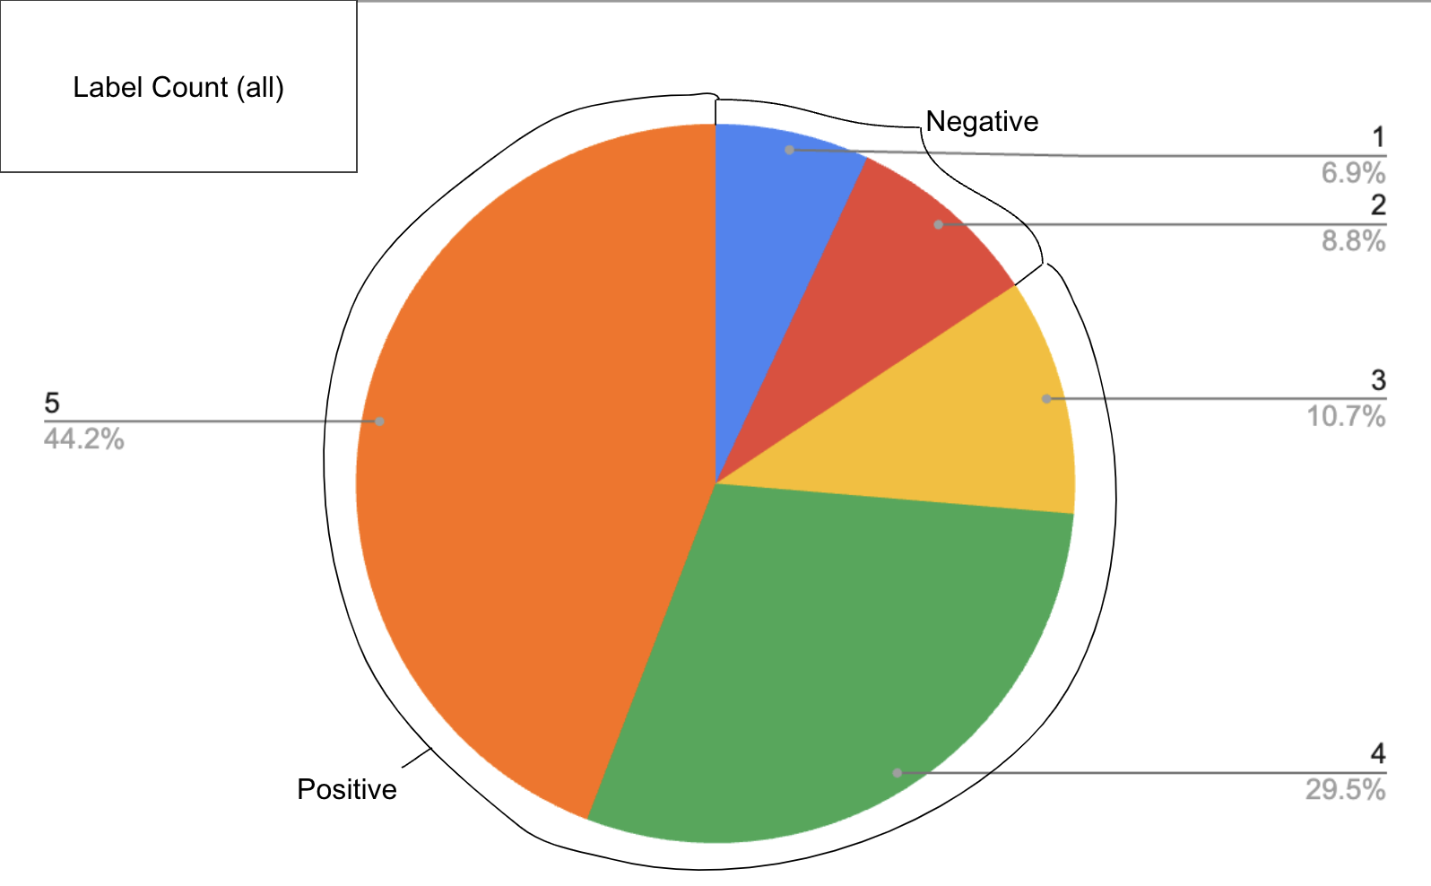
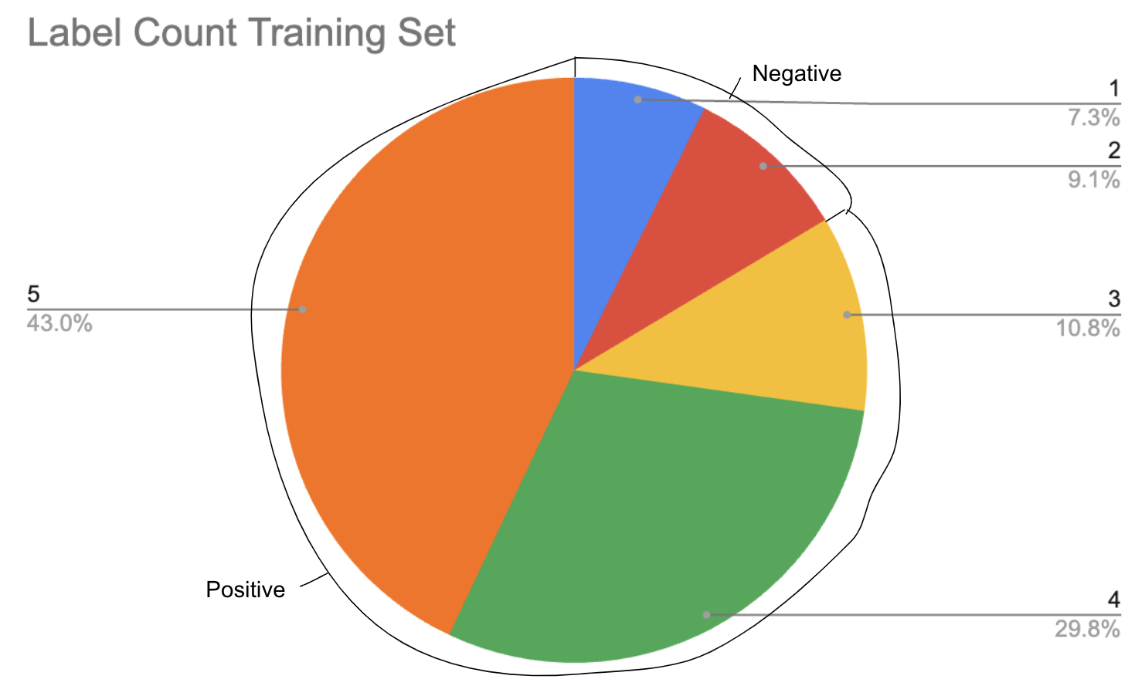
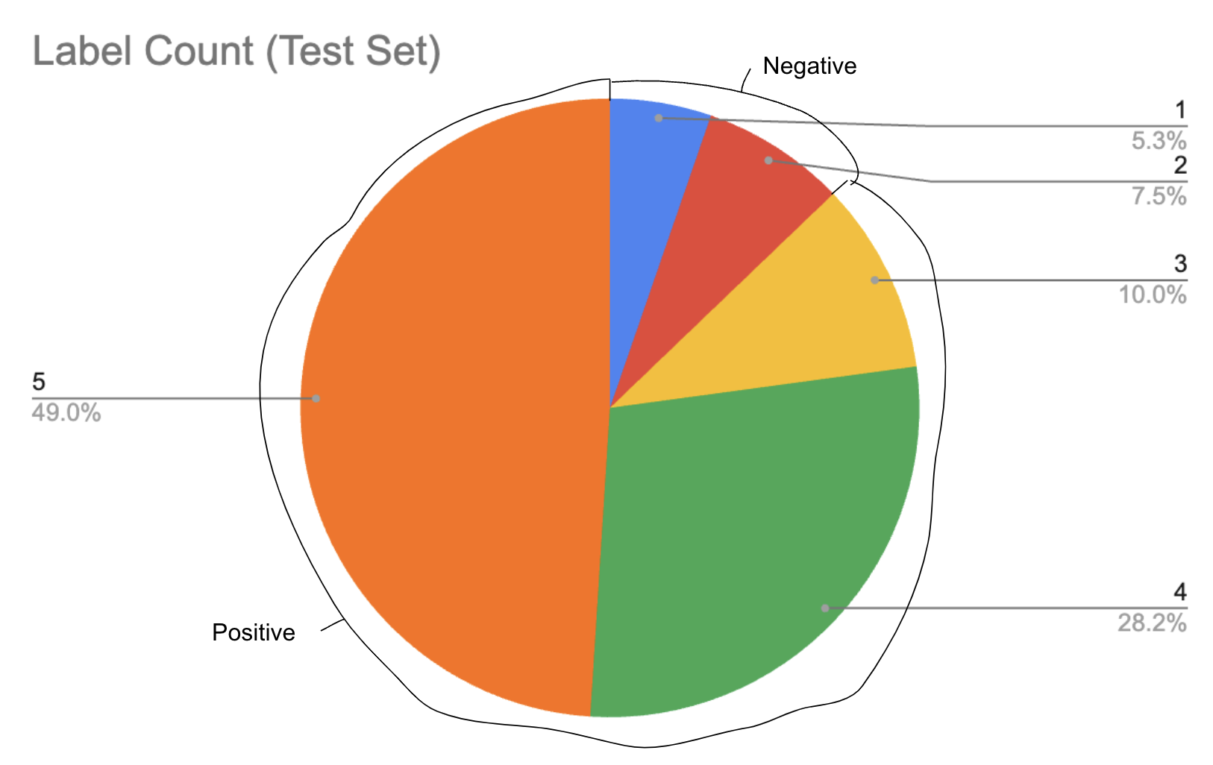
Training / Test Sets

Slide 4
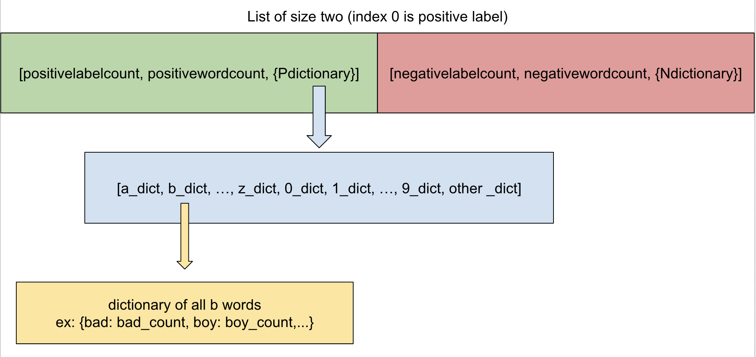
My Approach
Data Structure:
Adding Reviews to Classifier (pseudocode):
Each review comes with a sentence and rating.
addReview(sentence, label):
increment label count
prepare sentence (eliminate certain characters, separate words joined by punctuation, etc.)
for each word in sentence:
increment label word count
add/increment to dictionary
Actual Implementation:
Each row in the data calls addClause, to process a sentence, prepareSentence is called, and for each word in the sentence, addWord is called.
Reasoning for Structure:
Since there are a lot of rows to process, resulting in a lot of words, splitting the label’s dictionary by first character eliminates word addition time.

Slide 5
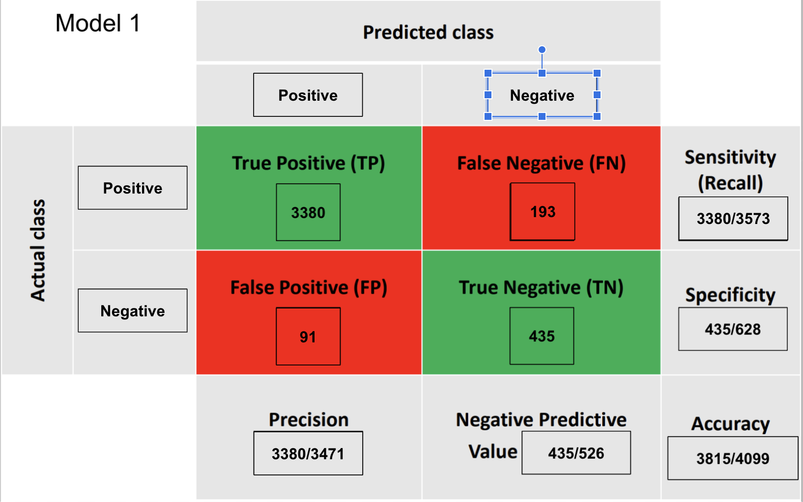
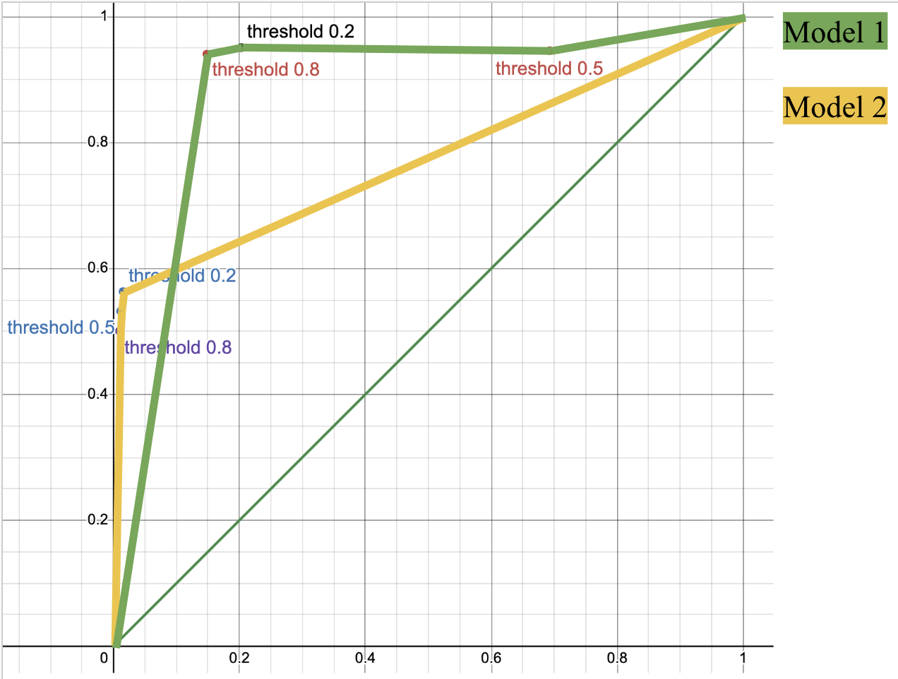
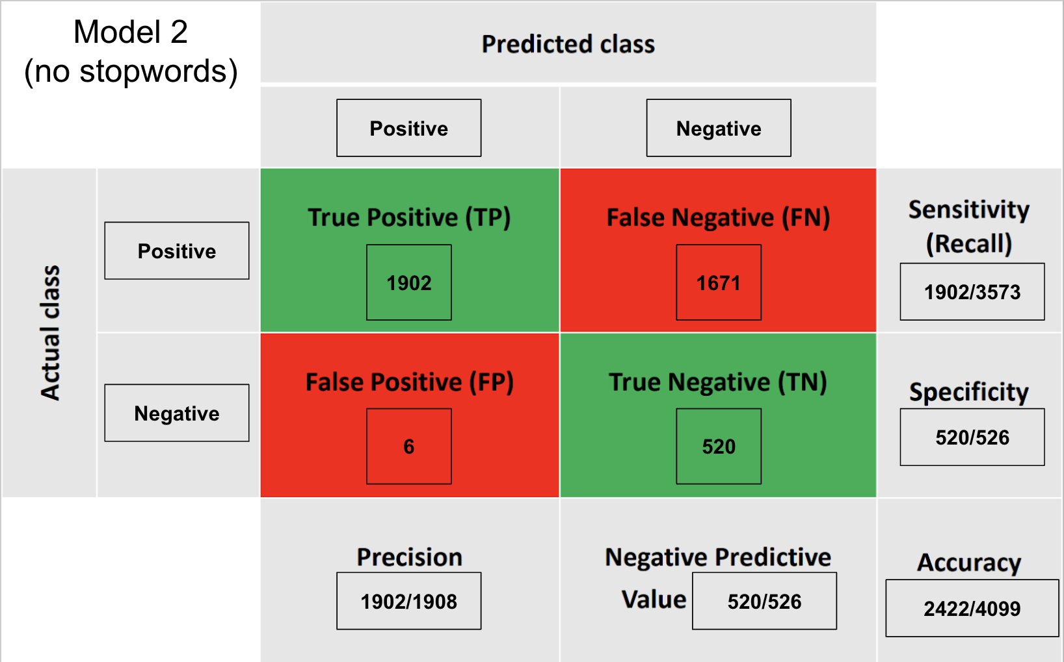
Evaluation
F-score: 0.960
F-score: 0.694

Slide 6
Summary / comments
One takeaway from the dataset is the rarity of negative hotel reviews leading to a low chance for false positives. Overall, I thought my classifier performed exceptionally well. While it had quite a problem with falsely identifying negative review, it performed in every other category. I think, as a way to fix this, we could keep a threshold towards identifying positive reviews.
I am a bit surprised removing the stop words led to quite worse performance but after thinking about it, it kind of makes sense. My hypothesis is that removing the stop words evened the probability of positive/negative reviews which should not happen because positive reviews are much more apparent.
I think a big challenge I ran into was handling certain characters/strings in the document. I talked about this in the “Data Set Information” slide but some reviews weren’t in English or had errors in the translation which led to the appearance of unknown characters. In order to handle this, I just handled these words as an “other” category which often had only one appearance of that word. I think a way to fix this would be to further processing of these unknown words or totally dismissing them in the classifier.
Other than the ways I have already mentioned to improve the classifier, I think an implementation that I could add with my current understanding is to recognize negation words and include those as a 2-ary word.

