Slide 1
Designing a Log
for the Datacenter
Micah Murray, Wen Zhang, Aisha Mushtaq,
Natacha Crooks, Aurojit Panda*, Scott Shenker
UC Berkeley *New York University
Notes:
[SLOW] Hello everyone, as Hugo said, my name is Micah and today, I’ll be talking about our work on designing a distributed shared log for the datacenter.

Slide 2

What are distributed shared logs?
Clients
append
read
m0
m1
m2
m3
m4
m5
Log
A simple interface to totally order operations
Notes:
First, let’s introduce distributed shared logs. [CLICK]
Distributed shared logs allow [CLICK] multiple clients to totally order a set of operations by [CLICK] writing to the same log. [CLICK]
Shared logs have an extremely simple API, where you just append to the log and read from the tail. This API abstracts away the complexities of distribution, like how to persist or order operations. [CLICK]
So, the primary purpose for shared logs is to provide a simple interface to totally order operations. [pause] [CLICK]

Slide 3





Where are shared logs used?
kafka
Google Pub/Sub
Azure Event Hubs
Notes:
Distributed shared logs are pretty popular, and there are many logging implementations available today. These range from open source logs like Kafka and Corfu to cloud-provided logging services like Google Pub/Sub, Amazon Kinesis, and Azure Event Hub. Many different applications use shared logs for different reasons, so let’s take a look at some example use cases: [CLICK]

Slide 4
Where are shared logs used?
In microservice architectures for interoperability
  e.g., Heroku uses Kafka to message between microservices
UI Service
Event Consumer
kafka
Notes:
In microservice architectures, distributed shared logs provide interoperability by allowing every microservice to communicate with every other microservice through a single totally ordered abstraction. For example, Heroku, the cloud platform, uses Kafka to asynchronously communicate between different microservices, like the UI service and an event consumer service. [CLICK]

Slide 5

Where are shared logs used?
In Change-Data-Capture for interoperability
  e.g., Debezium uses Kafka for streaming data
Source
Database
Change-Data-Capture
Kafka
Target
Database
Notes:
Logs are also used for interoperability in Change Data Capture, or a CDC, systems. CDC is a method used in databases to track and record changes made to data. In this example, Kafka takes captured data from the Change-Data-Capture tool debezium, and then provides a consistent stream of totally ordered operations from the source database to the target database, allowing it to read and query over the data. [CLICK]

Slide 6
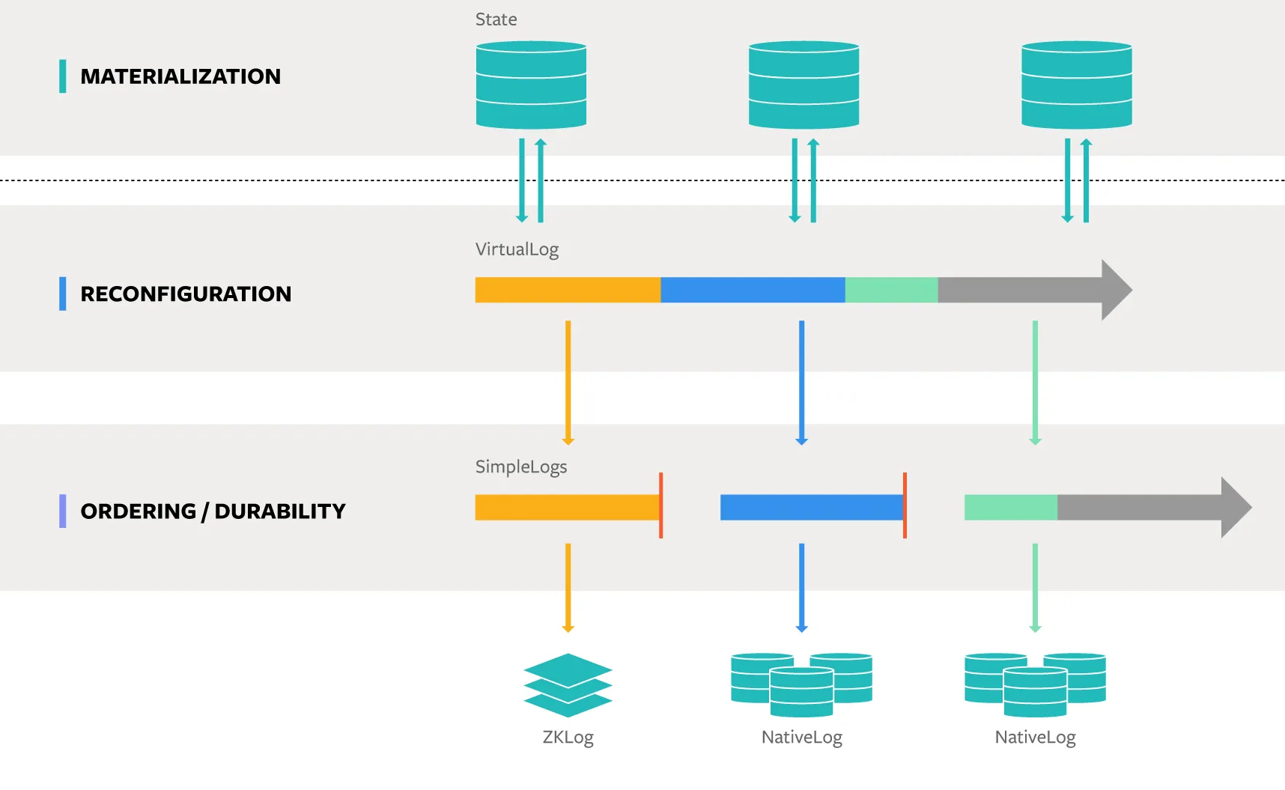
Where are shared logs used?
In database systems for simplicity
  e.g., Delos simplifies implementing distributed applications
Notes:
Shared logs are also used in databases. They can simplify the design and implementation of new database systems by providing consistency and durability. For example, Meta’s Delos platform uses shared logs to implement distributed applications including replicated databases. [brief pause] [CLICK]

Slide 7
Everyone has their own log...
Notes:
So, logging is great for interoperability and simplicity. And these properties are desired by many many applications in the datacenter.
But, one thing we’ve noticed is that most applications run their own individual log. So we were thinking: [brief] if many applications already use logging [pause], they all already run their own log instances [pause], and this is hotos so we know we can go a bit crazy, [CLICK]

Slide 8
Why not just have one?
Proposal: One log for the
entire datacenter!
Challenge: Scale??
Notes:
Why don’t we just say to heck with all these individual logs and create one big shared log for everyone in the datacenter! In other words, let’s have every application replace their personal log with a single shared log which constructs a total order over all appends in the datacenter. The goal is to make this log performant with extremely high throughput, so in the best case, we can provide interoperability between arbitrary services and a simple interface for constructing distributed applications [draw out] and in the worst case, your application can just keep doing what it was doing before! [pause]
The first question we should ask and will focus on for the rest of this talk is [brief]: is this even feasible? [CLICK]
Well in order to build this log, we must address the core challenge of this proposal which is how on earth will we scale a log to that size?

Slide 9
Log must serve ~10s of billions req/s
Problem: Prior solutions don’t support this throughput
Notes:
According to our estimations, we’re going to need a log which can serve 10s of billions of appends per second. [pause, CLICK]
Prior solutions don’t support this incredibly high throughput, and to understand current scaling limitations, we first need to understand how logging protocols are structured.

Slide 10
Shared Logging Protocols
Sequencing
Replication
Sequencer
Global Sequence number: 0
m0
Sequencing: Enforces total order
Notes:
Shared logging protocols can be broken into two main components [CLICK]: sequencing [CLICK] and replication. Let’s go through a quick example to demonstrate how they work. While sequencing and replication can happen in different orders, we choose for this example to have sequencing occur first and then replication. [brief]
The sequencing subprotocol is comprised of the sequencer [CLICK], whose purpose [CLICK] is to totally order all operations appended to the log. This task is quite simple, since it only requires a single counter. [CLICK] At any one time, the counter value is equal to the largest assigned global sequence number in the system. [brief] And in order to enforce a total order, every request must go through this counter. [CLICK]
So say our sequencer receives an append request for this message m zero. [CLICK]

Slide 11
Shared Logging Protocols
Sequencing
Replication
Sequencer
Global Sequence number: 1
m0
1, m0
Sequencing: Enforces total order
Notes:
The sequencer sees that next available global sequence number is 1. So the sequencer assigns 1 to m zero, and updates its internal counter. [CLICK]

Slide 12
Shared Logging Protocols
Sequencing
Replication
Sequencer
Global Sequence number: 1
Replicator
m0
1, m0
1, m0
Sequencing: Enforces total order
Replication: Ensures durability
Notes:
The sequenced message is then passed to the replication subprotocol, [CLICK] whose purpose is to replicate log entries to ensure durability. During replication, the sequenced entry is sent to all the replicas.

Slide 13
Shared Logging Protocols
Sequencing
Replication
Sequencer
Global Sequence number: 1
Replicator
Acks: 2
m0
1, m0
ack 1
ack 1
Sequencing: Enforces total order
1, m0
1, m0
1, m0
Replication: Ensures durability
Notes:
The replicas then write the received value to storage,
while the replicator waits for the replicas to acknowledge when they’ve stored the sequenced entry. Once the replicator receives enough acknowledgements, we now have durability for the log entry m zero at sequence number 1. [pause]
So [brief] let’s see how this scales. [CLICK]

Slide 14
Shared Logging Protocols
Sequencing
Replication
Replicator
Replicator
Sequencer
Global Sequence number: 1
m0
1, m0
Replicator
Replicator
Replicator
Replicator
Replicator
Replicator
Replication: Infinitely parallelizable!
Notes:
Replication is infinitely parallelizable, and it can be scaled up quite easily by sharding and adding more storage servers. [CLICK]

Slide 15
Shared Logging Protocols
Sequencing
Replication
Replicator
Replicator
Sequencer
Global Sequence number: 1
m0
1, m0
Replicator
Replicator
Replicator
Replicator
Sequencer: Not parallelizable!
Replicator
Replicator
Replication: Infinitely parallelizable!
Notes:
Unfortunately, sequencing is not parallelizable. [pause]
In prior work, sequencing typically becomes the bottleneck, since all requests must go through the counter in order to maintain our total ordering guarantee. [pause]
While some protocols have scaled their sequencing to support millions of appends per second, that is still not high enough for the throughput we need in order to support an *entire* datacenter. [pause]
So if sequencing is the bottleneck, [CLICK]

Slide 16
Can we scale
sequencing?
Insight #1: Sequencing is simple and purely compute
Action #1: ‘Cheat’ with specialized hardware
Notes:
we have to figure out how to scale it. [pause] Well [CLICK] sequencing is a simple task – you just increase a counter - as compared to replication, which is much more complex. So let’s ask a naive question, [conf sugg] can we just run the counter faster? [pause]
If we look in our bag of systems tricks, we actually have a perfect tool for doing just this: [CLICK]
We can use specialized hardware! In almost all prior systems, sequencing and replication were both run on commodity servers. [brief] But if we “cheat” and run the sequencer in an accelerated environment, sequencing throughput can immediately increase, almost for free! [pause, self deprecate] Well, it’s free for me, my advisors might have a different opinion. [brief]
Anyways, let’s run sequencing on an accelerated hardware platform, and watch the throughput immediately go up. But [brief], this isn’t going to be enough. [CLICK]

Slide 17
Can we scale
sequencing infinitely?
Insight #2: Need multiple sequencer nodes
Action #2: Distribute sequencing using a ring
Notes:
After all, faster hardware may make a single sequencer run a couple orders of magnitude faster, but sharding is infinitely parallelizable! So, we also need to scale sequencing *infinitely*. [pause]
Well, replication infinitely scales by continually sharding and adding more nodes. Why can’t sequencing do the same? [pause][CLICK]
In order to scale to 10s of billions of appends per second, we must run sequencing on multiple nodes. But [brief] of course that’s a problem, right: [brief] all sequencing needs to go through that one central counter. So we clearly need some communication mechanism between sequencer nodes to enforce a total order, while still being able to scale our throughput with the number of nodes we use.
[CLICK] Well, we propose using a ring of sequencer nodes. There’s a line of work which talks about using *rings* for distributed protocols. They have shown that rings are great for achieving high throughput which scales with the number of nodes in the ring. Of course, there are some caveats with the ring design, but we will cover in a little bit. [pause]
Ok, now there’s still one question left to answer: [CLICK]

Slide 18
Which accelerated hardware?
???
???
???
???
Notes:
Which accelerated hardware are we going to use? While there are many options, if we think about the sequencer we just constructed, we’re basically building a communication topology out of these individual nodes of the sequencer. And every message that goes through the log will need to go through one of the nodes in this ring. So, a great candidate hardware would be: [CLICK]

Slide 19
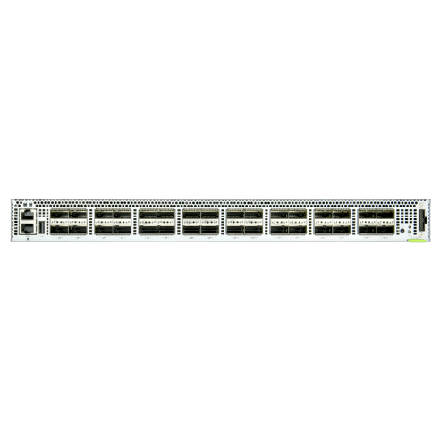
Programmable switches!
Notes:
programmable switches! Programmable switches are built to do simple tasks fast. They are approximately three orders of magnitude faster than commodity servers, and their line rate is a couple tera bits per second. [brief]
Programmable switches are ultimately the ideal platform because they inherently provide both the computation and communication required by this sequencer design. [pause]
So now that we’ve got our candidate setup that will let us scale, let’s talk about [CLICK]

Slide 20
How does this new sequencer work?
Notes:
How exactly does this ring of switches work? Let’s walk through some examples to understand the basic mechanism behind this sequencer and also intuit why this sequencer can infinitely scale. [CLICK]

Slide 21
Ring: Example
Message In
Queue
m0
Message Out
Queue
Cntrl In
Queue
Cntrl: 0
Switch A
Cntrl Out
Queue
Control Packet: 0
Message Out
Queue
Message In
Queue
Cntrl Out
Queue
Cntrl In
Queue
Switch B
Notes:
Take two switches, and let’s label this top switch switch A and the bottom switch switch B. [CLICK]
In order to communicate between switches, we introduce this special packet called a control packet. This control packet is the one component in this system which will always have the true maximum global sequence number across the entire log. [CLICK]
To setup our example, we’ve got two message in queues [CLICK] and two message out queues. These track the state of the message when it is first received by the switch and after it is processed by the switch. [CLICK]
We also have a control packet in queue [CLICK] and a control packet out queue. These queues again are for demonstrating the state of the control packet when it is received by the switch versus its state post processing. Note that the messages in the message out queue will be sent on to replicas for replication, but the control packet is only ever sent to the next switch in the ring. [pause] Ok, let’s start with a simple example. [CLICK]
Let’s send a single append for a record m zero to Switch A. Since the control packet also needs to start somewhere, let’s say it also starts at Switch A. [CLICK]

Slide 22
Ring: Example
Message In
Queue
m0
1, m0
Message Out
Queue
Cntrl In
Queue
Cntrl: 0
Switch A
Cntrl: 1
Cntrl Out
Queue
Message Out
Queue
Message In
Queue
Cntrl Out
Queue
Cntrl In
Queue
Switch B
Notes:
So when Switch A inspects the control packet, it sees that the current maximum global sequence number is 0. So, Switch A knows that it is safe to assign sequence number 1 to record m zero. Before passing the control packet onto Switch B, [CLICK] Switch A updates the control packet’s internal counter to be 1. This prevents any other switch in the ring from assigning sequence number 1. The next switch in the ring will know that the next available global sequence numbers start at sequence number 2. [CLICK]

Slide 23
Ring: Example
Message In
Queue
1, m0
Message Out
Queue
Cntrl In
Queue
Switch A
Cntrl: 1
Cntrl Out
Queue
Message Out
Queue
Message In
Queue
Cntrl Out
Queue
Cntrl: 1
Cntrl In
Queue
Switch B
Notes:
[CLICK] But for this example, switch B has no records to sequence. When switch B receives the control packet, [CLICK] it has no updates for the global sequence number. [pause]
Okay – pretty simple right? But now, let’s make it more complex and answer our original question: can this ring scale? [CLICK]

Slide 24
Ring: Scale Via Batching
Message In
Queue
mi+1
mi
Message Out
Queue
Cntrl In
Queue
Cntrl: 1
Switch A
Cntrl Out
Queue
Message Out
Queue
mk
mk+1
Message In
Queue
Cntrl Out
Queue
Cntrl In
Queue
Switch B
Notes:
Well, each switch can receive [CLICK] many packets at one time, which can all be stored in an ordered queue. Let’s say that after the control packet has already made one round around the ring, each switch has now received 100 packets. [brief]
Well, when switch A receives the control packet once more, it can actually batch the assignment of sequence numbers. In order to ‘claim’ sequence numbers for the incoming messages, all the switch has to do is keep track of how many packets it has, so that once it receives the control packet [CLICK]

Slide 25
Ring: Scale Via Batching
Message In
Queue
mi+1
mi
2, mi
101, mi+100
Message Out
Queue
Cntrl In
Queue
Cntrl: 1
Switch A
Cntrl: 101
Cntrl Out
Queue
Message Out
Queue
mk
mk+1
Message In
Queue
Cntrl Out
Queue
Cntrl In
Queue
Switch B
Notes:
[CLICK] It can automatically add the number of packets in the queue to the control packet’s global sequence number. So sequencing in this case takes the same amount of time for 1 packet as it does for all 100 packets in that queue. And now, [CLICK] we have a global sequence number of 101. [CLICK]

Slide 26
Ring: Scale Via Batching
Message In
Queue
2, mi
101, mi+100
Message Out
Queue
Cntrl In
Queue
Switch A
Cntrl: 101
Cntrl Out
Queue
Problem: Latency?
Message Out
Queue
201, mk+100
102, mk
mk
mk+1
Message In
Queue
Cntrl Out
Queue
Cntrl: 201
Cntrl In
Queue
Switch B
Notes:
Now, Switch B must [CLICK] wait for the control packet in order to finish globally sequencing its entries, but once it receives the control packet, [CLICK] it can sequence all of its messages all at once. [pause]
So each individual switch can process many many packets and if we can sequence those packets all at once, we can combine the speed of our accelerated hardware and multiply it by the number of nodes in the ring to get better sequencer throughput. [pause] But, you may have already identified one key caveat with this approach [CLICK]
What about latency? Ultimately, we still can’t parallelize sequencing – this control packet is the one central component of our sequencer which must, in the worst case, travel around the entire ring in order for a message to be sequenced. [tone] So [brief] we need to determine whether this ring provides poor latency, which would kill our hope for infinite scaling. [pause] Let’s take a look at some numbers. [CLICK]

Slide 27
Ring: Latency
10μs
# Switch | Tput (req/s) | Latency
2 | 1.25 billion | 20μs
Notes:
Since the ring is a dedicated topology for our log, we estimate the propagation delay of our control packet between switches to be 10 microseconds. Let’s also assume our log is appending payloads of size 1 kilobyte. [CLICK] We see then, that our throughput for requests is around 1 billion requests per second, and the worst case latency around the ring is 20 microseconds.

Slide 28
Ring: Latency
10μs
# Switch | Tput (req/s) | Latency
2 | 1.25 billion | 20μs
4 | 2.5 billion | 40μs
Notes:
When we can increase the node count to 4, our throughput for requests is around 2.5 billion requests per second, and the worst case latency around the ring is 40 microseconds. [tone] And to get an idea of how a very large ring would perform:

Slide 29
Ring: Latency
10μs
# Switch | Tput (req/s) | Latency
2 | 1.25 billion | 20μs
4 | 2.5 billion | 40μs
100 | 62.5 billion | 1ms
Comparison:
RocksDB write
takes ~.5ms
Notes:
If we increase the node count to 100, our throughput jumps to 62.5 billion requests per second, and the worst case latency around the ring is 1 millisecond. And we think this latency for a 100 node ring is reasonable, [CLICK] given that it is only 2x slower than issuing a single write request in RocksDB.
And the key insight is that latency for sequencing is comparable to latency for replication because we are able to run sequencing at a much higher rate on the programmable switch. [pause]

Slide 30
Key Challenges
Failure handling and ring recovery [done]
Streams [in progress]
Augmented ring designs [in progress]
And more!
Notes:
[tone] There are many other challenges in designing a log for the datacenter, including what to do when a node in the ring fails (which we’ve already thought about and have an initial design for), how to build streams over the log so applications only read the data that is relevant to them, and how to improve the ring design to get even better performance. Please come talk to me or any of my colleagues afterwards about these challenges – we’d love to chat about it! [CLICK]

Slide 31
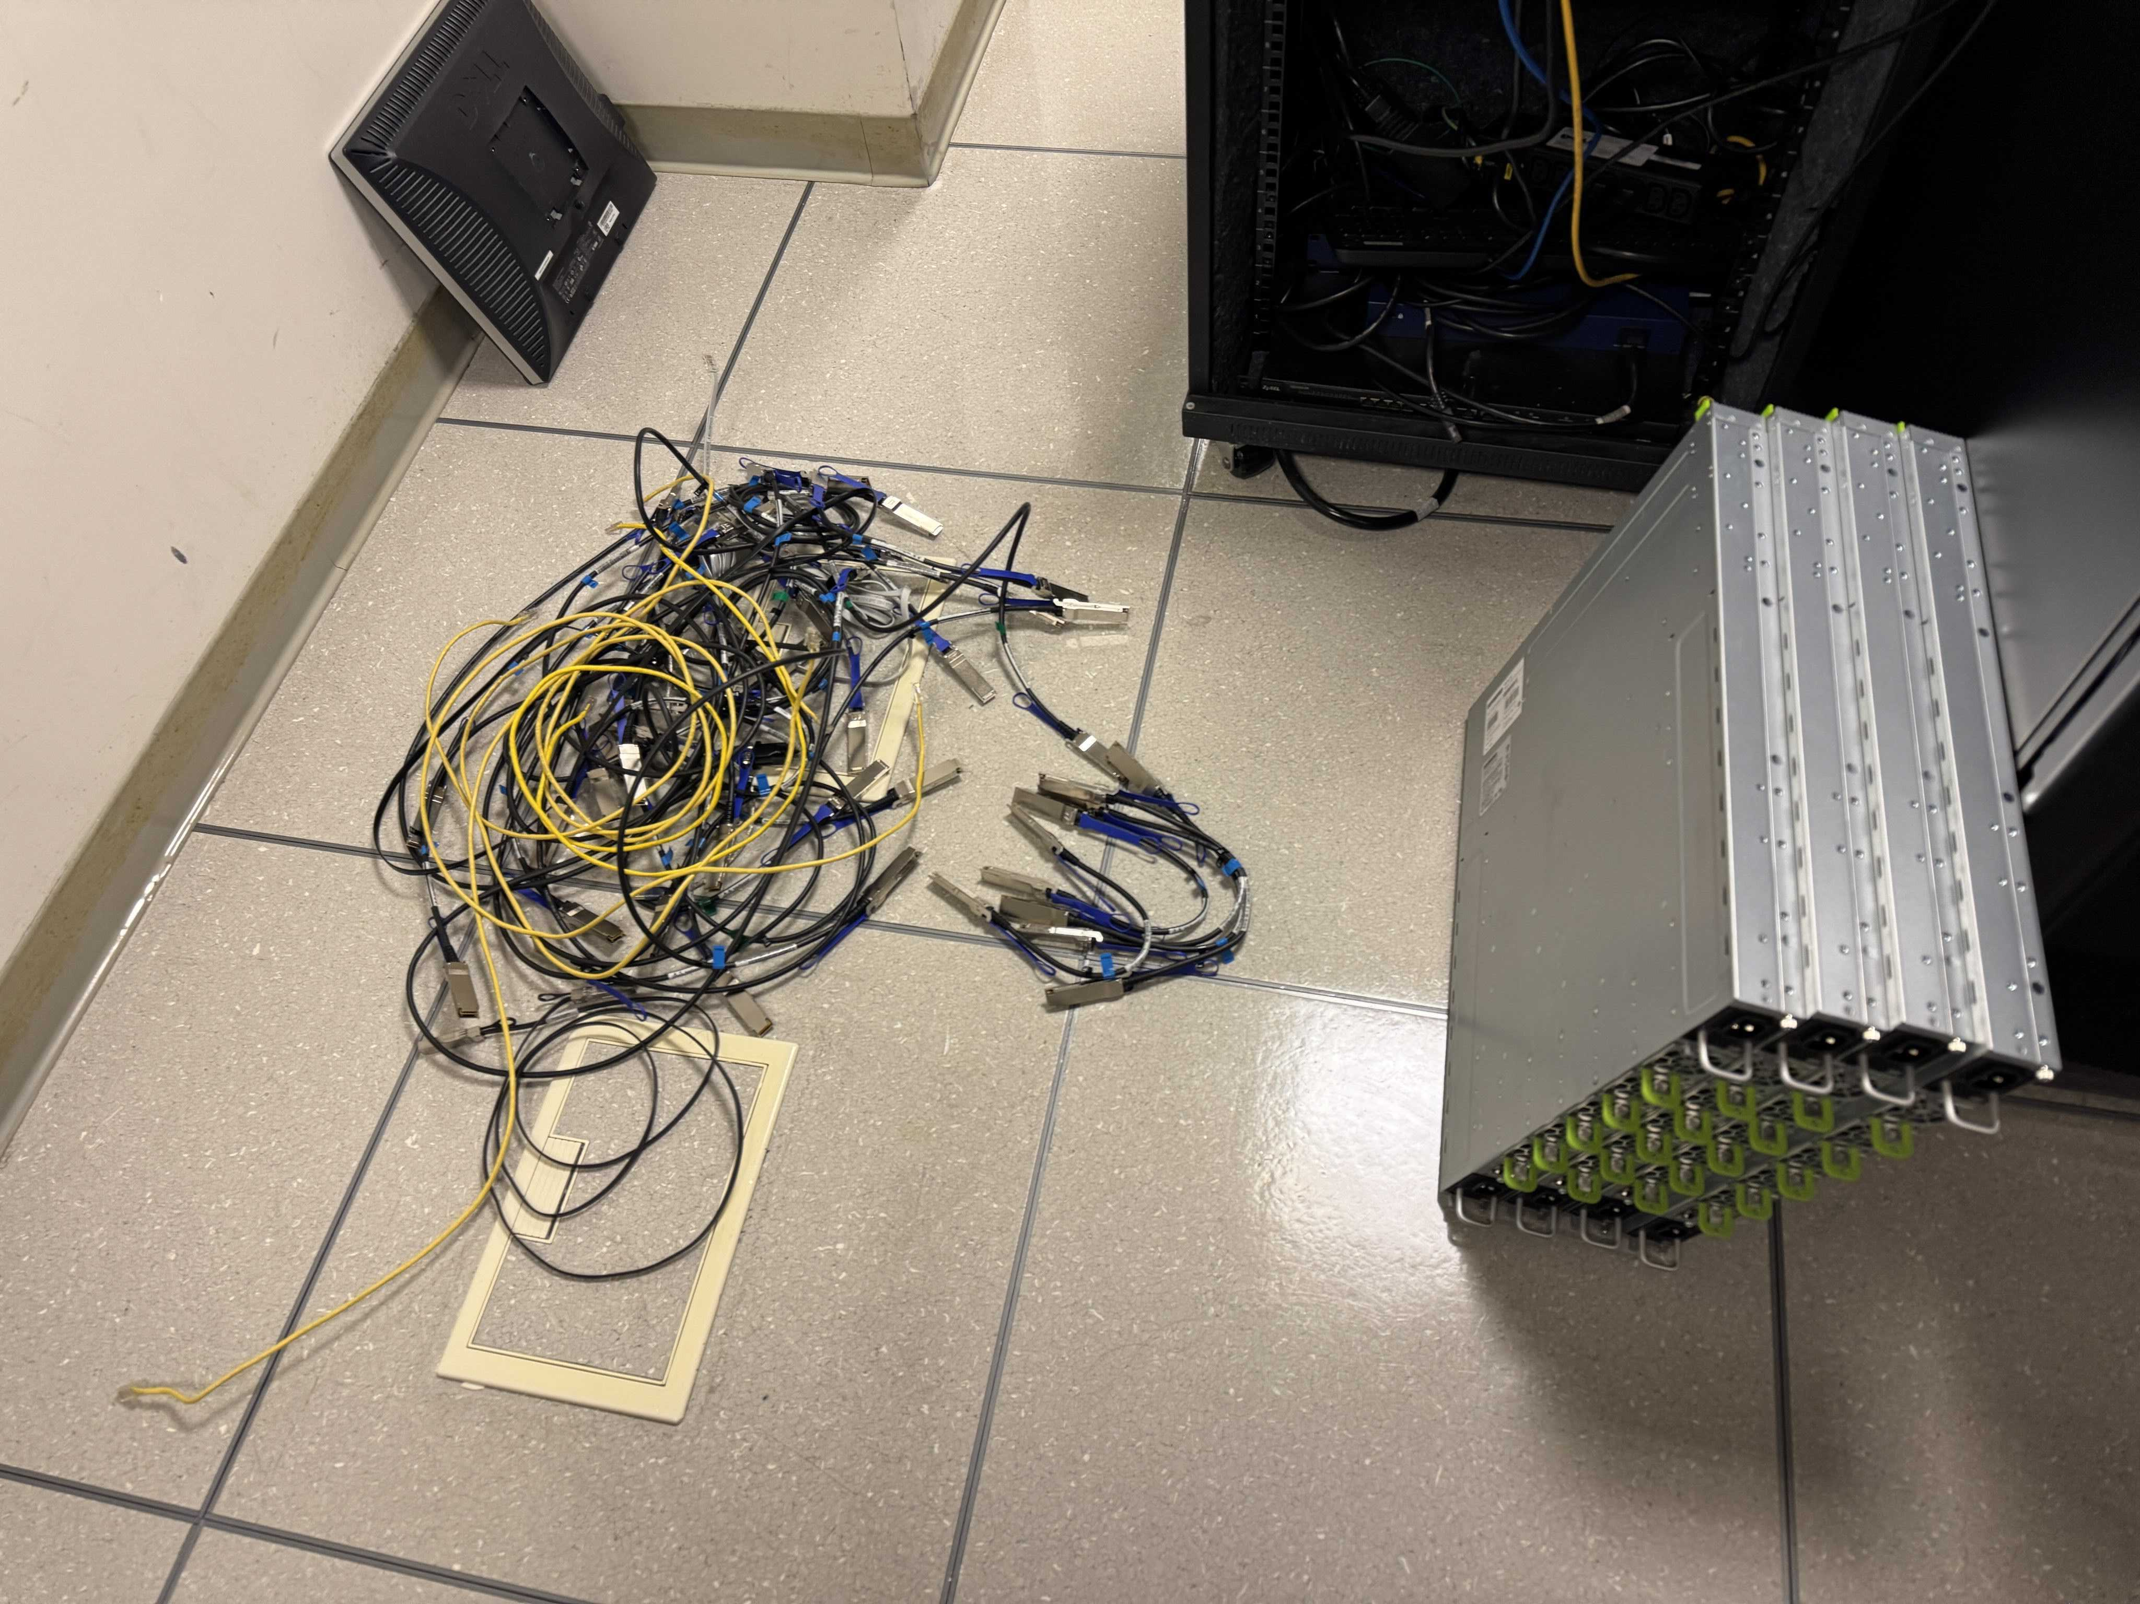
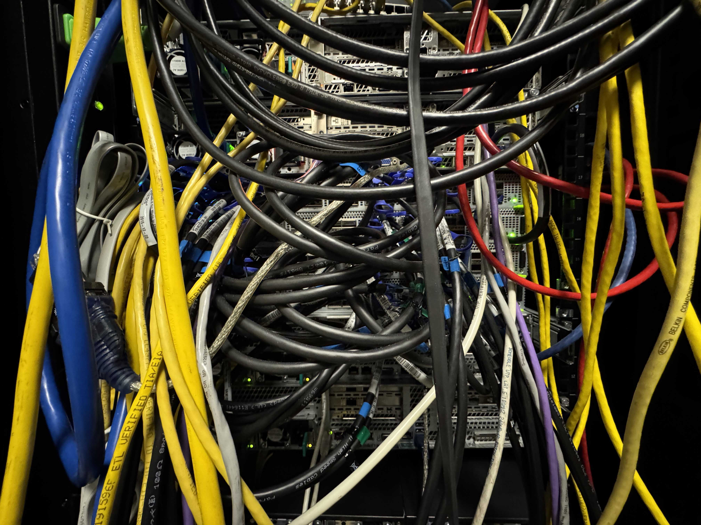
Now time to build it! 🚧
Notes:
And as we wrap up, I thought I’d show you that we are also physically building the log to realize our design. The pictures you see are from our lab’s frustrated sysadmin who installed the switches in our datacenter. As with any fun networking project involving physical hardware, you can spend weeks at a whiteboard making sure your design is perfect only to realize that proper cable management is the real unsolved problem of our time. [pause] [CLICK]

Slide 32

Email: micahmurray@berkeley.edu
Goal: One log for the datacenter
Challenge: Need to scale sequencing
Insight #1: Sequencing is simple
Action #1: ‘Cheat’ with specialized hardware
Insight #2: Need multiple sequencer nodes
Action #2: Distribute sequencing using a ring
Other insight: Accelerated hardware keeps ring latency comparable to replication
Notes:
Alright, to recap: [brief, CLICK] Our goal was to design a log which can service every application in the datacenter. The core challenge for this work is determining how to scale sequencing. [CLICK]
Our first insight is that sequencing is simple, and thus can be run much faster than replication using specialized hardware. [CLICK]
Our second insight is that in order to scale with replication, we need to use multiple sequencer nodes and in order to achieve this we use a ring topology. [brief] [CLICK]
And one other insight we had is that although ring topologies tend to have high latencies, using accelerated hardware as ring nodes allows us to perform computation very quickly, thus keeping the latency comparable to replication. [pause]
And so to fulfill our goal of a single scalable datacenter log, we use a sequencer comprised of a ring of switches! [CLICK]
If you want to read the paper, you can scan the QR on screen, and I’ve got my contact info on the slide, so please reach out. Thank you for your time, and I look forward to the discussion!
REMEMBER: KEEP YOUR ANSWERS SHORT AND SAY I DON’T KNOW.
Failures – Avoid split brain scenarios; 1) recover ring 2) recompute sequence # + complete replication 3) restart token passing [member + leader-change]
Streams - Basing off the same approach as tango had (starting point), start investigating where breaks.
Topology – physically connect ToR switches in ring, redundant connections for failures; tree topology for sending messages
Replication – acks tracked in the switches
Sequencing – compute, not much state, simple
Numbers – saturate all log servers, 1KB, 24 mil req/sec/server, 500 racks/20K servers in datacenter, 25/75 workload, 80 bil/5ms see paper for details

Slide 33
Extra Slide!
Notes:
Sequencing – not much state, compute, simple
So in summary, we talked about a new sequencer that takes advantage of [pause] programmable switches, which run much faster than commodity servers, [pause] and a ring topology, where sequencing throughput can scale linearly with the number of nodes. When combined, we get a ring of programmable switches, where due to the switch being an accelerated hardware platform, we get the throughput benefits without suffering severely high latency. [CLICK]
Split brain scenarios

Slide 34
Why the total order?
Kafka: Need to shard for scalability, but want total order across partitions
Cross data store transactions in the age of ever expanding microservice architectures
LLM Agents: Accessing many applications at once and will need to know the order in which application operations occurred
Notes:
TODO: Add script, make slide visual
- Kafka: transaction boundaries (Natacha cursing kafka)
- Cross txn: Meta, MongoDB (2PC)
- LLM: on the slide

