Slide 1
Assembly Language for x86 Processors 6th Edition
Kip Irvine
Chapter 4: Control Flow Instructions and Directives
(Includes Chapter 6, Sections 6.3--6.5, 6.7)
Slides prepared by the author
Revision date: 2/15/2010
(c) Pearson Education, 2010. All rights reserved. You may modify and copy this slide show for your personal use, or for use in the classroom, as long as this copyright statement, the author's name, and the title are not changed.

Slide 2
Jumps and Loops
The basic instructions for branching are jumps and loops
Loops are instructions to repeat a block of code a certain number of times
Jumps are instructions that branch to a distant labeled instruction when a flag condition is met
Status flags are modified by arithmetic instructions so these are normally used just before a jump
Example: the JNZ (jump if not zero) instruction jumps to the destination-label if ZF = 0. Usage:
JNZ destination-label
Syntax: JCOND Dest_label;
Jump/Branch to Label If COND is True

Slide 3
Jcond Instruction
A conditional jump instruction branches to a label when specific register or flag conditions are met
Specific jumps:
JB, JC - jump to a label if the Carry flag is set
JE, JZ - jump to a label if the Zero flag is set
JS - jump to a label if the Sign flag is set
JNE, JNZ - jump to a label if the Zero flag is clear
JECXZ - jump to a label if ECX = 0

Slide 4
Simple Example of Jump Using JNZ (Jump if Not Zero)
This program prints all the lower case letters in increasing order
We jump to again whenever ZF=0
(when bl != al)
We do not jump (and execute exit) when ZF=1
(when ebx = eax)
The code would be simpler if the SUB instruction would not change the value of the destination operand
We do have such an instruction. It is the CMP (compare) instruction.
INCLUDE Irvine32.inc
.code
Main PROC
mov al, 61h ; or mov al, 'a’
again:
mov bl, 7bh ; char after 'z'
CALL WriteChar
inc al
sub bl, al
jnz again
exit
main ENDP
END main

Slide 5
The CMP Instruction
Usage: cmp dst, src
Performs dst – src just like SUB
But dst is unchanged
Affects same flags as SUB
Same restrictions as for SUB
Very often used just before performing a jump
The previous program is now simpler
INCLUDE Irvine32.inc
.code
main:
mov al, 'a’
again:
CALL WriteChar
inc al
cmp al, 7bh
jnz again
ret
end

Slide 6
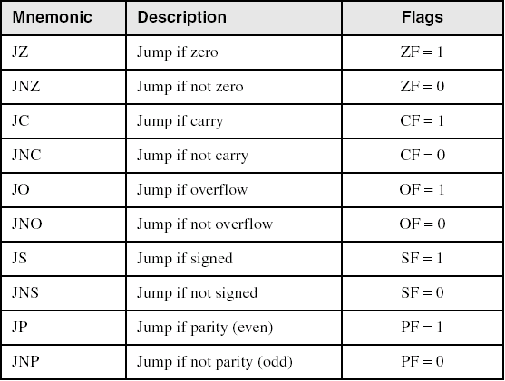
Jumps Based on Specific Flags (Single-Flag Jumps)

Slide 7
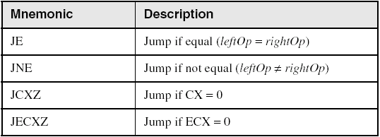
Jumps Based on Equality (Single-Flag Jumps)
Note:
Sometimes, the same jump instruction has 2 different mnemonics
Example: JZ ↔ JE
The value of the flag is the condition for jumping
Example: Jump to dst-label when the zero flag is set
Jumping based on register condition: JCXZ and JECXZ

Slide 8
Jumping on a Inequality Condition
Often, we need to branch when some value is larger (or smaller) than an other. Ex:
CMP eax, ebx
;now jump somewhere when eax > ebx
However, integer order (larger or smaller) depends on the chosen interpretation
Ex: if AL contains 05h and BL contains A0h. Then:
AL > BL for a signed interpretation: for AL = +5, BL = -96
AL < BL for a unsigned interpretation: for AL = 5, BL = 160
Hence, we have these two categories of jumps:
Unsigned comparison jumps: for an unsigned interpretation of a comparison used just before the jump (ex: with CMP)
Signed comparison jumps: for a signed interpretation of a comparison used just before the jump (ex: with CMP)

Slide 9
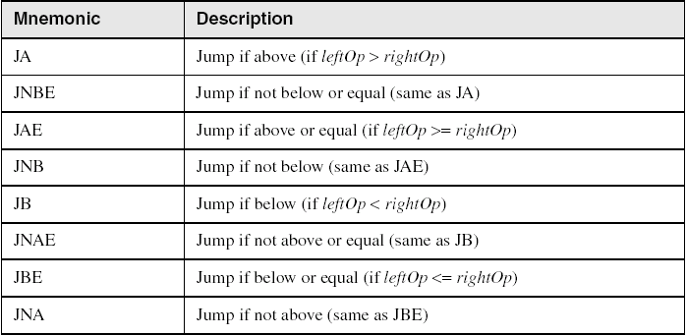
Jumps Based on Unsigned Comparisons
Each of these instructions have 2 different mnemonics
We normally used them just after a CMP op1,op2 instruction and the jumping condition is given by a unsigned interpretation of the comparison

Slide 10
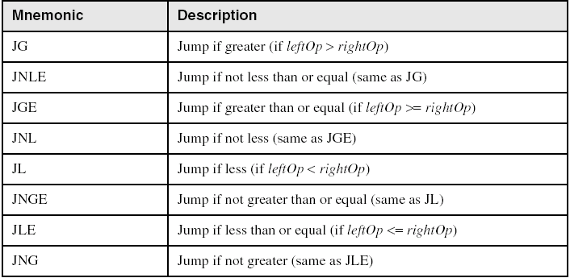
Jumps Based on Signed Comparisons
Each of these instructions have 2 different mnemonics
We normally used them just after a CMP op1,op2 instruction and the jumping condition is given by a signed interpretation of the comparison

Slide 11
Using Comparison Jumps
CMP is normally used before a comparison jump
Ex: to branch to exit when AX > BX under a signed interpretation (ex: AX=1, BX=FFFFh):
cmp ax,bx; ax = +1, bx = -1
jg exit
But to branch to exit when AX > BX under a unsigned interpretation:
cmp ax,bx; ax = 1, bx = 65535
ja exit
Note that the jump is not performed when
AX=1 and BX =FFFFh

Slide 12
Applications
Compare unsigned AX to BX, and copy the larger of the two into a variable named Large
mov Large,bx
cmp ax,bx
jna Next
mov Large,ax
Next:
Compare signed AX to BX, and copy the smaller of the two into a variable named Small
mov Small,ax
cmp bx,ax
jnl Next
mov Small,bx
Next:

Slide 13
Unconditional JMP Instruction
Sometimes we need to jump without a condition. JMP is an unconditional jump to a label that is usually within the same procedure.
Syntax: JMP target
Logic: EIP ← target
Example:
target:
.
.
jmp target
A jump outside the current procedure must be to a special type of label called a global label (see Section 5.5.1 for details).

Slide 14
Unconditional Jump
INCLUDE Irvine32.inc
.data
msg BYTE ”hello”,0
.code
main PROC
mov edx,12345678h
jmp over
mov edx,OFFSET msg
over:
CALL WriteString
exit
main ENDP
end main
Instruction “mov edx,OFFSET msg” has not been executed

Slide 15
Application: an Echo Program
ReadChar returns AL=0 when an extended key is pressed, else it returns an ASCII code
WriteChar prints any character read in AL != 0.
Repeats until user press an extended key, i.e. AL = 0.
Hence this program echoes on the screen the user string entered on the keyboard
Try it!
INCLUDE Irvine32.inc
.code
main PROC
continue:
CALL ReadChar ;char in AL
cmp al, 0 ;extended key?
je stop ;yes, then exit
CALL WriteChar ;no, print char
jmp continue
stop:
exit
main ENDP
END main

Slide 16
High-Level Flow Control Structures
High-level languages uses high-level structures such as if-then-else, switch, while or repeat statements to control the flow of execution
algorithms are normally expressed in terms of these high-level structures
Processors only provide conditional and unconditional jump and loop instructions
thus we need to decompose the high-level control flow structures into low-level ones
We give here a few examples on how this can be done by using jump instructions

Slide 17
Conditional Structures Block-Structured IF Statements
Assembly language programmers can easily translate logical statements written in C++/Java into assembly language. For example:
if( op1 == op2 )
X = 1;
else
X = 2;
mov eax,op1
cmp eax,op2
jne L1
mov X,1
jmp L2
L1: mov X,2
L2:

Slide 18
If-Then-Else
HLL Observation
If Condition
{ Code-Block-1 }
else
{ Code-Block-2 }
The program branches to Code-Block-2 if Condition is False
The program branches to Code-Block-2 if cc e.g.,JE or JNZ, is True
Assembler Observation
Jcc Code-Block-2
Therefore HLL not Condition ⬄ Assembler Jcc

Slide 19
If-Then-Else (Continued…)
Example:
if (op1 < op2) then
statement 1
else
statement 2
end_if
Analysis:
there is a conditional jump (JXXX) to else when
op1 >= op2
there is an unconditional jump (JMP) from end of “statement 1” to end_if
ASM solution for signed comparison:
cmp op1, op2
jge else_
;put statement 1 here
jmp end_if
else_:
;put statement 2 here
end_if:
Note: “else” is a ASM reserved word. We use “else_” instead

Slide 20
Your turn . . .
Implement the following pseudocode in assembly language. All values are 32-bit signed integers:
if( var1 <= var2 )
var3 = 10;
else
{
var3 = 6;
var4 = 7;
}
mov eax,var1
cmp eax,var2
jle L1
mov var3,6
mov var4,7
jmp L2
L1: mov var3,10
L2:
(There are multiple correct solutions to this problem.)

Slide 21
Conditional Structures Compound Expression with AND
When implementing the logical AND operator, consider that HLLs use short-circuit evaluation
In the following example, if the first expression is false, the second expression is skipped:
if (al > bl) AND (bl > cl)
X = 1;

Slide 22
Compound Expression with AND
if (al > bl) AND (bl > cl)
X = 1;
This is one possible implementation . . .
cmp al,bl ; first expression...
ja L1
jmp next
L1:
cmp bl,cl ; second expression...
ja L2
jmp next
L2: ; both are true
mov X,1 ; set X to 1
next:

Slide 23
Compound Expression with AND
if (al > bl) AND (bl > cl)
X = 1;
But the following implementation uses much less code by reversing the first relational operator. We allow the program to "fall through" to the second expression:
Reversing means testing the negative of the conditional
cmp al,bl ; first expression...
jbe next ; quit if false
cmp bl,cl ; second expression...
jbe next ; quit if false
mov X,1 ; both are true
next:

Slide 24
Your turn . . .
Implement the following pseudocode in assembly language. All values are unsigned:
if( ebx <= ecx
&& ecx > edx )
{
eax = 5;
edx = 6;
}
cmp ebx,ecx
ja next
cmp ecx,edx
jbe next
mov eax,5
mov edx,6
next:
(There are multiple correct solutions to this problem.)

Slide 25
Conditional Structures Compound Expression with OR
When implementing the logical OR operator, consider that HLLs use short-circuit evaluation
In the following example, if the first expression is true, the second expression is skipped:
if (al > bl) OR (bl > cl)
X = 1;

Slide 26
Compound Expression with OR
if (al > bl) OR (bl > cl)
X = 1;
We can use "fall-through" logic to keep the code as short as possible:
Fall-through here means testing the positive of the conditional
cmp al,bl ; is AL > BL?
ja L1 ; yes
cmp bl,cl ; no: is BL > CL?
jbe next ; no: skip next statement
L1: mov X,1 ; set X to 1
next:

Slide 27
Conditional Structures WHILE Loops
A WHILE loop is really an IF statement followed by the body of the loop, followed by an unconditional jump to the top of the loop. Consider the following example:
while( eax < ebx)
eax = eax + 1;
This is a possible implementation:
top: cmp eax,ebx ; check loop condition
jae next ; false? exit loop
inc eax ; body of loop
jmp top ; repeat the loop
next:

Slide 28
While
Example :
do while (op1 < op2)
statement
end do
Analysis:
JXXX to end_do when
op1 >= op2
JMP from end_do to while
ASM solution for an unsigned comparison:
do_while:
cmp op1, op2
jae end_do
;put statement here
jmp do_while
end_do:

Slide 29
Your turn . . .
Implement the following loop, using unsigned 32-bit integers:
while( ebx <= val1)
{
ebx = ebx + 5;
val1 = val1 - 1
}
top: cmp ebx,val1 ; check loop condition
ja next ; false? exit loop
add ebx,5 ; body of loop
dec val1
jmp top ; repeat the loop
next:

Slide 30
Case or Switch
ASM solution 1:
cmp input,’A’
jne L1
JMP DestA
L1:
cmp input,’B’
jne L2
JMP DestB
L2:
cmp input,’C’
jne L3
JMP DestC
L3:
Example:
case input of
‘A’ :DestA
‘B’ :DestB
‘C’ :DestC
end case
Analysis: CMP and JXXX for each case

Slide 31
Case (Continued…)
ASM solution 2:
cmp input,’A’
jne L1
DestA Code here
Jmp L3
L1:
cmp input,’B’
jne L2
DestB Code here
Jmp L3
L2:
cmp input,’C’
jne L3
DestC Code here
L3:
Example:
case input of
‘A’ :DestA
‘B’ :DestB
‘C’ :DestC
end case
Analysis: CMP and JXXX for each case

Slide 32
Exercise 1
Write a small piece of code that will display the character in AL if and only if it is an uppercase letter.
Write a small piece of code that will display the character in AL if and only if it is a letter.
Write a small piece of code that will display the character in AL if and only if it is a digit.
Write a small piece of code which reads a string from the keyboard and then returns the number of lowercase characters contained in the string.

Slide 33
LOOP Instruction
The LOOP instruction creates a counting loop
that is, a for loop
Allows to repeat a statement-block a specific number of times
ECX must be initialized with the number of iterations
Syntax: LOOP target
target must precede LOOP by less than 128 bytes of codes
Logic:
ECX ← ECX – 1
if ECX != 0, jump to target

Slide 34
Your turn . . .
mov ax,6
mov ecx,4
L1:
inc ax
loop L1
What will be the final value of AX?
10
How many times will the loop execute?
mov ecx,0
X2:
inc ax
loop X2
4,294,967,296

Slide 35
The LOOP Instruction
Example: the following code fragment will print all the ASCII codes by starting with 7Fh:
mov ecx,7Fh
next:
mov al,cl
CALL WriteChar
loop next
If (instead) ECX would be initialized to zero, then:
after executing the block for the 1st time, ECX would be decremented by 1 and thus contain 0FFFFFFFFh.
the loop would thus be repeated again 0FFFFFFFFh times = 4,294,967,296!!
Hence, if ECX contains an unspecified value, it is better to write:
;a loop to be ;executed ECX times
jecxz over; ecx = 0?
next:
mov al, cl
CALL WriteChar
loop next
over:

Slide 36
Nested Loop
If you need to code a loop within a loop, you must save the outer loop counter's ECX value. In the following example, the outer loop executes 100 times, and the inner loop 20 times.
.data
count DWORD ?
.code
mov ecx,100 ; set outer loop count
L1:
mov count,ecx ; save outer loop count
mov ecx,20 ; set inner loop count
L2: .
.
loop L2 ; repeat the inner loop
mov ecx,count ; restore outer loop count
loop L1 ; repeat the outer loop

Slide 37
Conditional Loop Instructions LOOPZ and LOOPE
Syntax:
LOOPE destination
LOOPZ destination
Logic:
ECX ← ECX – 1
if ECX > 0 and ZF=1, jump to destination
Useful when scanning an array for the first element that does not match a given value.
In 32-bit mode, ECX is the loop counter register. In 16-bit real-address mode, CX is the counter, and in 64-bit mode, RCX is the counter.

Slide 38
Conditional Loop Instructions LOOPNZ and LOOPNE
LOOPNZ (LOOPNE) is a conditional loop instruction
Syntax:
LOOPNZ destination
LOOPNE destination
Logic:
ECX ← ECX – 1;
if ECX > 0 and ZF=0, jump to destination
Useful when scanning an array for the first element that matches a given value.

Slide 39
Conditional Loops
LOOPZ and LOOPE continues a loop while ZF=1 and ECX!=0
ECX is first decremented, then the condition is tested (a trivial extension of LOOP)
LOOPNZ and LOOPNE continues a loop while ZF=0 and ECX != 0
Syntax (same as LOOP):
loop** dest-label
The dest-label must precede LOOPX[Y] by < 128 bytes
The following program will print character 20h before exiting
INCLUDE Irvine32.inc
.code
main PROC
mov ecx, 7Fh
next:
mov al, cl
Call WriteChar
cmp ecx, 20h
loopnz next
exit
main ENDP
END main

Slide 40
Exercise 2
Write a small piece of code that will read a string from the keyboard, then returns 1) the length of the string in the byte variable Len, and 2) the number a characters in the string which are either uppercase letters or digits
Write a small piece of code that will read a string from the keyboard, then displays only the characters which are either letters or digit.
In both program above, you should use a LOOP instruction somewhere.

Slide 41
46 69 6E 61 6C

Slide 42
Creating Conditional Statements
Runtime Expressions
Relational and Logical Operators
MASM-Generated Code
.REPEAT Directive
.WHILE Directive

Slide 43
Runtime Expressions
.IF, .ELSE, .ELSEIF, and .ENDIF can be used to evaluate runtime expressions and create block-structured IF statements.
Examples:
.IF eax > ebx
mov edx,1
.ELSE
mov edx,2
.ENDIF
.IF eax > ebx && eax > ecx
mov edx,1
.ELSE
mov edx,2
.ENDIF
MASM generates "hidden" code for you, consisting of code labels, CMP and conditional jump instructions.

Slide 44
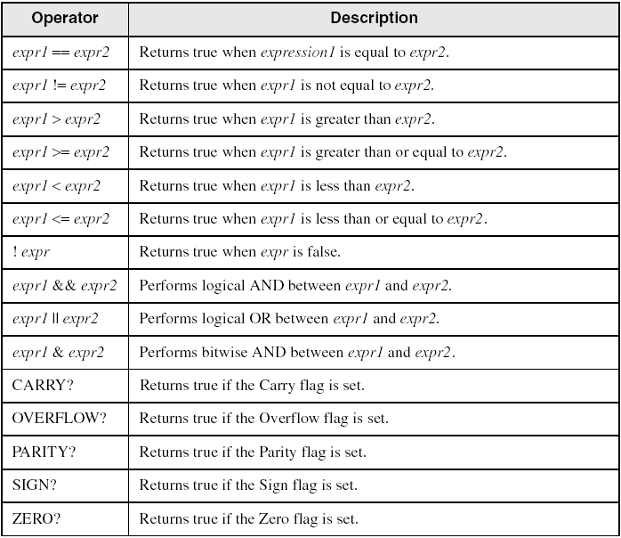
Relational and Logical Operators

Slide 45
Signed and Unsigned Comparisons
.data
val1 DWORD 5
result DWORD ?
.code
mov eax,6
.IF eax > val1
mov result,1
.ENDIF
Generated code:
mov eax,6
cmp eax,val1
jbe @C0001
mov result,1
@C0001:
MASM automatically generates an unsigned jump (JBE) because val1 is unsigned.

Slide 46
Signed and Unsigned Comparisons
.data
val1 SDWORD 5
result SDWORD ?
.code
mov eax,6
.IF eax > val1
mov result,1
.ENDIF
Generated code:
mov eax,6
cmp eax,val1
jle @C0001
mov result,1
@C0001:
MASM automatically generates a signed jump (JLE) because val1 is signed.

Slide 47
Signed and Unsigned Comparisons
.data
result DWORD ?
.code
mov ebx,5
mov eax,6
.IF eax > ebx
mov result,1
.ENDIF
Generated code:
mov ebx,5
mov eax,6
cmp eax,ebx
jbe @C0001
mov result,1
@C0001:
MASM automatically generates an unsigned jump (JBE) when both operands are registers . . .

Slide 48
Signed and Unsigned Comparisons
.data
result SDWORD ?
.code
mov ebx,5
mov eax,6
.IF SDWORD PTR eax > ebx
mov result,1
.ENDIF
Generated code:
mov ebx,5
mov eax,6
cmp eax,ebx
jle @C0001
mov result,1
@C0001:
. . . unless you prefix one of the register operands with the SDWORD PTR operator. Then a signed jump is generated.

Slide 49
.REPEAT Directive
Executes the loop body before testing the loop condition associated with the .UNTIL directive.
Example:
; Display integers 1 – 10:
mov eax,0
.REPEAT
inc eax
call WriteDec
call Crlf
.UNTIL eax == 10

Slide 50
.WHILE Directive
Tests the loop condition before executing the loop body The .ENDW directive marks the end of the loop.
Example:
; Display integers 1 – 10:
mov eax,0
.WHILE eax < 10
inc eax
call WriteDec
call Crlf
.ENDW

Slide 51
Table-Driven Selection (1 of 4)
Table-driven selection uses a table lookup to replace a multiway selection structure
Create a table containing lookup values and the offsets of labels or procedures
Use a loop to search the table
Suited to a large number of comparisons

Slide 52
Table-Driven Selection (2 of 4)
Step 1: create a table containing lookup values and procedure offsets:
.data
CaseTable BYTE 'A' ; lookup value
DWORD Process_A ; address of procedure
EntrySize = ($ - CaseTable)
BYTE 'B'
DWORD Process_B
BYTE 'C'
DWORD Process_C
BYTE 'D'
DWORD Process_D
NumberOfEntries = ($ - CaseTable) / EntrySize

Slide 53
Table-Driven Selection (3 of 4)
Table of Procedure Offsets:

Slide 54
Table-Driven Selection (4 of 4)
Step 2: Use a loop to search the table. When a match is found, call the procedure offset stored in the current table entry:
mov ebx,OFFSET CaseTable ; point EBX to the table
mov ecx,NumberOfEntries ; loop counter
L1: cmp al,[ebx] ; match found?
jne L2 ; no: continue
call NEAR PTR [ebx + 1] ; yes: call the procedure
call WriteString ; display message
call Crlf
jmp L3 ; and exit the loop
L2: add ebx,EntrySize ; point to next entry
loop L1 ; repeat until ECX = 0
L3:
required for procedure pointers

Slide 55
4C 6F 70 70 75 75 6E

