Slide 1
Assembly Language for x86 Processors 6th Edition
Kip R. Irvine
Chapter 12: Floating-Point Processing and Instruction Encoding
Slide show prepared by the author
Revision date: 2/15/2010
(c) Pearson Education, 2010. All rights reserved. You may modify and copy this slide show for your personal use, or for use in the classroom, as long as this copyright statement, the author's name, and the title are not changed.

Slide 2
IEEE Floating-Point Binary Reals
Types
Single Precision
32 bits: 1 bit for the sign, 8 bits for the exponent, and 23 bits for the fractional part of the significand.
Double Precision
64 bits: 1 bit for the sign, 11 bits for the exponent, and 52 bits for the fractional part of the significand.
Double Extended Precision
80 bits: 1 bit for the sign, 16 bits for the exponent, and 63 bits for the fractional part of the significand.

Slide 3
Floating Point Representation
Floating point numbers are finite precision numbers used to approximate real numbers
We will describe the IEEE-754 Floating Point Standard since it is adopted by most computer manufacturers: including Intel
Like the scientific notation, the representation is broken up in 3 parts
Scientific notation: -245.33 = -2.4533*10⁻² = -2.4533E-2
A sign s (either 0 or 1) ‘-’
An exponent e -2
A mantissa m (sometimes called a significand) -2.4533
So that a floating point number N is written as: (-1)^{s} × m × 10e
Or, if m is in binary, N is written as:
Were the binary mantissa is normalized such that :
m = 1.f with 1 ≤ m < 2 and 0 ≤ f < 1

Slide 4
Floating Point Representation (cont.)
Hence we can write N in terms of fraction f: 0 <= f < 1
The IEEE-754 standard defines the following formats:
Sign bit s
Sign bit s
8 bits
23 bits
11 bits
52 bits
Exponent
Fraction
Exponent
Fraction
Single precision (32 bits)
Double precision (64 bits)
Hence, the value 1 in 1+f (= 1.f) is NOT stored: it is implied!
Mantissa: 1 ≤ m = 1.f = 1+f < 2 → 0 ≤ f < 1
Extended precision formats (on 80 bits) with more bits for the exponent and fraction is also defined for use by the FPU

Slide 5
Single-Precision Format
Approximate normalized range: 2^{–126} to 2⁺¹²⁷. Also called a short real.
The three formats are similar but differ only in their sizes. Thus, our discussions will focus only on the Single-Precision format.
Double-Precision: 2^{–1022} to 2⁺¹⁰²³
Extended-Precision: 2^{–32766} to 2⁺³²⁷⁶⁷

Slide 6
Components of a Single-Precision Real
Sign s
1 = negative, 0 = positive
Significand m
All decimal digits to the left & right of decimal point
Weighted positional notation
Example: 123.154 = (1 x 10²) + (2 x 10¹) + (3 x 10⁰) + (1 x 10^{–1}) + (5 x 10^{–2}) + (4 x 10^{–3})
Exponent e
signed integer: -126 ≤ e ≤ +127 for single precision
integer bias: an unsigned biased exponent E = e + bias is stored in the exponent field instead, where bias =
127 for single precision (thus 0 ≤ E < 256)
1023 for double precision (thus 0 ≤ E < 2048)
32767 for extended precision (thus 0 ≤ E < 65536)

Slide 7
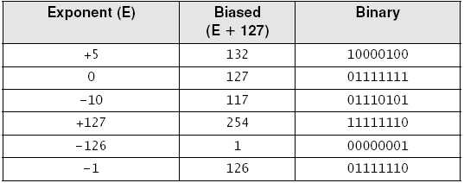
The Exponent
Sample Exponents represented in Binary
Add bias 127 (for single-precision) to the actual exponent e to produce the biased exponent E = e+127
Example:
Floating point number 1.27 has exponent e = 0. Hence: E = 0 + 127 = 127 = 7Fh is stored in the exponent field
Floating point number 12.3 = 1.537..x 2³ has e = 3. Hence: E = 3 + 127 = 130 = 82h is stored in the exponent field
Floating point number 0.15 = 1.2 x 2⁻³ has e = -3. Hence: E = -3 + 127 = 124 = 7Ch is stored in the exponent field.
The mantissa must first be normalized before biasing the exponent

Slide 8
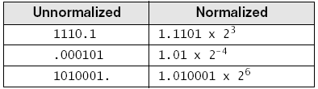
Normalizing Binary Floating-Point Numbers
Mantissa m is normalized when a single 1 appears to the left of the binary point
Unnormalized: shift binary point until exponent is zero
Examples
Hence we can write N in terms of fraction f, 0 ≤ f < 1
The value 1 in 1+f (= 1.f) is NOT stored: it is implied!

Slide 9
Representation for the Fraction
In base 2, any fraction f < 1 can be written as:
Where each
is a bit
and
is the most significant bit (msb) of the fraction
The algorithm to find each bit of a fraction f (ex: f = .6):
The msb of the fraction is 1 iff f >= ½. Hence the msb = 1 iff 2f >= 1.
Let f’ be the fraction part of 2f. Then the next msb of f is 1 iff 2f’ >=1.
Let f’’ be the fraction part of 2f’. Then the next msb of f is 1 iff 2f’’ >=1.
… and so on

Slide 10
Representation for the Fraction (cont.)
Example: find all the bits of fraction f = .15
2 x 0.15 = 0.30 msb = 0
2 x 0.30 = 0.60 0
2 x 0.60 = 1.20 1
2 x 0.20 = 0.40 0
2 x 0.40 = 0.80 0
2 x 0.80 = 1.60 1
2 x 0.60 repeat of last 4 bits
Hence: 0.15 = 0.001001 = 0.001001100110011001...
ten
two
two
When truncation is used, the following 23 bits will be stored in the single precision fraction field: 00100110011001100110011

Slide 11
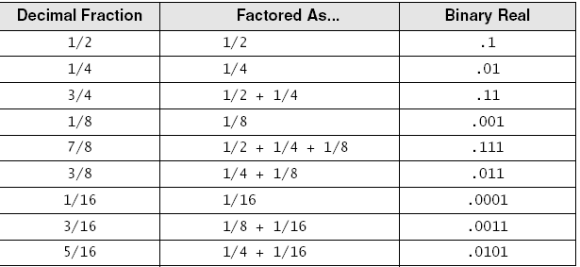
Converting Fractions to Binary Reals
Express as a sum of fractions having denominators that are powers of 2 (or, sum of negative powers of 2)
Examples

Slide 12
Defining Floating Point Values in ASM
We can use the REAL4 directive to define a single precision floating point value. Ex:
float1 REAL4 17.15 ;single precision float
float2 REAL4 1.715E+1 ;same value as above
The bits will be placed in memory according to the IEEE standard for single precision. Here we have:
17 = 10001b and 0.15 = 0.001001b
17.15 = 10001.001001b = 1.0001001001b x 2^{4}
Hence e=4. So E = 127+4 = 131 = 10000011b
So if truncation is used for rounding, we have:
MOV eax,float1
; eax = 0 10000011 00010010011001100110011b
; eax = 41893333h
;so float3 REAL4 41893333h is same as above definitions float1 and float2
We can use the REAL8 directive to define a double precision floating point value. Ex:
double1 REAL8 0.001235 ;double precision value
double2 REAL8 1.235E-3 ;same value as above

Slide 13
Rounding
Most of the real numbers are not exactly representable with a finite number of bits.
Many rational numbers (like 1/3 or 17.15) cannot be represented exactly in an IEEE format
Rounding refers to the way in which a real number will be approximated by another number that belongs to a given format
Ex: if a format uses only 3 decimal digit to represent a fraction, should 2/3 be represented as 0.666 or 0.667 ?
Truncation is only one of the methods used for rounding. Three other methods are supported by the IEEE standard:
Round to nearest number (the default for IEEE)
Round towards + infinity
Round towards – infinity
Rounding to nearest is usually the best rounding method so it is chosen as the default. But since other methods are occasionally better, the IEEE standard specifies that the programmer can choose one of these 4 rounding methods.

Slide 14
Real-Number Encodings
Normalized finite numbers
all the nonzero finite values that can be encoded in a normalized real number between zero and infinity
Positive and Negative Infinity
NaN (not a number)
bit pattern that is not a valid FP value
Two types:
Quiet NaN: does not cause an exception
Signaling NaN: causes an exception
Example: Divide-by-Zero

Slide 15
Representation of Specific Values
Recall that exponent e uses a biased representation. It is represented by unsigned int E such that e = E – 0111...1b
Let F be the unsigned integer obtained by concatenating the bits of the fraction f
Hence a floating point number N is represented by (S,E,F) and the “1” in 1+f = 1.f is implied (not represented or included in F).
Then note that we have no representation for zero!!
Because of this, the IEEE standard specifies that zero is represented by E = F = 0
Hence, because of the sign bit, we have both a positive and a negative zero
Only a few bits are allocated to E. So, a priori, numbers with very large (and very low) magnitudes cannot be represented.

Slide 16
Representation of Specific Values (cont.)
Hence, the IEEE standard has reserved the following interpretation when E contains only ones
+infinity when S = 0, E = 111..1, and F = 0
-infinity when S = 1, E = 111..1, and F = 0
Not a Number (NaN) when E = 111..1, and F != 0
Hence “normal” floating point values exist only for E < 111..11.
The +/- infinity value arises when a computation gives a number that would require E >= 111..11
The +/- infinity value can be used in operands with predictable results. Ex:
+infty + N = +infty
-infty + N = -infty
+infty + +infty = +infty
Undefined values are represented by NaN. Examples:
+infty + -infty = NaN
+infty / +infty = NaN
0 / 0 = NaN

Slide 17
Denormalized Numbers
Now, the smallest nonzero magnitude would be when E=0 and F = 00..01. This would give a value of 1.00…01 x 2^{-127} in single precision
To allow smaller magnitudes to be represented, IEEE have introduced denormalized numbers
A denormalized number has E=0 and F!=0. The implicit “1” to the left of “.” now becomes “0”.
Hence, the smallest nonzero single precision denormalized number is
0.00…01 x 2^{-127} = 2^{-23} x 2^{-127} = 2^{-150}
The largest single precision denormalized number is then
2^{-127} x (1 - 2^{-23}).
Hence normal numbers, called normalized numbers, use E such that 0 < E < 11…1.
The smallest (positive) single precision normal number is then 1.00…0 x 2^{-126}

Slide 18
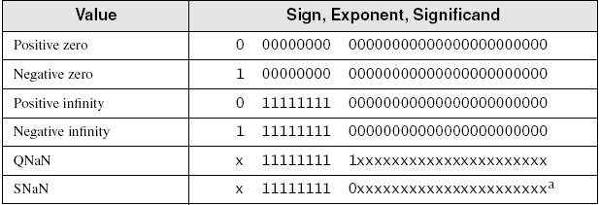
Real-Number Encodings (cont)
Specific encodings (single precision):

Slide 19
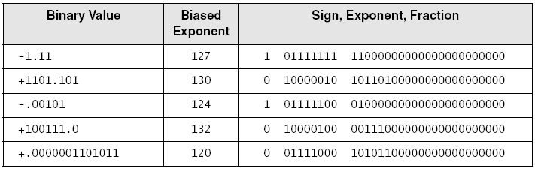
Examples (Single Precision)
Order: sign bit, exponent bits, and fractional part (mantissa)

Slide 20
Converting Single-Precision to Decimal
If the MSB is 1, the number is negative; otherwise, it is positive.
2. The next 8 bits represent the exponent. Subtract binary 01111111 (decimal 127), producing the unbiased exponent. Convert the unbiased exponent to decimal.
3. The next 23 bits represent the significand. Notate a “1.”, followed by the significand bits. Trailing zeros can be ignored. Create a floating-point binary number, using the significand, the sign determined in step 1, and the exponent calculated in step 2.
4. Unnormalize the binary number produced in step 3. (Shift the binary point the number of places equal to the value of the exponent. Shift right if the exponent is positive, or left if the exponent is negative.)
5. From left to right, use weighted positional notation to form the decimal sum of the powers of 2 represented by the floating-point binary number.

Slide 21
Example
Convert 0 10000010 0101100000000000000000 → Decimal
S E F → (s,e,f)
The number is positive. S = 0
s = +
2. The unbiased exponent is binary 00000011, or decimal 3.
e = E-127 = 10000010 – 01111111 = 130 – 127 = +3
3. Combining the sign s, exponent e, and significand f, the binary number is +1.01011 X 2³.
F = 0101100000000000000000 → f = 1. 01011
4. The unnormalized binary number is +1010.11.
Shift the binary point “.” until the unbiased exponent e = 0
5. The decimal value is +10 3/4, or +10.75.
Simply convert +1010.11 to decimal: +1010.11 → +10.75

Slide 22
Summary of IEEE Floating Point Numbers
Each number is represented by (S,E,F)
S represents the sign of the number
The exponent “e” of the number is: e = E – 011..1b
F is the binary number obtained by concatenating the bits of the fraction
Normalized numbers have: 0 < E < 11..1
The implicit bit on the left of the decimal point is 1
Denormalized numbers have: E = 0 and F != 0
The implicit bit on the left of the decimal point is 0
Zero is represented by E = F = 0
+/- Infinity is represented by E = 11..1 and F = 0
NaN is represented by E = 11..1 and F != 0

Slide 23
Exercises
Exercise 1: Find the IEEE single precision representation, in hexadecimal, of the following decimal numbers (assume that truncation is used for rounding):
1.0
0.5
-83.7
1.1E-41
Exercise 2: Give the decimal value represented by the IEEE single precision representation given below in hexadecimal:
45AC0000h
C4800000h
3FE00000h

Slide 24
The Floating Point Unit (FPU)*
A FPU unit, designed to perform efficient computation with floating point numbers, is built (directly) on the Pentium processors
It is backward compatible with older numerical coprocessors that were provided on a separate chip (ex: 8087 up to 387)
Use the .387, or .487, or .587, or .687 … to enable assembly of FPU/coprocessor instructions
There are 8 general-purpose FPU registers; each 80-bit wide.
Single-precision or double-precision values of the IEEE-754 standard are placed within those 80 bits in an extended format specified by Intel. (Intel FPUs conforms to the IEEE-754 standard)

Slide 25
General-Purpose FPU Registers
They are organized as a stack maintained by the FPU
The current top of the stack is referred by ST (Stack Top) or ST(0). ST(1) is the register just below ST and ST(n) is the n-th register below ST
15 bits are reserved for the exponent: e = E – 3FFFh
The “1” in the mantissa 1.f is stored as an explicit 1 bit at position 63. Hence f is stored from bit 0 to bit 62.
79
78
64
63
0
Tags
ST or ST(0)
S
Exponent
Fraction
tag(0)
ST(1)
tag(1)
ST(2)
tag(2)
ST(3)
tag(3)
ST(4)
tag(4)
ST(5)
tag(5)
ST(6)
tag(6)
ST(7)
tag(7)

Slide 26
The Tag Register
The Tag register is a 16-bit register
The first 2 bits, called tag(0), specify the “type” of data contained in ST(0).
Tag(i) specify the “type” of data contained in ST(i) for i=0..7
The 2-bit value of tag(i) indicates the following about the content of ST(i):
00 : st(i) contains a valid number
01 : st(i) contains zero
10 : st(i) contains NaN or infty
11 : st(i) is empty

Slide 27
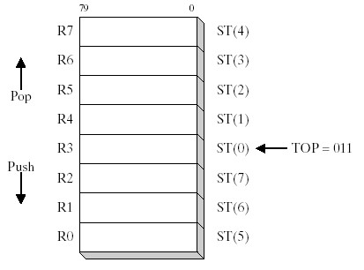
FPU Register Stack
Eight individually addressable 80-bit data general-purpose registers named R0 through R7, organized as a stack
Three-bit field named TOP in the FPU status word identifies the register number that is currently the top of stack.

Slide 28
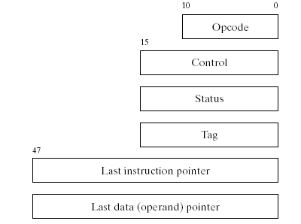
Special-Purpose Registers
• Opcode register: stores opcode of last noncontrol instruction executed
• Control register: controls precision and rounding method for calculations
• Status register: top-of-stack pointer, condition codes, exception warnings
• Tag register: indicates content type of each register in the register stack
• Last instruction pointer register: pointer to last non-control executed instruction
• Last data (operand) pointer register: points to data operand used by last executed instruction

Slide 29
Rounding
FPU attempts to round an infinitely accurate result from a floating-point calculation
may be impossible because of storage limitations
Example
suppose 3 fractional bits can be stored, and a calculated value equals +1.0111.
rounding up by adding .0001 produces 1.100
rounding down by subtracting .0001 produces 1.011

Slide 30
Floating-Point Exceptions
Six types of exception conditions
Invalid operation
Divide by zero
Denormalized operand
Numeric overflow
Inexact precision
Each has a corresponding mask bit
if set when an exception occurs, the exception is handled automatically by FPU
if clear when an exception occurs, a software exception handler is invoked

Slide 31
FPU Instruction Set
Instruction mnemonics begin with letter F
Second letter identifies data type of memory operand
B = bcd instruction ex: FBLD
I = integer instruction ex: FILD
no letter: floating point instruction ex: FLD
Examples
FBLD load binary coded decimal
FISTP store integer and pop stack
FMUL multiply floating-point operands

Slide 32
FPU Instruction Set
Operands
zero, one, or two
no immediate operands
no general-purpose CPU registers (EAX, EBX, ...)
integers must be loaded from memory onto the stack and converted to floating-point before being used in calculations
if an instruction has two operands, one must be a FPU register

Slide 33
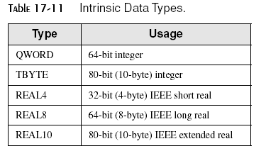
FP Instruction Set
Data Types
Note that QWORD and TBYTE are integer data types, not real data type.
QWORD used for defining integers
TBYTE used for defining packed BCD integers

Slide 34
Data allocation directives
Single-Precision: Use the REAL4 or DD directive to allocate 32 bits of storage for a floating point number and store a value according to the IEEE-754 standard. Ex:
spno REAL4 1.0 ; spno = 3F800000h
Double-Precision: Use the REAL8 or QWORD or DQ directive to allocate 64 bits of storage and store a IEEE double precision value. Ex:
dpno REAL8 1.0 ; dpno = 3FF0000000000000h
Extended Double-Precision: Use the REAL10 or TBYTE or DT directive to allocate 80 bits (Ten bytes) of storage and store a floating point number according to Intel’s 80-bit extended precision format. Ex:
epno REAL10 1.0 ; epno = 3FFF8000000000000000h
Exercise 3: Explain why value 1.0 is represented as above in single precision, double precision, and extended precision.

Slide 35
FPU Data Transfer Instructions
Use the FLD source instruction to transfer data from a memory source onto ST.
The mem operand can either be a real4, real8, real10, a quad word, or a ten byte.
The data is converted from the IEEE format to Intel’s extended precision format during the data transfer to ST.
Example:
.data
A REAL8 4.78E-7
B REAL10 5.6E+8
.code
fld A
fld B
The FPU stack after
loading A and B
ST(0)
B
ST(1)
A
ST(2)
ST(3)
ST(4)
ST(5)
ST(6)
ST(7)

Slide 36
Data Transfer Instructions (cont.)
ST(n) can be used as an operand of FLD.
A CPU register cannot be an operand of FLD
In that case FLD ST(n) copies the content of ST(n) onto ST.
Example: If we now execute FLD ST(1) after the previous instructions. We get the following FPU stack:
ST(0)
A
ST(1)
B
ST(2)
A
ST(3)
ST(4)
ST(5)
ST(6)
ST(7)

Slide 37

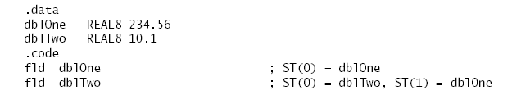
Load Floating-Point Value
FLD
copies floating point operand from memory into the top of the FPU stack, ST(0)
Example
Use
FILD for loading integers
FBLD for loading BCD integers

Slide 38
Data Transfer Instructions (cont.)
The FST destination instruction can be used to transfer data from ST to a memory destination.
The mem operand can either be 32 bits, 64 bits, or 80 bits.
The CPU and FPU are executing concurrently
This is why we normally cannot directly transfer data between CPU registers and FPU registers
When the FPU transfers data onto memory that is to be manipulated by the CPU, we should instruct the CPU to wait that the FPU completes the data transfer.
Example:
.data
float1 REAL4 1.75
result DWORD ?
.code
fld float1
...FPU inst...
fist result
FWAIT
mov eax,result
FWAIT tells the CPU to wait that the FPU finishes the instruction just before FWAIT
If FWAIT is not used, EAX may not contain the result returned by the FPU !!

Slide 39
Data Transfer Instructions (cont.)
ST(n) can be used as operand of FST. Ex:
fst st(3); copies ST to ST(3)
FST does not change ST
But FSTP destination copies ST onto destination and pops ST
FSTP also permits a 80-bit mem operand
Example:
fld A
fld B
fld C
fstp result
finit ;clears stack
ST(0)
C
ST(1)
B
ST(2)
A
Before fstp result
ST(0)
B
ST(1)
A
ST(2)
After fstp result
ST(0)
ST(1)
ST(2)
After finit

Slide 40
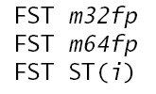
Store Floating-Point Value
FST
copies floating point operand from the top of the FPU stack into memory
FSTP
pops the stack after copying
Use
FIST (FISTP) for storing as integers
FBST (FBSTP) for storing as BCD integers

Slide 41
Data Transfer Instructions (cont.)
The FXCH instruction swaps the content of two registers. It can be used either with zero or one operand.
If no operands are used, FXCH swaps the content of ST and ST(1)
If one operand is used, then it must be ST(n). Example:
fld A
fld B
fld C
fxch ST(2) ; FXCH swaps the content of ST and ST(2)
ST(0)
C
ST(0)
A
ST(1)
B
ST(1)
B
ST(2)
A
ST(2)
C
Before fxch ST(2)
After fxch ST(2)

Slide 42
IEEE Format Conversion
The FLD source instruction loads a memory floating point value onto ST in an extended 80 bit format regardless of whether source is a single precision, double precision, or extended precision floating point value
The FST[P] destination instruction stores ST into memory regardless of whether destination is 32, 64, or 80 bits
Hence we can convert from one format to another simply by pushing onto and popping from the FPU stack. Ex:
.data
Adouble REAL8 –7.77E-6 ; double-precision value
Afloat REAL4 ? ; single-precision value
.code
FLD Adouble ; double to extended precision
FSTP Afloat ; extended to single precision

Slide 43
Integer-to-Floating Point Conversion
To convert from integer to floating point format we can use the FILD instruction. Ex:
.data
A DWORD 5
.code
FILD A ; Stores 5.0 on ST(0)
To convert from floating point to integer format we can use the FIST instruction. Ex:
.data
A REAL4 5.64
B DWORD ?
.code
FLD A ; stores 5.64 on ST(0)
FIST B ; stores 6 in variable B
The FIST instruction takes the floating point value in ST(0) and rounds it to an integer before storing it in the destination operand.
By default, the rounding method used is “round to the nearest” (but this can be changed by the programmer)

Slide 44
Floating-Point I/O
Irvine32 library procedures
ReadFloat
reads FP value from keyboard, pushes it on the FPU stack. Accept the following formats:
35, +35., -3.5, .35, 3.5E5, 3.5E005,
-3.5E+5, 3.5E-4, +3.5E-4
WriteFloat
writes value from ST(0) to the console window in exponential format
ShowFPUStack
displays contents of FPU stack

Slide 45
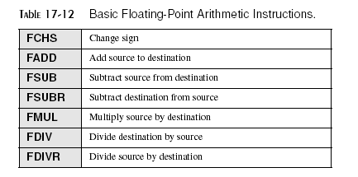
Arithmetic Instructions
Same operand types as FLD and FST
All of these instructions have their FIXXX counterparts except FCHS. Example: FIDIVR, …
They can have up to two operands as long as one of them is a FPU register.
CPU registers are not allowed as operands
A memory operand must be 32, or 64 bits
Memory-to-memory operations are not allowed.
Several addressing modes are provided.

Slide 46
Addressing Modes for Arithmetic Instructions
Keyword XXX may be one of:
ADD : add source to destination
SUB : subtract source from destination D = D - S
SUBR : subtract destination from source D = S - D
MUL : multiply source into destination
DIV : divide destination by source D = D / S
DIVR : divide source by destination D = S / D
The result is always stored into the destination operand
Operands surrounded by {…} are implicit operands: not coded explicitly, by the programmer, in the instruction

Slide 47
Classical Stack Addressing Mode
The classical stack addressing mode is invoked when we use FXXX without operands.
ST is the implied source operand
ST(1) is the implied destination operand
The result of the instruction is temporarily stored into ST(1) and then the stack is popped. Hence, ST will then contain the result. Example:
FLD A
FLD B
FLD C
FSUB ;st(1) = st(1) – st(0) = B-C
Note: ST(0) would contain C-B if FSUBR was used instead
ST(0)
C
ST(0)
B - C
ST(1)
B
ST(1)
A
ST(2)
A
ST(2)
Before FSUB
After FSUB

Slide 48
Register Addressing Mode
Uses explicitly two registers as operands where one of them must be ST.
ST can either be the source or the destination operand, so two forms are permitted: ST, ST(n) or ST(n), ST.
In fact, both operands can be ST.
The stack is not popped after the operation. Ex:
FLD A
FLD B
FLD C
FMUL ST(2),ST ;st(2) = st(2) * st(0) = A*C
ST(0)
C
ST(0)
C
ST(1)
B
ST(1)
B
ST(2)
A
ST(2)
A x C
Before FMUL st(2),st
After FMUL st(2),st

Slide 49
Register + Pop Addressing Mode
Uses explicitly two registers as operands.
The source operand must be ST and the destination operand must be ST(n) where n must be different from 0.
The result of the operation is first stored into ST(n) and then the stack is popped (so the result is then in ST(n-1). Ex:
FLD A
FLD B
FLD C
FMULP ST(2),ST ;st(2) = st(2) * st(0) = A*C
;then pop st(0) is popped,
;hence st(1) = A*C, in the end
ST(0)
C
ST(0)
B
ST(1)
B
ST(1)
A x C
ST(2)
A
ST(2)
Before FMULP st(2),st
After FMULP st(2),st

Slide 50
Memory Addressing Mode
ST is an implicit destination operand
The source operand is either a 32, or a 64 bit memory operand
Here is an example program that computes the area of a circle
INCLUDE Irvine32.inc
.data
pi REAL4 3.14159
radius REAL4 2.0
area REAL4 ?
.code
main PROC
fld pi
fld radius
fmul radius ;mem addr.
; ST = radius*radius
; ST(1) = pi
fmul ; ST = area
call WriteFloat
; display area
exit
main ENDP
END main

Slide 51
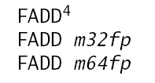
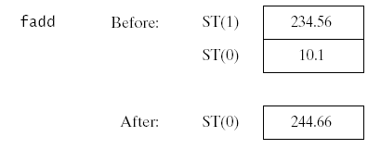
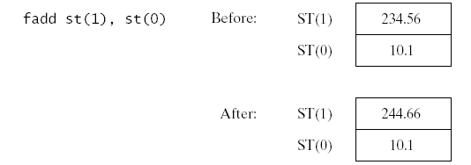
Floating-Point Add
FADD
adds source to destination
No-operand version pops the FPU stack after subtracting
Examples:

Slide 52
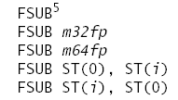
Floating-Point Subtract
FSUB
subtracts source from destination.
No-operand version pops the FPU stack after subtracting
Example:

Slide 53
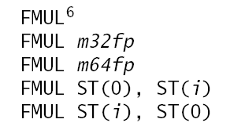

Floating-Point Multiply
FMUL
Multiplies source by destination, stores product in destination
FDIV
Divides destination by source, then pops the stack
The no-operand versions of FMUL and FDIV pop the stack after multiplying or dividing.

Slide 54
Arithmetic with an Integer
The memory addressing mode also supports an integer for its explicit operand.
The arithmetic instruction must now be FIXXX
The single operand must be either 16 or 32 bits integer
.data
five DWORD 5 ; an integer
my_float REAL4 3.3 ; a floating point
.code
…
fld my_float ; ST = 3.3
fimul five ; ST = 16.5
fiadd five ; ST = 21.5

Slide 55
Exercise 4
Suppose that we have the following FPU stack content before each instruction below:
ST(0) = 1.1, ST(1) = 1.2, ST(2) = 1.3, and the rest of the FPU stack is empty.
Give the stack content after the execution of each instruction:
fstp result ; result is a dword variable
fdivr st(2),st
fmul
fsubrp st(1),st
fadd
fdivp st,st(1)

Slide 56
Other FPU Instructions
These instructions use ST as an
Implicit operand and store the result
back into ST:
These instructions push
a constant onto ST:
Example: Finding the roots of a
quadratic equation using:
For more instructions see Intel’s Documentation at:
http://www.intel.com/design/litcentr/index.htm
In particular, see Intel’s Architecture Software Developer’s Manual Vol. 1 & 2

Slide 57
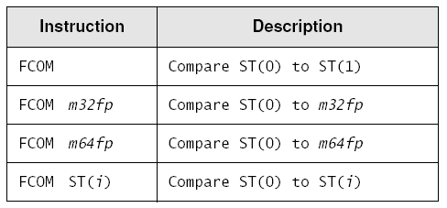
Comparing FP Values
FCOM instruction
Operands:

Slide 58
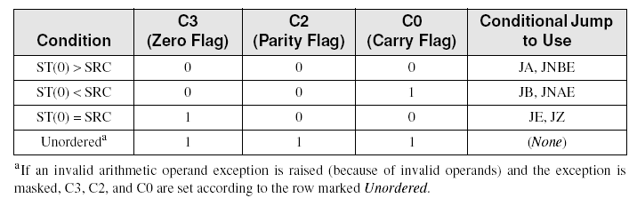
FCOM
Condition codes set by FPU
codes similar to CPU flags

Slide 59
Branching after FCOM
Required steps:
Use the FNSTSW instruction to move the FPU status word into AX.
Use the SAHF instruction to copy AH into the EFLAGS register.
Use JA, JB, etc to do the branching.
Fortunately, the FCOMI instruction does steps 1 and 2 for you.
fcomi ST(0), ST(1)
jnb Label1

Slide 60
Comparing for Equality
Calculate the absolute value of the difference between two floating-point values
.data
epsilon REAL8 1.0E-12 ; difference value
val2 REAL8 0.0 ; value to compare
val3 REAL8 1.001E-13 ; considered equal to val2
.code
; if( val2 == val3 ), display "Values are equal".
fld epsilon
fld val2
fsub val3
fabs
fcomi ST(0),ST(1)
ja skip
mWrite <"Values are equal",0dh,0ah>
skip:

Slide 61
Exception Synchronization
Main CPU and FPU can execute instructions concurrently
if an unmasked exception occurs, the current FPU instruction is interrupted and the FPU signals an exception
But the main CPU does not check for pending FPU exceptions. It might use a memory value that the interrupted FPU instruction was supposed to set.
Example:
.data
intVal DWORD 25
.code
fild intVal ; load integer into ST(0)
inc intVal ; increment the integer

Slide 62
Exception Synchronization
(continued)
For safety, insert a fwait instruction, which tells the CPU to wait for the FPU's exception handler to finish:
.data
intVal DWORD 25
.code
fild intVal ; load integer into ST(0)
fwait ; wait for pending exceptions
inc intVal ; increment the integer

Slide 63
FPU Code Example
expression: valD = –valA + (valB * valC).
.data
valA REAL8 1.5
valB REAL8 2.5
valC REAL8 3.0
valD REAL8 ? ; will be +6.0
.code
fld valA ; ST(0) = valA
fchs ; change sign of ST(0)
fld valB ; load valB into ST(0)
fmul valC ; ST(0) *= valC
fadd ; ST(0) += ST(1)
fstp valD ; store ST(0) to valD

Slide 64
Mixed-Mode Arithmetic
Combining integers and reals.
Integer arithmetic instructions such as ADD and MUL cannot handle reals
FPU has instructions that promote integers to reals and load the values onto the floating point stack.
Example: Z = N + X
.data
N SDWORD 20
X REAL8 3.5
Z REAL8 ?
.code
fild N ; load integer into ST(0)
fwait ; wait for exceptions
fadd X ; add mem to ST(0)
fstp Z ; store ST(0) to mem

Slide 65
Masking and Unmasking Exceptions
Exceptions are masked by default
Divide by zero just generates infinity, without halting the program
If you unmask an exception
processor executes an appropriate exception handler
Unmask the divide by zero exception by clearing bit 2:
.data
ctrlWord WORD ?
.code
fstcw ctrlWord ; get the control word
and ctrlWord,1111111111111011b ; unmask divide by zero
fldcw ctrlWord ; load it back into FPU

Slide 66
The End

Slide 67
x86 Instruction Encoding
x86 Instruction Format
Single-Byte Instructions
Move Immediate to Register
Register-Mode Instructions
x86 Processor Operand-Size Prefix
Memory-Mode Instructions

Slide 68
x86 Instruction Format
Fields
Instruction prefix byte (operand size)
opcode
Mod R/M byte (addressing mode & operands)
scale index byte (for scaling array index)
address displacement
immediate data (constant)
Only the opcode is required

Slide 69
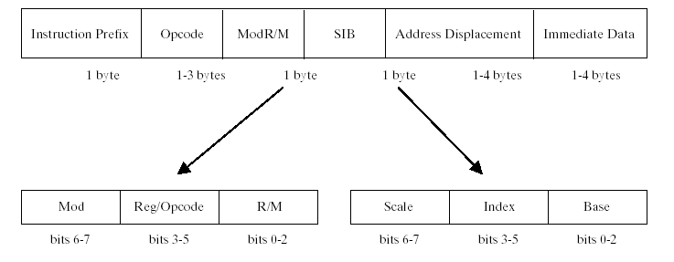
x86 Instruction Format

Slide 70
Single-Byte Instructions
Only the opcode is used
Zero operands
Example: AAA
One implied operand
Example: INC DX

Slide 71
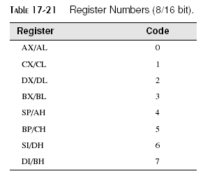
Move Immediate to Register
Op code, followed by immediate value
Example: move immediate to register
Encoding format: B8+rw dw
(B8 = opcode, +rw is a register number, dw is the immediate operand)
register number added to B8 to produce a new opcode

Slide 72
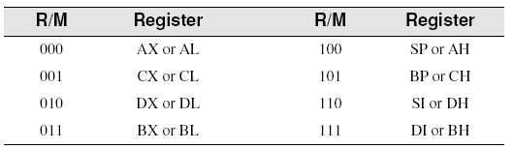

Register-Mode Instructions
Mod R/M byte contains a 3-bit register number for each register operand
bit encodings for register numbers:
Example: MOV AX, BX

Slide 73
x86 Operand Size Prefix
Overrides default segment attribute (16-bit or 32-bit)
Special value recognized by processor: 66h
Intel ran out of opcodes for x86 processors
needed backward compatibility with 8086
On x86 system, prefix byte used when 16-bit operands are used

Slide 74
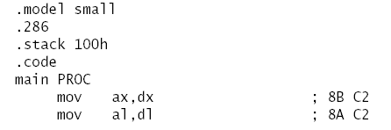
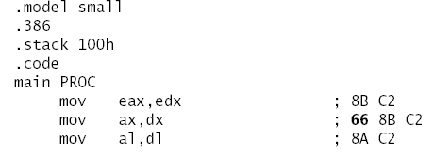
x86 Operand Size Prefix
Sample encoding for 16-bit target:
Encoding for 32-bit target:
overrides default operand size

Slide 75

Memory-Mode Instructions
Wide variety of operand types (addressing modes)
256 combinations of operands possible
determined by Mod R/M byte
Mod R/M encoding:
mod = addressing mode
reg = register number
r/m = register or memory indicator

Slide 76
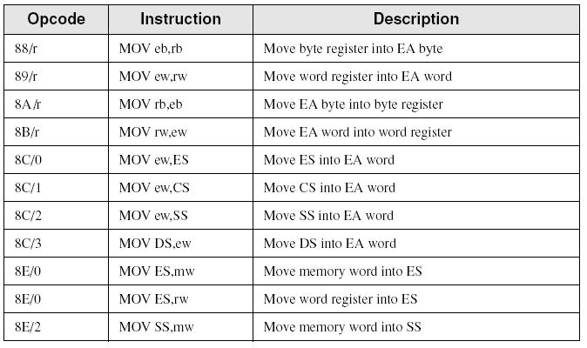
MOV Instruction Examples
Selected formats for 8-bit and 16-bit MOV instructions:

Slide 77
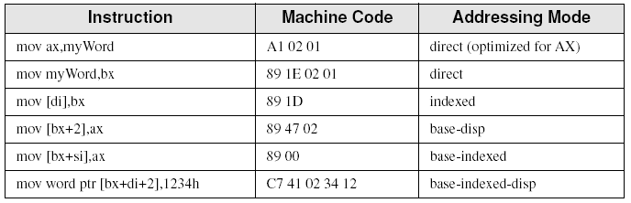
Sample MOV Instructions
Assume that myWord is located at offset 0102h.

Slide 78
Summary
Binary floating point number contains a sign, significand, and exponent
single precision, double precision, extended precision
Not all significands between 0 and 1 can be represented correctly
example: 0.2 creates a repeating bit sequence
Special types
Normalized finite numbers
Positive and negative infinity
NaN (not a number)

Slide 79
Summary - 2
Floating Point Unit (FPU) operates in parallel with CPU
register stack: top is ST(0)
arithmetic with floating point operands
conversion of integer operands
floating point conversions
intrinsic mathematical functions
x86 Instruction set
complex instruction set, evolved over time
backward compatibility with older processors
encoding and decoding of instructions

Slide 80
The End

