Slide 1
∏-SOD-M

Slide 2
MIDAS Framework
π-SOD-M
SOD-M
Computation Independent Model
Domain
Modeling
Business
Modeling
Value Model
Business
Process Model
Use Case Model
extends
π-UseCase Model
Platform Independent Model
Extended Use Case
Model
Service Process
Model
Platform Specific Model
Service Composition
Model
extends
π-Service
Composition Model
CONTENT
HYPERTEXT
BEHAVIOUR
π-PEWS Model
Code
PEWS
Code
Notes:
MIDAS proposes to model the WIS according to two orthogonal dimensions.
On the one hand, taking into account the platform dependence degree (based on MDA approach): that is, specifying the whole system by Computation Independent Models (CIMs), Platform Independent Models (PIMs) and Platform Specific Models (PSMs); and also specifying the mapping rules between these models.
And on the other hand, according to three basic aspects : hypertext, content and behavior.
In this work we focus on the PIM models involved in the hypertext aspect modeling of a WIS (marked in red) taken into account Content and behavior models.
And we introduce four new models (shadowed in the Figure) the user services model, the extended use cases model, the extended slices model and the extended navigation model.

Slide 3
∏-SODM method
Computation Independent Model
Value Model
Business Process
Model
Platform Independent Model
π-UseCase Model
π-Service
Composition Model
Platform Specific Model
π-PEWS Model
Code
PEWS
Code

Slide 4
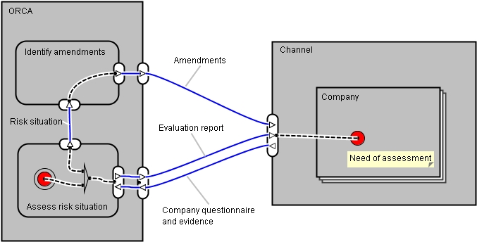
Value Model

Slide 5
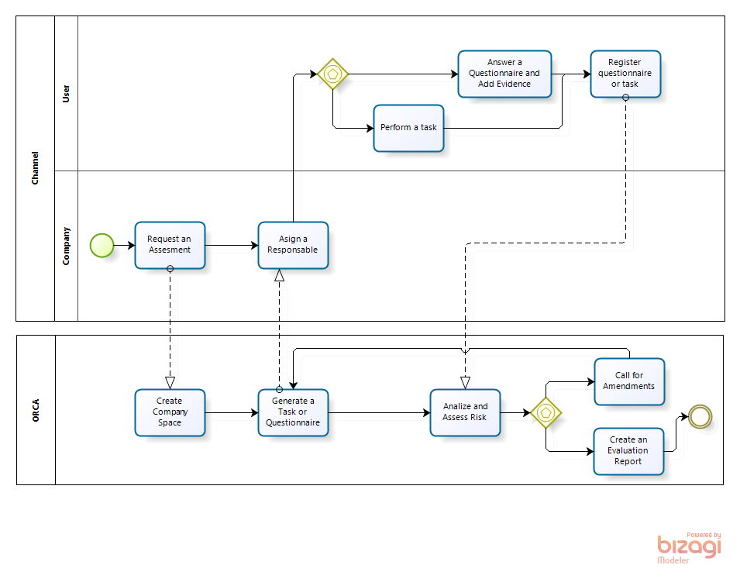
Business Process Model

Slide 6
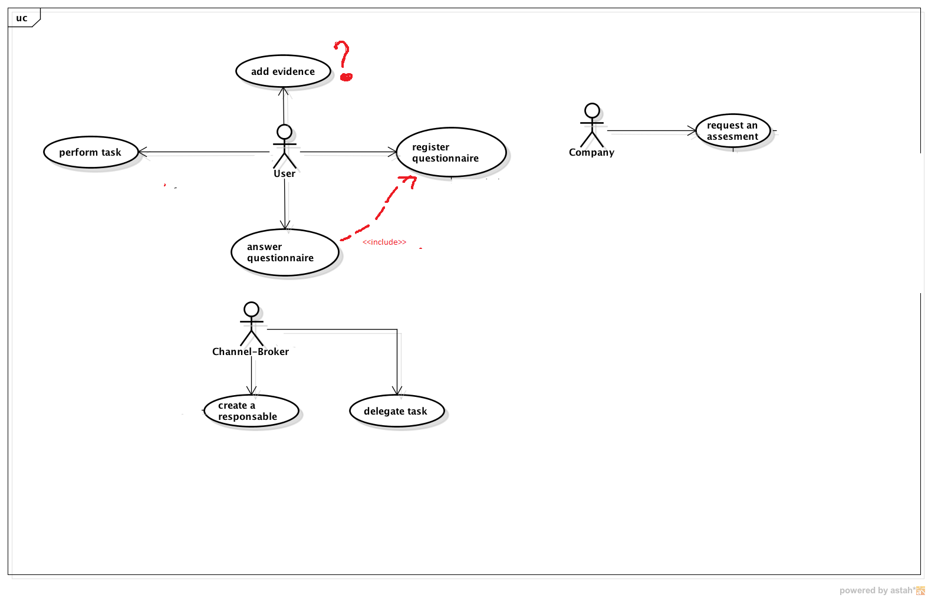
Use Case Model:
Here we need to represente the user of the system and their interaction with the system.
I agree with the user represented, but I delete activity that are carried out by the systems. This kinf of
activities are represented in the service compositon model but not here.
From my point of view these are the service the system provides for each one of the user identified
In this case.

Slide 7
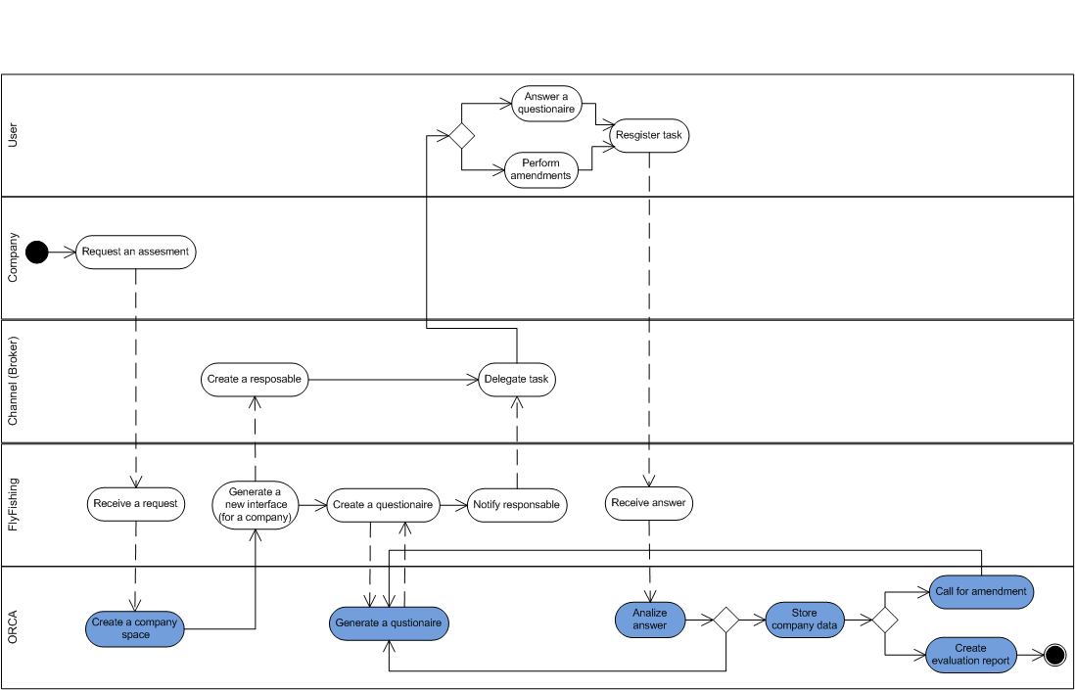
Service Composition Model:
Here we should to represent all the process and participants that collaborates in
the service provided by the system to the users. Here we model all the process in just one
diagram but we could represent one of this diagram for each one of the use case identified in
the use case model.
Tarea: We need to think in the process that occurs at systems level for each use case and represent that process
using and activity diagram.

