Slide 1





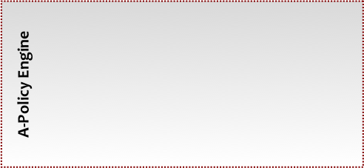
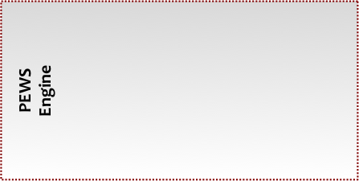

Models
Plug-ins
π-ServiceComposition Model Plug-in
π−PEWS Model Plug-in
. . .
π-SCM
Metamodel.ecore
π−PEWS
Metamodel.ecore
Editor
Editor
ConformsTo
ConformsTo
Mappings
Plug-in
P-ServiceComposition2PEWSCT Plug-in
π-ServiceComposition
Model
π-SCM 2
π−PEWS.atl
π−PEWS
Model
Code Generation
PEWS.mt
PEWSChain
PEWS
Code
Manager
A-Executor
C-Evaluator
Event Monitor
MOM

Slide 2
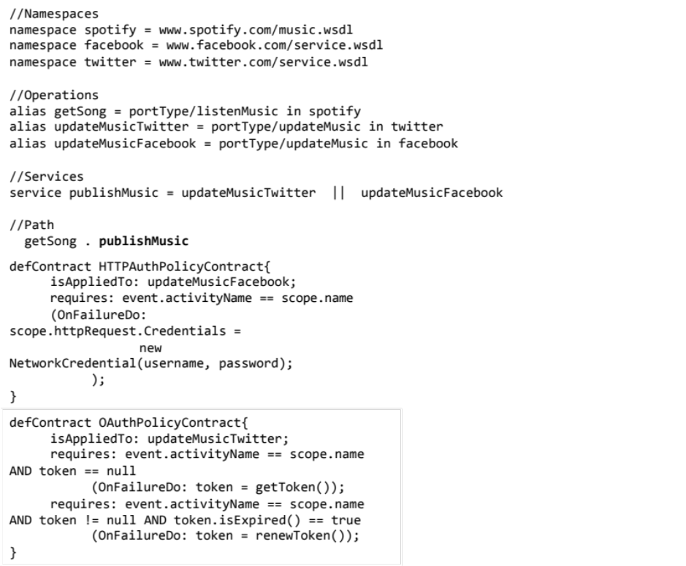
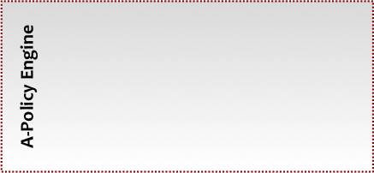
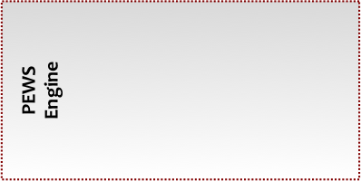

Models
Plug-ins
π-ServiceComposition Model Plug-in
π−PEWS Model Plug-in
. . .
π-SCM
Metamodel.ecore
π−PEWS
Metamodel.ecore
Editor
Editor
ConformsTo
ConformsTo
Mappings
Plug-in
P-ServiceComposition2PEWSCT Plug-in
π-ServiceComposition
Model
π-SCM 2
π−PEWS.atl
π−PEWS
Model
Code Generation
PEWS.mt
PEWSChain
PEWS
Code
Manager
A-Executor
C-Evaluator
Event Monitor
MOM

