Slide 1
//Namespaces
namespace spotify = www.spotify.com/music.wsdl
namespace facebook = www.facebook.com/service.wsdl
namespace twitter = www.twitter.com/service.wsdl
//Operations
alias getSong = portType/listenMusic in spotify
alias updateMusicTwitter = portType/updateMusic in twitter
alias updateMusicFacebook = portType/updateMusic in facebook
//Services
service publishMusic = updateMusicTwitter || updateMusicFacebook
//Path
getSong . publishMusic
Service composition writing in parallel on the
Facebeook and Twitter book walls of a user
(private application in the E3value model)
Application ListenMusic
PublishMusic
Confirmation
<<External false>>
AOP
GetSong
AOP
PublishMusic
AOP
PublishingOK
Spotify
SongData
SongData
<<External true>>
WS
ListenMusic
Facebook
WS
UpdateMusic
SongData
OK
<<External true>>
OK
defContract HTTPAuthPolicyContract{
isAppliedTo: updateMusicFacebook;
requires: event.activityName == scope.name
(OnFailureDo: scope.httpRequest.Credentials =
new NetworkCredential(username, password);
);
}
Policy
Twitter
WS
UpdateMusic
<<External true>>
Policy
defContract OAuthPolicyContract{
isAppliedTo: updateMusicTwitter;
requires: event.activityName == scope.name AND token == null
(OnFailureDo: token = getToken());
requires: event.activityName == scope.name AND token != null AND token.isExpired() == true
(OnFailureDo: token = renewToken());
}

Slide 2
//Namespaces
namespace spotify = www.spotify.com/music.wsdl
namespace facebook = www.facebook.com/service.wsdl
namespace twitter = www.twitter.com/service.wsdl
//Operations
alias getSong = portType/listenMusic in spotify
alias updateMusicTwitter = portType/updateMusic in twitter
alias updateMusicFacebook = portType/updateMusic in facebook
//Services
service publishMusic = updateMusicTwitter || updateMusicFacebook
//Path
getSong . publishMusic
defContract HTTPAuthPolicyContract{
isAppliedTo: updateMusicFacebook;
requires: event.activityName == scope.name
(OnFailureDo: scope.httpRequest.Credentials =
new NetworkCredential(username, password);
);
}
defContract OAuthPolicyContract{
isAppliedTo: updateMusicTwitter;
requires: event.activityName == scope.name AND token == null
(OnFailureDo: token = getToken());
requires: event.activityName == scope.name AND token != null AND token.isExpired() == true
(OnFailureDo: token = renewToken());
}

Slide 6






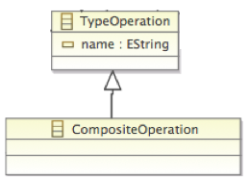

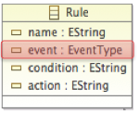
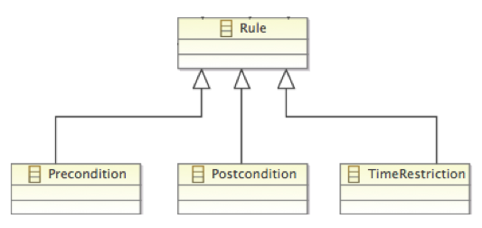



Business collaborator
Activity
Control
Node
Activity
Service Activity

Slide 7
Application ListenMusic
PublishMusic
Confirmation
<<External false>>
AOP
ListenMusic
AOP
PublishMusic
AOP
Confirmation
Spotify
SongData
SongData
<<External true>>
WS
ListenMusic
Facebook
WS
UpdateMusic
SongData
OK
<<External true>>
OK
Twitter
WS
UpdateMusic
<<External true>>
<<A-Policy>>
HTTPAuthPolicy
<<A-Policy>>
OAuthPolicy
Username: String
Password: String
Token: token
<<Rule>>
R₁
<<Rule>>
R₁
<<Rule>>
R₂
Event: PRE
Condition: event.activityName == scope.name
Action: Scope.httpRequest.Credentials = newNetworkCredential(username, password);
Event: PRE
Condition: event.activityName == scope.name AND token == null
Action: token = getToken()
Event: PRE
Condition: event.activityName == scope.name AND token != null AND token.isExpired() == true
Action: token = renewToken()

Slide 8
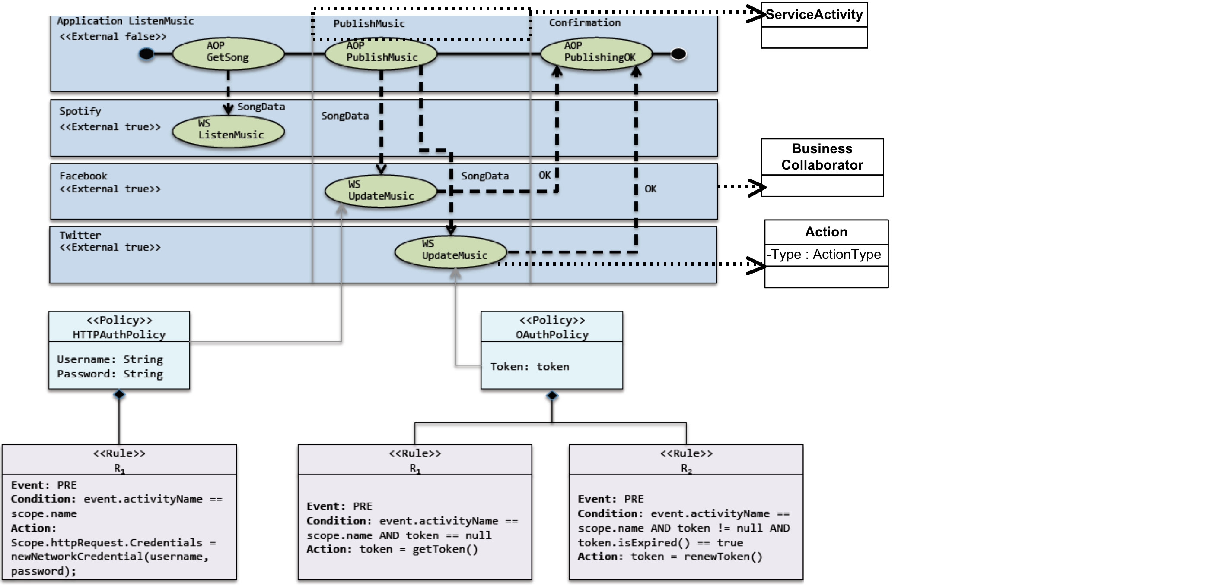

Slide 9
Services Composition elements π-SCM → π-Pews
A-Policy elements π-SCM → π-Pews
Rule elements π-SCM → π-Pews

